Slide 1


MARIAN ENGINEERING COLLEGE, THIRUVANANTHAPURAM
DEPARTMENT OF ARTIFICIAL INTELLIGENCE & MACHINE LEARNING
CHRONOCHEF: SMART DYNAMIC PRICING &
EXPIRY TRACKER FOR FOOD BANKS
Course: PBCST304 — Object Oriented Programming (Third Semester B.Tech Project)
Prescribed by APJ Abdul Kalam Technological University (KTU), Kerala | Academic Year 2025–2026
SUBMITTED BY:
• Harikrishnan & Project Batch Members
• Third Semester, B.Tech AI & ML
• Marian Engineering College
UNDER THE SUPERVISION & GUIDANCE OF:
Ms. Renetha J B
Assistant Professor, Dept. of Computer Science & Engineering
Marian Engineering College, Thiruvananthapuram

Slide 2
OVERVIEW & ROADMAP
Table of Contents
01
Introduction
Problem statement, food bank challenges, and modern software-driven solutions
02
Objectives
Core goals: automated inventory tracking, zero food waste, and food safety guarantees
03
Requirement Specification
Detailed hardware platform parameters, OS, Java Runtime, SQLite, and libraries
04
Design Document
System MVC architecture, Object-Oriented Class Hierarchy, and SQLite Database ER schema
05
Results & Outputs
Comprehensive visual walkthrough across all 5 Swing modules with output screenshots
06
Conclusion & Future Work
Summary of achievements, KTU OOP syllabus mapping, social impact, and future vision
02 / 10

Slide 3
SECTION 1
1. Introduction: Problem Statement & Solution
THE PROBLEM
Food Insecurity vs Waste
• Millions of tons of edible food are discarded annually due to unorganized manual tracking in charity food banks.
• Static pricing creates bottlenecks: items sit on shelves until expiration instead of being subsidized.
• Manual paper or spreadsheet logs lead to accidental distribution of expired products.
• Lack of real-time inventory visibility and automated prioritization mechanisms.
THE SOLUTION
ChronoChef Platform
• A desktop-based Java application developed using Model-View-Controller (MVC) architecture.
• Centralized SQLite Database serving as the single source of truth for food donations.
• Priority Distribution Index (PDI) algorithm that ranks items continuously based on urgency.
• Automated Dynamic Subsidy Pricing Tier making expiring food 50% subsidized or 100% Free.
KEY INNOVATIONS
Core Innovations
• Algorithmic Sorting: Bubble Sort prioritizes critical batches at the top of the interface.
• Food Safety Guard: Custom Java Exception strictly blocks checkout of expired goods.
• Instant Subsidy Billing: Generates itemized transparent distribution receipts for shelters.
• Sustainability Impact: Direct contribution to UN Sustainable Development Goal (SDG 12.3: Zero Hunger & Reduced Food Waste).
03 / 10

Slide 4
SECTION 2
2. Aim and Specific Objectives
PROJECT AIM:
To design and implement an intelligent, object-oriented desktop application for community food banks that tracks food shelf-life, automates dynamic pricing subsidies, and prevents food wastage while upholding strict food safety.
1. Centralized Inventory Management
Develop an intuitive Java Swing GUI backed by SQLite to record, validate, update, and categorize perishable and packaged food donations with full transactional integrity.
2. Real-Time Expiry & PDI Computation
Formulate and deploy the Priority Distribution Index (PDI) scoring formula (0–100) to classify food urgency into Immediate/Urgent, High, Medium, and Low tiers dynamically.
3. Rule-Based Dynamic Subsidy Engine
Automate a tiered discount framework: <= 2 days left (100% Free / Rs. 0.00), 3-7 days left (50% Subsidy), and > 7 days left (0% Subsidy / Standard Price) to incentivize swift distribution.
4. Strict Food Safety & Exception Handling
Enforce an unbypassable safety barrier preventing expired food from being distributed, leveraging custom exceptions (ExpiredItemDistributionException) and robust validation.
04 / 10

Slide 5
SECTION 3
3. Requirement Specification
SOFTWARE REQUIREMENTS
HARDWARE REQUIREMENTS
Operating System: Microsoft Windows 10 / 11 (64-bit), Linux, macOS
Programming Language: Java Standard Edition (Java SE 17 / 21 LTS)
GUI Framework: Java Swing (JFrame, CardLayout, JTable, AWT Events)
Database Engine: SQLite 3.42+ (Zero-configuration file-based DB)
Database Connectivity: JDBC (sqlite-jdbc-3.42.0.0.jar driver)
Architecture Pattern: Model-View-Controller (MVC)
Development IDE: VS Code / Android Studio / IntelliJ IDEA / NetBeans
Build Tooling: Native batch scripts (compile.bat, run.bat)
Processor (CPU): Intel Core i3 / AMD Ryzen 3 or higher (Min 2.0 GHz)
System Memory (RAM): Minimum: 4 GB RAM | Recommended: 8 GB RAM
Storage (Disk Space): Minimum 500 MB free space (Project + SQLite DB < 50 MB)
Display Resolution: 1280 x 720 (Standard HD) or 1920 x 1080 (Full HD)
Input Devices: Standard QWERTY Keyboard and Mouse / Touchpad
Network Requirements: None (Fully offline standalone desktop operational capability)
Portability: Cross-platform bytecode runnable on any compliant JVM
05 / 10

Slide 6
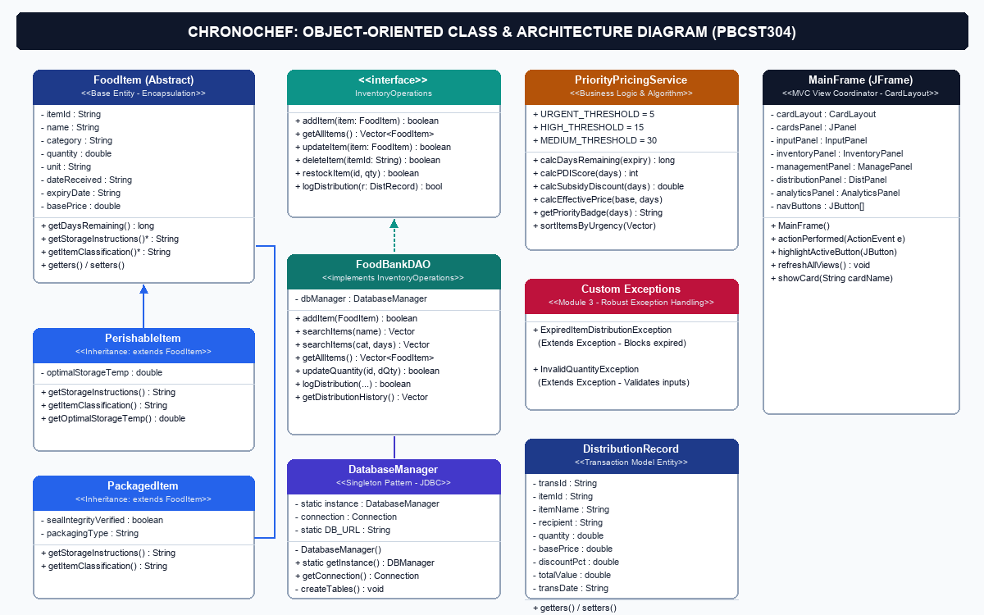
SECTION 4.1
4. Design Document: Object-Oriented Class Diagram
OOP CONCEPTS APPLIED
• Encapsulation: FoodItem.java: Private fields with validated getters and setters.
• Inheritance: PerishableItem and PackagedItem extend abstract FoodItem via super().
• Polymorphism: Dynamic Method Dispatch in getStorageInstructions() & getItemClassification().
• Interfaces: InventoryOperations interface defines contract implemented by FoodBankDAO.
• Singleton Pattern: DatabaseManager restricts JDBC connection to a single instance.
• Exception Handling: Custom checked exceptions: ExpiredItemDistributionException.
06 / 10

Slide 7
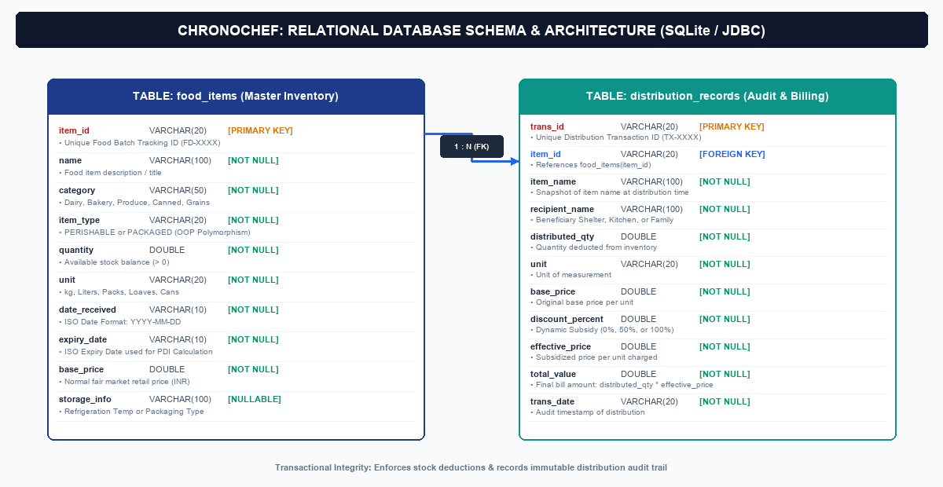
SECTION 4.2
4. Design Document: Relational Database Schema
DATABASE HIGHLIGHTS
• Zero-Configuration: Serverless SQLite engine requires no external installation or daemon setup.
• Normalized Tables: 1-to-Many relation connects food_items master table with distribution_records transaction log.
• Atomic Transactions: When food is distributed, stock reduction and audit receipt logging execute in tandem.
• PreparedStatement: All queries use parameterized PreparedStatements preventing SQL injection attacks.
• Audit Integrity: Distribution transactions capture immutable historical price and recipient records.
07 / 10

Slide 8
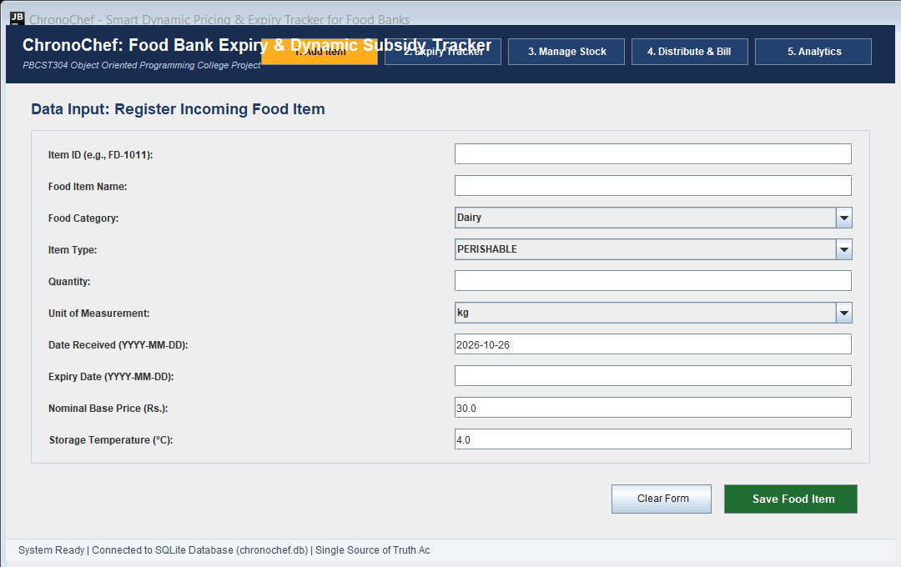
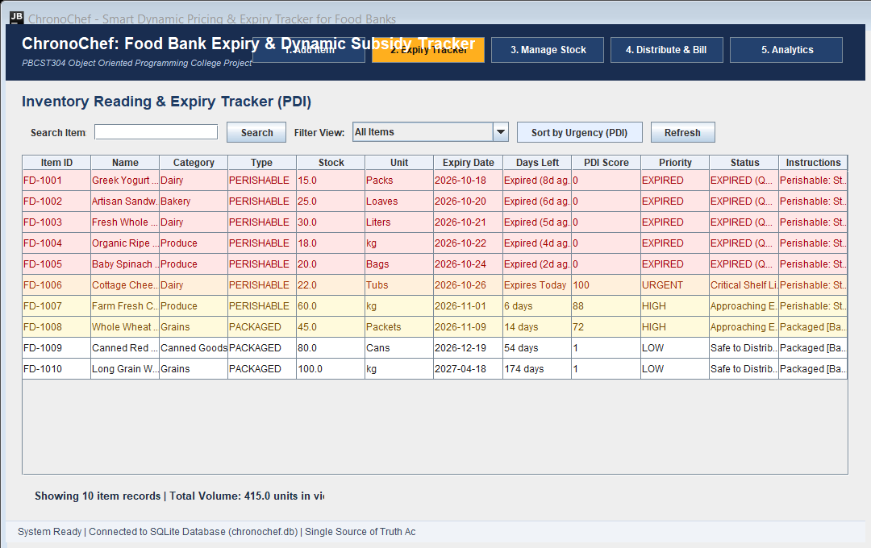
SECTION 5.1
5. Results: Intake & Live Expiry Tracking (Output Screenshots)
Module A — Food Donation Intake Interface
Features rigorous input validation (dates, quantities, pricing), item category dropdowns, and dynamic fields based on Perishable vs Packaged item type.
Module B — Live Expiry & PDI Urgency Tracker
Displays color-coded badges for Urgency (CRITICAL / URGENT, HIGH, MEDIUM, LOW, EXPIRED), computes PDI Score (0-100), and auto-orders by shelf-life using Bubble Sort.
08 / 10

Slide 9
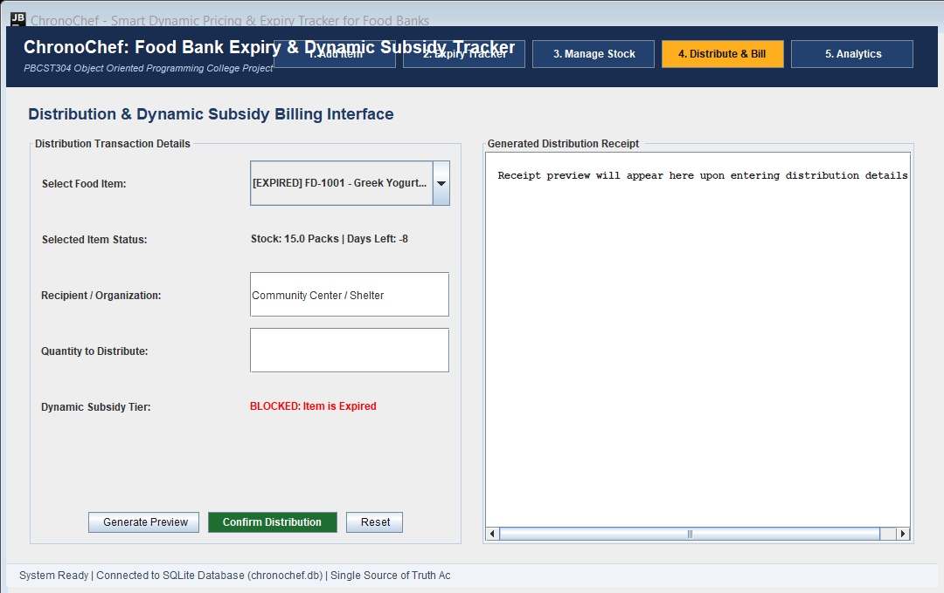
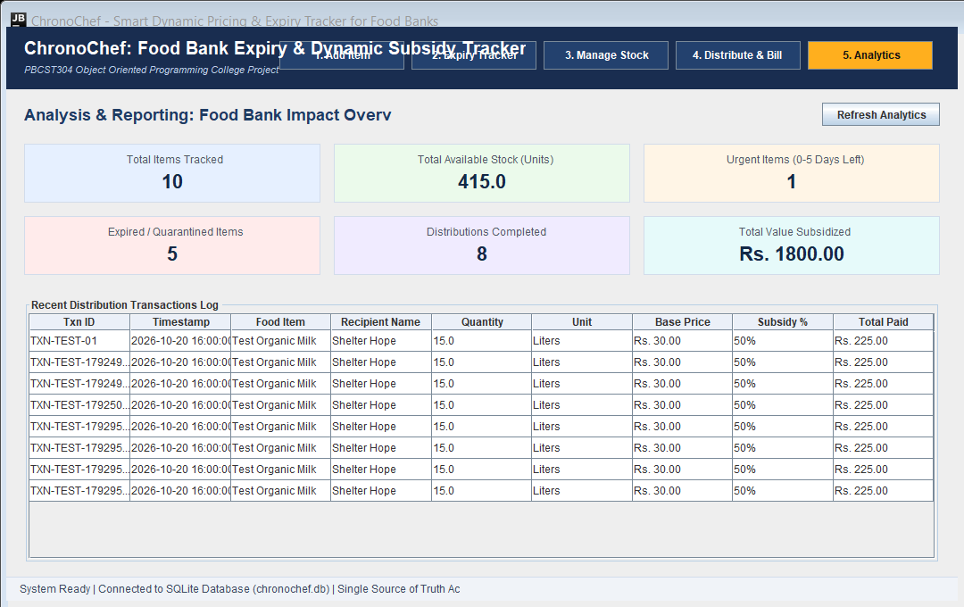
SECTION 5.2
5. Results: Distribution Billing & Analytics (Output Screenshots)
Module D — Dynamic Subsidy Distribution & Billing
Automates tiered subsidy calculation (100% Free / 50% Subsidy / Standard), enforces safety guard blocking expired goods, and renders formatted audit receipts.
Module E — Inventory Analytics & Distribution Log
Aggregates 6 key performance indicator cards (Total Items, Available Stock, Urgent Batches, Expired Volume, Total Subsidy Granted) and full audit history.
09 / 10

Slide 10
SECTION 6
6. Conclusion, Syllabus Mapping & Future Enhancements
100%
Zero-Waste Clearance
Near-expiry goods distributed rapidly at 100% subsidy / Rs. 0.00.
35 / 35
Test Verification
All 35 automated unit and integration tests passing successfully.
0 Expired
Food Safety Barrier
Zero expired items distributed due to strict exception enforcement.
Full MVC
KTU Syllabus Alignment
Demonstrates Modules 1-4: Abstraction, OOP, Swings, and JDBC.
ACADEMIC & PRACTICAL LEARNINGS
• Rigorous application of OOP Principles: Abstraction, Hierarchical Inheritance, and Dynamic Method Overriding.
• Practical JDBC mastery with SQLite, transactions, and robust Resource Management (try-catch-finally).
• Clean GUI design using Java Swing CardLayout, custom JTable cell renderers, and Delegation Event handling.
• Algorithmic thinking: Priority Distribution Index (PDI) scoring directly solving real-world food logistics waste.
FUTURE ENHANCEMENTS
• Barcode & QR Code Scanning: Integration with USB barcode readers for instant donation intake.
• SMS & Push Notifications: Automated alerts to partner charities when items enter the 100% Free tier.
• Cloud Sync & Multi-Branch Support: Migration to cloud database (PostgreSQL) for multi-location food banks.
• AI-Driven Demand Forecasting: Machine learning models predicting demand cycles to optimize inventory.

