Slide 1
RISK V MACKATHON
8-BIT COMPUTER ARCHITECTURE
TEAM SYNTHORA
KAVIYASI N
BHAVANAASRI A S
HARIKRISHNAN R
TEAM SYNTHORA | RISK V MACKATHON | 8-BIT COMPUTER ARCHITECTURE

Slide 2
1. Introduction to 8-Bit Computer Architecture
An 8-bit computer processes data in groups of 8 bits. Each bit can be 0 or 1.
The architecture is made of memory, registers, an Arithmetic Logic Unit (ALU), a control section and a shared bus. Each block has a separate task, but they work together to run a program.
The Program Counter identifies the next instruction, the decoder interprets it, and the ALU performs the required operation.
Main stages: Fetch → Decode → Execute → Store or Display
TEAM SYNTHORA | RISK V MACKATHON | 8-BIT COMPUTER ARCHITECTURE
2

Slide 3
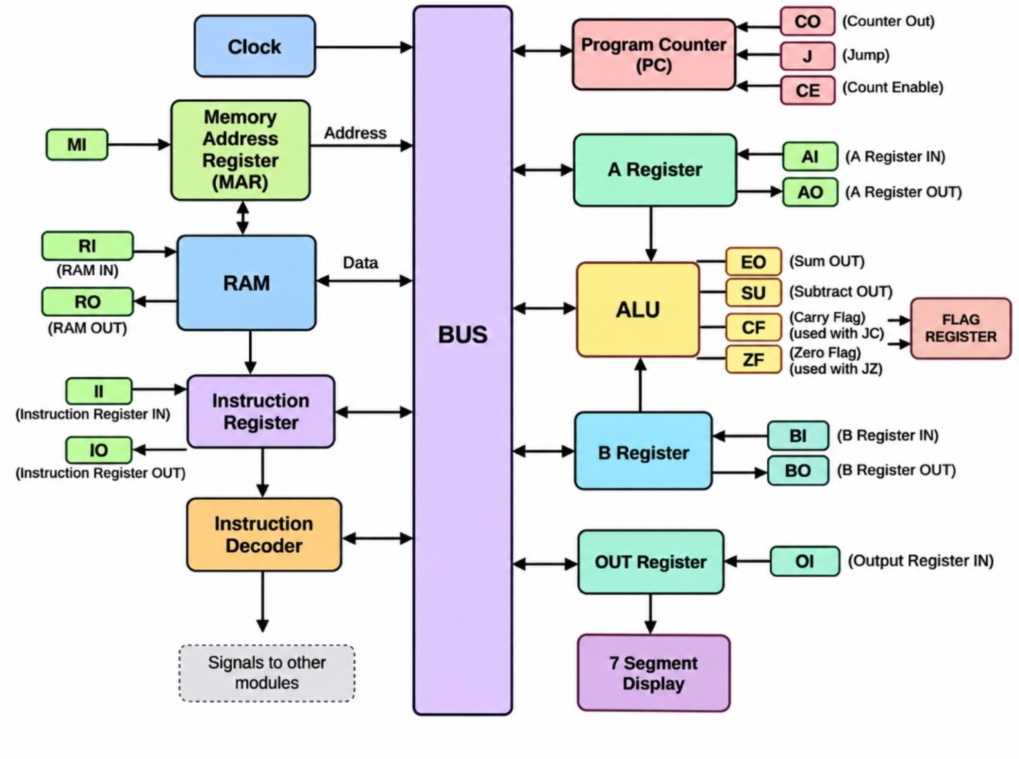
2. Circuit / Architecture Diagram
Circuit diagram with the component names and control-signal labels.
TEAM SYNTHORA | RISK V MACKATHON | 8-BIT COMPUTER ARCHITECTURE
3

Slide 4
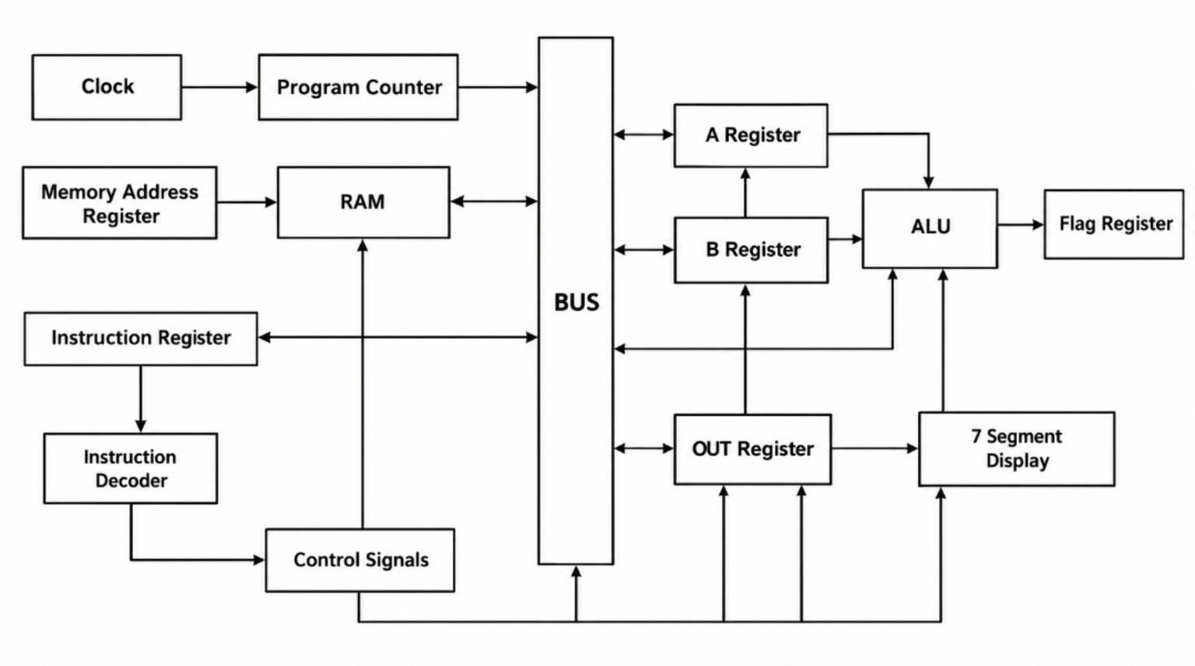
3. Block Diagram
The block diagram gives a simplified view of the main units and their connections.
TEAM SYNTHORA | RISK V MACKATHON | 8-BIT COMPUTER ARCHITECTURE
4

Slide 5
4. Clock and Common Bus
Clock
Common BUS
The clock generates regular timing pulses. These pulses help the computer perform one control step after another in the correct order.
The bus is a shared path for transferring data between RAM, registers and the ALU. A control signal selects which unit can place data on the bus.
Why are they important?
Without timing, operations may occur in the wrong sequence. Without the bus, each block would need separate data connections to communicate. The clock coordinates timing; the bus carries data.
The bus carries data; control signals decide when data moves.
TEAM SYNTHORA | RISK V MACKATHON | 8-BIT COMPUTER ARCHITECTURE
5

Slide 6
5. Program Counter, MAR and RAM
Program Counter (PC)
Memory Address Register (MAR)
Stores the address of the next instruction. It normally advances after an instruction is fetched, but a jump instruction can load a different address.
Holds the address of the RAM location that the computer wants to access. It identifies where data or an instruction should be read or written.
RAM — Random Access Memory
RAM stores the program instructions and data used by the architecture. RAM OUT places the selected memory value on the bus; RAM IN enables a write into the selected memory location.
Address path: PC / address source → MAR → RAM location
TEAM SYNTHORA | RISK V MACKATHON | 8-BIT COMPUTER ARCHITECTURE
6

Slide 7
6. Instruction Register, Decoder and Control
Instruction Register (IR)
Instruction Decoder
Holds the instruction currently being processed so that its operation code can be examined by the decoder.
Interprets the instruction's operation code. It identifies the required action, such as loading data, adding, subtracting or jumping.
Control signals
The decoder activates the signals needed for the selected instruction. These signals control register inputs and outputs, RAM access, ALU mode, PC changes and output loading. The exact timing depends on the implementation.
Instruction → IR → Decoder → Control signals → Selected operation
TEAM SYNTHORA | RISK V MACKATHON | 8-BIT COMPUTER ARCHITECTURE
7

Slide 8
7. Registers and Their Functions
A Register
B Register
Stores one 8-bit operand. When enabled, it can send its value to the bus or provide an input to the ALU.
Stores the second operand. Together, A and B provide the values needed for an ALU operation.
OUT Register
Flag Register
Stores the value selected for output. It holds the value steady while the display logic presents it.
Stores status information from the ALU, including Carry Flag (CF) and Zero Flag (ZF) where supported.
Registers are small, fast storage locations used to hold addresses, instructions, operands and results temporarily.
TEAM SYNTHORA | RISK V MACKATHON | 8-BIT COMPUTER ARCHITECTURE
8

Slide 9
8. ALU — Arithmetic Logic Unit
The ALU is the part of the computer that performs arithmetic and logic operations on data.
Inputs
Outputs
The A Register and B Register supply the operand values. Control signals select which operation the ALU should perform.
The ALU produces a result. Depending on the circuit, the result can be placed on the bus, and status information is sent to the flag register.
Example operations
Addition: A + B | Subtraction: A − B | Logic: AND / OR (if implemented)
An 8-bit result uses 8 data bits; a carry may be stored separately in the Carry Flag.
TEAM SYNTHORA | RISK V MACKATHON | 8-BIT COMPUTER ARCHITECTURE
9

Slide 10
9. Flag Register: Carry and Zero
Carry Flag (CF)
Zero Flag (ZF)
Indicates that an arithmetic operation produced a carry beyond the 8-bit result. The design may use it for a conditional jump such as JC.
Becomes 1 when the ALU result is zero. The design may use it for a conditional jump such as JZ.
Why do flags matter?
Flags provide extra information about an ALU result. A program can use that information to decide whether to continue normally or jump to another instruction. Actual behaviour depends on the implemented control logic.
CF = carry status | ZF = zero-result status
TEAM SYNTHORA | RISK V MACKATHON | 8-BIT COMPUTER ARCHITECTURE
10

Slide 11
10. Control Signals — Meaning
MI
RI / RO
II / IO
Memory Address Register IN — load an address into MAR.
RAM IN / RAM OUT — write data to RAM / read data onto the bus.
Instruction Register IN / OUT — load or send instruction data.
AI / AO
BI / BO
OI
A Register IN / OUT — load A / send A to the bus.
B Register IN / OUT — load B / send B to the bus.
Output Register IN — load the value for display.
CO / CE / J
EO / SU
CF / ZF
Counter OUT / Count Enable / Jump control for the PC.
ALU result OUT / select subtraction, as defined by the design.
Carry Flag / Zero Flag status indicators.
Signal labels describe their function; active level and timing depend on the circuit.
TEAM SYNTHORA | RISK V MACKATHON | 8-BIT COMPUTER ARCHITECTURE
11

Slide 12
11. Instruction Flow: Fetch to Output
1. FETCH
PC identifies the next instruction address. The address is selected for RAM access and the instruction is read.
2. LOAD
The fetched instruction is placed in the Instruction Register. The PC advances unless the instruction changes the flow.
3. DECODE
The decoder examines the instruction and activates the control signals required for that operation.
4. EXECUTE
Operands are moved into the A and B registers. The ALU performs the selected operation.
5. STORE
The result may be transferred to a register or written to RAM. Status flags may be updated.
6. DISPLAY
For an output operation, the OUT Register receives the value and the 7-segment display shows it.
The clock and control signals coordinate these steps.
TEAM SYNTHORA | RISK V MACKATHON | 8-BIT COMPUTER ARCHITECTURE
12

Slide 13
12. Example: Adding 5 and 3
Step 1 — Fetch
The computer fetches the ADD instruction from RAM.
Step 2 — Load A
The value 5 is loaded into the A Register.
Step 3 — Load B
The value 3 is loaded into the B Register.
Step 4 — Execute
The ALU is set to addition and calculates 5 + 3 = 8.
Step 5 — Store result
The result is transferred through the bus to the selected destination.
Step 6 — Display
For an output instruction, the result is loaded into the OUT Register and shown as 8.
This example explains the data movement concept; actual control steps depend on the implemented instruction set.
TEAM SYNTHORA | RISK V MACKATHON | 8-BIT COMPUTER ARCHITECTURE
13

Slide 14
13.Cycle
1. T Cycle (Timing Cycle):
One clock period; the smallest timing unit in the processor.
2. Machine Cycle:
One basic operation, such as memory read or write. It consists of multiple T cycles.
3. Instruction Cycle:
One complete instruction execution process — Fetch → Decode → Execute.
4. Clock Cycle:
One complete clock period, which synchronizes processor operations.
Important: Basic 8085 terminology-la, one T-state is one clock period. Multiple T-states make a machine cycle; one instruction cycle may contain multiple machine cycles.
TEAM SYNTHORA | RISK V MACKATHON | 8-BIT COMPUTER ARCHITECTURE

Slide 15
14. OUT Register and 7-Segment Display
OUT Register
7-Segment Display
Receives and temporarily stores the value selected for output. This prevents the displayed value from needing to be taken directly from every internal block.
Uses seven LED segments to show digits and some symbols. Decoder/driver logic converts the output value into the segment pattern.
Output path
BUS / selected result → OUT Register → display decoding/driver → 7-segment display
The exact display circuit determines whether the value is shown in decimal, hexadecimal or another format.
TEAM SYNTHORA | RISK V MACKATHON | 8-BIT COMPUTER ARCHITECTURE
14

Slide 16
15. Summary and Conclusion
• The PC and MAR help select the memory location.
• RAM stores program instructions and data.
• The IR and decoder identify the instruction and activate control signals.
• A and B registers hold operands for the ALU.
• The ALU performs the selected operation and may update the flags.
• The OUT Register and 7-segment display present the result.
• The clock, bus and control signals coordinate the whole system.
THANK YOU
TEAM SYNTHORA | RISK V MACKATHON

