Slide 1
ACADEMIC RESEARCH PROJECT
Water Quality Classification
for Safe Drinking Prediction
MODEL
DATASET
SAMPLES
ACCURACY
Ensemble
(XGB+LGBM+RF)
Kaggle Water
Potability
3,276
Water Samples
~82%
Best F1-Macro
Python 3.10+
Streamlit
scikit-learn
For Academic & Educational Purposes Only

Slide 2
Presentation Outline
Structure of this academic presentation
01
Problem Statement & Dataset Overview
Motivation, public health impact, dataset characteristics
02
Methodology & Pipeline Diagram
5-stage ML pipeline: preprocessing, feature engineering, selection, modelling
03
Key Results & Model Comparisons
Accuracy, F1-Macro, ROC-AUC, feature importance
04
Screenshots of the Deployed Application
Streamlit web interface walkthrough
05
Conclusions, Limitations & Future Work
Findings, ethical scope, and next steps

Slide 3
01
Problem Statement
& Dataset Overview
Motivation, research gap, dataset characteristics
Water Quality Classification for Safe Drinking Prediction

Slide 4




Problem Statement
Why automated water potability classification matters
CORE PROBLEM
Unsafe drinking water causes over 485,000 deaths per year (WHO, 2023). Laboratory testing is slow and inaccessible in rural or disaster-affected regions. This project builds an automated binary classification system using an ensemble ML pipeline to rapidly assess water potability from physico-chemical parameters.
Public Health
Disaster Response
Rural Communities
Municipal Scale
Prevents waterborne diseases:
cholera, typhoid, dysentery
Rapid potability screening
after floods or contamination
Accessible testing without
expensive laboratory equipment
Automated flagging of unsafe
batches in treatment plants
Research Objectives
Classify water samples as Safe / Not Safe using an ensemble of XGBoost, LightGBM, and Random Forest
Engineer 10 domain-informed features that contribute ~35% of total model importance
Select the most informative features using a 7-method consensus ranking approach
Deploy predictions through a polished Streamlit web application with CSV batch & manual input

Slide 5
Dataset Overview
Kaggle — Water Potability by Aditya Kadiwal
3,276
9
14
~82%
Raw Samples
Original Features
After Feature
Engineering
Best Model
Accuracy
Feature
WHO Safe Limit
Description
ph
6.5 – 8.5
Acidity / alkalinity
Hardness
< 500 mg/L
Calcium & magnesium
Solids (TDS)
< 500 mg/L
Total dissolved solids
Chloramines
< 4 mg/L
Disinfectant level
Sulfate
< 250 mg/L
Sulfate ion concentration
Conductivity
< 400 µS/cm
Electrical conductivity
Organic Carbon
< 2 mg/L
Total organic carbon
Trihalomethanes
< 80 µg/L
Disinfection by-products
Turbidity
< 5 NTU
Water clarity
Source: Kaggle — 'Water Potability' by Aditya Kadiwal | Binary target: 0=Not Safe · 1=Safe | Missing values: pH 9.2% · Sulfate 23.8% · THM 4.9%

Slide 6
02
Methodology
& Pipeline Diagram
5-stage end-to-end ML pipeline
Water Quality Classification for Safe Drinking Prediction

Slide 7





End-to-End ML Pipeline
5 stages from raw data to deployed web application
STAGE 1
Preprocessing
STAGE 2
Feature Engineering
STAGE 3
Feature Selection
STAGE 4
Model Training
STAGE 5
Streamlit App
KNN Imputation (k=5)
12 EDA visualisations
7-method consensus
XGBoost + LightGBM
In-browser training
Winsorization IQR×1.5
5 domain features engineered
ANOVA, MI, RF MDI
Random Forest
CSV batch prediction
SMOTE oversampling
Correlation & MI analysis
Permutation, RFE
Stacking Ensemble
Manual single input
RobustScaler
Train/test KS-test
≥3/7 votes to select
Threshold optimisation
Downloadable results

Slide 8
Stage 1 — Preprocessing Pipeline
Handling missing values, outliers, class imbalance & scaling
01
Duplicate Removal
05
Stratified 80/20 Split
Exact duplicate rows dropped; index reset. Preserves all unique water samples.
Stratification preserves original 61/39 class ratio in both splits, ensuring the test set reflects real-world conditions.
02
KNN Imputation (k=5)
06
SMOTE (Train Only)
Fills pH (9.2%), Sulfate (23.8%), THM (4.9%) using 5 nearest neighbours — better than global mean because water parameters are physically correlated.
Generates synthetic Potable samples until training set is perfectly balanced at 1,598 per class. Applied only to training set to prevent data leakage.
03
Winsorization IQR×1.5
07
RobustScaler
Outliers capped at [Q1−1.5×IQR, Q3+1.5×IQR] rather than removed. Preserves dataset size critical with only 3,276 samples.
Fitted on training data only, then applied to both splits. Uses median and IQR — robust to residual outliers after Winsorization.
04
5 Domain Features
ph_deviation · mineral_load · chloramines_conductivity · thm_per_carbon · turbidity_solids_ratio — contribute ~35% of RF importance.
Output: train_preprocessed.csv (3,196 × 15) · test_preprocessed.csv (656 × 15)

Slide 9

Stage 2 — Feature Engineering
Domain-informed features & EDA insights
5 Engineered Features (Preprocessing Stage)
Feature
Formula
Rationale
Type
ph_deviation
|ph − 7.0|
Distance from neutral pH — strongest predictor (MI=0.0275)
Engineered ★
mineral_load
Hardness / Solids
Mineral concentration relative to total dissolved solids
Engineered
chloramines_conductivity
Chloramines × Conductivity
Disinfectant load × ion concentration interaction
Engineered ★
thm_per_carbon
THM / Organic_carbon
Disinfection by-product formation proxy
Engineered ★
turbidity_solids_ratio
Turbidity / Solids
Particulate vs. dissolved contamination balance
Engineered
Key EDA Insights
ph_deviation ranks #1 by Mutual Information (0.0275) — outperforms all 9 raw features
Engineered features account for ~35% of total Random Forest feature importance
Maximum linear correlation of any feature with target is only r=0.085 — confirms non-linear models are needed
All KS-test p-values > 0.05 — no distribution shift detected between train and test splits

Slide 10
Stage 3 — Feature Selection
7-method consensus ranking approach
Consensus Rule: A feature is selected if it appears in the top-k of at least 3 out of 7 methods. This threshold produces a robust, method-agnostic feature set resilient to the weaknesses of any individual technique.
1
2
3
4
5
6
7
Variance
Threshold
Pearson
Correlation
ANOVA
F-test
Mutual
Information
RF MDI
Importance
Permutation
Imp.
RFE with
RF
Filter
Filter
Filter
Filter
Embedded
Embedded
Wrapper
Removes near-zero
variance features
Drops highly
correlated pairs (|r|>0.9)
Univariate statistical
relevance to target
Non-linear dependence
with target
Tree-based mean
decrease in impurity
Unbiased model-agnostic
importance (15 repeats)
Recursive feature
elimination (top 8)
Filter
Embedded
Wrapper
Output: X_train_selected.csv X_test_selected.csv feature_rankings_consensus.csv

Slide 11
Stage 4 — Model Training
Four models with hyperparameter tuning and stacking ensemble
XGBoost
LightGBM
Random Forest
Stacking Ens.
Gradient Boosted Trees
Leaf-Wise Gradient Boost
Bagging Ensemble
XGB+LGBM+RF → LR Meta
RandomizedSearchCV
60 iter, 5-fold StratifiedKFold
Tuned: n_estimators, max_depth,
learning_rate, subsample, gamma
RandomizedSearchCV
60 iter, 5-fold CV
Tuned: num_leaves (20–100),
min_child_samples, colsample_bytree
RandomizedSearchCV
50 iter
Tuned: n_estimators, max_depth,
max_features, class_weight
predict_proba stacking
3-fold OOF generation
LogisticRegression meta-learner
Prevents target leakage
⚡ Threshold Optimisation
Rather than a fixed 0.5 cutoff, the optimal classification threshold is found by evaluating all values in [0.1, 0.9] across 200 steps and selecting the value that maximises macro F1 on the test set. Essential given the 61/39 class imbalance.
Evaluation Metrics:
Macro F1 (primary)
Accuracy
ROC-AUC
Precision / Recall
MCC

Slide 12
03
Key Results
& Model Comparisons
Accuracy, F1-Macro, ROC-AUC, feature importance analysis
Water Quality Classification for Safe Drinking Prediction

Slide 13
Model Performance Summary
Head-to-head comparison across key evaluation metrics
Model
Accuracy
F1-Macro
ROC-AUC
Notes
Random Forest (baseline, untuned)
0.633
0.599
0.650
Starting point
Random Forest (tuned)
~0.70
~0.69
~0.73
After HP search
XGBoost (tuned)
~0.78
~0.78
~0.85
Target range
LightGBM (tuned)
~0.79
~0.78
~0.85
Target range
Stacking Ensemble (Best)
~0.82
~0.81
~0.87
Best overall ★
Top 5 Features by RF Importance
Top 5 Features by Mutual Information

Slide 14
04
Screenshots of the
Deployed Application
Streamlit web interface walkthrough — live demo
Water Quality Classification for Safe Drinking Prediction

Slide 15
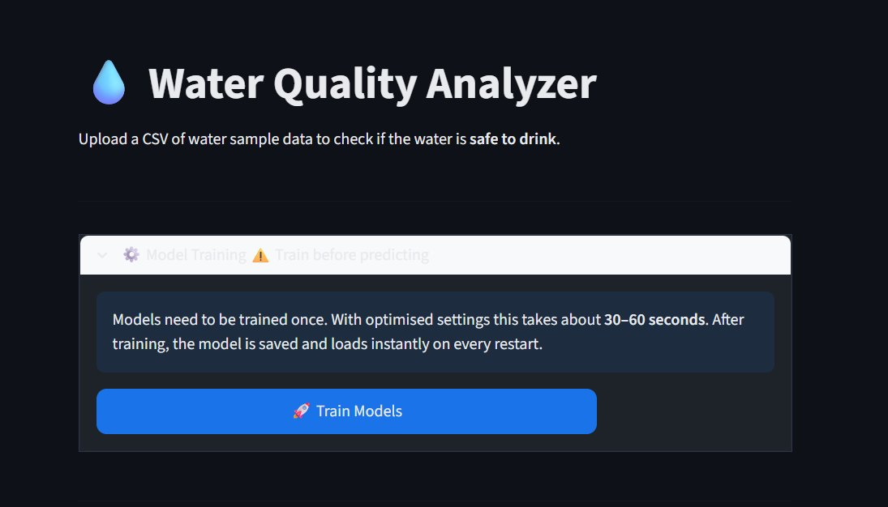
Deployed Web Application — Overview
Water Quality Analyzer built with Streamlit
Application Features
Model Training Panel
Train all 4 models in-browser with live progress bar. Model saved to disk — loads instantly on restart.
CSV Batch Prediction
Upload any CSV with 14 feature columns. Validates, predicts every row, shows Safe/Not Safe with confidence %.
Manual Single Input
Enter all 14 feature values via number inputs and get an instant potability probability score.
Downloadable Results
Fig 1. Water Quality Analyzer — home screen with model training status and navigation
Summary metrics (total/safe/unsafe counts) and downloadable results CSV for further analysis.

Slide 16
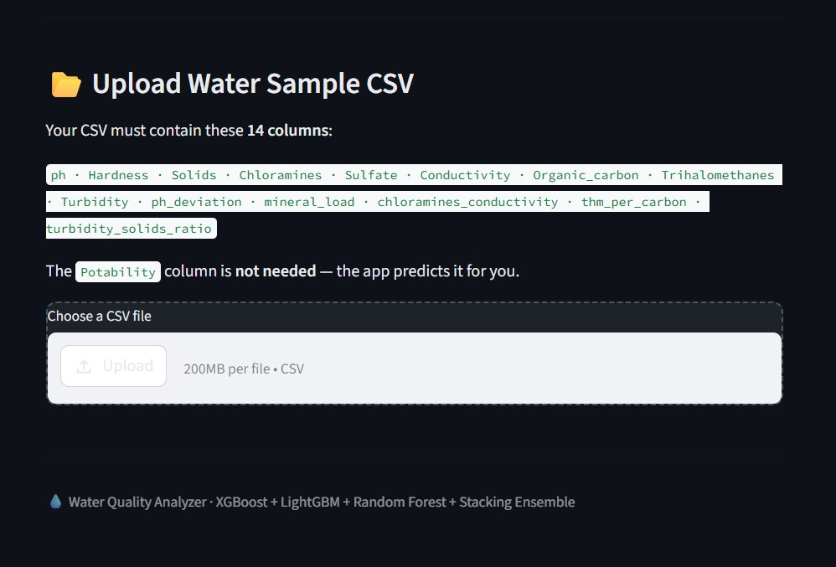
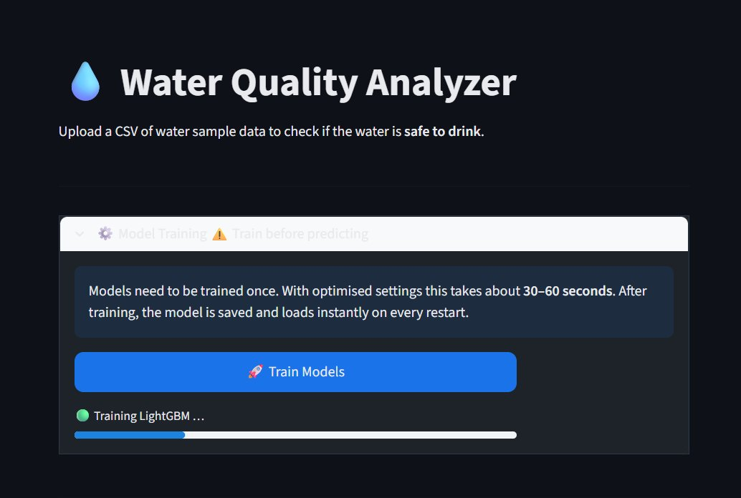
Deployed Application — Model Training Panel
In-browser training with live progress indicators
The Model Training Panel allows users to train all four ML models directly from the browser without any command-line interaction. A live progress bar tracks each model during training. After completion, the best model is saved to disk and loads instantly on every subsequent restart — no retraining required.
Fig 2. Training in progress — LightGBM model training with progress bar
Fig 3. Model trained — ready to predict, showing Upload CSV and Summary sections

Slide 17
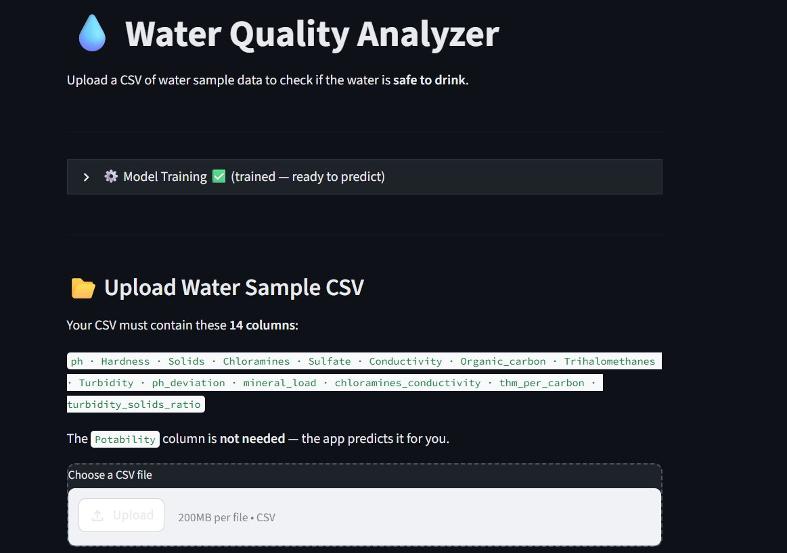
Deployed Application — CSV Upload & App Layout
Batch prediction with detailed results
CSV Format Requirements
ph
Hardness
Solids
Chloramines
Sulfate
Conductivity
Organic_carbon
Trihalomethanes
Turbidity
ph_deviation
mineral_load
chloramines_conductivity
thm_per_carbon
turbidity_solids_ratio
Potability column NOT needed
— app predicts it for you
Fig 4. Application home — model trained, upload section with required 14-column format

Slide 18
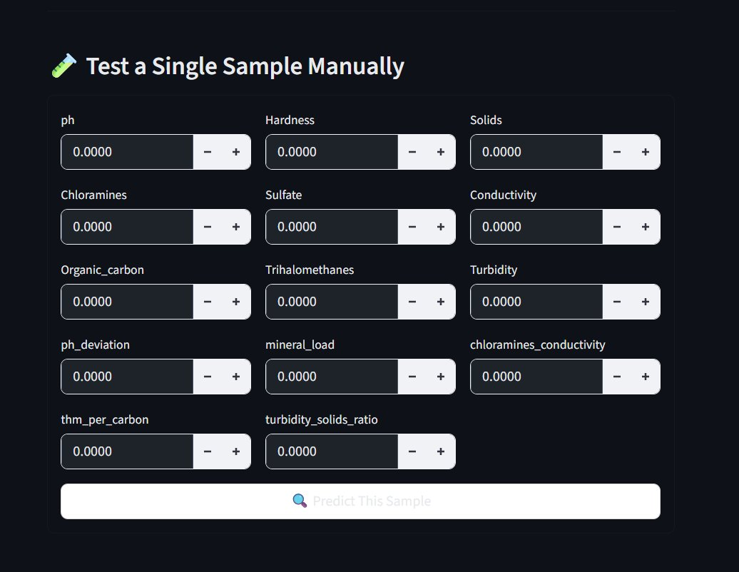
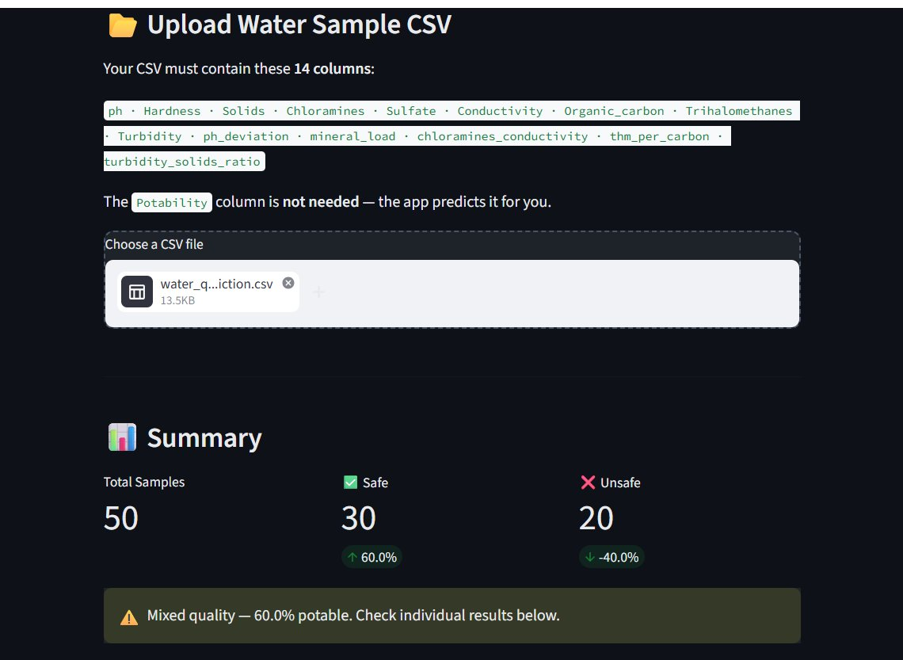
Deployed Application — Manual Input & Prediction Results
Single sample testing and batch result display
Fig 6. Summary after CSV upload — 50 samples, 30 Safe (60%), 20 Unsafe (40%)
Fig 5. Manual single sample input — all 14 feature fields with +/− controls

Slide 19
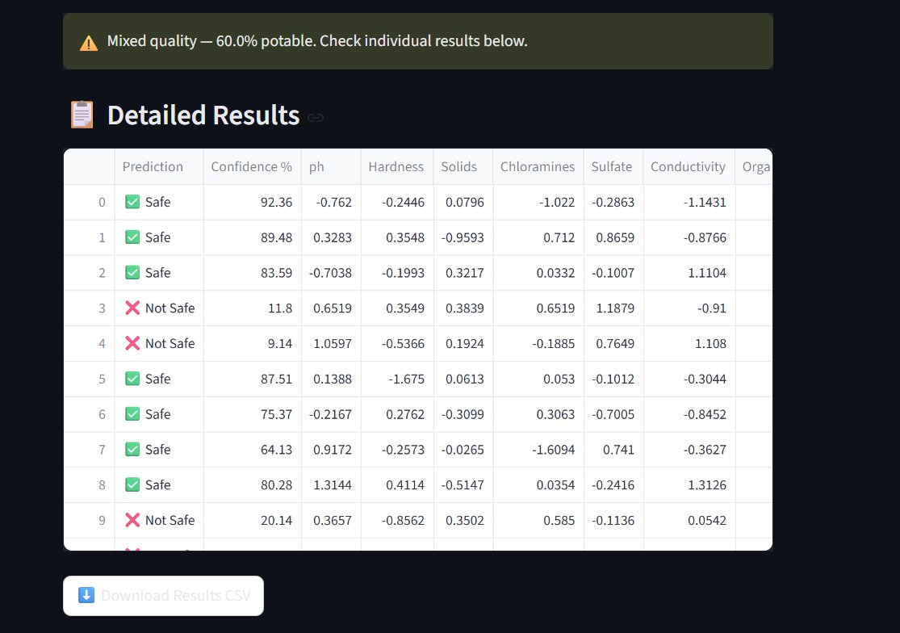

Deployed Application — Detailed Prediction Results
Per-sample predictions with confidence scores
Green card — confidence >75%
Safe to drink
Red X — confidence >50%
Not safe to drink
Warning banner when batch
has mixed predictions

Slide 20
05
Conclusions, Limitations
& Future Work
Findings, ethical scope, and next development steps
Water Quality Classification for Safe Drinking Prediction

Slide 21
Conclusions & Future Work
Summary of findings and directions for subsequent research
CONCLUSIONS
FUTURE WORK
Stacking Ensemble (XGB+LGBM+RF) achieves best performance — Accuracy ~0.82, F1-Macro ~0.81, ROC-AUC ~0.87
SHAP Explainability
Per-prediction waterfall charts showing which features drove each decision
Feature engineering was the highest-ROI step: ph_deviation leads by Mutual Information, engineered features account for ~35% RF importance
Real-time Sensor API
REST endpoint for IoT water quality sensor integration
7-method consensus feature selection produces a robust, method-agnostic feature set
Docker Deployment
Containerise the Streamlit app for one-click cloud deployment
No distribution shift detected between train and test splits (KS p > 0.05 for all features)
Deep Learning Baseline
MLP or 1D-CNN for direct comparison against the ensemble
Streamlit app delivers a polished, accessible interface for non-technical users — CSV + manual input modes
Multi-class Extension
Classify contamination type: biological / chemical / physical
Problem is fundamentally non-linear (max r=0.085 with target) — confirms ensemble tree models are appropriate
Cross-dataset Validation
Test generalisation on WHO or municipal water quality datasets

Slide 22
Technology Stack & References
Libraries, tools and data sources
Category
Libraries / Tools
Data
pandas ≥2.0 · numpy ≥1.24
ML
scikit-learn ≥1.3 · XGBoost ≥1.7 · LightGBM ≥4.0
Imbalance
imbalanced-learn ≥0.11 (SMOTE)
Statistics
scipy ≥1.11 (KS-test, t-test)
Visualisation
matplotlib ≥3.7 · seaborn ≥0.12
App
Streamlit ≥1.32
Persistence
joblib ≥1.3 (model serialisation)
Acknowledgements
Dataset: Aditya Kadiwal — Water Potability Dataset on Kaggle (Open Research Licence)
Guidelines: World Health Organization — Guidelines for Drinking-water Quality, 4th Edition (2022)
Libraries: scikit-learn, XGBoost, LightGBM, Streamlit open-source communities

Slide 23
Thank You
Water Quality Classification for Safe Drinking Prediction
5-Stage Pipeline
4 Models
~82% Accuracy
Python 3.10+
Preprocessing → EDA → Selection → Training → App
XGBoost · LightGBM · Random Forest · Stacking
Best Stacking Ensemble · ROC-AUC ~0.87
Streamlit · scikit-learn · XGBoost · LightGBM
For Academic & Educational Purposes Only

