Slide 1
Vote Maadi
A place to host your elections!

Slide 2
What is Vote Maadi?
Vote maadi is a web application built to host small scale elections for free!
A school, college or even an apartment can host their own elections for its members to take part in.
Using the website is simple as this –
Admin creates an account and hosts an election with filling in all the candidate and election details.
Voter signs up, chooses to take part in an election and cast their vote to their favorite candidate.
After the election is completed the voters and the admin can view the results.

Slide 3
Where to use Vote Maadi?
reddybhargava.pythonanywhere.com

Slide 4
Individual Contributions…
Bhargava N Reddy
Registrations(Sign Up and Sign In) pages and Base template and respective CSS, Views and Models.
Kruthik JT
Voting page, Data retrieval from database and respective CSS, Views and Models.
Harikrishnan V
Index page, vote results page(by using necessary database retrievals) and the required CSS, Views and Models.

Slide 5
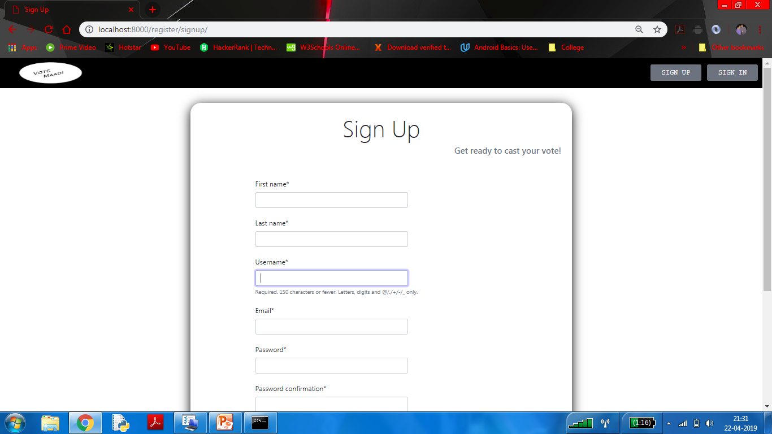
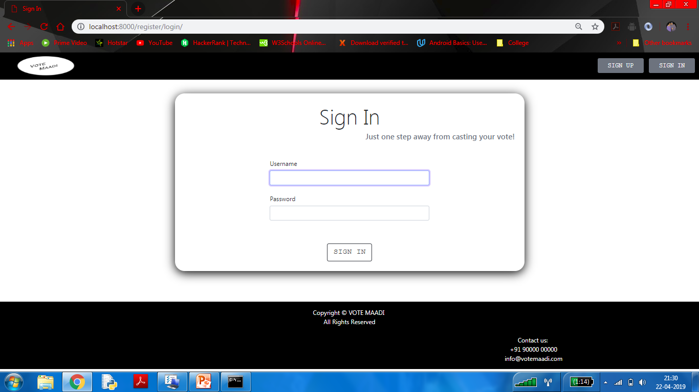
How fancy does it look?

Slide 6
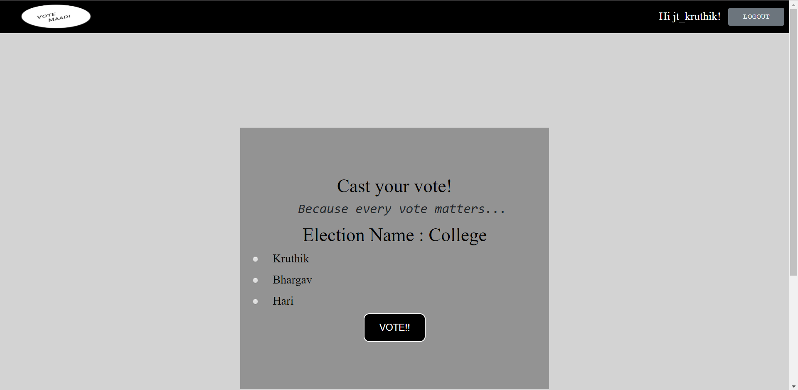
How fancy does it look?

Slide 7
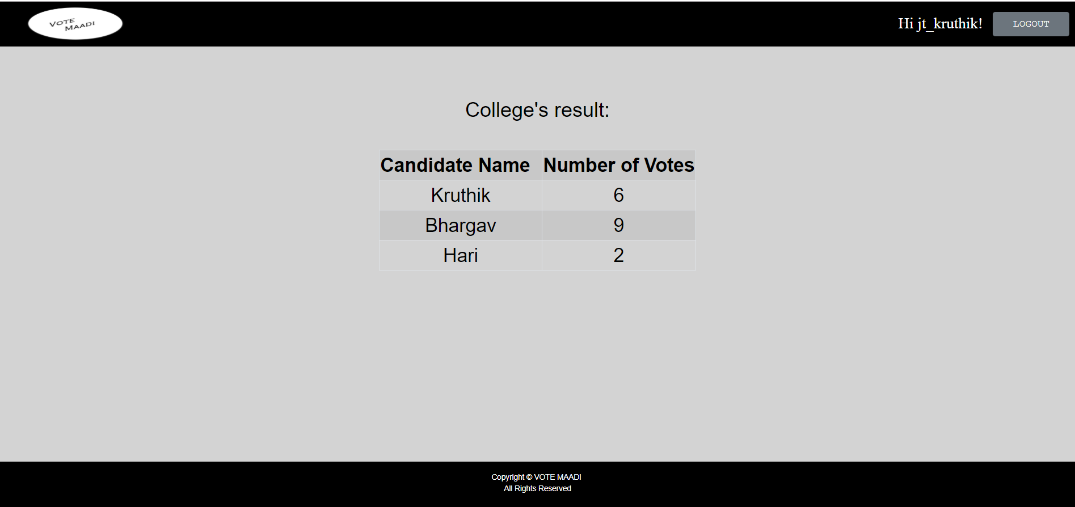
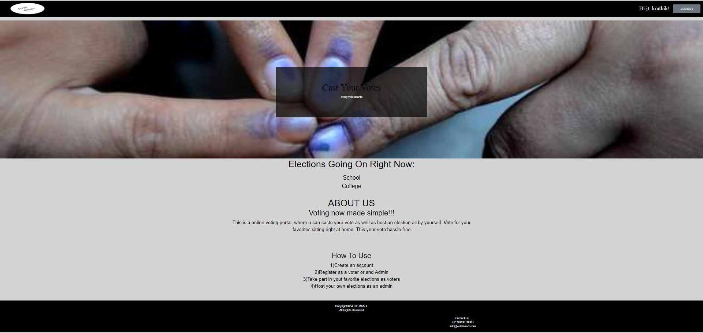
How fancy does it look?

Slide 8
What’s in it for us?
A hands-on project/work is always the best way to learn something!(after making a million mistakes)
Learnt how to build and (more importantly) design to custom models and views.
Getting comfortable with Django Framework and how it works!!

Slide 9
Difficulties we faced …
Extending the default Django User Model (or even inheriting it and creating a new model)
Getting all the static files and the templates files in right places or in its respective folders.
Creating the correct urls for different views.
Accessing the Objects retrieved and using only particular properties.

Slide 10
GITHUB REPOSITORY LINK:
https://github.com/harikrishnanv1311/WebFrameworks

Slide 11
TEAM DETAILS
Bharagava N Reddy
PES1201701016
bharghava.n.reddy@gmail.com
Kruthik JT
PES1201701509
jt.kruthik@gmail.com
Harikrishnan V
PES1201700155
harikrishnanv1311@gmail.com

