Slide 1

Directory Watcher
Hari
SWDC-IN
Using Blockchain

Slide 2
Agenda
1 | Scope
2 | Architecture
3 | Technology used
4 | Why Blockchain?
5 | Demo
To shift Highlight
Click the arrow, press shift key and move top or bottom

Slide 3
Scope
Monitor the (installation) directory
Configure directory path to be listened for changes.
Monitors and Identifies the changes made to directory path.
Uses Sha256 hashing to generate file hashes.
Stores the history of modifications (Created/Modified/Deleted/Renamed).
Maintains both Directory and File tampering list.
Directory Watcher
D:\SampleApp
Configure
#Sha256
DB
Uploads changes
Blockchain

Slide 4
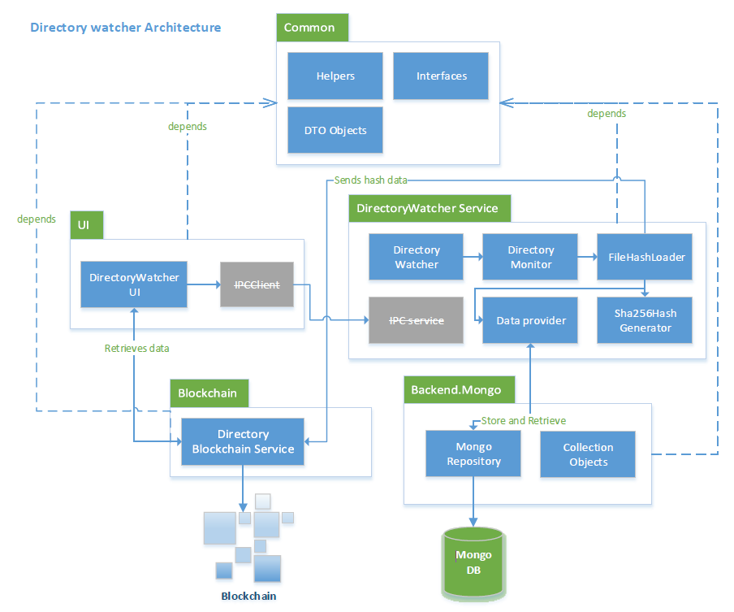
Architecture

Slide 5










Technology Used
Technology stack
Tools used
Remix
.NET Standard
Geth

Slide 6
Why Blockchain?
Ethereum
State is immutable
Trustless
Smart Contracts
Decentralized ledger
Peer to Peer network
Cryptographic hashing
Mining
Notes:
Distributed across p2p network
Each transaction is hashed.
Chain of blocks, upcoming blocks depends upon the previous blocks hash
Blockchains don’t actually eliminate trust. What they do is minimize the amount of trust required from any single actor in the system. They do this by distributing trust among different actors in the system by incentivizing the actors to cooperate with the rules defined

Slide 7

DEMO

