Slide 1

Directory Watcher
Hari
SWDC-IN
Using Blockchain

Slide 2
Agenda
1 | Scope
2 | Architecture
3 | Technology used
4 | Demo
To shift Highlight
Click the arrow, press shift key and move top or bottom

Slide 3
Scope
Monitor the (installation) directory
Configure directory path to be listened for changes.
Monitors and Identifies the changes made to directory path.
Uses Sha256 hashing to generate file hashes.
Stores the history of modifications (Created/Modified/Deleted/Renamed).
Maintains both Directory and File tampering list.
Directory Watcher
D:\SampleApp
Configure
#Sha256

Slide 4
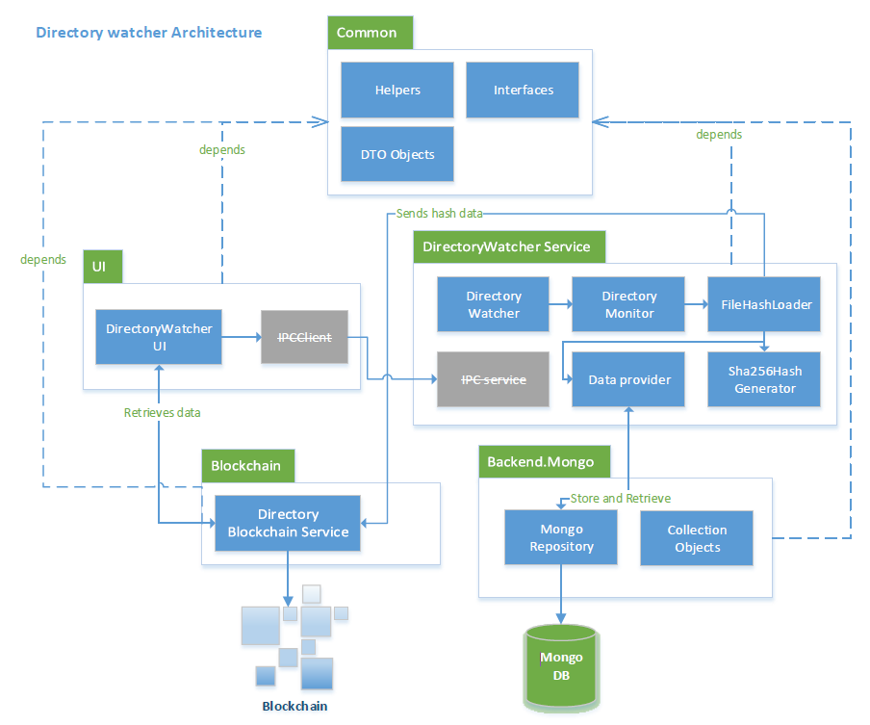
Architecture

Slide 5










Technology Used
Technology stack
Tools used
Remix
.NET Standard
Geth

Slide 6

DEMO

