Slide 1




3D SCANNER
Presented By Group 3

Slide 2



OUR TEAM
1. Dinesh 23EC30054 -circuit
2. Lakshman 23CS10009 -Code& structure
3. Sanskar 23MI33020 - structure& presentation
4.Aryan 23CY10007- code&circuit

Slide 3


INTRODUCTION
In today's digital era, 3D scanning technology offers immense potential for creators, innovators, and hobbyists. Our mission is to make this technology accessible to all by providing a step-by-step guide to building your own 3D scanner using affordable materials and tools. Throughout this presentation, we'll cover the principles of 3D scanning, the construction process, software setup, calibration, and potential applications. Join us as we explore the exciting world of DIY 3D scanning and unleash your creativity!
.

Slide 4



PROBLEM
Despite the incredible potential and versatility of 3D scanning technology, accessibility remains a significant barrier for many individuals and small businesses. Traditional 3D scanners often come with hefty price tags, complex setups, and proprietary software, limiting their reach and usability
Moreover, the lack of customization options and flexibility inherent in commercial solutions stifles innovation and creative expression. As a result, many aspiring creators, educators, and entrepreneurs find themselves restricted in their ability to explore the vast possibilities offered by 3D scanning technology.

Slide 5

GOAL
Accessibility: The primary goal is to make 3D scanning technology accessible to a wider audience by providing DIY solutions that are affordable, easy to build, and require minimal technical expertise. This includes ensuring that the necessary components are readily available and that the assembly process is straightforward and well-documented.
Affordability: Another key objective is to significantly reduce the cost barrier associated with 3D scanning technology. By utilizing off-the-shelf components and open-source software, the goal is to create DIY 3D scanners that are significantly more affordable than their commercial counterparts, thereby enabling individuals and small businesses with limited resources to access this technology.

Slide 6


COMPONENTS
·ARDUINO UNO R3
·NEMA17 4.2 Kg-cm Stepper Motor (4)
·Micro SD card Reader Module: 1.0
·A4988 Stepper Motor Driver Module : 2.0
·VL53L0X Laser Range Finder Distance Sensor Module: 1.0
·GT2 20 Teeth Aluminium Timing pulley 5mm bore for nema17 motor : 1.0
·GT2 Open loop Timing Belt 6mm : 1.0
·Radial Ball Bearing 4mm Dia : 1.0

Slide 7
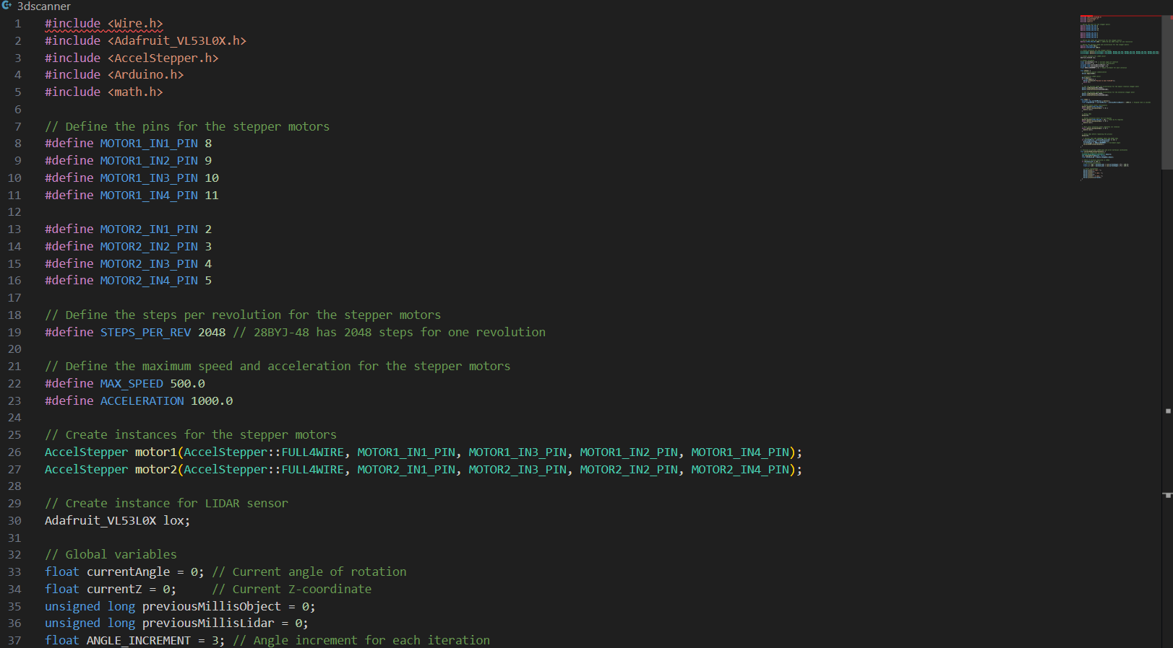
THE CODE

Slide 8
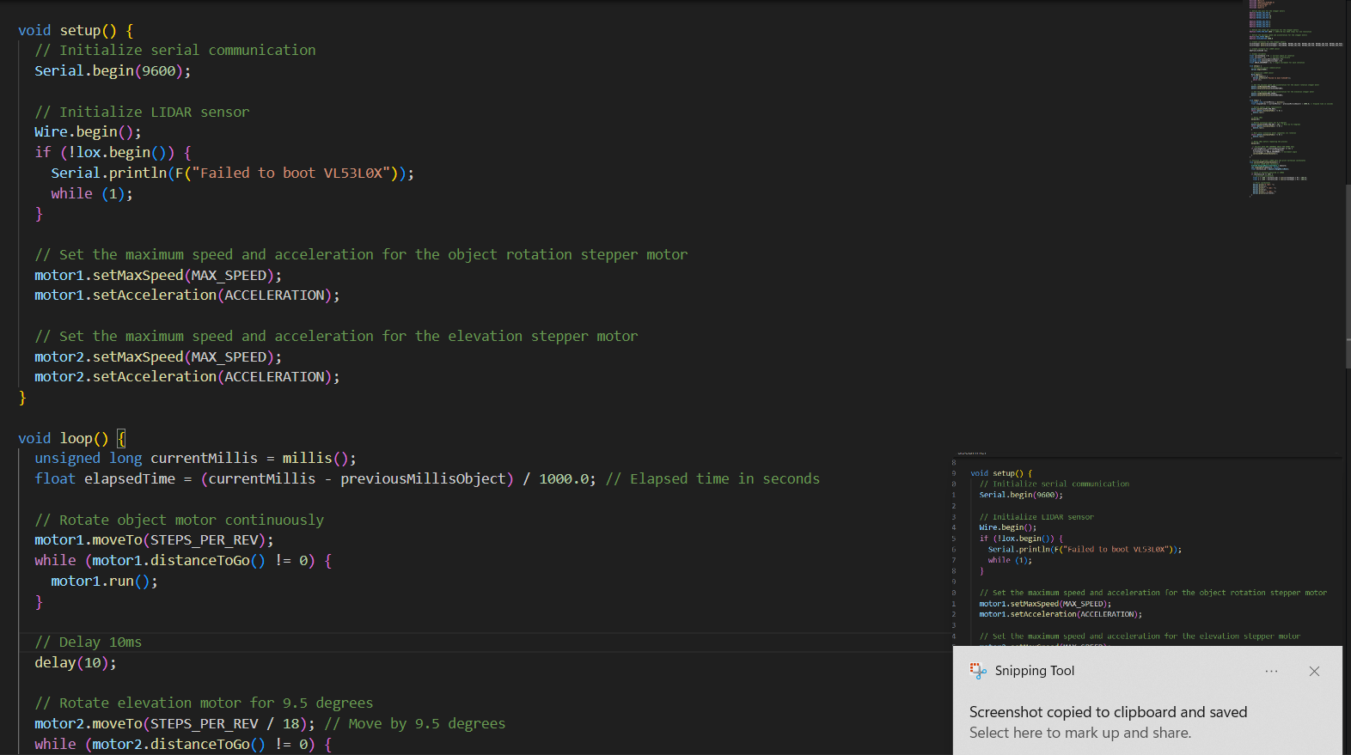

Slide 9
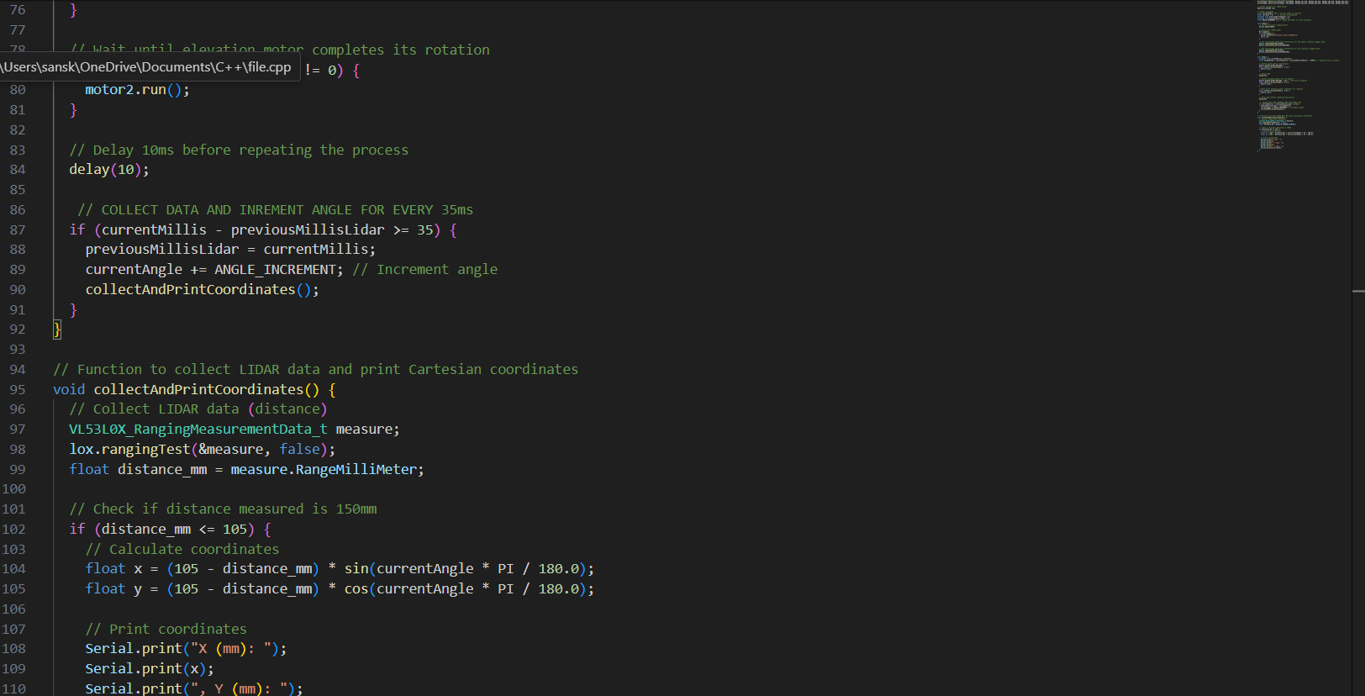

Slide 10

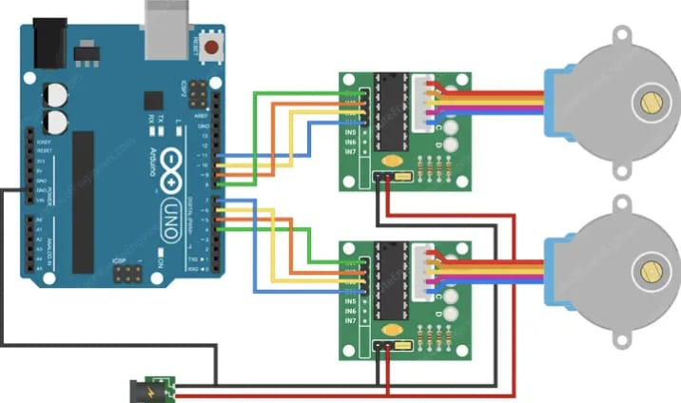
THE CIRCUIT

Slide 11
CHALLENGES FACED
1) Writing the code was not easy, we surfed online sought help from seniors to get the required code.
2) Working with LIDAR was new to us
3)Connections and Circuit

Slide 12

WHAT DO WE GET?
•FUNCTIONAL DIY 3D SCANNER:
•Successfully constructed a functional 3D scanner using readily available materials and tools.
•Demonstrated the feasibility of building a DIY 3D scanner with affordable components, empowering individuals to access 3D scanning technology.

Slide 13


CONCLUSION
Through our exploration, we have highlighted the transformative potential of DIY 3D scanning in unlocking new possibilities for creators, educators, entrepreneurs, and hobbyists alike. From empowering individuals with the tools to turn their imagination into reality to fostering collaboration and community-driven innovation, DIY 3D scanning projects stand as a testament to the ingenuity and resourcefulness of the maker movement.
As we look to the future, the goals we have outlined - accessibility, affordability, customizability, usability, functionality, and community building - serve as guiding principles for continued progress and innovation in the realm of DIY 3D scanning. By staying true to these principles and embracing the spirit of open collaboration and shared knowledge, we can collectively shape a future where technology is not just accessible to the few, but truly belongs to the many.

Slide 14


Thank You

