Slide 1
AI-Driven Traffic Violation Detection
Technical Breakdown & Architecture Overivew
Model: YOLO11x + Cognitive LLM Brain

Slide 2
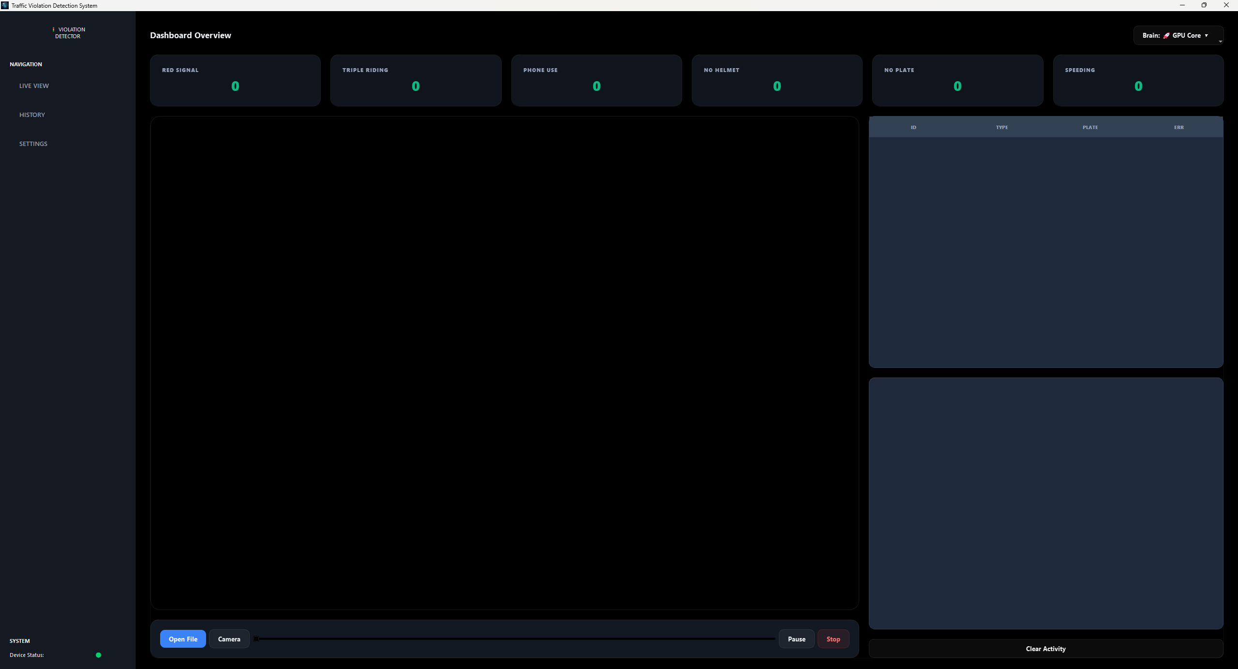

Slide 3
1. Object Detection Engine (YOLO11x)
Main Model: YOLO11x (Extra Large) for high-precision vehicle/person tracking.
Specialized Models: YOLOv8 Nano for real-time Helmet and Plate classification.
Hardware Acceleration: Optimized for NVIDIA RTX GPUs using CUDA cores.
Dynamic ROI: focuses computing power only on active motion zones.

Slide 4
2. Cognitive Reasoning (LLM Brain)
Primary Model: Gemini 2.0 Flash (or OpenAI GPT-4o).
Purpose: Secondary verification layer to eliminate false positives.
AI Voting: Multi-frame analysis ensures 99% accuracy on human pose/helmet status.
Feedback: Provides Cyan-colored visual verification in the dashboard.

Slide 5
3. Intelligent Detection Features
No-Helmet: ROI-based head analysis using spatial containment.
Excess Riding: Person-centric counting logic (Detects 3+ riders).
Red Signal: Computer Vision color segmentation + Stop-line gating.
Phone Usage: MediaPipe Pose estimation + YOLO object association.

Slide 6
4. Data Storage & Real-Time Dashboard
Storage: SQLite Industrial Database (v3.0) with Evidence Linkage.
Dashboard: 'Premium Glass Slate' UI based on PyQt5.
Export: One-click CSV/PDF reports for legal enforcement.
Scalability: Designed for multi-stream urban deployment.

Slide 7
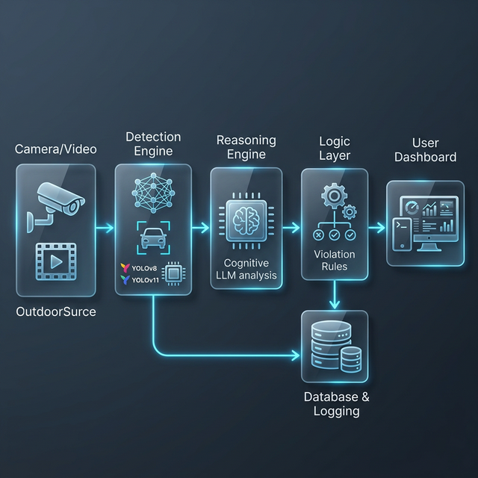
5. System Data Flow
Input: Real-time CCTV / High-res Video stream.
Process: YOLO Detection -> SORT Tracking -> Logic Layer.
Verify: Cognitive LLM Brain adjudication.
Action: Final Database Entry & Operator Alert.

