Slide 1
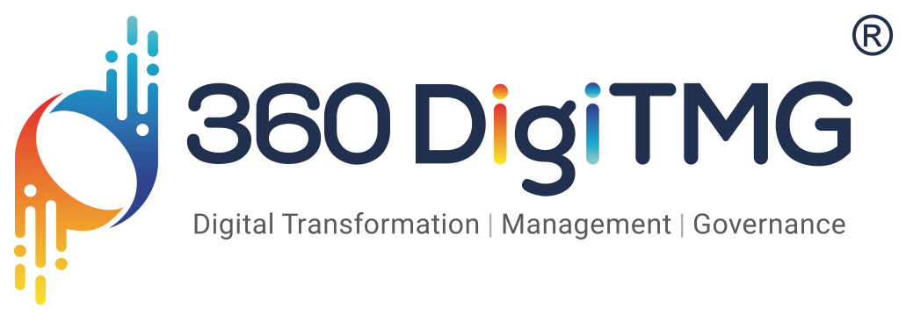


Marketing Analytics: Competitor Analysis and App Performance Optimization Model

Slide 2

Project Leadership
Sharat Manikonda
Director at Innodatatics and Sponsor
linkedin.com/in/sharat-chandra
Sampath Bukya
Project Mentor
https://www.linkedin.com/in/sampathbukya/

Slide 3
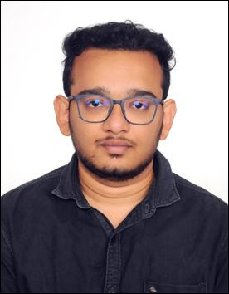
Team Members
Name: Hari krishna sri sai prasad machavarapu
https://www.linkedin.com/in/machavarapu-hari-krishna-sri-sai-prasad-526790218

Slide 4

Contents
Introduction
Project Goals
CRISP-ML(Q) Methodology
Technical Stacks
Project Architecture
Data Collection
Data Information
Model Building
Model Deployment
Output
Challenges
Future scope
Notes:
Change

Slide 5
Introduction
The need for mobile application is expanding quickly today. Having right features greatly impact the success of the app. Finding features that affect the success of the app is time consuming process, which increases the cost of app development.
Offering high quality app will increase the user acceptance and help the business to grow and compete with competitors.
Affordable app development will help the app development businesses to grow and increase their margins by reducing the app development time.

Slide 6
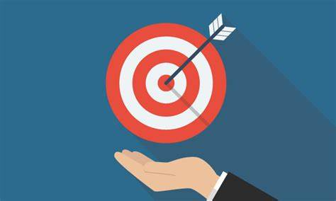
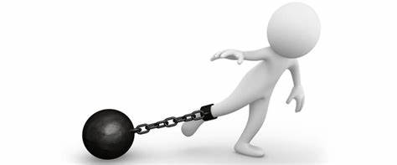
Project Goals
Objective:
Maximize the success rate of the apps.
Constraints:
Feature selection optimization to increase user acceptance.

Slide 7
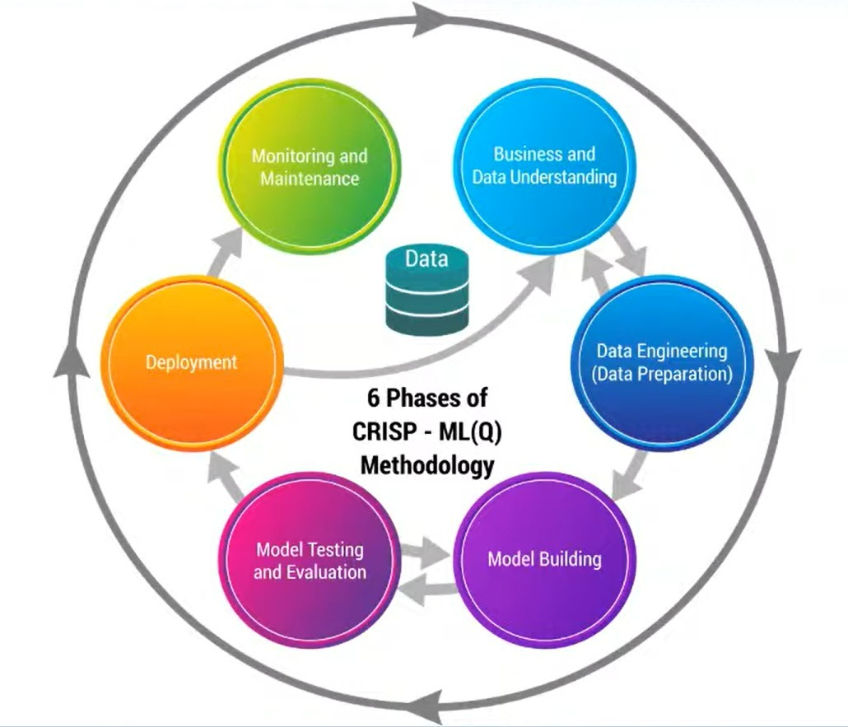
CRISP-ML(Q) Methodology

Slide 8

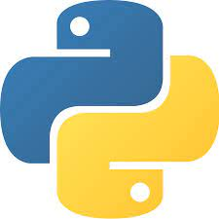



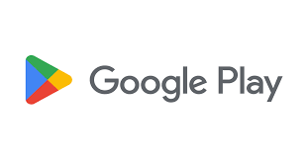
Technical Stacks
Notes:
Pycharm add Tableau

Slide 9




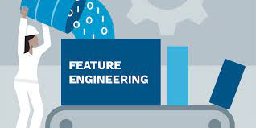


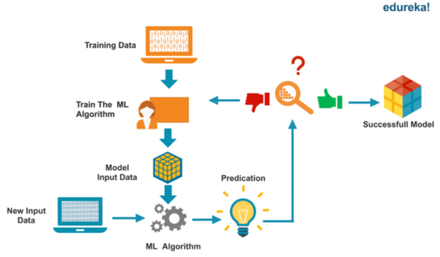
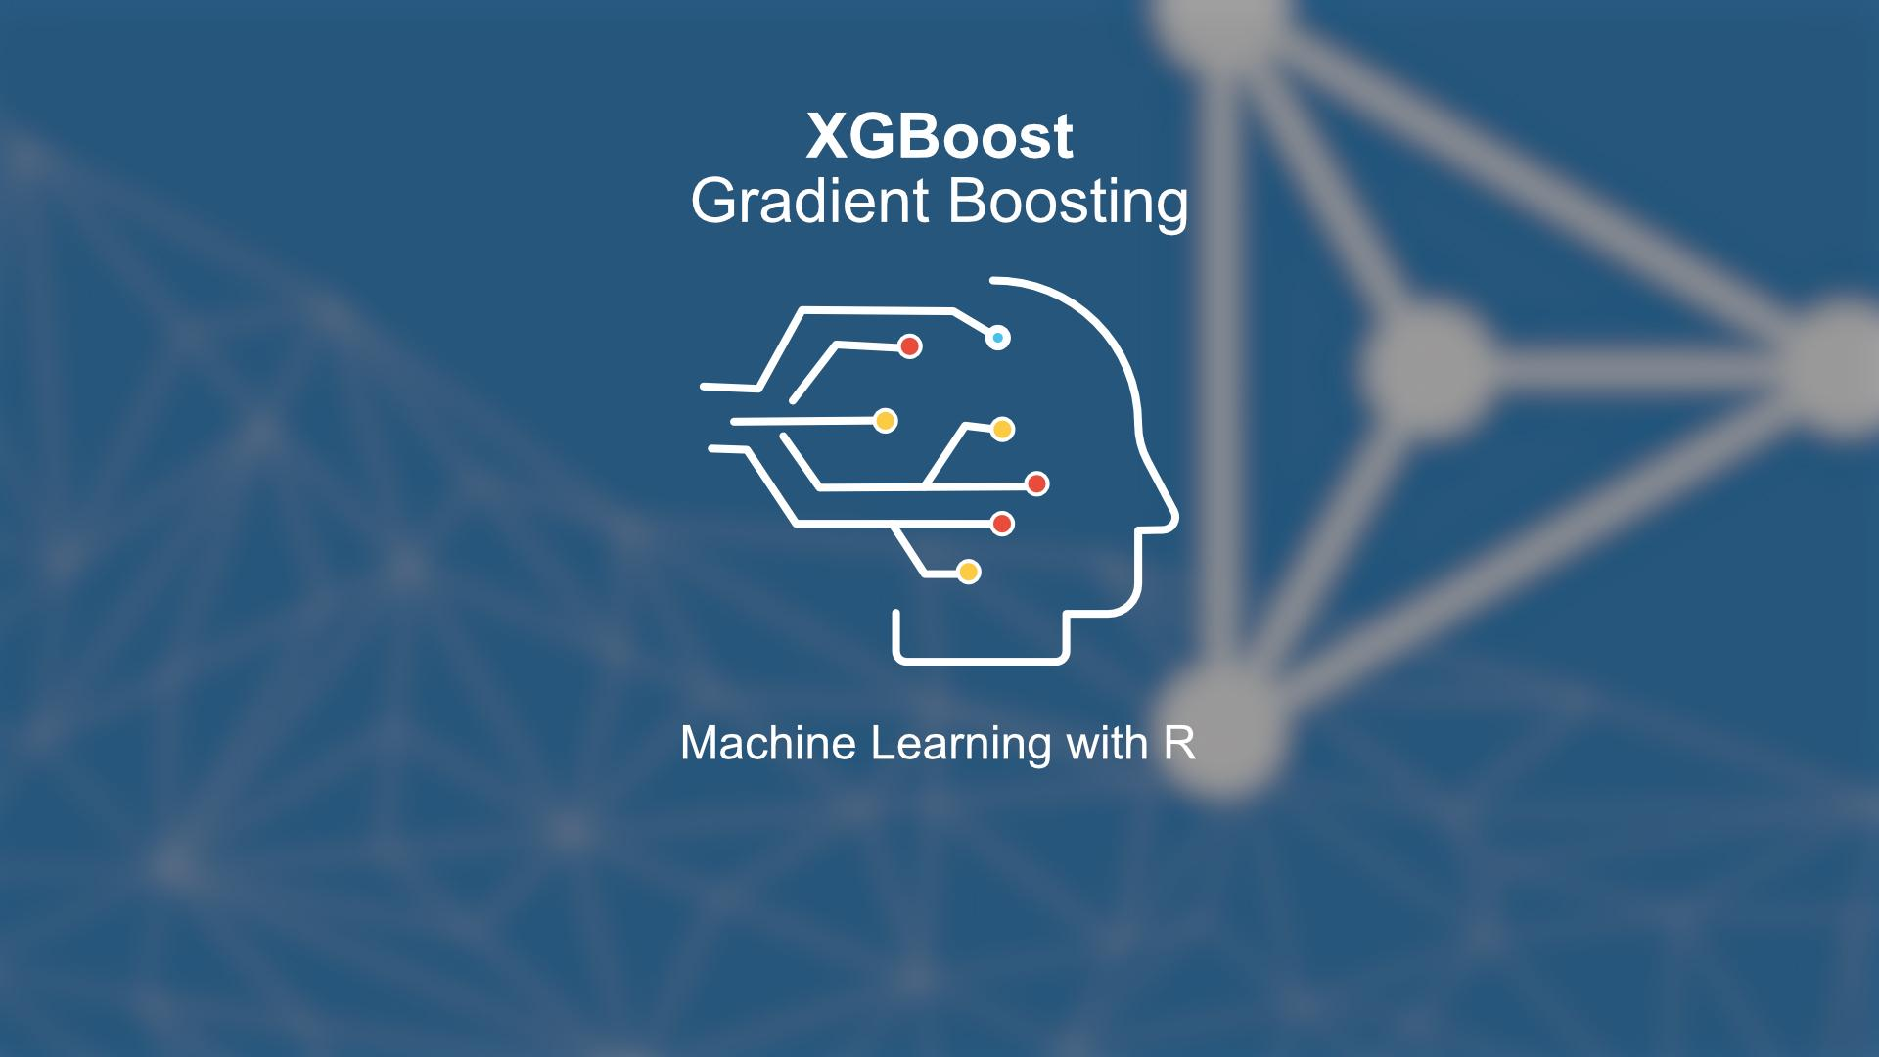
Project Architecture
Data Understanding and Data Pre-processing
Feature Engineering
Model Deployment
Model Building

Slide 10
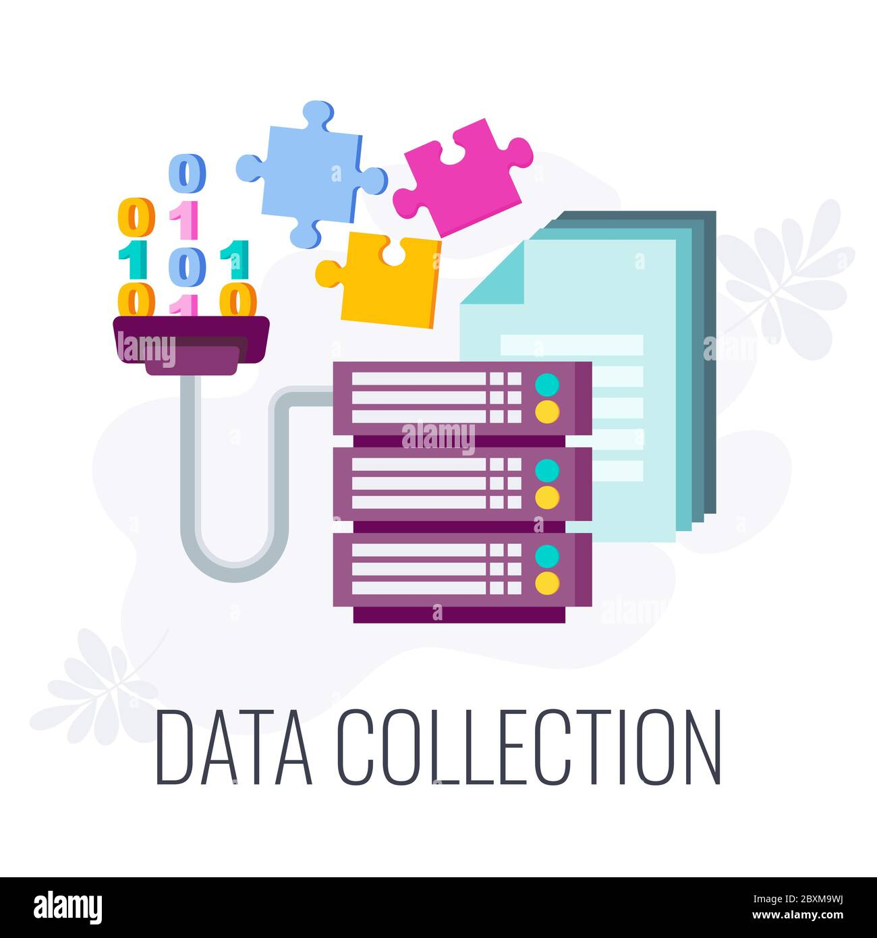

Data Collection
Data Collection is defined as the procedure of collecting, measuring and analyzing accurate insights for research using standard validation techniques.
Data collection :
Primary Data Sources : Data collected at source (web scrapping).
Data collected through Web scraping.

Slide 11
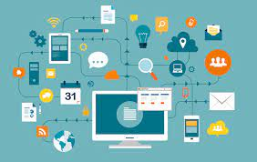
Data Information
In this model the data is analyzed considering the below features for the model building.
 | Data Dictionary
Sr.no | Name of the features | Description
1. | Title | Name of the app.
2. | Description | Description about the business and the app.
3. | Description HTML | Description using HTML.
4. | Summary | Short description about business.
5. | Installs | Number of installation of apps.

Slide 12
Data Information
 | Data Dictionary
Sr.no | Name of the features | Description
6. | MinInstalls | Minimum level of installs.
7. | RealInstalls | Actual number of installs.
8. | Score | Average rating of the app given by users.
9. | Ratings | Number of rating received by app.
10. | Reviews | Number of reviews received.
11. | Price | Cost of the app.
12. | Free | Is app free to install.

Slide 13
Data Information
 | Data Dictionary
Sr.no | Name of the features | Description
13. | Currency | Currency used in the app.
14. | Sale | Is sale offered by app.
15. | Developer | App developer information.
16. | DeveloperId | App Developer id given by google play store.
17. | DeveloperEmail | Email Id of the developer.
18. | Developerwebsite | Website of the developer.
19. | DeveloperAddress | Address of the app developer.

Slide 14
Data Information
 | Data Dictionary
Sr.no | Name of the features | Description
20. | PrivacyPolicy | Web page link for privacy policy of app.
21. | Genre | Category of the app.
22. | GenreId | Category Id given by google play store.
23. | Contentrating | Who can give rating of the app.
24. | adSupported | Are ads are supported on the app ?
25. | ContainsAds | Is ads present in the app ?

Slide 15
Data Information
 | Data Dictionary
Sr.no | Name of the features | Description
26. | Released | Date of release of app.
27. | Updated | Update Id.
28. | Version | Current version of the app.
29. | Recentchanges | Description of the recent changes done in the app.
30. | RecentChangesHTML | Description in HTML.
31. | AppId | Unique app id given by google play store.

Slide 16
Data Information
 | Data Dictionary
Sr.no | Name of the features | Description
32. | Url | Url of the app.

Slide 17
Model Building
Google play scrapper API has been used to extract the data of the app from the google play store.
Description, Review, and Recent Changes data was used for analysis.
The data was preprocessed using nltk and regular expression library.
Speller, removal of special characters, Stop word removal and Lemmatization was performed.
Frequent words list was created and arranged according to the frequency of repetition in descending order.
Unigram, Bigram and trigram are used as tokens.
Top words are selected from the results.

Slide 18
Model Deployment - Strategy
Streamlit is an open source app framework in Python language. It helps us create web apps for data science and machine learning in a short time. It is compatible with major Python libraries such as scikit-learn, Keras, PyTorch, SymPy(latex), NumPy, pandas, Matplotlib etc.

Slide 19
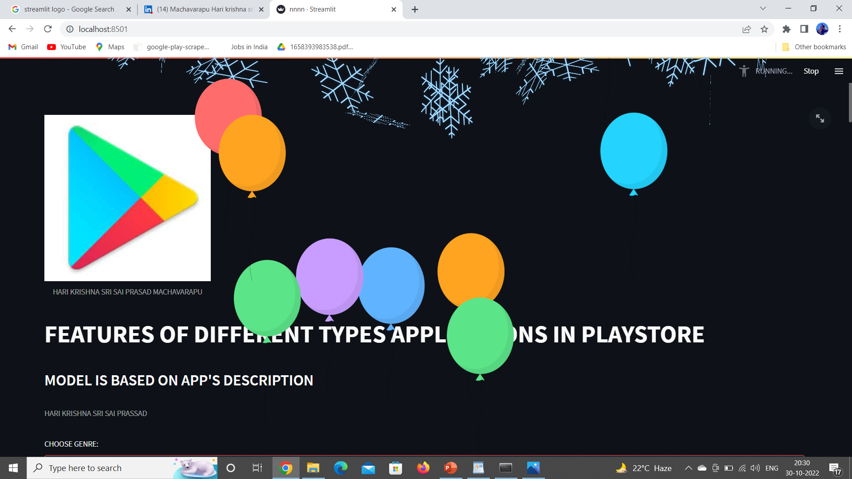
Screenshot Of Output

Slide 20
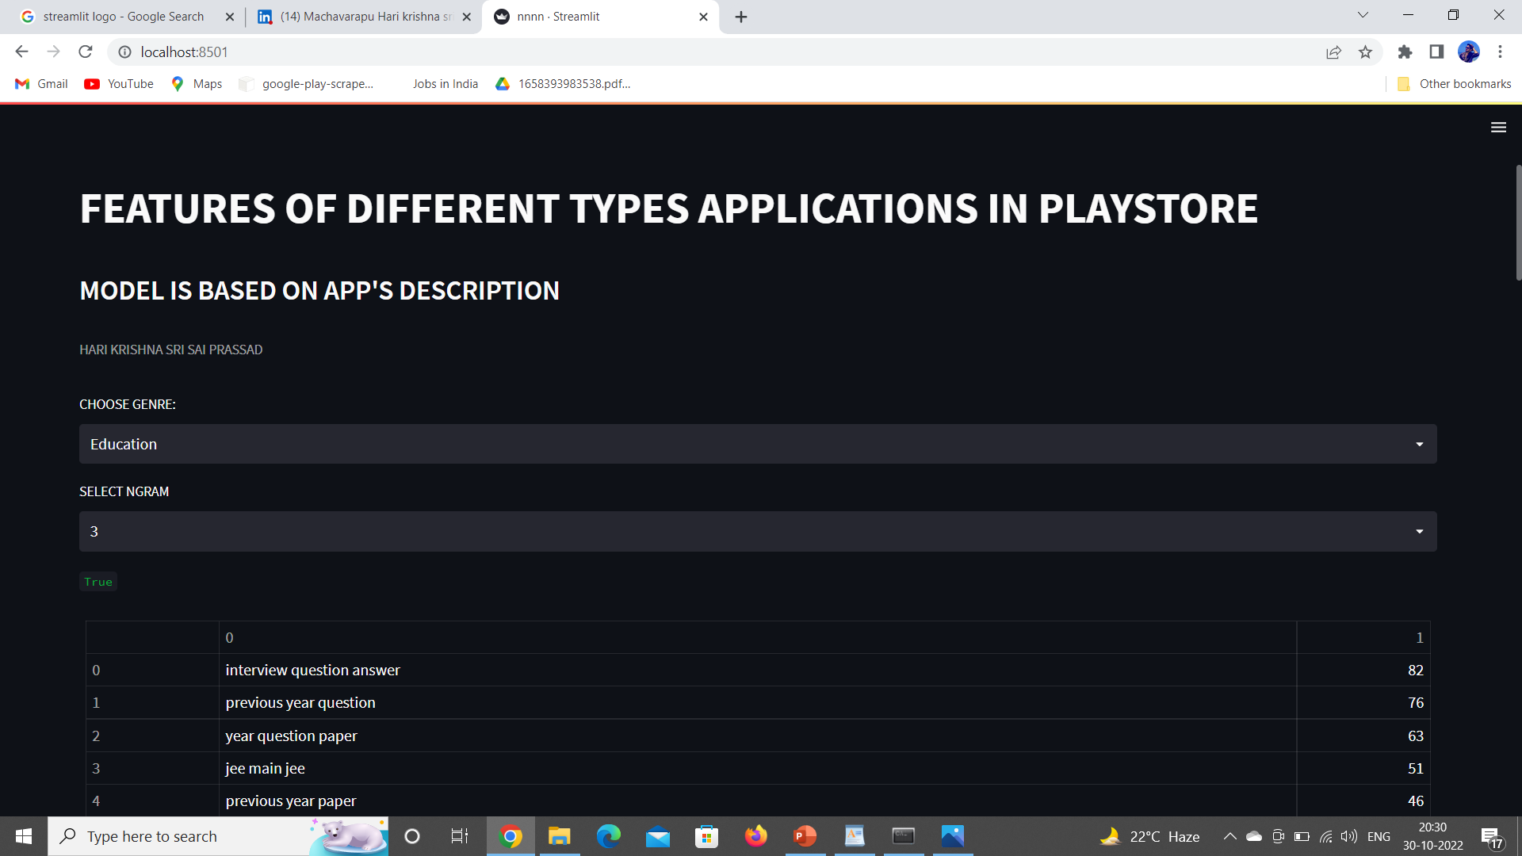
Screenshot Of Output

Slide 21

Video of output

Slide 22

Challenges
Limited Budgets for app development.
High market competition.
Dynamically changing features.

Slide 23

Future Scope
Features updation according to the new trend.
Enhance Visualization and Improve Interactivity.
Measuring the success rate of the app.
Data collection through other online sources.
This model can be used for existing app’s also.
45

Slide 24

Queries ?

Slide 25


