Slide 1
Customer Relationship Management
Team Members : Vishal S, Hari.k , Sumanth.D, Chinmay

Slide 2
Points
Handle
Handle NaN Data
Handle
Handle Categorical Columns
Deal
Deal With Class Imbalance

Slide 3
Handle NaN Data
Remove certain columns which have more NaNs than a threshold level
For numeric columns, replace with mean or mode. We have chosen to replace with mean.
Unlike say Decision Trees, we do not have yet the advantage of surrogate splits.
For categorical columns, we might not want to replace with mode; it might be better to lose the data in return for Logistic Regression.

Slide 4
How to deal with Categorical Data
Delete the columns
Handle them safely?

Slide 5
Deleting the columns
The easier way, is to delete all the categorical columns and deal only with the numeric columns.

Slide 6
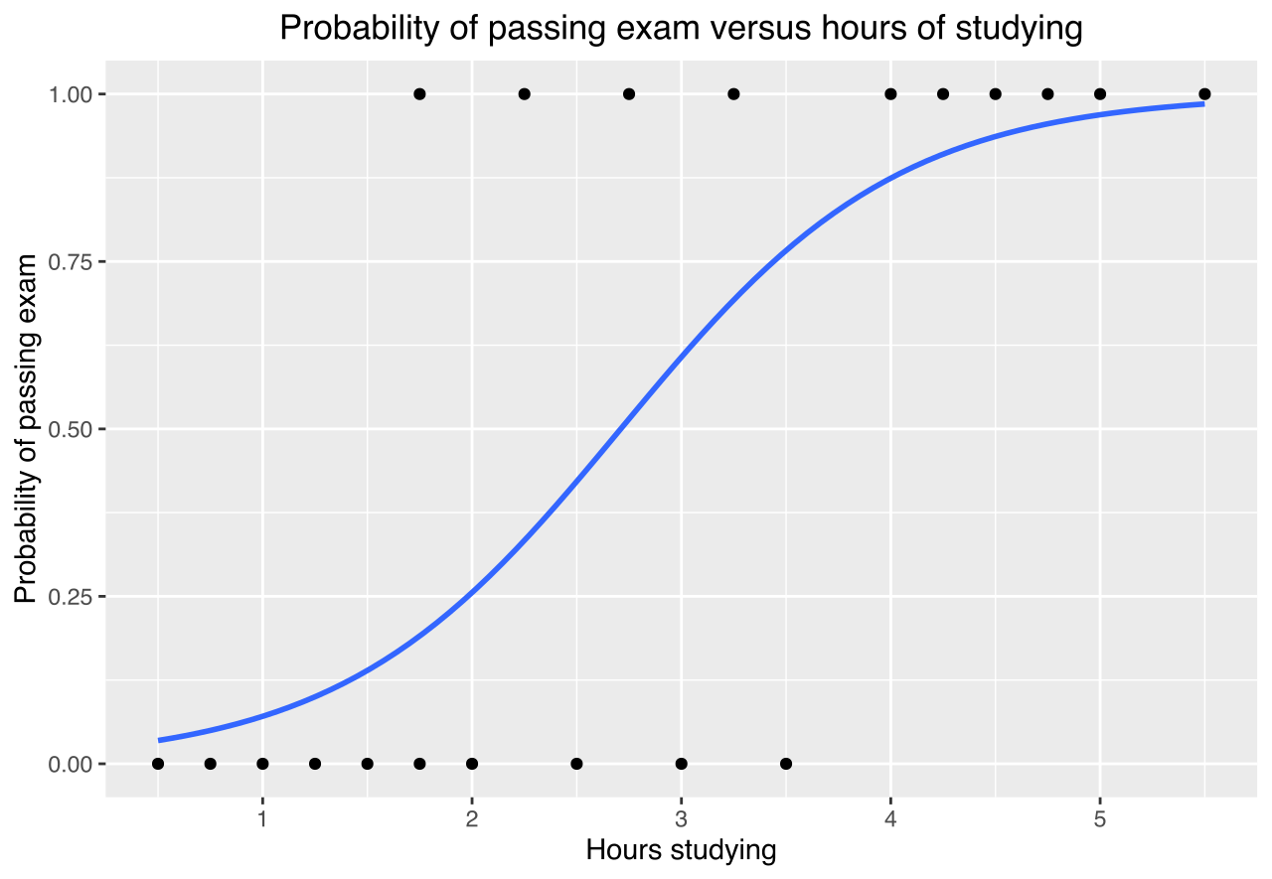
Logistic Regression

Slide 7

Handling the categorical columns
Can try to encode the columns to retain the data in these columns
We have 40 cat columns, and if we apply 1Hot Encoding, we get a sparse matrix with ~100000 columns.
This will be a pain to deal with.
We need to think of a better way to deal with this.

Slide 8

Handling the columns
We can take only the columns which have 10 unique categories or less in the initial modelling strategy
We can drop the rest
We finally get 8 such categorical columns.

Slide 9
Deal with Class Imbalance
We can see that the data is really unbalanced, with non-churn customers being more than 90% of the data set.
This, if left undealt with, will cause problems with predicting churn cases with the model.
We have tried to counter this, by upsampling, i.e creating duplicate points of the churn rows to make the classes more balanced.

Slide 10
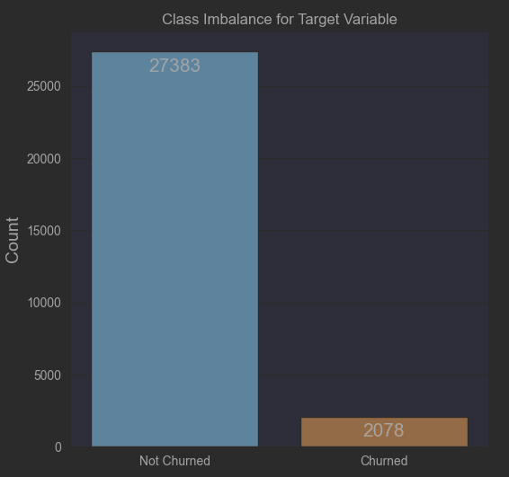
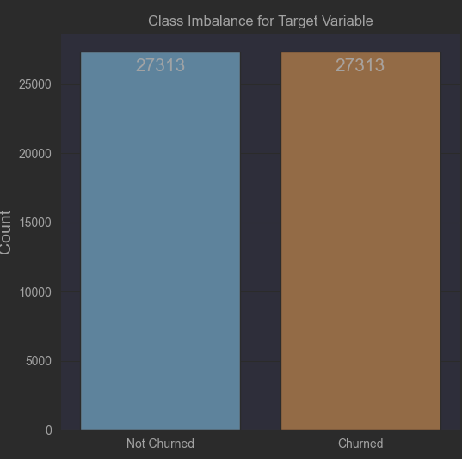
IMBALANCE CORRECTION

Slide 11
Logistic Regression Results
For the first approach, we get an AUC of 0.57.
For the second approach we get an AUC of 0.61, which is marginally better.
This is slightly better than predicting at random, and rather worse than predicting not churn for all data points (although this will cause losses to the company with false negatives).
We may improve our predictions by using better models.

Slide 12
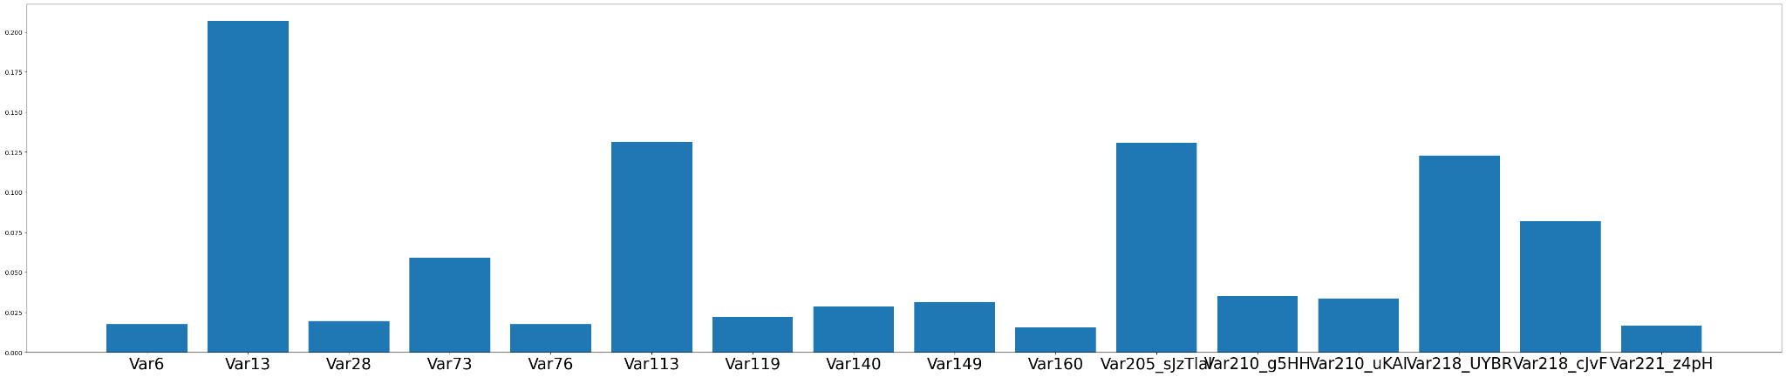
Feature Importance for Decision Trees

Slide 13
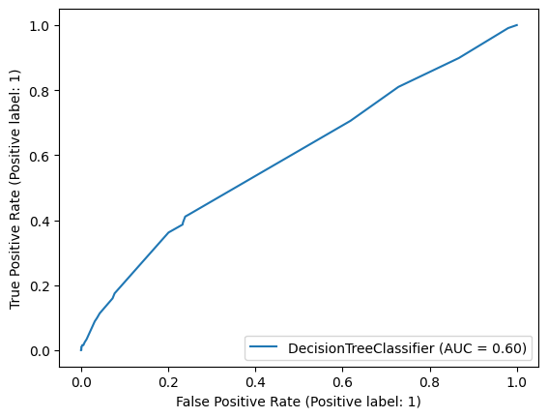
ROC-AUC Curve for Decision Trees

Slide 14
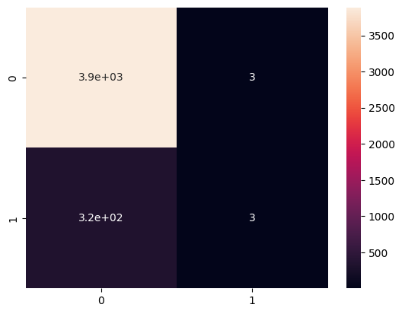
Confusion Matrix for Decision Trees

Slide 15
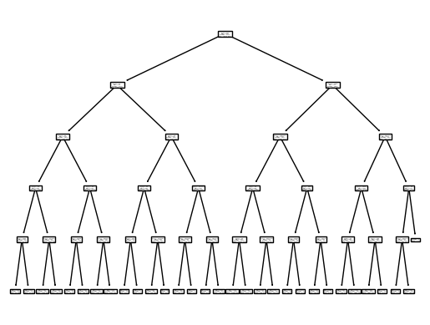
The Decision Tree

Slide 16
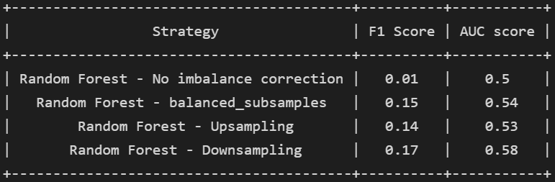
Random Forest

Slide 17
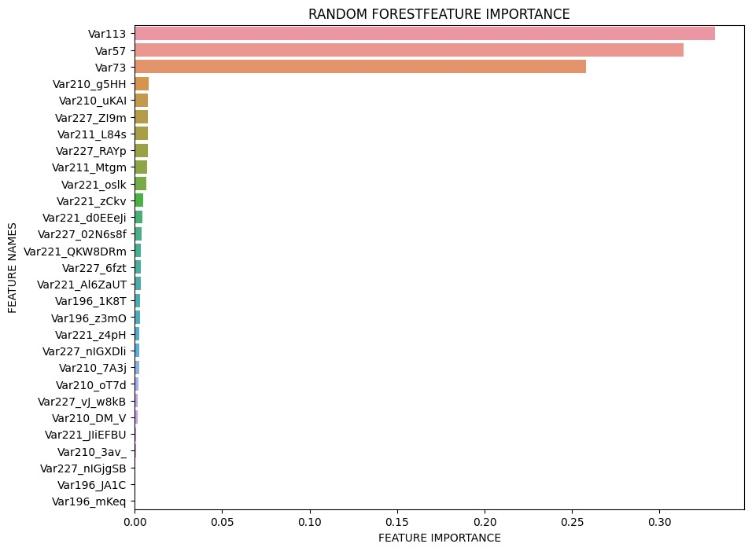
Feature Importance for Random Frest

Slide 18
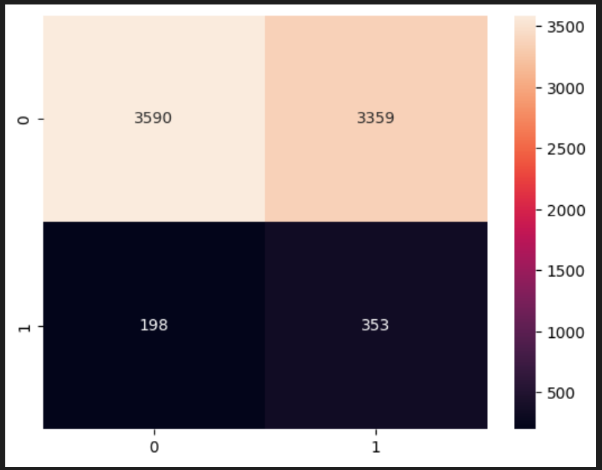
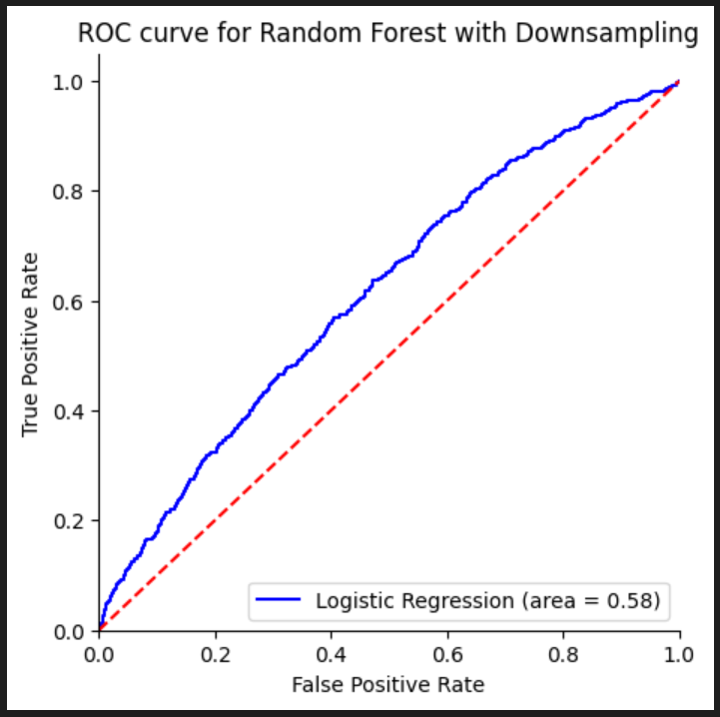
Performance on Random Forest with Downsampling

Slide 19
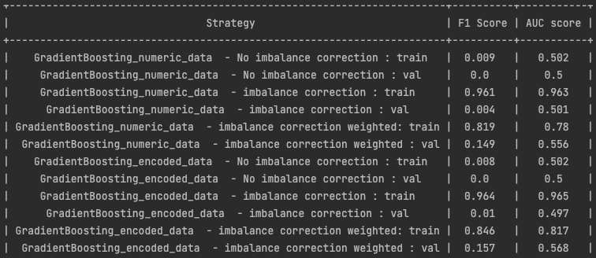
Gradient Boosting Results

Slide 20
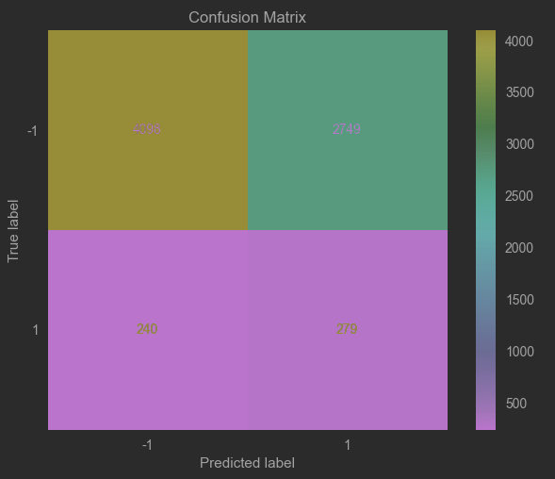
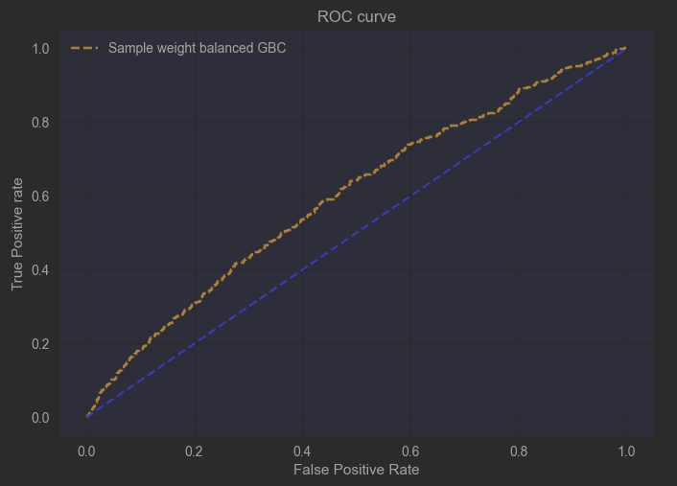
Performance – GBC on sample weights
4098
2749
240
279

