Slide 1
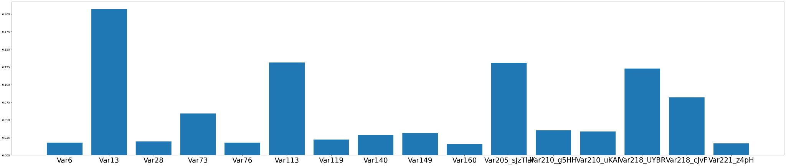
Feature Importance for Decision Trees

Slide 2
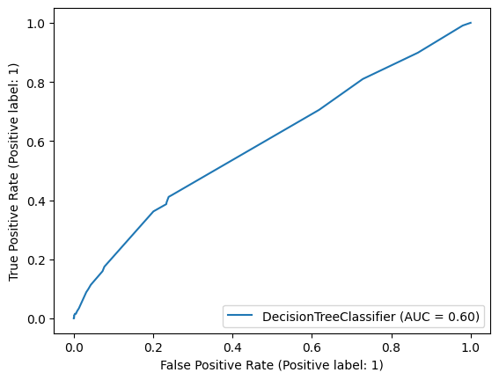
ROC-AUC Curve for Decision Trees

Slide 3
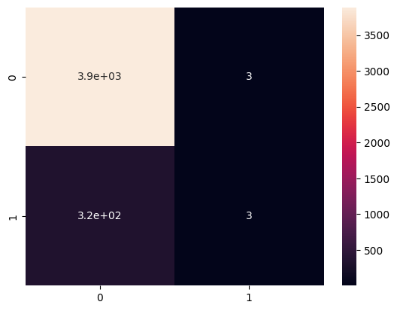
Confusion Matrix for Decision Trees

Slide 4
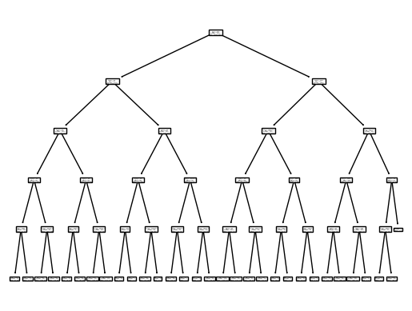
The Decision Tree

