Slide 2
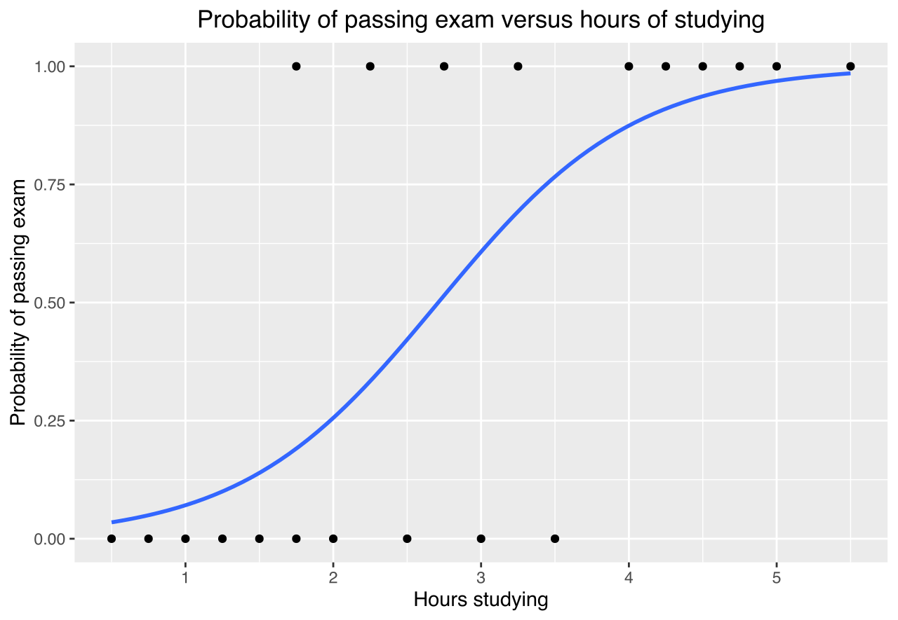
Logistic Regression

Slide 3
Points
Handle
Handle NaN Data
Handle
Handle Categorical Columns
Deal
Deal With Class Imbalance

Slide 4
Handle NaN Data
Remove certain columns which have more NaNs than a threshold level
For numeric columns, replace with mean or mode. We have chosen to replace with mean.
Unlike say Decision Trees, we do not have yet the advantage of surrogate splits.
For categorical columns, we might not want to replace with mode; it might be better to lose the data in return for Logistic Regression.

Slide 5
How to deal with Categorical Data
Delete the columns
Handle them safely?

Slide 6
Deleting the columns
The easier way, is to delete all the categorical columns and deal only with the numeric columns.

Slide 7

Handling the categorical columns
Can try to encode the columns to retain the data in these columns
We have 40 cat columns, and if we apply 1Hot Encoding, we get a sparse matrix with ~100000 columns.
This will be a pain to deal with.
We need to think of a better way to deal with this.

Slide 8

Handling the columns
We can take only the columns which have 10 unique categories or less
We can drop the rest
We finally get 8 such categorical columns.

Slide 9
Deal with Class Imbalance
We can see that the data is really unbalanced, with non-churn customers being more than 90% of the data set.
This, if left undealt with, will cause problems with predicting churn cases with the model.
We have tried to counter this, by upsampling, i.e creating duplicate points of the churn rows to make the classes more balanced.

Slide 10
Results
For the first approach, we get an AUC of 0.57.
For the second approach we get an AUC of 0.61, which is marginally better.
This is slightly better than predicting at random, and rather worse than predicting not churn for all data points (although this will cause losses to the company with false negatives).
We may improve our predictions by using better models.

Slide 11
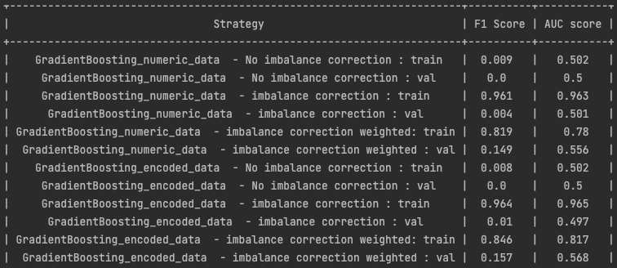
Gradient Boosting

Slide 12
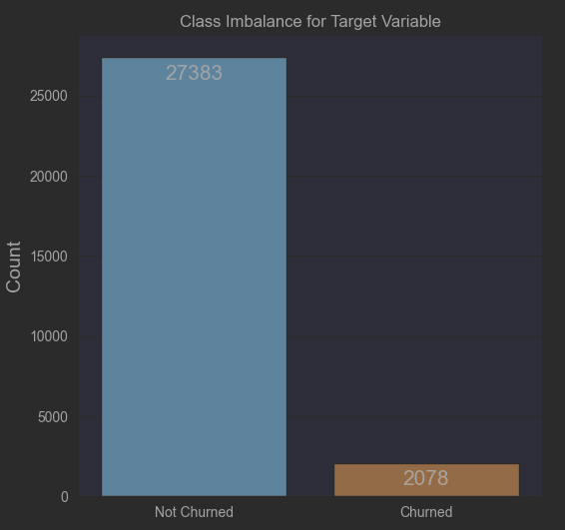
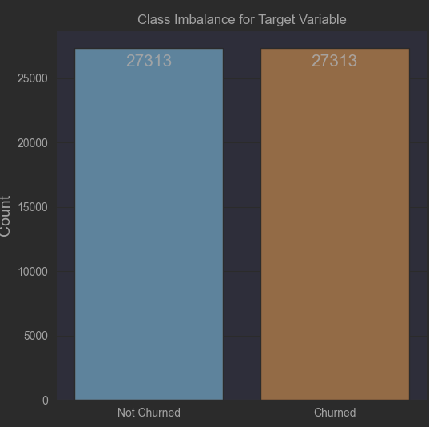
IMBALANCE CORRECTION

Slide 13
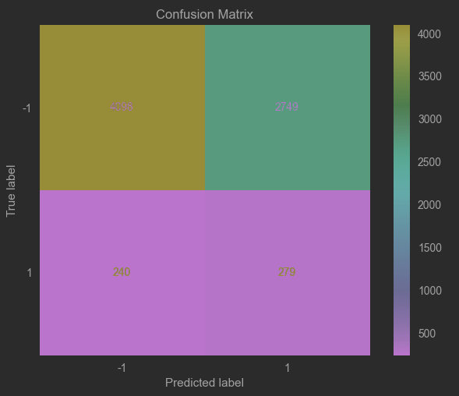
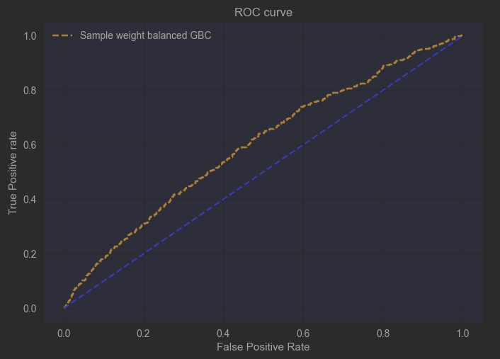
Performance – GBC on sample weights

Slide 14
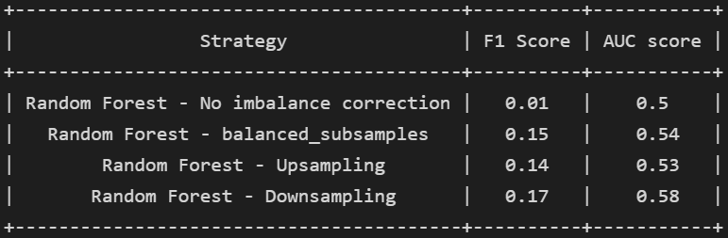
Random Forest

Slide 15
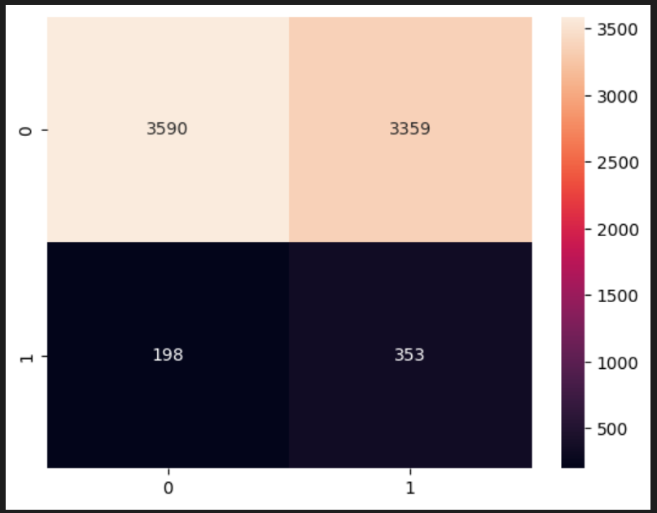
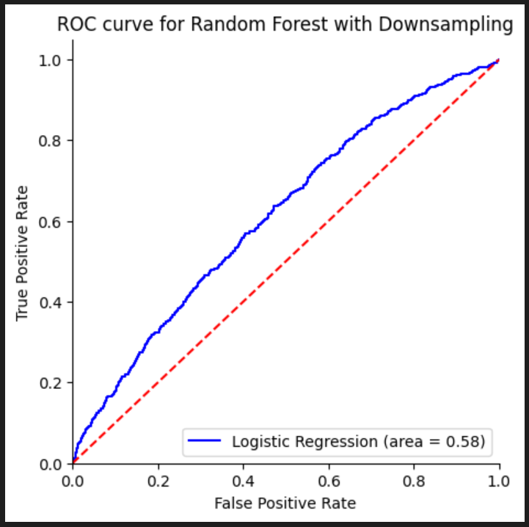
Performance on Random Forest with Downsampling

