Slide 1
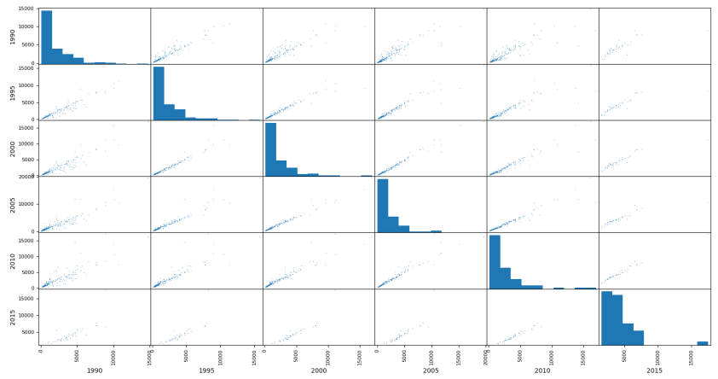
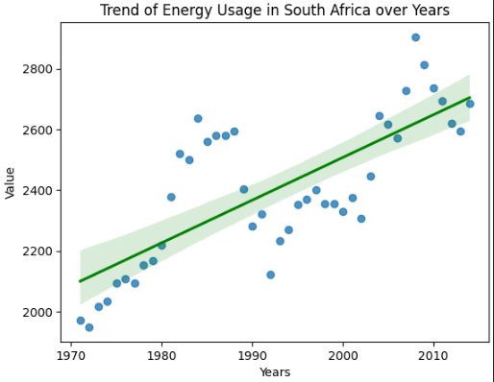
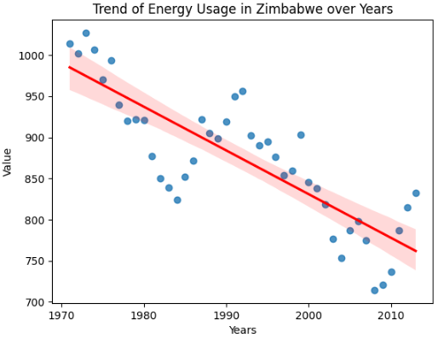
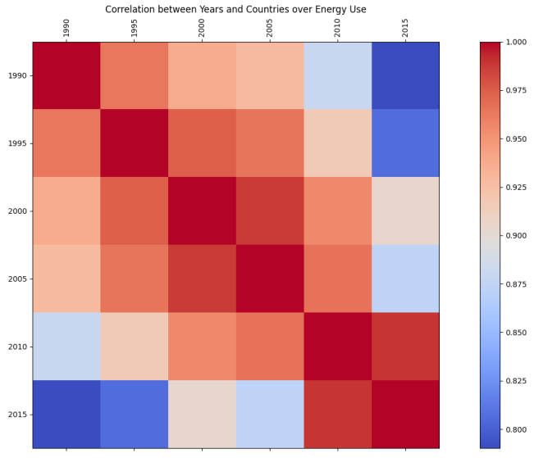
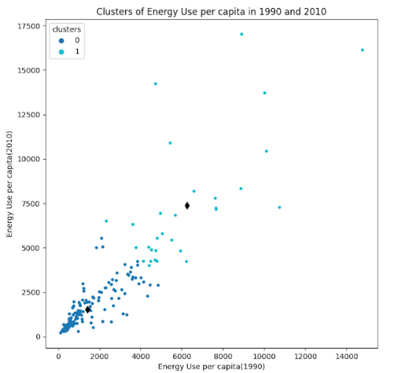
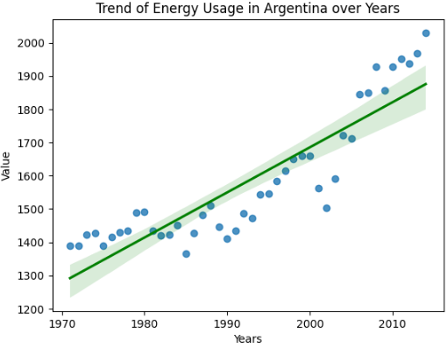
Energy Utilization Trends of Countries Student Name- Hari Bahadur Gharti Magar Student ID- 22075765
Abstract
A study has been performed over the application of K-means algorithm in order to conduct evaluation of cluster method. The cluster method is improvised over the dataset comprises of energy use per capita which has been withdrawn from World Bank. The main objective behind this evaluation of dataset is to explore the distinct results of energy consumption belongs to different countries. Based-on the groups of countries formed from clustering technique, their trends of consuming the energy is recognized and insight gained.
Introduction
The sustainable development of nations along with its mutual effect over the environmental factors are determine from its energy consumption. Subsequently, the scaling of energy consumption is accomplished via considering the Energy use per capita of that specific nation. This parameter optimizes the resource utilization, policy formulation and energy planning which is the outcome of utilization of diverse energy. Hence, we have applied the k-means algorithm to conduct analysis over the energy use per capita reflects in the dataset.
Evaluation of Utilization of Energy
Data belongs to energy used per capita of different years correlates its values with each other have been obtained before implementing the cluster technique. The figure is shown as:
The correlation exhibit the connection of one data with another when we analyze through different years. Each correlation reaches nearly to 1 between the two years. Based on these multiple correlations between the pairs of years, a scatter plot of energy utilization per capita has been designed.
It has been observed that the utilization of energy per capita becomes concentrated showing lower value for the various pairs of year if the year 2015 is excluded.
Likewise, a cluster has been formed on the basis of values of energy utilization ranges from the year 1990 to 2010. It has been noticed that the utilization of energy happened below 5000 Kg oil among most of the nations which is clustered over 0. In addition, it has been explored that 3 nation’s energy utilizations found to be less than 3000 Kg oil. Moreover, the consumption of oil or energy value becomes higher than 5000 KG by the year it reached to 2010.
The changing trends of energy use per capita has been obtained for South Africa, Zimbabwe and Argentina of African continents. These are mentioned below:
Conclusion
From the study, it has been concluded that the implementation of clustering technique to the chosen dataset has successfully presents the trends of energy consumption in distinct nations. It explores the differential factors and similar attributes of energy consumption per capita along the nations. It is found that the consumption of energy has increased globally with the increasing years emphasizing the governmental bodies to take initiative.
GitHub Source: https://github.com/harimagar/Applied-Data-Science-1.git

