Slide 1
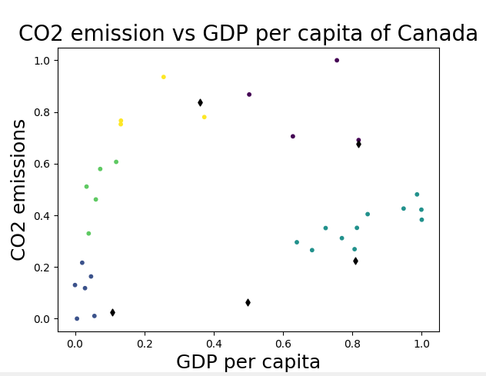
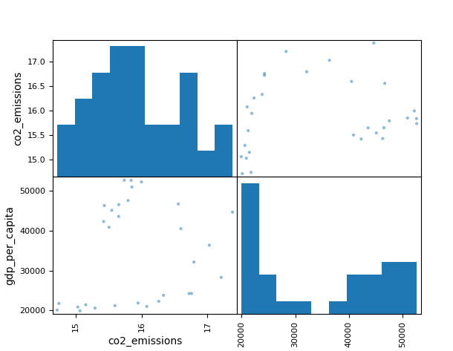
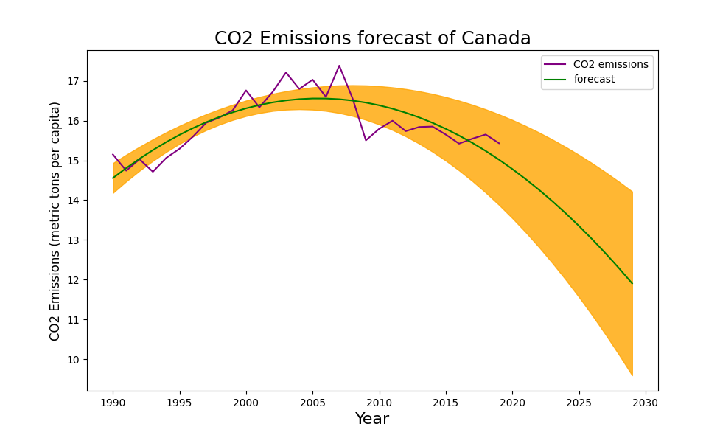
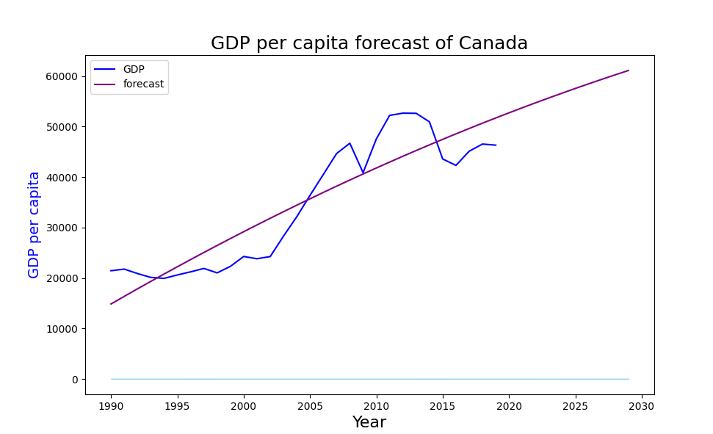
CO2 Emission and Gross Domestic Product
Student Name: Hari Bahadur Gharti Magar
Student ID: 22075765
Introduction
Gross domestic product conveys the availability of industries and industries makes people able to use more vehicles from which more air pollution takes place. Hence, an indirect relationship can be found between an environment and GDP factor of any area. The motive of this visual presentation and analysis is to gain a deep insight toward CO2 emission in the environment and develop an understanding about the role of Gross Domestic product (GDP). This poster presentation would synthesize the complex characteristics of CO2 emission and GDP.
Critical Evaluation Between CO2 Emission and GDP of Canada
The scattered plot shown in the first image exhibited the CO2 emission versus GDP per capita of Canada. It has been found that the points are spread in the lower GDP zone and higher GDP zone of graph rationalizing a distinct outcomes in the emission of gas in Canada. It is understood that the CO2 emission were increased in the environment of Canada.
CO2 Emissions Forecast of Canada
Prior information of CO2 emission since the year 1990 is being considered for forecasting purpose. The emission were increased excessively by the years 2010 and 2015. The CO2 emission will get reduced by the year 2030.
Implementation of K-Means Cluster to CO2 Emission of Canada
The K-means cluster algorithm has been applied to obtain the CO2 emission of Canada and it is gained in the form of histogram. The graphical representation is given in the form of 4-quadrants where the second and fourth quadrant have depicts the emission and GDP per capita respectively. It is true that K-means clustering exhibits the distance between the points and centroid. However, it completely depends upon the input or dataset based on which outcomes are obtained. Both GDP and CO2 emission of Canada are high showing its direct proportionality.
GDP per capita forecast of Canada
The visualization outlines the forecast for the year 2030 where it consistently increased the emission without much fluctuation.
Conclusion
From the above study, it has been concluded that the CO2 emission is consistently increasing in the environment of Canada. The nation’s growing GDP can be considered a key responsible cause because of which the environment is degrading constantly. However, it also indicates the lethargic approach of Canadian governmental bodies those have not taken any effective step to improve the condition. Apart from main objective, this analysis also shed lights over the various visualization technique used for understanding a real-time scenario.
GitHub Source: https://github.com/harimagar/Assignment3-Applied-data-science-1.git

