Slide 1
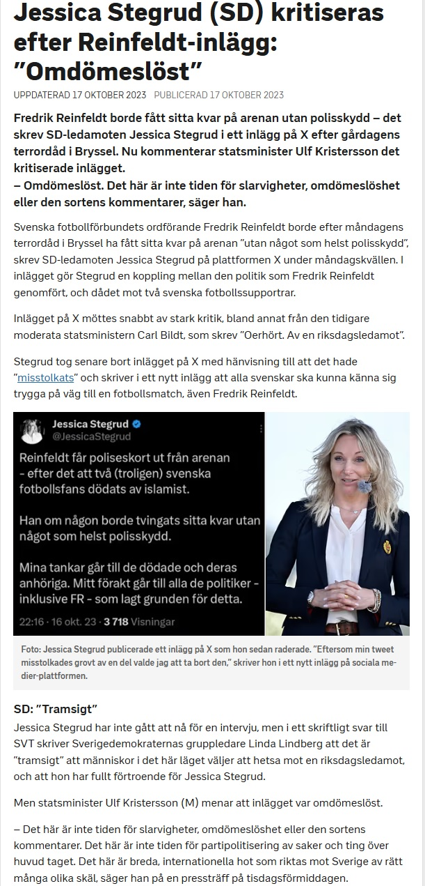


Slide 2
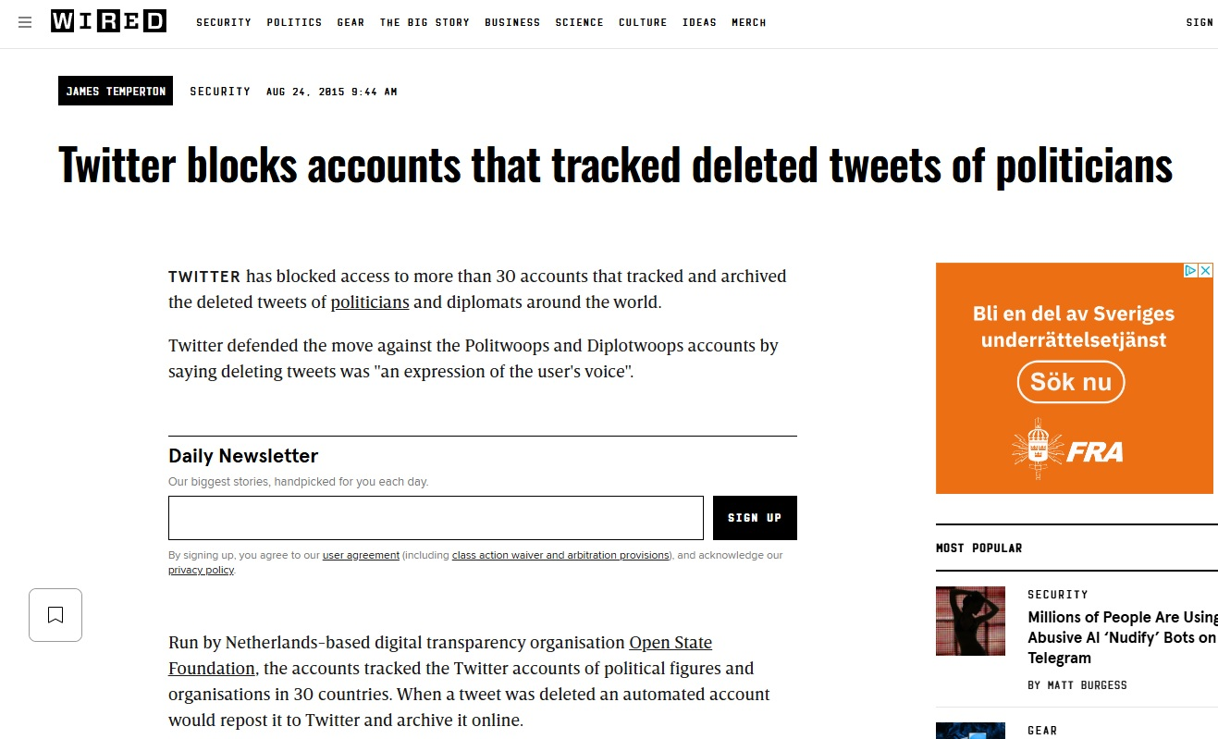

Slide 3
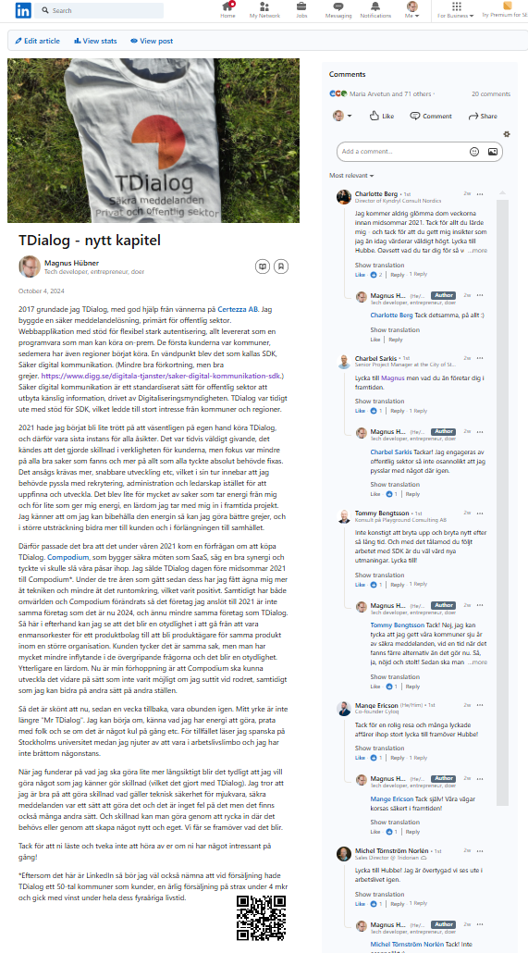

Slide 4
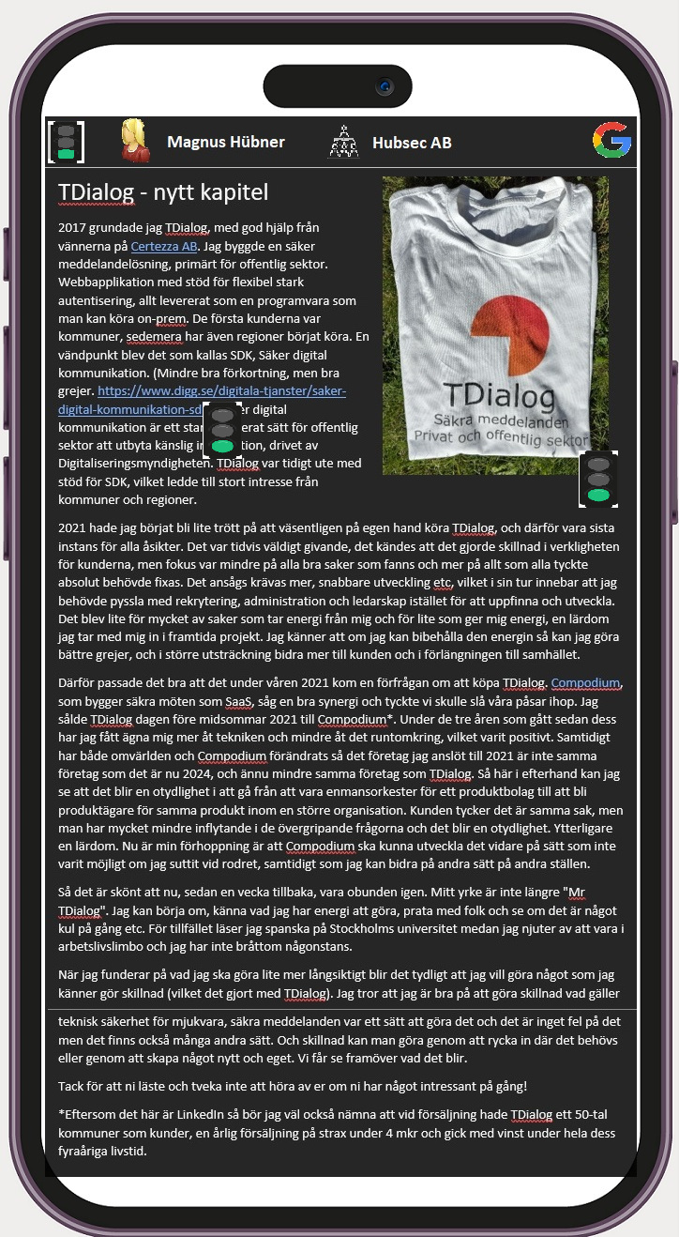

Slide 5

User flow: Reading
Any webpage
Click or scan
View in app

Slide 6

User flow: Signing
Write text, adding images and links
Press ”sign”
Login with your Identity Provider to sign
Sign
Google, Microsoft, universities etc

Slide 7
Who does what? Reading
Any webpage
Click or scan
View in app
Part of any CMS system
Part of project

Slide 8
Who does what? signing
Create your content in a CMS system
Press ”sign” from CMS system
Your document gets a hash sum from The Project, containing the text and the user info. (TODO: This flow is probably a bit complex).
The Project directs you to login to any endorsed Identity Provider (Google, Microsoft, universities etc)
After login, the Identity Provider sends a verification of login connected to the supplied hash back to The Project.
The Project signs the document hash with info on user, organization and Identity Provider, including the Identity Provider verification in full, and a timestamp.

Slide 9
What is stored?
The stored data is a text in markdown format with the following metadata:
User info: Display name, internal ID, possibly some external ID.
Organization info: Display name, internal ID, possibly some external ID
It’s the IDP:s responsibility to be able to trace users and organizations
There is also an Errata URL stored. Here, any updates to the content will be published (the update list is similarly signed) so that the reader can be notified of updates, whilst still being able to view the linked version.

Slide 10
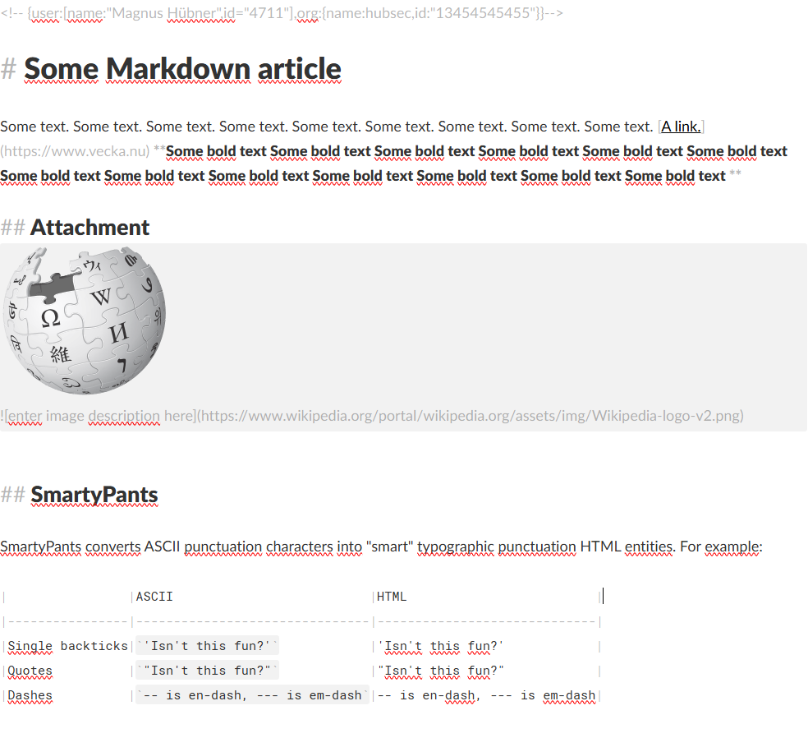
What is stored? Example

Slide 11
Standards and requirements
How is the signing performed and what is required by a signing service
No cost
Open source
No marketing
No tracking
What is required by an identity provider

