Slide 1
Disaster Tweets Classification
Group #2
Manasa Hari (013855075)
Feiyu Cai (008879234)
Tushar Sharma (009803885)
Amit Kamboj (013827489)

Slide 2
Introduction
500 million tweets everyday
Disaster tweets often get lost in the flood of tweets
Irrevocable loss if disaster news didn’t reach out to people in the right time
Notes:
Twitter has been the most important part of digital communication these days. It has been the channel of communication across the world for daily news starting from television gossips to case-of-emergency news. But due to large amounts of data flooding into the twitter base every minute, sometimes, a highly important piece of news such as a disaster occurrence can be submerged amidst not at all important tweets. Due to this, it may take days or even weeks before the disaster news reaches to people, meanwhile, a huge irrevocable loss can happen already.

Slide 3
Problem Statement
To classify the tweets into real disaster tweets or not
Highlight the disaster emergency news
Users are notified on the emergency issues out of millions of other tweets
Notes:
This project aims to highlight the disaster emergency news so that users can be constantly notified on the emergency issues out of millions of other tweets.

Slide 4
Data
train.csv - 7613 samples
test.csv - 3263 samples
Columns:
id, text, location, keyword, target (train.csv only)

Slide 5
Key Challenge
Build a machine learning model
Use NLP
Sentiment analysis
Notes:
We take the challenge to build a machine learning model that classifies between tweets about real disasters and the rest. The key challenge is to distinguish metaphorical usage of tragedy vocabulary and the real intended usage of disaster terms. For example, a user tweets ‘Thoughts are a storm, unexpected’. This is clearly a metaphorical statement. Even though it is obvious for humans to interpret that this tweet is not about a real disaster, but it is less clear to a machine.

Slide 6
Solution - Six steps
1) Study the data
2) Data pre-processing & data cleaning
3) Develop a model
4) Train the model
5) Test the model (make predictions)
6) We will fine-tune the model

Slide 7
State-of-art
Why Recurrent Neural Network (RNN)?
Words are related in each other
Internal memory
Shortage: Gradient vanishing
Solution: Long Short-Term Memory (LSTM)
Notes:
“Recurrent neural networks (RNNs) are naturally suitable for speech recognition because of their ability of utilizing dynamically changing temporal information.”
Gradients are values used to update neural network weights, which will shrink during back-propagation. When the gradient becomes too small, it doesn't contribute to the learning process.

Slide 8
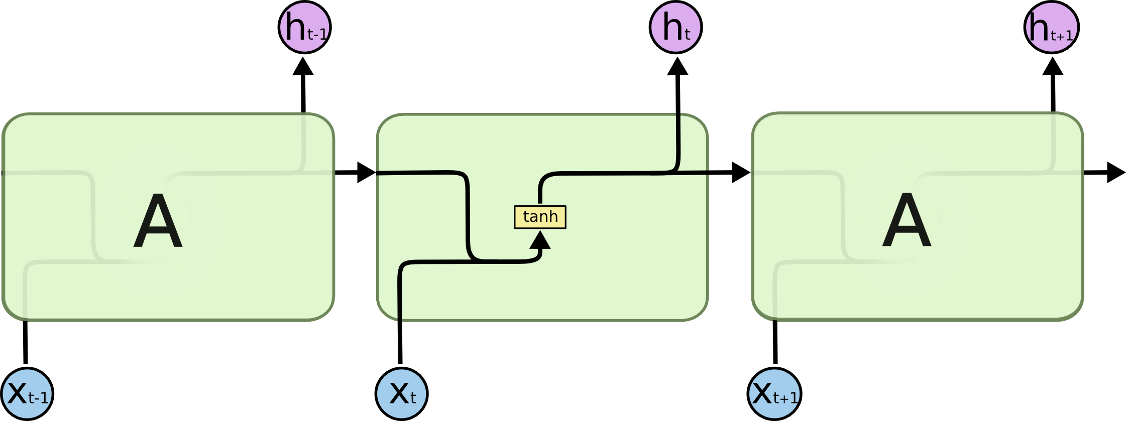
RNN - Diagrammatic representation

Slide 9

LSTM - Diagrammatic representation
Notes:
· Forget gate: used to decide what detail can be discarded from the block
· Input gate: used to decide which input should be used to modify the memory
· Output gate: used to calculate the cell state

Slide 10
Demo - in Python notebook
In the attached python notebook, we covered:
Step by step process of this project
Code (right from data pre-processing till predictions in Kaggle)
Process of choosing optimal parameters for the LSTM model
Performance analysis
Visualization of the performance and comparison
Kaggle scores at each step

Slide 11
Results
Achieved 0.81492 accuracy in the ongoing Kaggle competition, by 4th submission itself.
Standing at 671th position in the leaderboard out of a total of 2299 submissions.

Slide 12
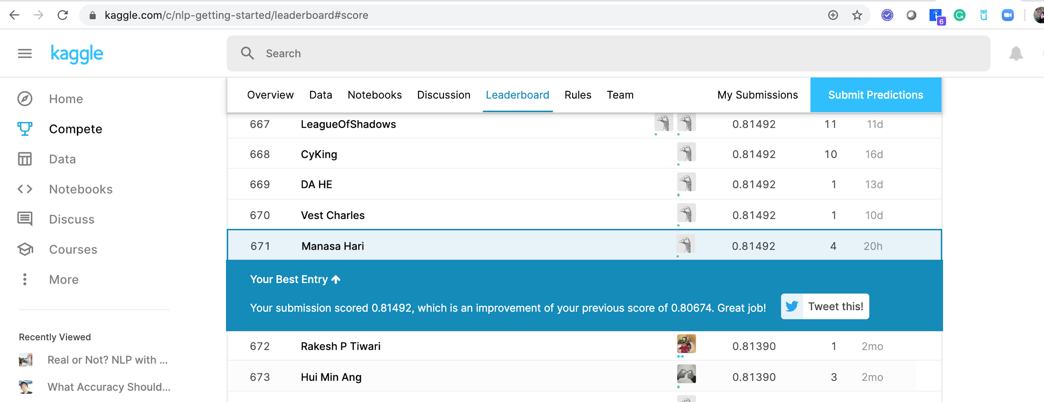
Kaggle competition (ongoing)
Kaggle link: https://www.kaggle.com/c/nlp-getting-started/leaderboard#score

Slide 13
Thank you

