Slide 1
Forecasting Accidents and Classifying
Accident Severity
Group 6
CMPE 256
Team Members:
Harshada Jivane
Manasa Hari
Pragati Sharma

Slide 2

Motivation
The number of road accidents contributes to a high number of casualties all over the world
We found it necessary to study the factors affecting these accidents

Slide 3
Objectives
Data mining tasks for data preprocessing, data analysis and feature engineering
Time series forecasting using Facebook’s Prophet and ARIMA (Autoregressive Integrated Moving Average) to predict number of accidents
Classification model to classify the severity of accidents given the data of circumstances such as vehicle type, weather, road conditions

Slide 4
Dataset
The dataset consists of accident, casualties and vehicle information for the years 2017 to 2019
It contains a variable lookup excel sheet which provides information about various features in the three CSVs
This dataset is available on UK government’s website:
https://data.gov.uk/dataset/cb7ae6f0-4be6-4935-9277-47e5ce24a11f/road-safety-data

Slide 5
Classification - Casualties
Data cleanup and feature extraction
Classification algorithms:
Logistic Regression
Logistic Regression with 10-fold CV
Random Forests with 10-Fold
Polynomial Kernel SVM
LinearSVC
Decision Tree Classifier
SGD Classifier
OneVsRestClassifier SVC model
KNeighborsClassifier & GridSearchCV
XGBoost
AdaBoost

Slide 6
Classification - Vehicles
Data Cleanup and feature manipulation
Classification algorithms:
Logistic Regression (Scaled dataset, Undersampling and Oversampling)
AdaBoost Default Classification
AdaBoost Custom setting Classification
RandomForest Classification

Slide 7
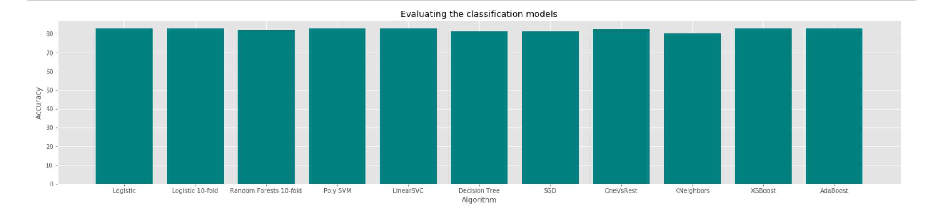
Results - Classification (Casualties)
Winning models: Logistic regression and AdaBoost

Slide 8
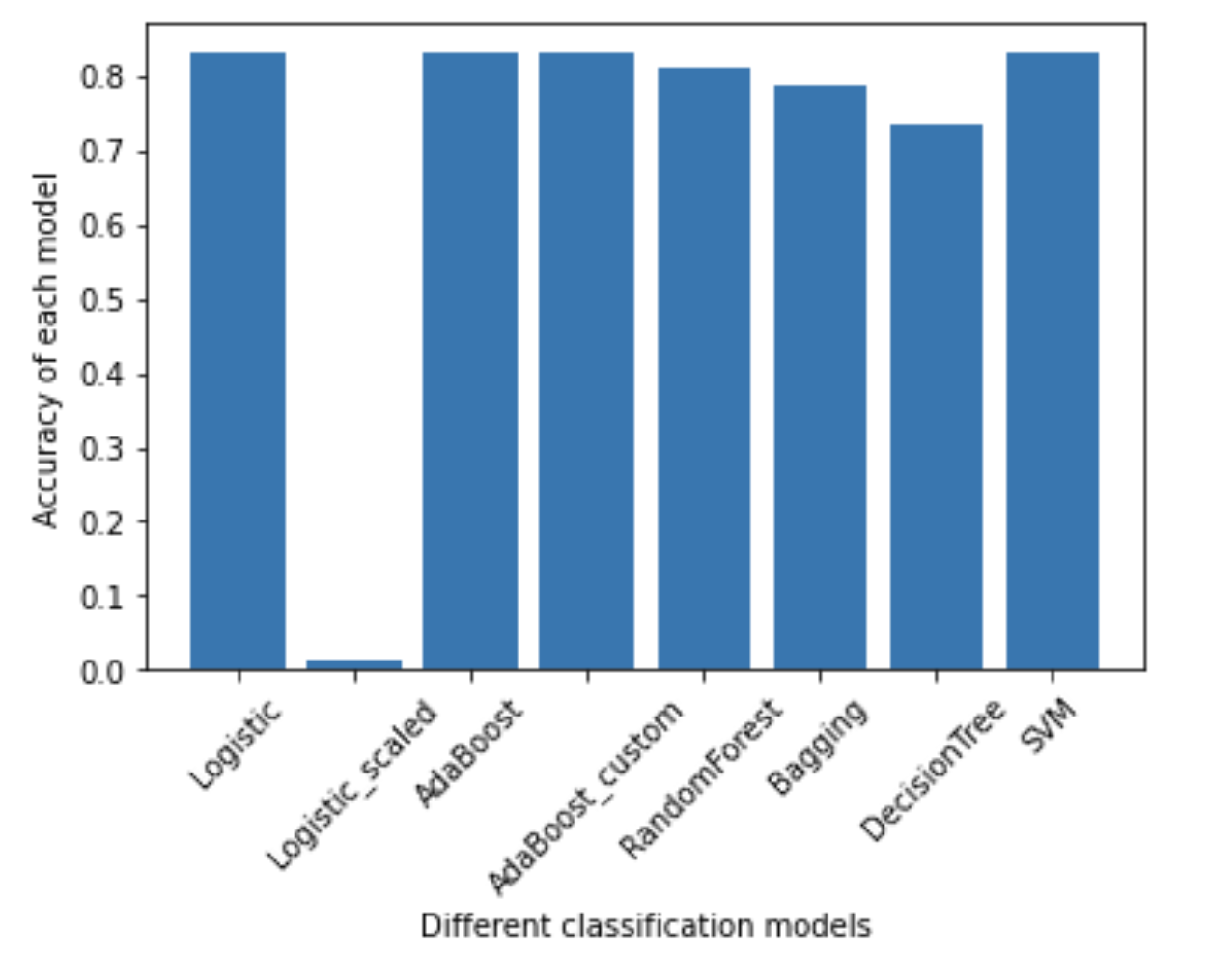
Results - Classification (Vehicles)
AdaBoost Custom setting Classifier gives best accuracy score

Slide 9
Time Series Forecasting
Prophet - Open-source library published by Facebook
Needs dataframe with ‘ds' and ‘y’
Sort by date
Split by date
Feature selection for regression
ARIMA - Autoregressive Integrated Moving Average
Needs Date columns as index and second column is the measurement we wish to forecast
AIC(Akaike Information Criterion) for grid search

Slide 10
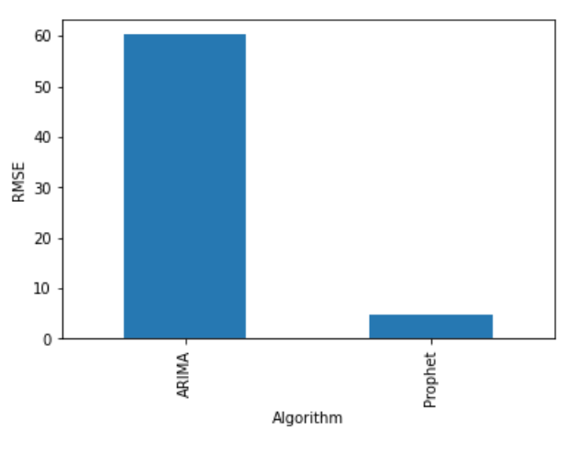
Results - Time Series Forecasting
Prophet gave the best result for our dataset

Slide 11
Conclusion
What went good?
Prophet was easier to implement than ARIMA because of more available documentation.
Able to predict if a route is accident prone or not.
Challenges
Some algorithms were very slow and time taking.

Slide 12
Thank You

