Slide 1
MultiPost
Kranthi Kumar Gangineni
Hari Manasa Ganganagunta
Sree Naga Sayana
Vineeth Reddy Kottam

Slide 2
AGENDA
Login to the app
Create a post or update
Use two social medias to post messages
Scheduler to post on social media
Conclusion

Slide 3
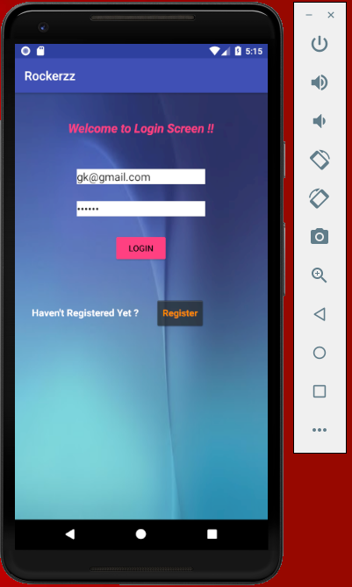
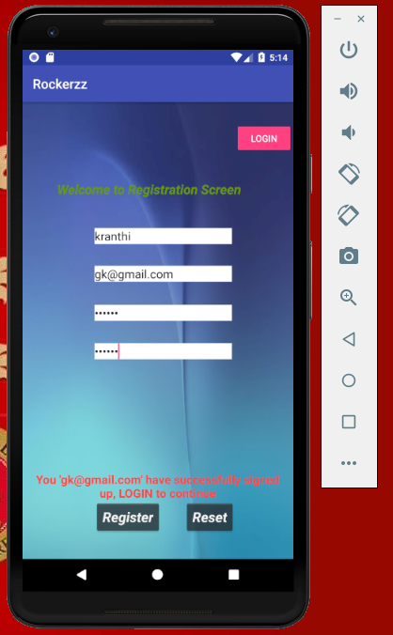
Login to the app
Created a login and registration page and provided basic validations

Slide 4
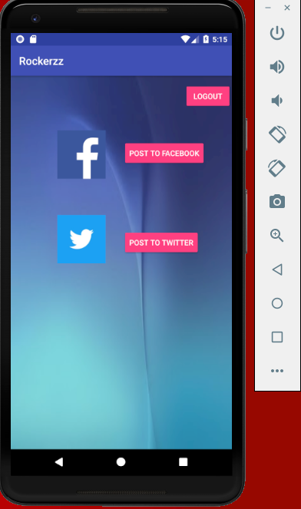
Create a post
Created a text field to post on facebook and twitter.

Slide 5
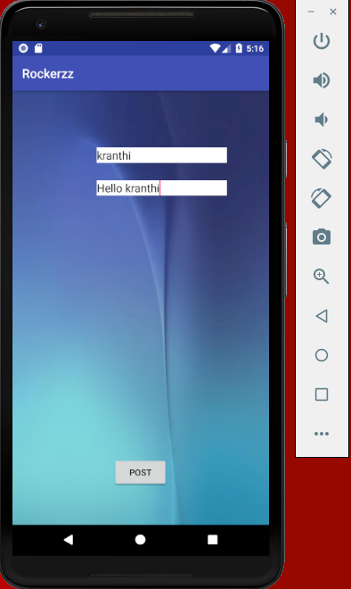
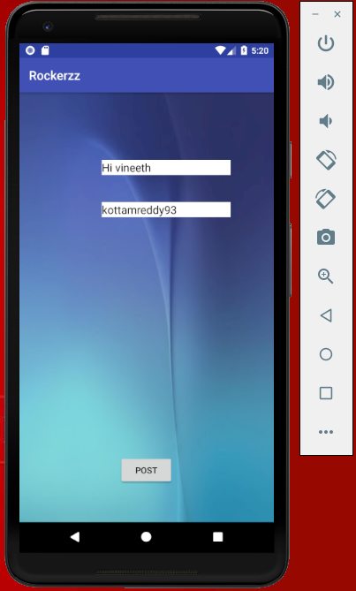
Use two social medias to post messages
Used facebook and twitter to post the messages.

Slide 6
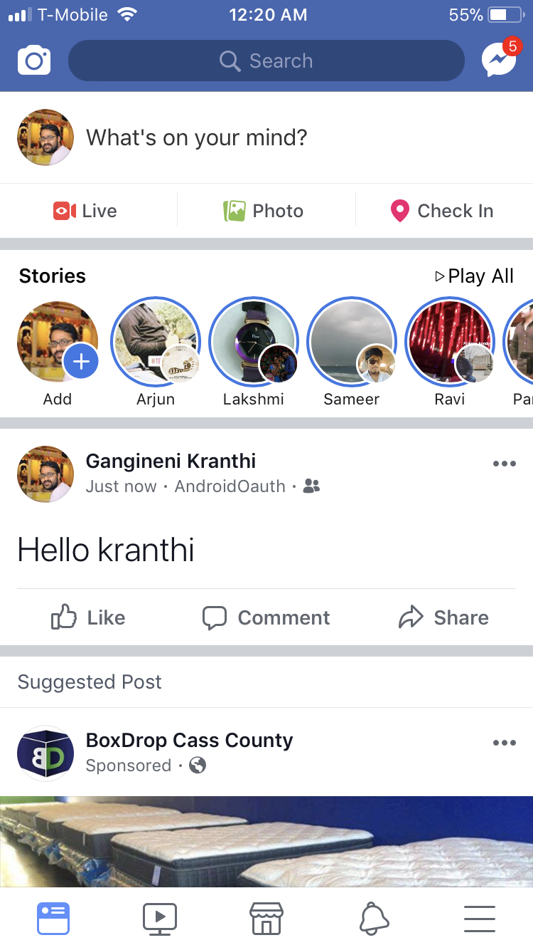
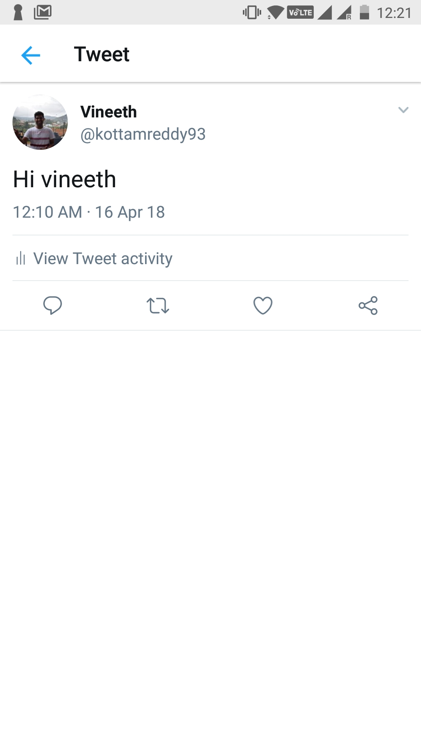
Conclusion
Successful posts on facebook and twitter.

Slide 7
Thank you

