Slide 1

ABSTRACT

Slide 2

Research Area
Machine Learning
Machine Learning (ML) is basically that field of computer science with the help of which computer systems can provide sense to data in much the same way as human beings do. In simple words, ML is a type of artificial intelligence that extract patterns out of raw data by using an algorithm or method. The key focus of ML is to allow computer systems to learn from experience without being explicitly programmed or human intervention.

Slide 3

Introduction To Project
FAKE NEWS DETECTION.
The main objective is to detect the fake news, which is a classic text classification problem with a straight forward proposition. It is needed to build a model that can differentiate between “Real” news and “Fake” news.
These days’ fake news is creating different issues from sarcastic articles to a fabricated news and plan government propaganda in some outlets.
Fake news and lack of trust in the media are growing problems with huge ramifications in our society.
In this PROJECT,it is seeked to produce a model that can accurately predict the likelihood that a given article is fake news or real news.

Slide 4
Existing System
Fake News Detector was a feature added by Flock-a new generation messaging and collaborative platform.
Wheneverlinks are being sent to each while chatting, FND algorithm gets activated.It checks the content of links to their databases of websites computed according to rankings.
It gives a statistic rating and generates a warning message if the source is not found to be reliable.
Flocks database has more than 600 news URL’S that are fact-checked.
Drawbacks:
The drawback of this system is that their database for fact checking is less in number and chances of hoaxes still not being determined are high.

Slide 5
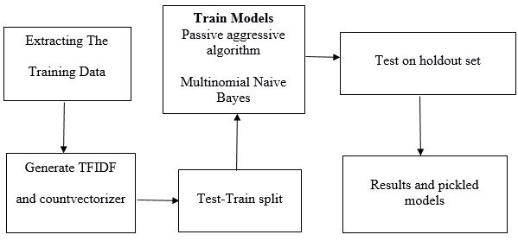
Proposed System
Since this problem is a kind of text classification, Implementing a Naive Bayes classifier will be best as this is standard for text-based processing.
The actual goal is in developing a model which was the text transformation and choosing which type of text to use (headlines vs full text) .
Next step is to extract the most optimal features .
This is done by using a n-number of the most used words, and/or phrases, lower casing or not, mainly removing the stop words which are common words such as “the”, “when”, and “there” and only using those words that appear at least a given number of times in a given text dataset.
ADVANTAGES:
The Naive Bayes Classifier helps to predict the output with more accuracy than that of the existing systems.

Slide 6
Requirements and Algorithms
LIAR Dataset
Python
Naive Bayes Classifier
Algorithm
Fake news
Sklearn
Numpy and Pandas

Slide 7
Conclusion
By using the above mentioned requirements and Algorithms we classify the given data set to get the desired output.
Project guide:
Mr.S.V.V.D.Jagadeesh
Assistant prof.
Department of IT
Aditya Engineering College
Surampalem.
Project Associates:
Ch.Sri Bala Vidyadhari -17A91A1210
P.Hari Priya -17A91A1243
M.Hari Krishna -17A91A1231
B.Sireesha -17A91A1205

Slide 8
THE PROFESSIONAL TEMPLATE
THANKS

