Slide 1


CONVOLUTIONAL RECURRENT NEURAL NETWORKS
FOR MUSIC GENRE CLASSIFICATION ON DIGITAL COMPOSITION
BATCH MEMBERS:
Abishek K K(17BEC3005)
Hari Krishnan P(17BEC3059)
Madhan K(17BEC3097)
GUIDED BY
Mr.S.Nandhagopal
AP/ECE

Slide 2
INTRODUCTION
Music genre prediction is one of the topics that digital music processing is interested in.
The Features of music have been extracted by using Digital Signal Processing techniques.
Then the music genre classification and music recommendations have been made by using machine learning methods.
In Addition, convolutional neural networks, which are deep learning methods, were used for genre classification and music recommendation and performance comparison of the obtained results.

Slide 3
PROBLEM FORMULATION
To develop a project to automatically classify different musical genres from audio files. We will classify these audio files using their low-level features of frequency and time domain.

Slide 4
OBJECTIVE OF THE PROPOSED WORK
The main objective of our project is to improve the accuracy of the Search results and Recommendations.
The first step for music genre classification project would be to extract features and components from the audio files.
It includes identifying the linguistic content and discarding noise.
Using Deep learning algorithm we are trying to classify the audio.
K-nearest neighbors algorithm because in various researches it has shown the best results for this problem.

Slide 5
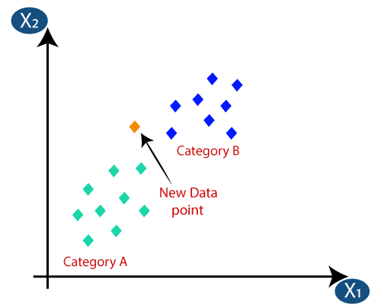
K- Nearest Neighbor Algorithm
The k-nearest neighbors (KNN) algorithm is a simple, easy-to-implement supervised machine learning algorithm that can be used to solve both classification and regression problems.
There’s no need to build a model, tune several parameters, or make additional assumptions.

Slide 6
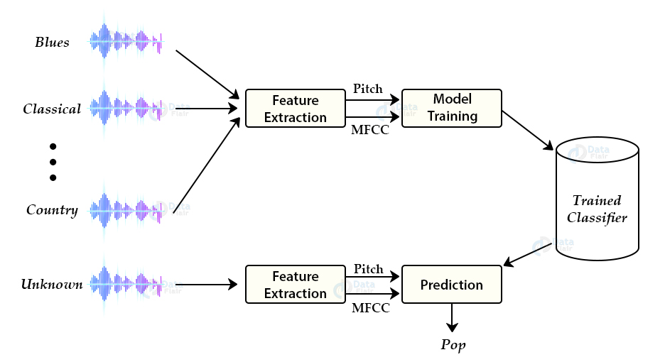
METHODOLOGY OF THE PROPOSED WORK

Slide 7
METHODOLOGY OF THE PROPOSED WORK
For this project we need a dataset of audio tracks having similar size and similar frequency range.
Since the audio signals are constantly changing, first we divide these signals into smaller frames. Each frame is around 20-40 ms long.
Then we try to identify different frequencies present in each frame and separate linguistic frequencies from the noise.
To discard the noise, it then takes discrete cosine transform (DCT) of these frequencies.
Using DCT we keep only a specific sequence of frequencies that have a high probability of information.

Slide 8
ALGORITHM AND TOOLS
Algorithm
Deep learning - Neural network
Tools
Python

Slide 9
REFERENCE
H.Lee, Y. Largman, P. Pham, A.Y. Ng Unsupervised
feature learning for audio classification using convolutional
deep belief networks. In NIPS 2009.
Yoshua Bengio Learning Deep Architecures for AI.
Foundations and Trend in Machine Learning Vol.2,
No. 1(2009)
Quac V. Le, et al. Building High-level Features Using
Large Scale Unsupervised Learning
GE. Hinton and R. R. Salakhutdinov Reducing the
Dimensionality of Data with Neural Networks 28 July
2006 VOL 313 Science

Slide 10
RESULT
This development helps in widespread use of online music and sales platforms.
Control of music copyright and music recommendations.
It can also be used in Search Engine Optimizer .

