Slide 1
OCEANIC PARAMETER PREDICTION USING DEEP LEARNING TECHNIQUES
SUPERVISED BY DR. SOURAV SIL
HARIPRIYA S | 21CL06011

Slide 2
CONTENTS
INTRODUCTION
LITERATURE REVIEW
OBJECTIVE
DATA AND METHODOLOGY
RESULTS AND DISCUSSIONS
SUMMARY
FUTURE WORK
REFERENCES

Slide 3
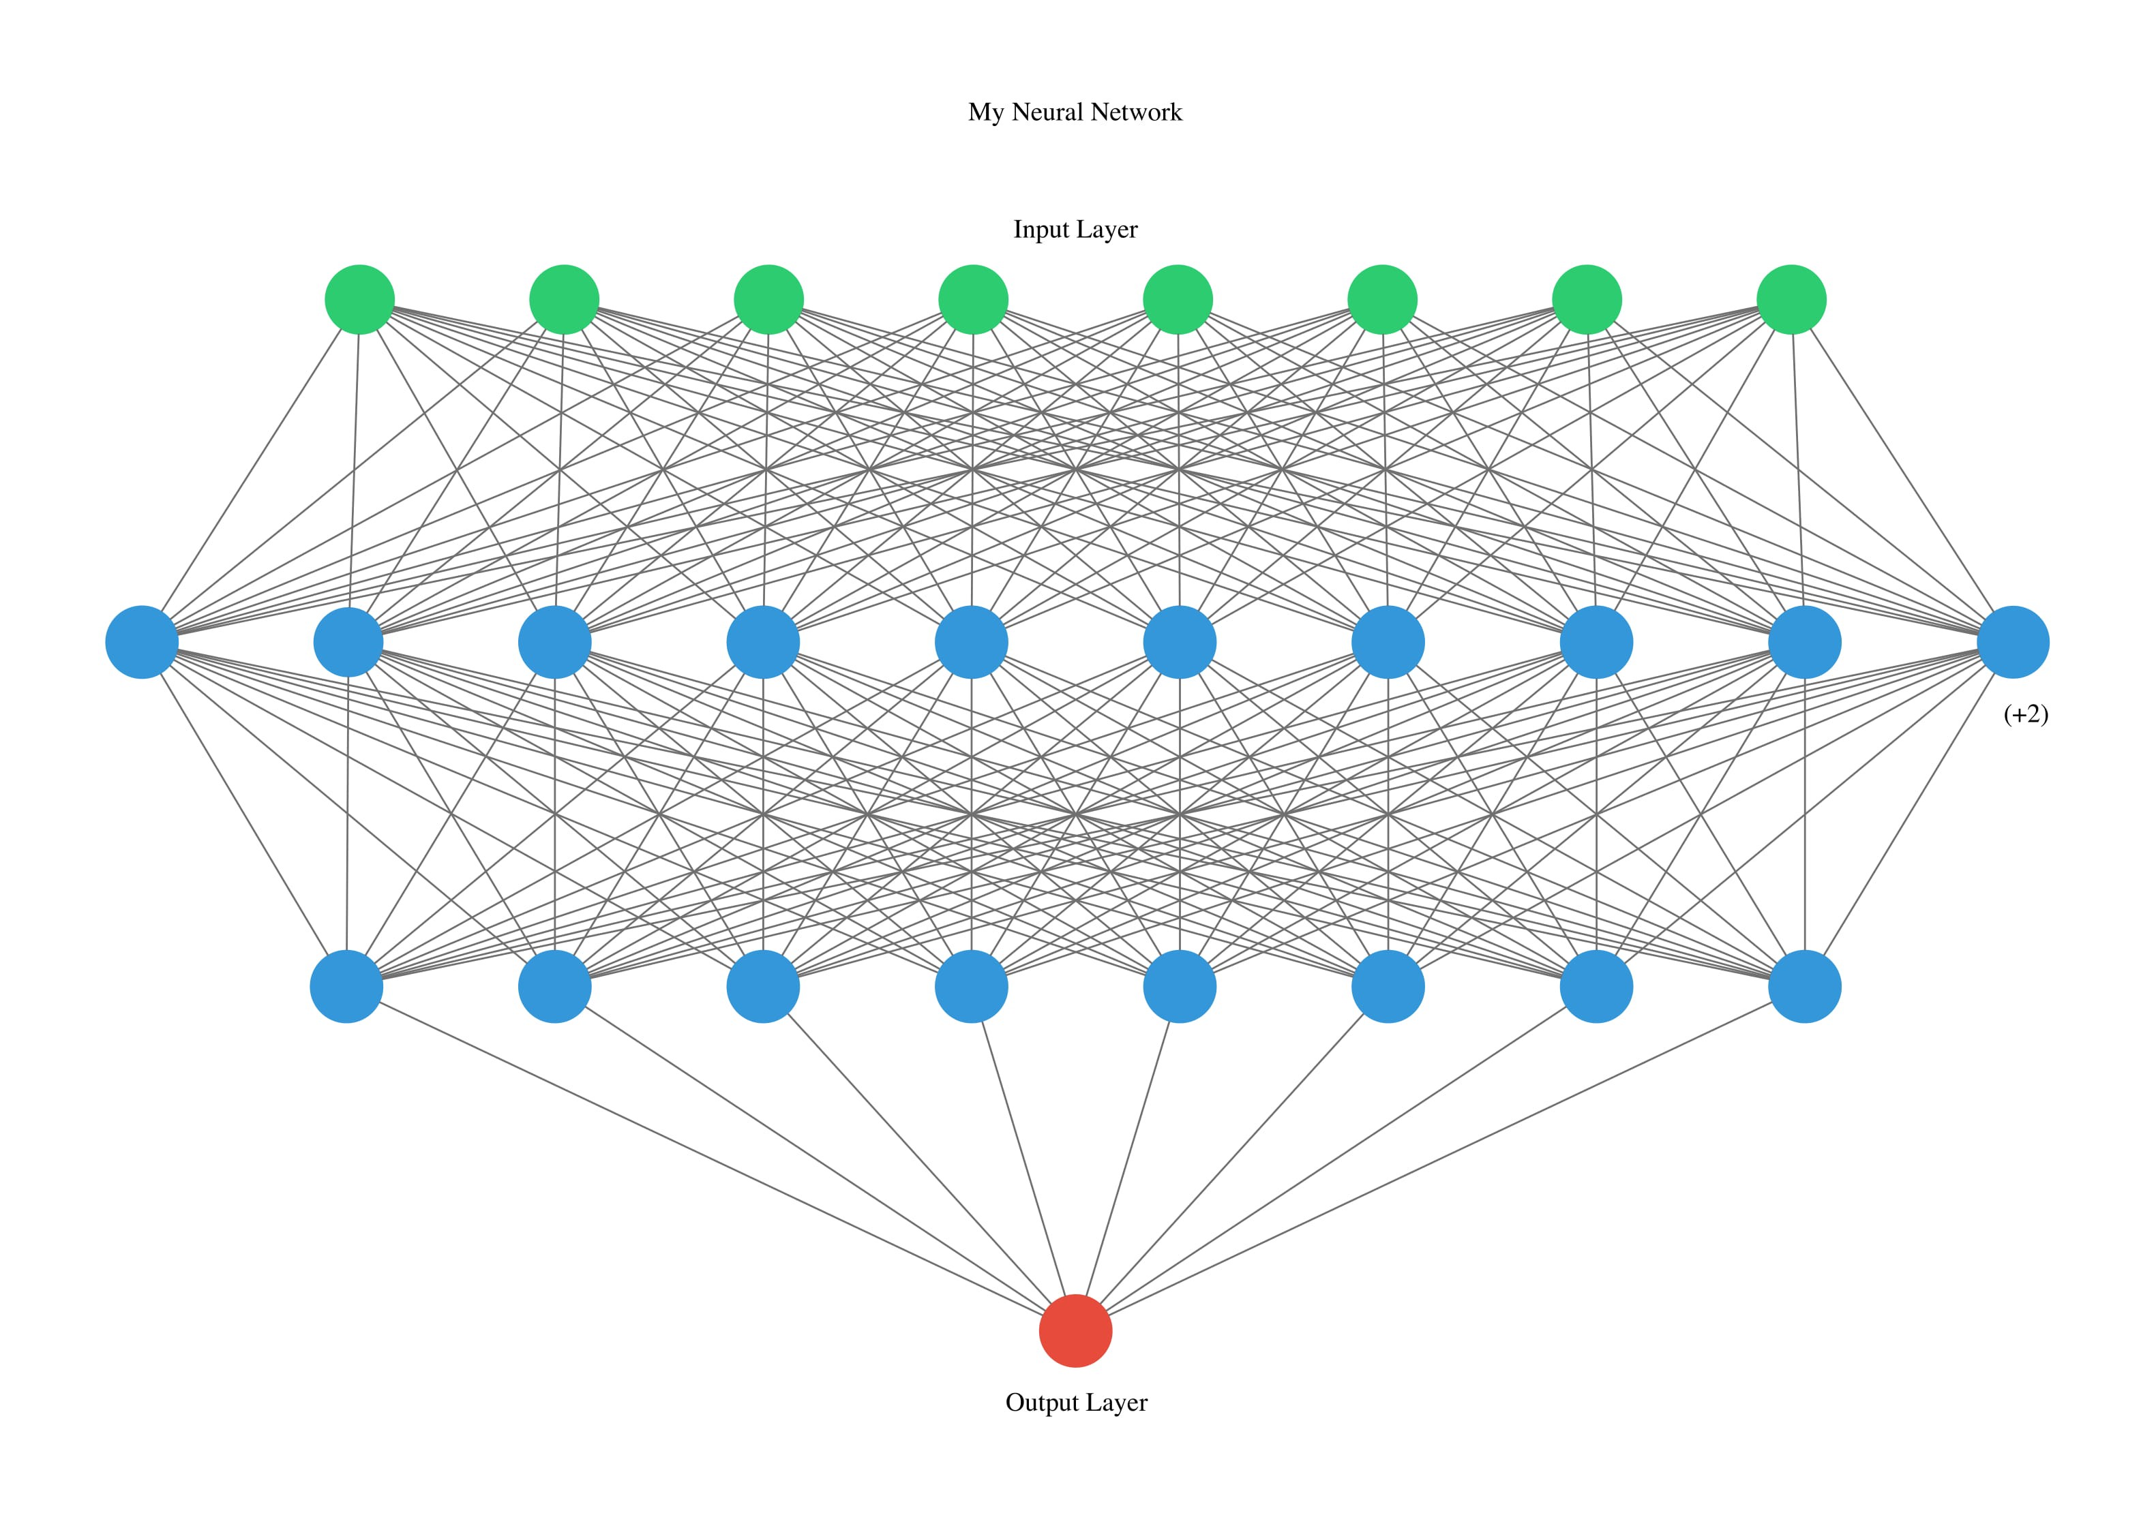
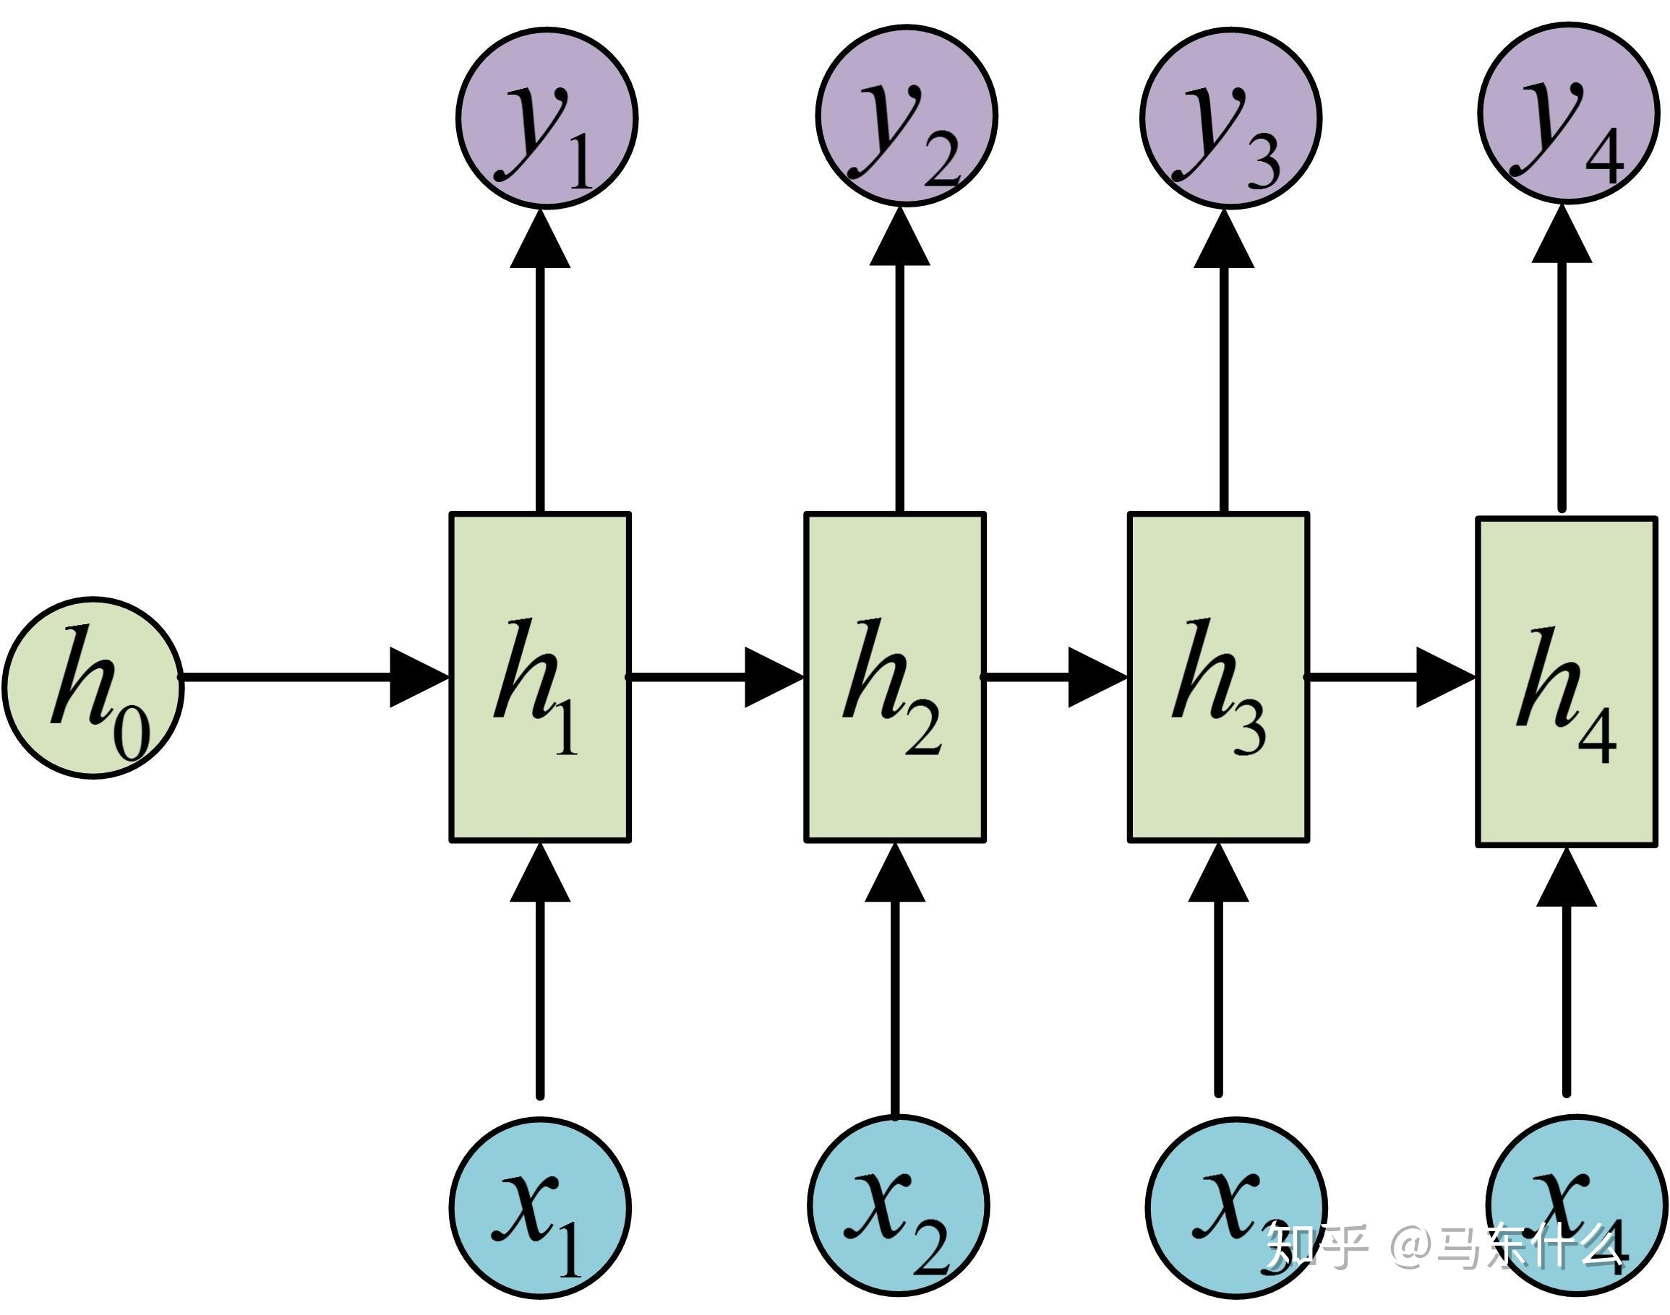
INTRODUCTION
Physics-based forecast methods are computationally expensive
Therefore a new predictive tool is needed for real time in-situ ocean parameter prediction
RNN is a state of the art method in modelling time series data
Long Short-Term Memory(LSTM) is an advanced version of recurrent neural network (RNN)
LSTM has composed gates that regulate better flow of information through the unit.

Slide 4
LITERATURE SURVEY
Sl No | Study by | Description | Imp. Results
1 | T. Song, J. Jiang, W. Li and D. Xu (2020) | A Deep Learning Method With Merged LSTM Neural Networks for SSHA Prediction | Merged-LSTM with one layer DENSE block performs better than general stacked of three layers LSTM. The input information is partially lost after two-layer LSTM. Merged-LSTM recombines the input information with output by two layers to make the result better
2 | Y. Yu, X. Si, C. Hu and J. Zhang (2019) | A Review of Recurrent Neural Networks: LSTM Cells and Network Architectures | In order to deal with the problem of “long-term dependencies LSTM cell was proposed. They improved the remembering capacity of the standard recurrent cell by introducing a gate into the cell
3 | Alexandre Immas, Ninh Do, Mohammad-Reza Alam (2021) | Real-time in situ prediction of ocean currents | Compared LSTM and transformer model and concluded that the LSTM is likely to be a better choice for future deployments because it is easier to train and more widely spread among the scientific and engineering community
4 | Qin Zhang, Hui Wang, Junyu Dong, Guoqiang Zhong, and Xin Sun (2017) | Prediction of Sea Surface Temperature using Long Short-Term Memory | Formulated the prediction of SST as a time series regression problem, and proposed a LSTM based network to model the temporal relationship of SST to predict the future value

Slide 5
OBJECTIVE
To predict various oceanic parameters using
deep learning techniques(Long Short Term Memory)

Slide 6
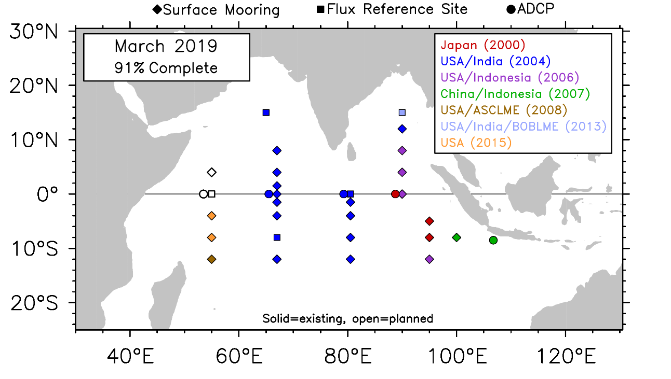
DATA
DATA | SOURCE | LOCATION | RESOLUTION(TEMPORAL) | TOTAL TIME PERIOD | TRAINING PERIOD | TESTING PERIOD
SEA SURFACE TEMPERATURE(SST) in °C | INCOIS(RAMA BUOY DATA) | 15.025°N, 90.025°E | DAILY | 2006-2020 | 1/4/2006-1/42018 | MAY 2018

Slide 7
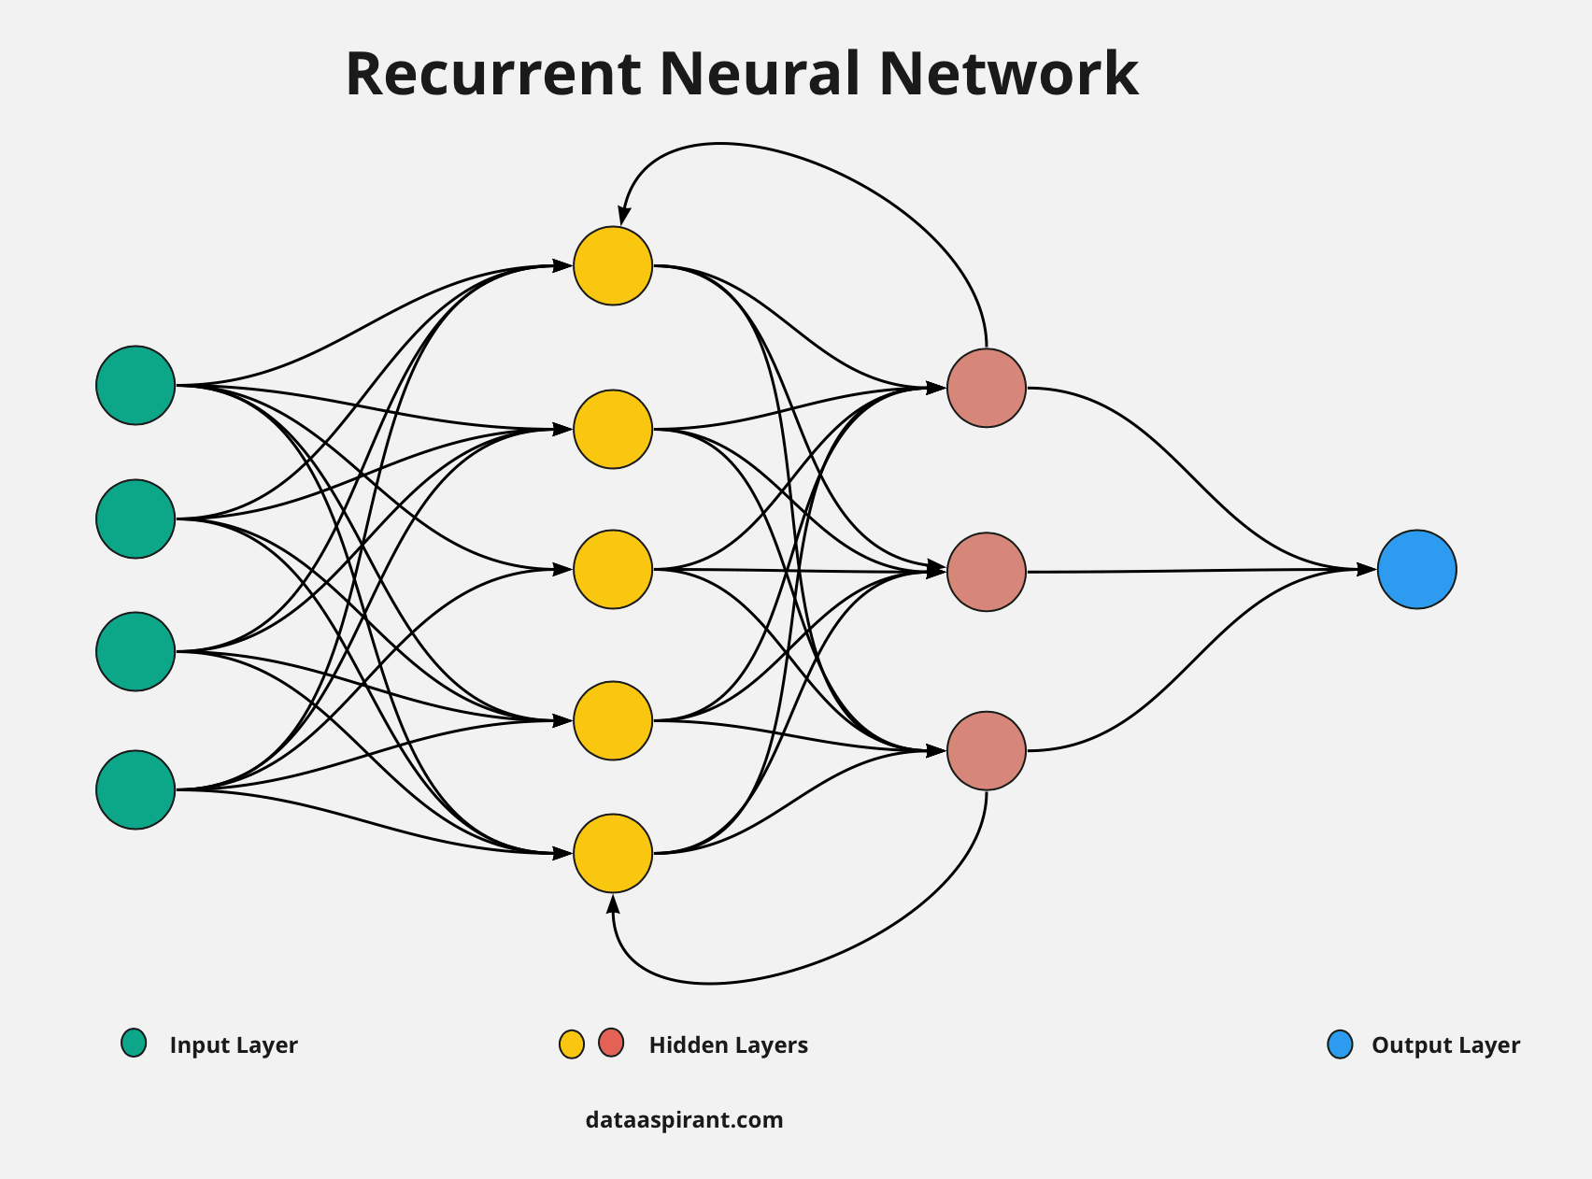
METHODOLOGY
SST values are inputted from day T(1) to T(L), and then calculating the values of SST for the coming T(L+1) − T(L+n) days
L is the number of historical days on which the prediction depends, and n indicates the number of predicted days
Currently 1 ocean parameter (Sea Surface Temperature) is used for training and testing
Several other parameters can be inputted for prediction of one parameter

Slide 8
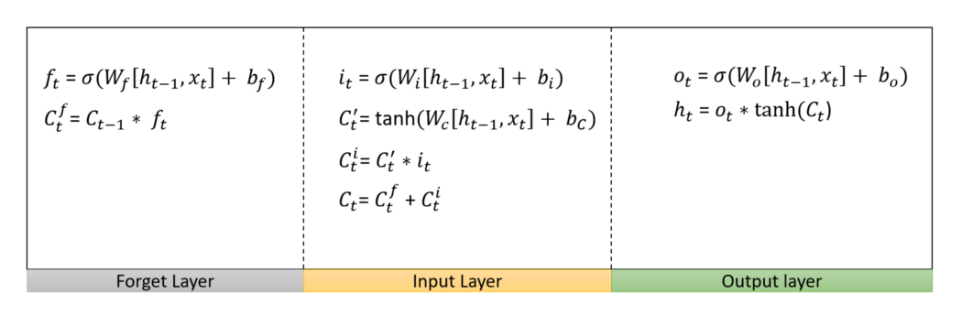
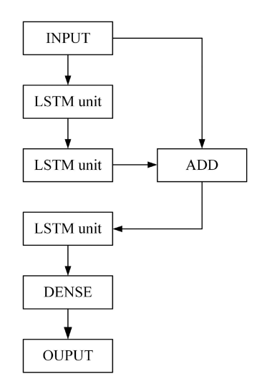
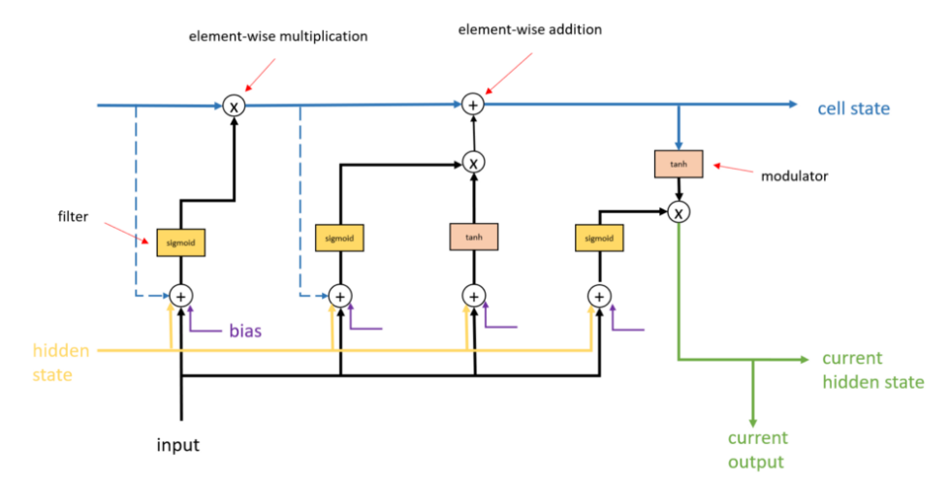
WHY LSTM?
RNN has long-term dependency problem
The LSTM discard or forget the irrelevant values using an extra forget gate
MERGED LSTM
It consists of 3 LSTM layers and 1 dense layer
2 LSTM layer is concatenated to another LSTM layer
Notes:
Recurrent unit means it contains cyclic connections.

Slide 9
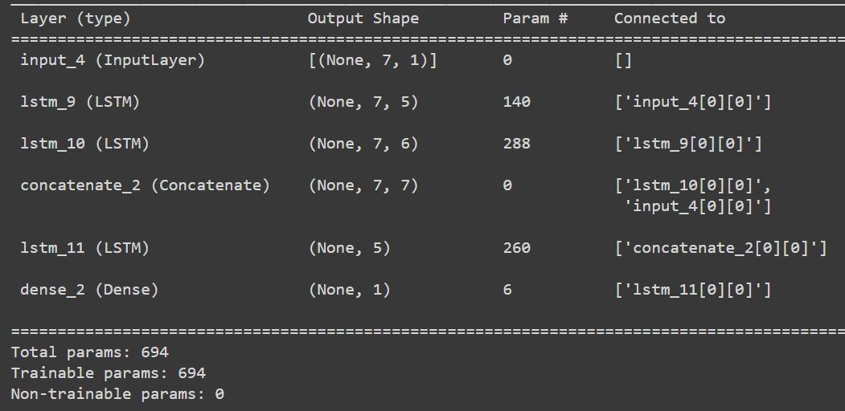
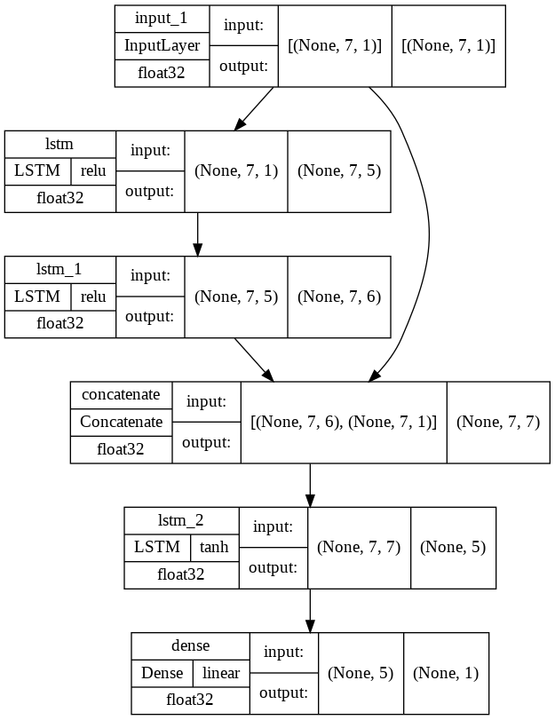
RESULTS AND DISCUSSIONS
Architecture for the merged-LSTM
It contains 3 LSTM units and 1 dense unit
Input layer is concatenated to the output the first 2 LSTM’s and given to the 3rd LSTM
This is for a lookback period of 7 days, so shape of input is 7 and output is 1
Notes:
Epochs used is 10 and batch size is 32
Adam optimizer and mean squared error loss function is used

Slide 10
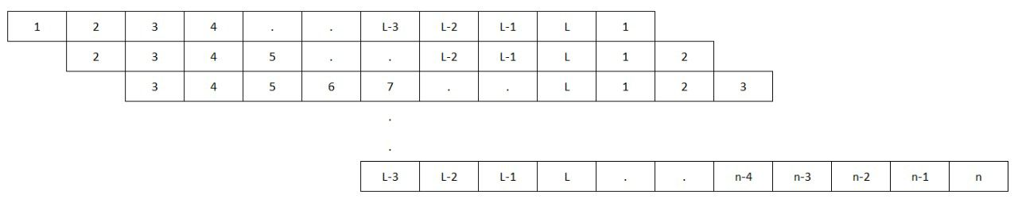
Lookback period is 7 days and no of days predicting are n=1,2,3,4
Predicted days are from 1/5/2018 to 31/5/2018
Predicted values are close to actual values when value of n is less
Similarly like L=7, L=15, 30 can be done for n equal to 1 to 5

Slide 11
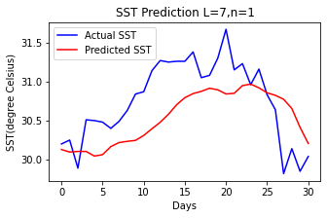
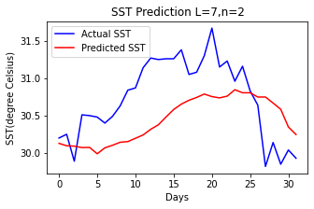
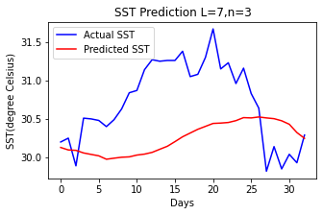
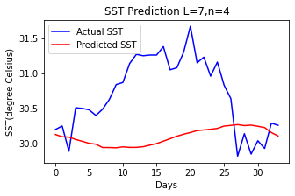
Lookback period=7, number of predicted days=1,2,3,4
MSE
0.2163
MSE
0.3102
MSE
0.5157
MSE
0.6852

Slide 12
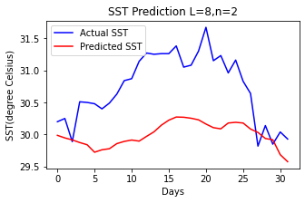
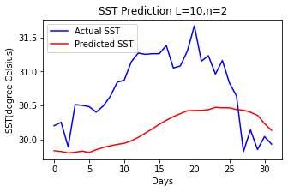
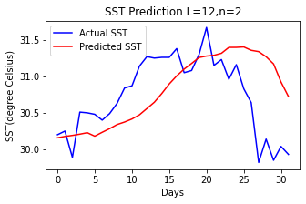
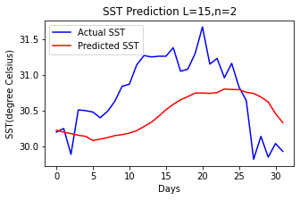
Lookback period=8,10,12,15, number of predicted days=2
MSE
0.7126
MSE
0.5791
MSE
0.3368
MSE
0.3297

Slide 13
SUMMARY
Merged -LSTM is used while creating the model for prediction of ocean parameters
SST is predicted for n=1,2,3,4 days using a lookback period of 7 days and keeping n constant and varying L
When n value is increased the prediction is deviating more from the actual output
We could see from the plots that:
Mean square error increased when number of predicted days are increased
Mean square error decreased when lookback period is increased

Slide 14
FUTURE WORK
More parameters are inputted for the prediction of SST
Merged-LSTM is compared with other deep learning models
Lookback period is increased, monthly and yearly predictions are to be done
Spatial plots are also to be created and predicted

Slide 15
REFERENCES
Immas A., Do N., Alam M.-R., Real-time in situ prediction of ocean currents,in Ocean Engineering,vol. 228, 108922, 2021, doi:10.1016/j.oceaneng.2021.108922.
M.Kim, H.Yang, and J.Kim, Sea Surface Temperature and High Water Temperature Occurrence Prediction Using a Long Short-Term Memory Model in Remote Sensing, vol.12, no.21,2020,doi:10.3390/rs12213654
Q. Zhang, H. Wang, J. Dong, G. Zhong and X. Sun, Prediction of Sea Surface Temperature Using Long Short-Term Memory, in IEEE Geoscience and Remote Sensing Letters, vol. 14, no. 10, pp. 1745-1749, Oct. 2017, doi: 10.1109/LGRS.2017.2733548.
T. Song, J. Jiang, W. Li and D. Xu, A Deep Learning Method With Merged LSTM Neural Networks for SSHA Prediction, in IEEE Journal of Selected Topics in Applied Earth Observations and Remote Sensing, vol. 13, pp. 2853-2860, 2020, doi: 10.1109/JSTARS.2020.2998461.
Y. Yu, X. Si, C. Hu and J. Zhang, A Review of Recurrent Neural Networks: LSTM Cells and Network Architectures, in Neural Computation, vol. 31, no. 7, pp. 1235-1270, July 2019, doi: 10.1162/neco_a_01199.

Slide 16
THANK YOU ☺

