Slide 1
Agentic AI
SpringShift Migrator
Mule Migration Platform
1
Confidential

Slide 2
Migration Engine — 6-Stage Pipeline
Deterministic static conversion: parse → convert → generate
1
2
3
4
5
6
XML Parser
Flow Converter
Connector Mapper
DataWeave Convert
Spring Generator
Swagger Gen
Parse MuleSoft XML
Extract flows, configs,
connectors, batch jobs
▶
Map flows to Spring
Controllers + Services
40+ connector handlers
▶
Maven dependencies
Spring Boot starters
Property mappings
▶
DWL → Java code
Transform expressions
Type mappings
▶
Full project scaffold
pom.xml, Docker, configs
Multi-profile support
▶
OpenAPI 3.0 spec
Endpoint documentation
Request/Response schemas
parser.py
flow_converter.py
connector_mapper.py
dataweave_converter.py
spring_generator.py
swagger_generator.py
Azure Functions
Python 3.14
Copilot/Azure OpenAI
Docker + ACI
2

Slide 3
Step-by-Step User Flow - UI
From MuleSoft upload to user ready Spring Boot in minutes
1
Login & Dashboard
2
Upload MuleSoft Project
Navigate to portal URL → Azure AD SSO auto-login.
Dashboard shows: total migrations, success rate,
recent activity, and quick-start buttons.
Click "Migrate" → Drag & drop project folder or paste XML.
Supports: .xml, .raml, .dwl, .yaml, .properties, .wsdl
Configure: name, Mule version, group/artifact ID.
3
Configure & Start Migration
4
Review Generated Code
Toggle AI Enhancement ON/OFF → Select AI provider.
Enable: Generate tests, Swagger, Documentation.
Click "Start Migration" → Watch Agent Live Feed.
File tree shows all generated files with syntax highlighting.
Edit any file inline → Save Changes.
Download ZIP, view Swagger, push to GitHub, or validate.
5
Test & Validate
6
Push to GitHub & Deploy
Click "Test & Validate" → Auto builds Docker image →
Deploys to ACI → Health check → API comparison.
Verdict: PASS / PARTIAL / FAIL with container logs.
Click "Push to GitHub" → Enter repo name, branch.
Create new or push to existing repository.
Get direct link to GitHub repo → CI/CD ready.
3

Slide 4
UI Screens — Detailed Technical Flow
Portal pages, data flow, and what happens behind each click
Migration Page — Behind the Scenes
Validation Page — Build & Deploy Flow
Upload
Files sent to POST /v2/migrations
with multipart/form-data
Trigger
Click "Test & Validate" button
POST /v2/builds/{id}/start
Parse
Queue trigger fires → parser.py
extracts flows & connectors
Auto-Patch
Passes and failures: imports, Map.of(), bean
names, POM, properties
Convert
flow_converter.py maps 40+
MuleSoft processors to Java
Docker Build
Source → Azure Blob → ACR Tasks
Multi-stage Maven → JRE image
LLM Enhance
LLM models reviews generated code
Handles unknown connectors and enhance the converted one’s aswell.
Deploy ACI
Image → Azure Container Instances
Generate
spring_generator.py creates
complete project structure
Health Check
Poll /actuator/health every 5s
Timeout: 120s, then proceed
Return
Files stored in DB, ZIP ready
for download via portal
Verdict
API comparison: MuleSoft vs Spring
PASS / PARTIAL / FAIL + logs
4

Slide 5
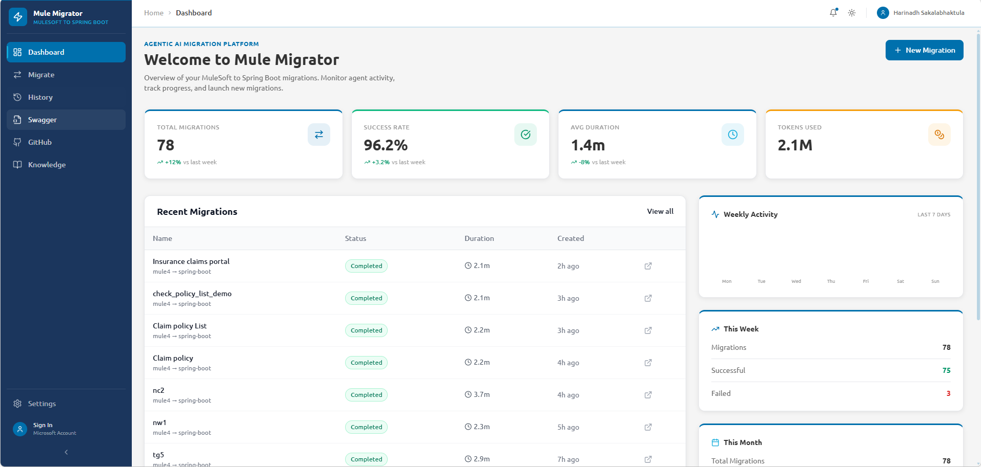
Step 1: Dashboard
Migration overview, stats, recent activity & weekly trends

Slide 6
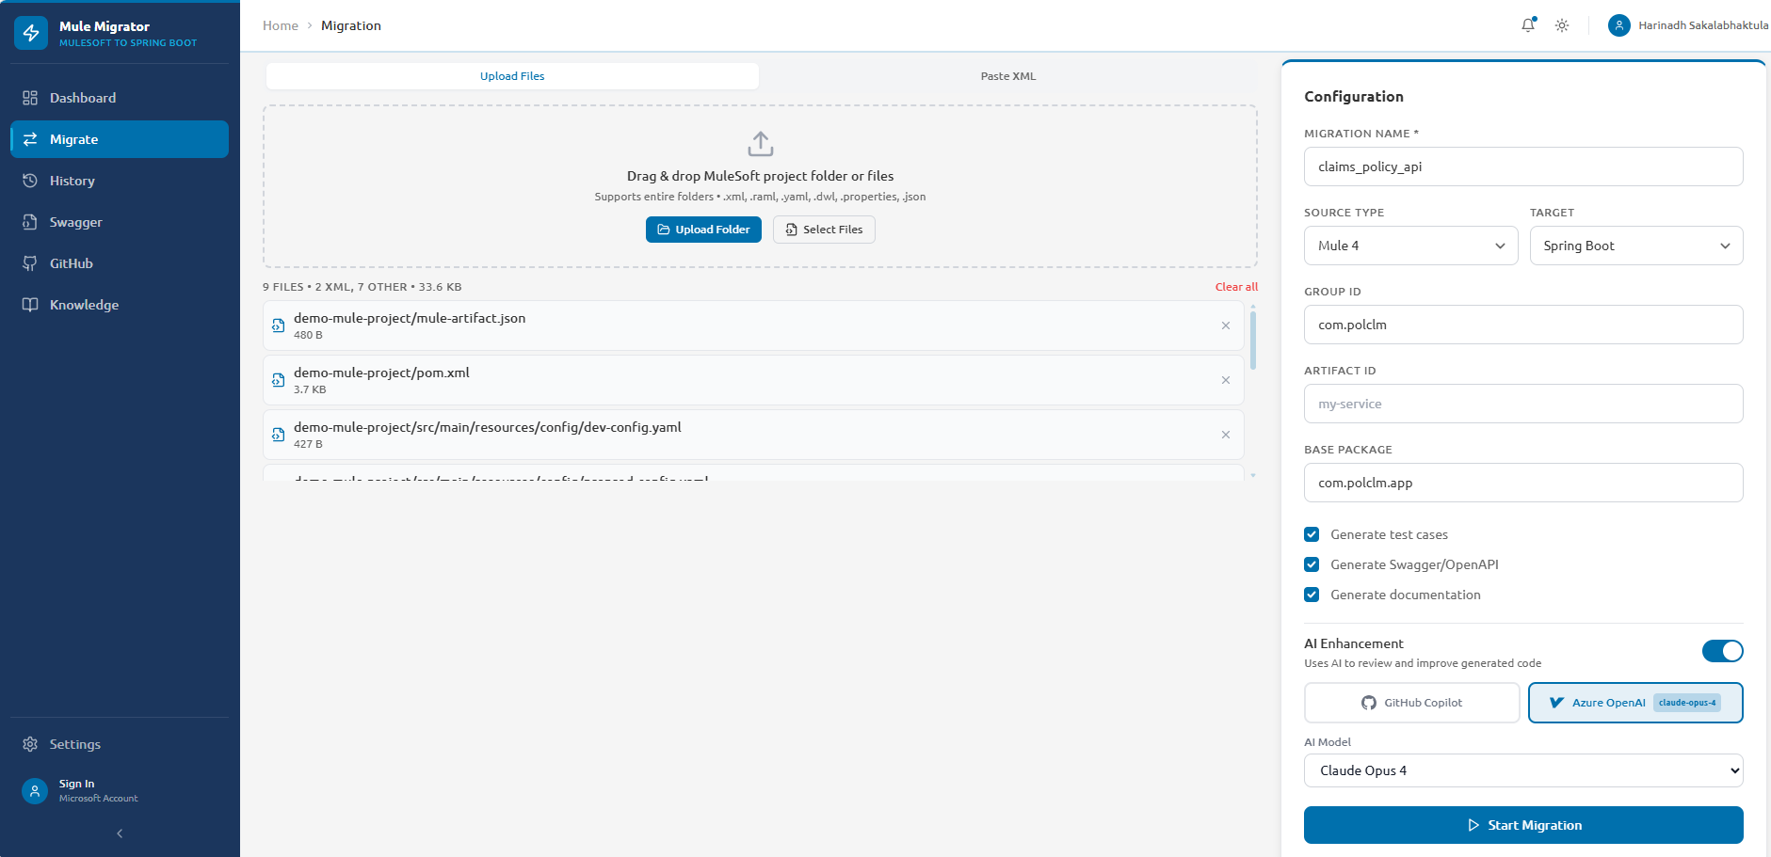
Step 2: Upload & Configure
Drag & drop MuleSoft project, set migration options, enable AI enhancement

Slide 7
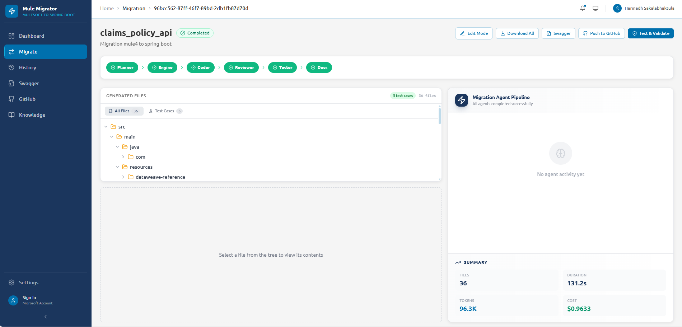
Step 3: Migration Complete
Generated files, agent pipeline status, cost summary & actions

Slide 8
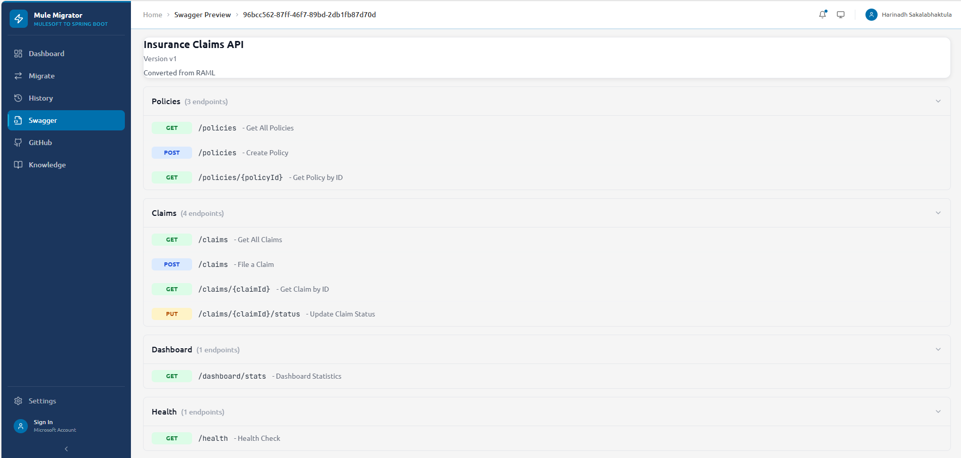
Step 4: Swagger Preview
Auto-generated OpenAPI 3.0 spec with all endpoints documented

Slide 9
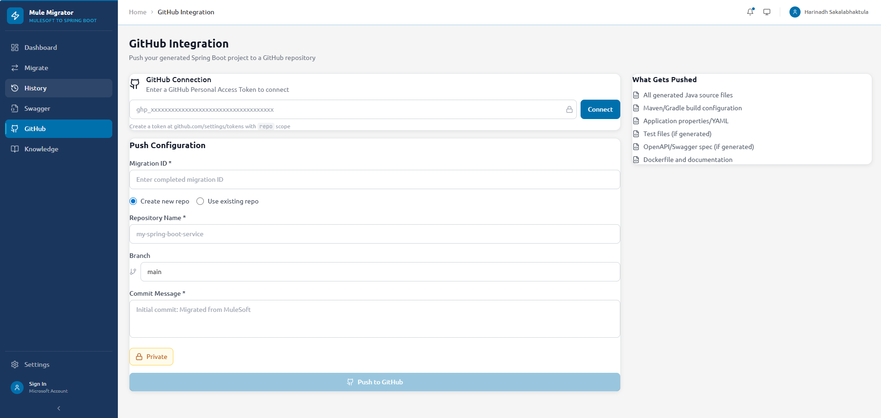
Step 5: Push to GitHub
Connect GitHub token, configure repo, branch & push generated code

Slide 10
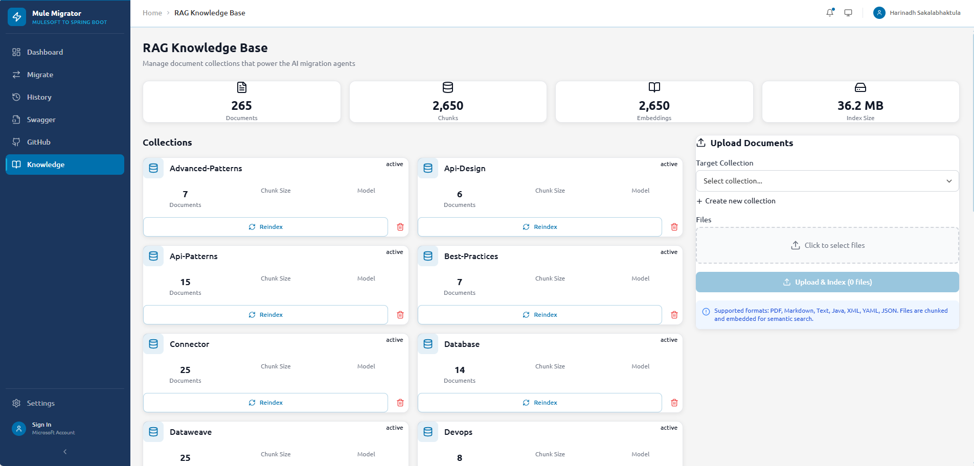
Step 6: RAG Knowledge Base
265 documents, 2650 embeddings powering AI migration agents

Slide 11
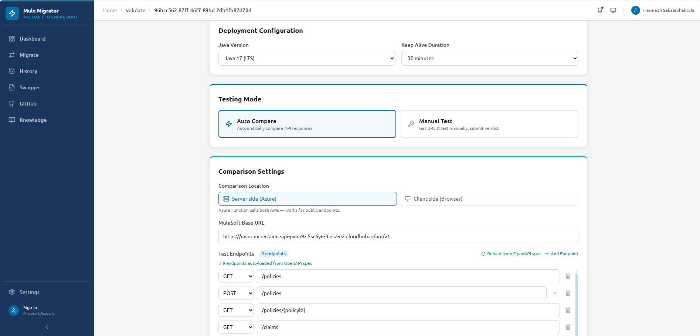
Step 7: Validation Config
Deployment settings, testing mode, MuleSoft base URL & endpoint list

Slide 12
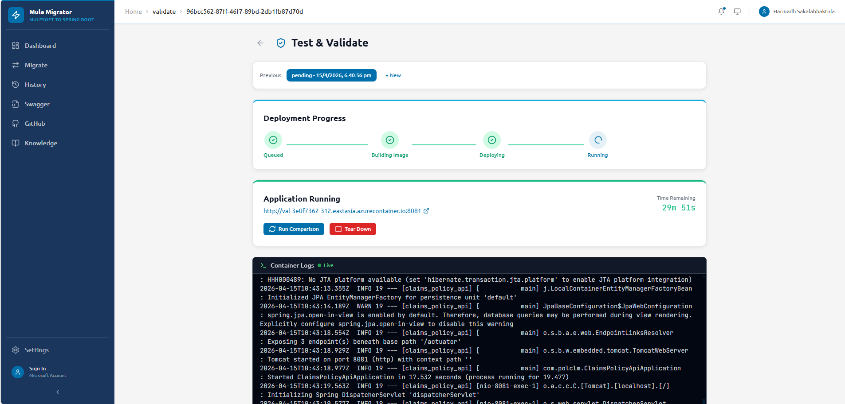
Step 8: Validation Running
Docker build, ACI deploy, health check & container logs

Slide 13
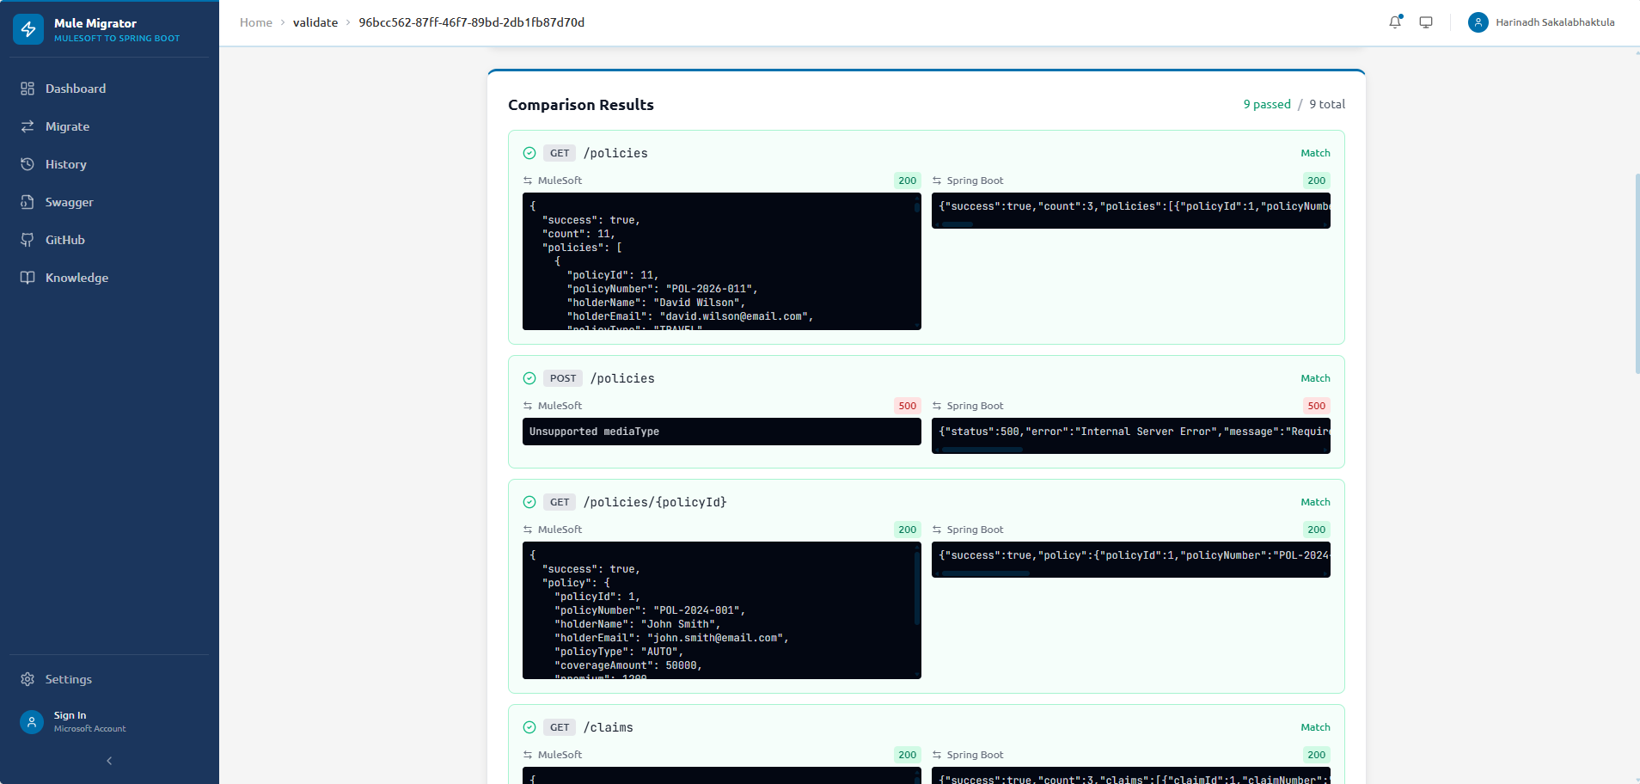
Step 9: API Comparison
9/9 endpoints matched — MuleSoft vs Spring Boot side-by-side

