Slide 1

Consumer Goods Ad-hoc Insights
SQL Project
Presented by: Hari Naga Sree Lakshmi

Slide 2
AGENDA
Project overview & objectives
Problem Statement
Dataset Description
Ad-hoc Requests, Results (queries),
Visualization & Insights

Slide 3
Project Overview & Objectives
Project Overview
AtliQ Hardwares is a leading computer hardware manufacturer in India with a strong global presence.
To improve business performance and support strategic decision-making, the company initiated a data-driven evaluation process for data analyst.
Objectives
Understand business questions from the ad-hoc request document and translate them into analytical tasks.
Write optimized SQL queries to extract accurate insights from the database.
Interpret results and convert data findings into meaningful business insights.

Slide 4
PROBLEM STATEMENT
Consumer Goods Ad-Hoc Analysis | AtliQ Hardwares
Domain: Consumer Goods
Function: Executive Management
Rapid growth, but leadership lacks fast actionable insights for smart decisions.
Need to decode real business scenarios and convert them into analytics tasks.
Solve 10 ad-hoc business queries using efficient SQL logic.
Turn raw data into executive ready insights for top management.

Slide 5
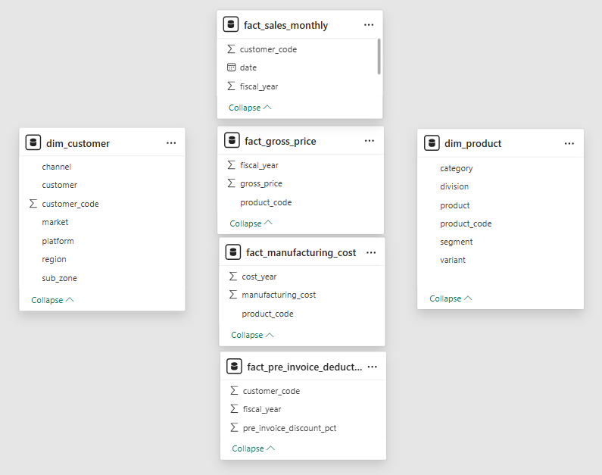
Dataset Description
dim_customer : Customer details including market, region, platform & channel.
dim_product : Product attributes division, segment, category & variants.
fact_gross_price : Product-wise yearly gross selling prices for the fiscal year 2020 & 2021.
fact_manufacturing_cost : Annual manufacturing costs for each product.
fact_pre_invoice_deductions : Customer-wise pre-invoice discount percentages.
fact_sales_monthly : Monthly sales data sold quantity, product & customer mapping.

Slide 6
Ad-hoc Requests, Results (queries),
Visualization & Insights

Slide 7
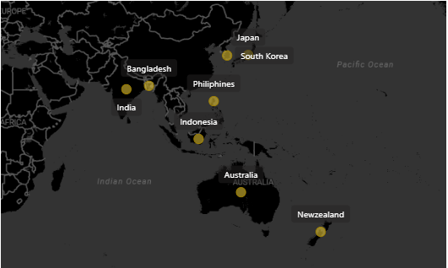
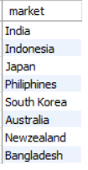
Market List of specific customer & in specific region
Request 1: Provide the list of markets in which customer "Atliq Exclusive"
operates its business in the APAC region.
Output:
Visual
Insights: Atliq Exclusive in the APAC region is operating its business in 8 countries around the world.

Slide 8
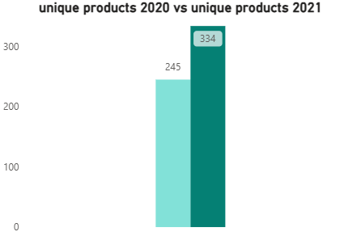

Total Unique product percentage change variance from the year 2020 to 2021
Request 2: What is the percentage of unique product increase in 2021 vs. 2020?
Output:
Visual
Insights: The percentage change between the unique products from the year 2020 to 2021 is observed as 36.33%.

Slide 9
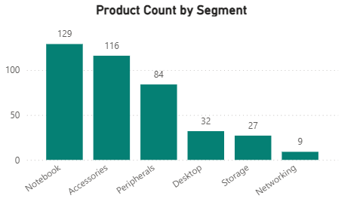
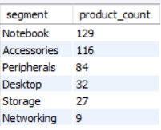
Unique product count for each segment
Request 3: Provide a report with all the unique product counts for each segment and
sort them in descending order of product counts.
Output:
Visual
Insights: Notebook and Accessories are the top-performing segments in terms of product sales, while Storage & Networking has the lowest product count, indicating an opportunity to review strategies and improve sales performance.

Slide 10
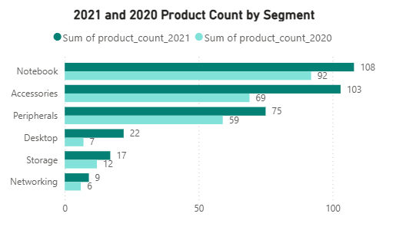
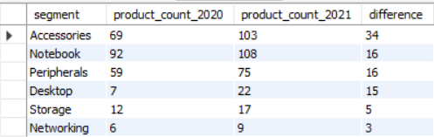
Most Varied product sales comparison in 2021 vs 2020
Request 4: Which segment had the most increase in unique products in
2021 vs 2020?
Output:
Visual
Insights: Between 2020 and 2021, the Accessories segment experienced the most significant growth in product count. In contrast, Networking and Storage witnessed negligible changes, reflecting limited expansion during this period.

Slide 11

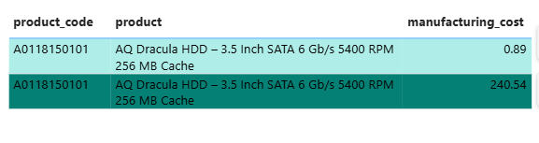
Highest & lowest manufacturing costs of products
Request 5: Get the products that have the highest and lowest manufacturing costs.
Output:
Visual
Insights: A significant cost disparity is observed for product A0118150101, where the manufacturing cost ranges between 0.89 and 240.54, pointing toward possible inefficiencies or variations in manufacturing practices that could be standardized to improve cost control.

Slide 12
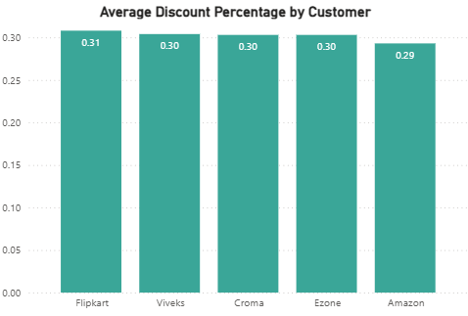
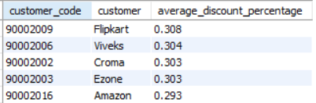
Market List of specific customer & in specific region
Request 6: Generate a report which contains the top 5 customers who received an
average high pre_invoice_discount_pct for the fiscal year 2021 and in the
Indian market.
Output:
Visual
Insights: The analysis reveals a discount-driven customer strategy, with Flipkart leading in average pre-invoice discounts. While this supports high-volume sales, continuous evaluation is required to ensure discounts are aligned with profitability goals.

Slide 13
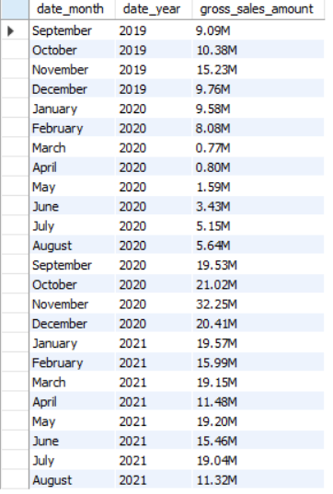
Market List of specific customer & in specific region
Request 7: Get the complete report of the Gross sales amount for the customer “Atliq
Exclusive” for each month.
Output:

Slide 14
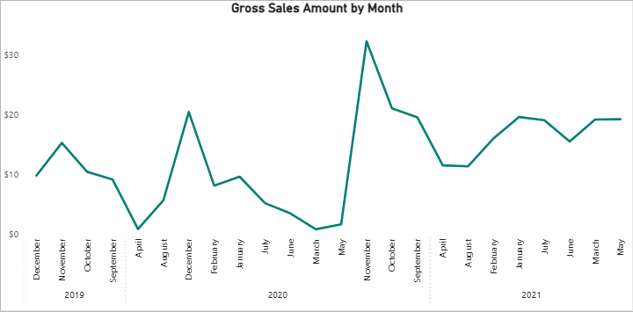
Atliq Exclusive gross sales amount for each month
Insights:
Clear seasonality observed, with sales fluctuating across months, indicating demand peaks driven by festive periods and promotional cycles.
November 2020 recorded the highest gross sales i.e., $32.25 highlighting a strong demand surge and serving as a benchmark period for future planning.
Early 2020 shows a sales dip, likely due to market disruptions, followed by a strong recovery in late 2020.
Sales performance in 2021 is more stable and consistent, reflecting improved demand forecasting and a strengthened customer relationship.
Reduced volatility in 2021 suggests better predictability, supporting more efficient inventory and supply-chain planning.

Slide 15
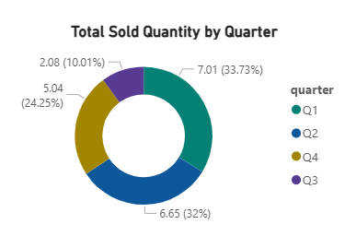
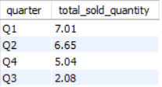
Quarter based sales analysis for the year 2020
Request 8: In which quarter of 2020, got the maximum total_sold_quantity?
Output:
Visual
Insights: Q1 recorded the highest total sold quantity at 7.01, while Q3 posted the lowest at 2.08, highlighting a clear seasonal or demand-related variation across quarters.

Slide 16
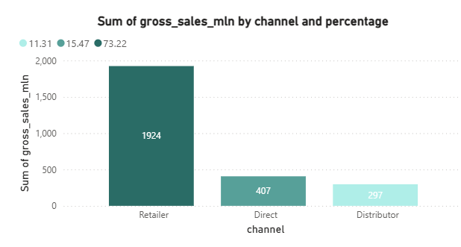
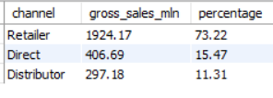
Each channel gross sales and the percentage contribution in fy:2021
Request 9: Which channel helped to bring more gross sales in the fiscal year 2021
and the percentage of contribution?
Output:
Visual
Insights: In FY 2021, the Retailer channel generated the highest gross sales and contributed the largest share of overall revenue. In contrast, the Distributor channel recorded the lowest percentage contribution, indicating underutilized reach and potential inefficiencies in channel strategy that may be limiting sales performance.

Slide 17
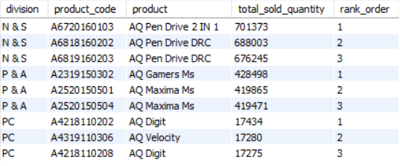
Market List of specific customer & in specific region
Request 10: Get the Top 3 products in each division that have a high total_sold_quantity
in the fiscal_year 2021?
Insights – Top Products by Division (FY 2021):
PC Division
AQ Digit series dominates PC sales, with all top 3 products contributing ~17K units each.
Sales distribution among the top products is highly balanced, indicating stable demand rather than dependence on a single product.
P & A (Peripherals & Accessories) Division
AQ Gamers Ms emerges as the top-performing product, leading with ~428K units sold.
This division demonstrates high volume scalability, making it ideal for promotional campaigns and cross-selling.
N & S (Networking & Storage) Division
AQ Pen Drive 2-in-1 is the clear leader with ~701K units, outperforming other products.
Pen Drive variants dominate the top 3, indicating strong customer preference for storage solutions.
This division contributes the highest overall sales volume among all divisions in FY 2021.
Output:

Slide 18
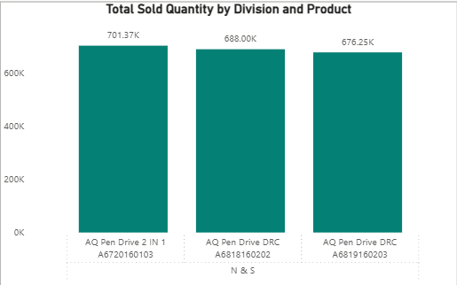
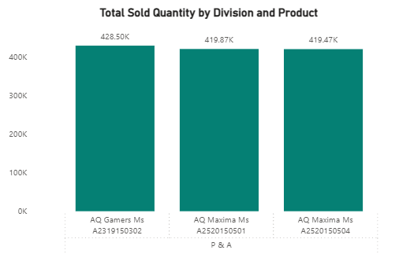
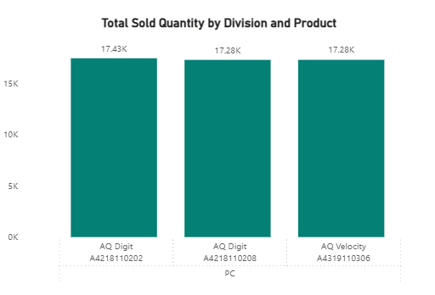
Top 3 products in each Division
N & S
P & A
PC
N & S division is the strongest growth driver by volume in FY 2021.
P & A division shows consistent high demand, suitable for revenue optimization strategies.
PC division has uniform product performance, suggesting room for innovation-led differentiation.
Focus on inventory optimization and marketing investments should prioritize N & S and P & A divisions.

Slide 19
THANK YOU

