Slide 1
Handling Distributed Transactions in the Microservice world

Slide 2
What is a distributed transaction?
Transactions that span over multiple physical systems or computers over the network, are simply termed Distributed Transactions. In the world of microservices a transaction is now distributed to multiple services that are called in a sequence to complete the entire transaction

Slide 3
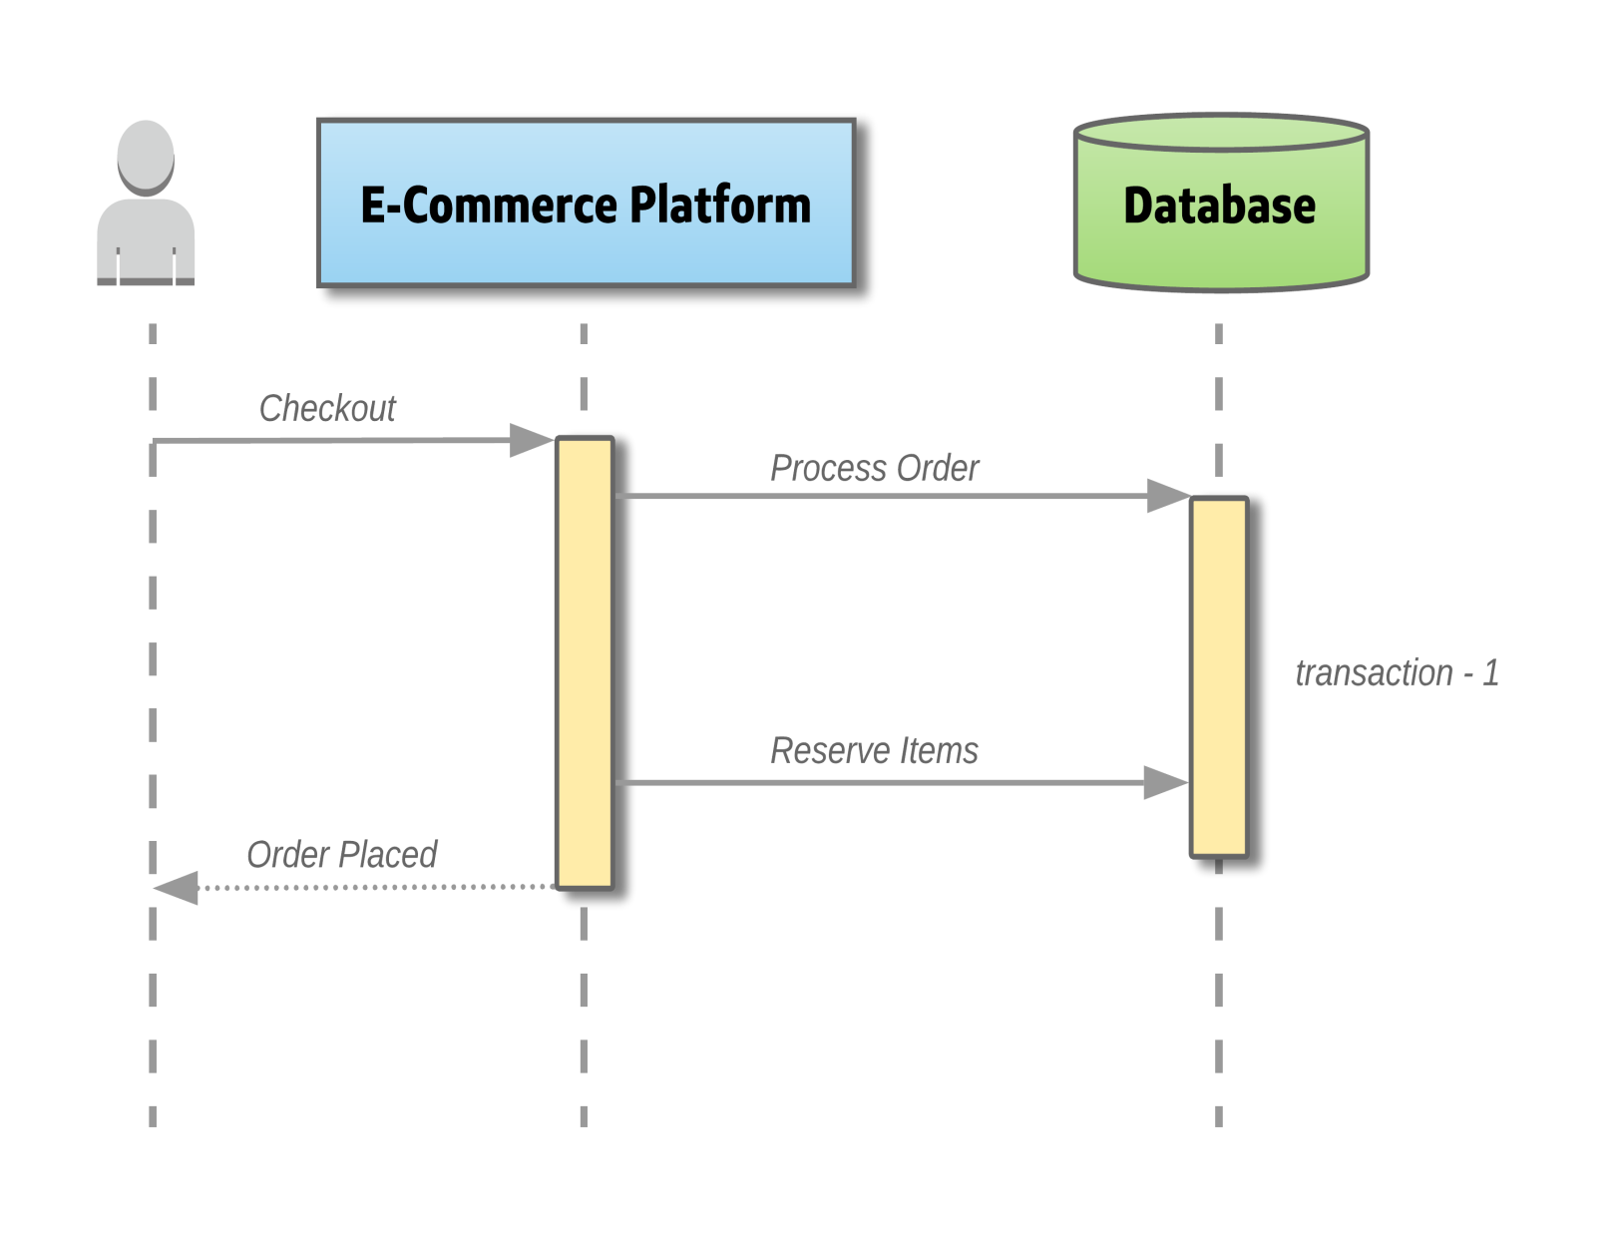
Transaction in a monolith

Slide 4
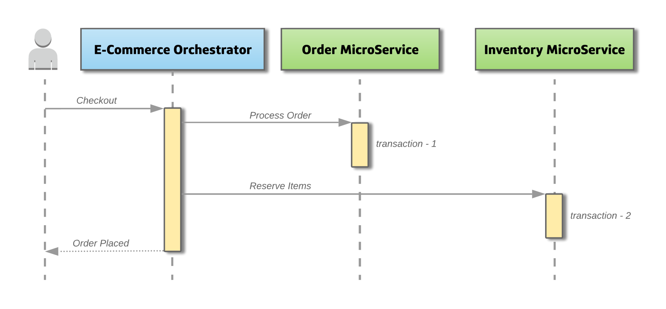
Decomposed as microservices

Slide 5
Possible Solutions
Two-Phase Commit
SAGA

Slide 6
Two-Phase Commit
As the name suggests, this way of handling transactions has two stages, a prepare phase and a commit phase. One important participant is the Transaction Coordinator which maintains the lifecycle of the transaction.

Slide 7
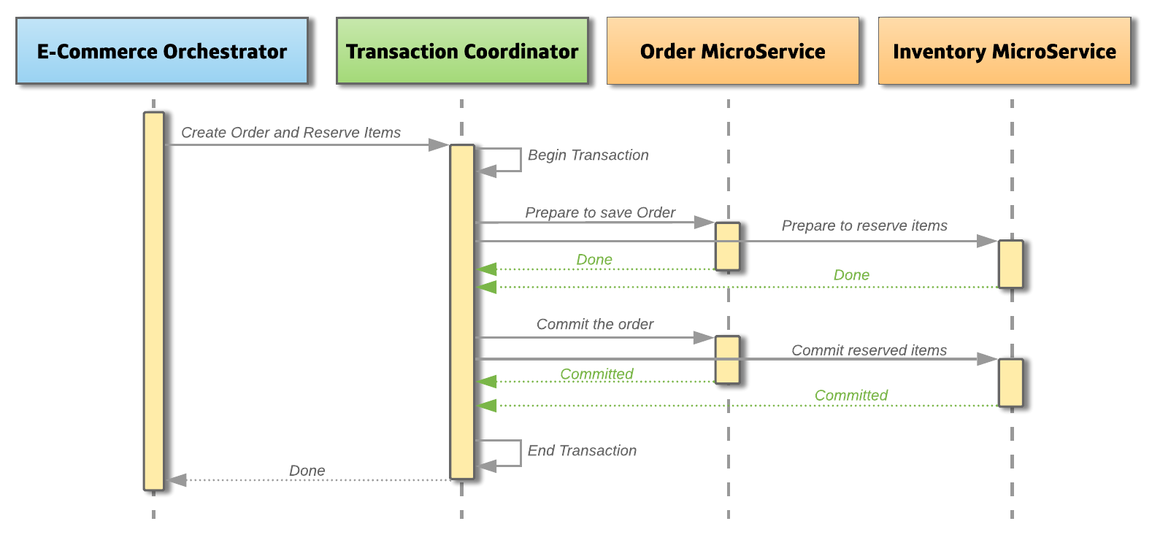
Successful Two Phase commit on Microservices

Slide 8
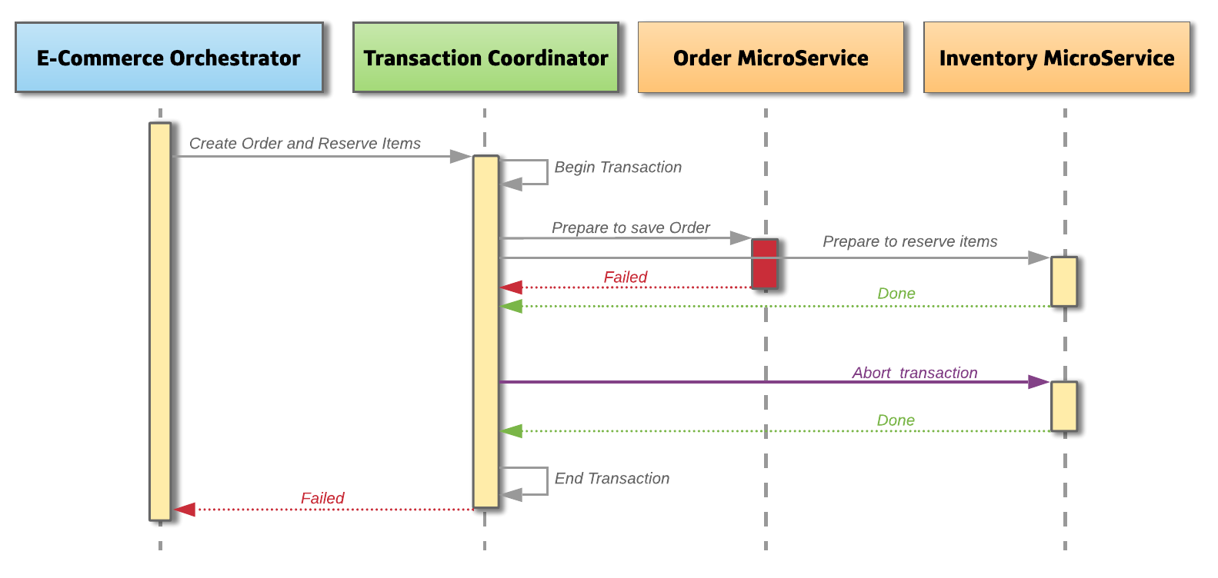
Failed Two Phase commit on Microservices

Slide 9
Advantages
The approach guarantees that the transaction is atomic. The transaction will end with either all microservices being successful or all microservices have nothing changed.
Secondly, it allows read-write isolation, the changes on objects are not visible until the transaction coordinator commits the changes.
The approach is a synchronous call, where the client would be notified of success or failure.

Slide 10
Dis-Advantages
The transaction manager is the single point of failure. All pending transactions will never complete.
If a given participant fails to respond, then the entire transaction will be blocked.
A commit can fail after voting. The 2PC protocol assumes that if a given participant has responded with a yes, then it can definitely commit the transaction too. This is not the case in most practical scenarios.

Slide 11
SAGA
Saga aims to solve the distributed transactions problem by grouping a given transaction into a sequence of sub-transactions and corresponding compensating ransactions.
All transactions in a Saga either complete successfully or, in the event of a failure, the compensating transactions are ran to roll back everything, which is done as part of the Saga.
• T1: Book flight, C1: Cancel flight
• T2: Book hotel, C2: Cancel hotel
• T3: Book car rental, C3: Cancel car rental

Slide 12
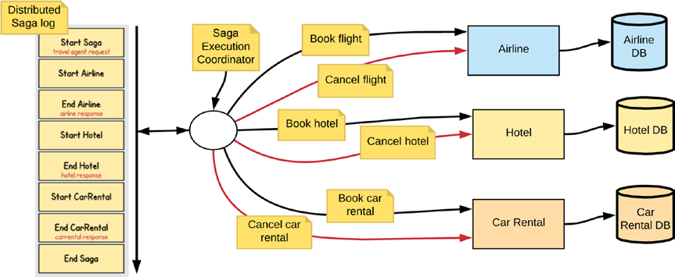
The implementation of Saga requires a Saga log, which is a distributed log that the Saga Execution Coordinator interacts with.

Slide 13
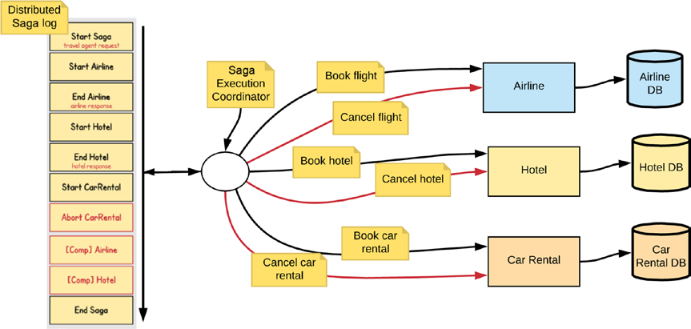
Execution steps of an unsuccessful Saga

Slide 14
Advantages
One big advantage of this approach is that each microservice focuses only on its own atomic transaction. Microservice’s are not blocked if another service is taking a longer time. This also means that there is no database lock required. Using this approach makes the system highly scalable under heavy load, due to its asynchronous event based solution.
Dis-Advantages
The main disadvantage, is the approach does not have read isolation. Which means, in the above example the client could see the order was created, but in the next second, the order is removed due to a compensating transaction. Also, when the number of microservices increase it becomes harder to debug and maintain.

