Slide 1

“1.5 million attacks every year, 4,000 attacks every day, 170 attacks every hour and nearly 3 attacks every minute.”
Cyber Security Services
Prevention at its best, within your budget

Slide 2

Cyber Security Industry Statistics
• Industry reached $75 Billion In 2015​ and expected to Reach $170 Billion By 2020
• Average U.S. company of 1,000 employees or more spends $15 million+ a year battling cybercrime, up 20 percent from last year.
• Labor epidemic - 800,000 unfilled U.S. cybersecurity jobs and should rise to 1.5 million by 2019.
• 28% of large corporations claim to have a “problematic” shortage of cyber security skills.
• 80 % of BOD’s say that cyber security is discussed at most or all board meetings.
• Cybersecurity Ventures projects $1 trillion will be spent globally on cybersecurity from 2017 to 2021.

Slide 3

Cyber Security Corporate Risk Facts
• 1.5 million attacks every year. 4,000 attacks every day. 170 attacks every hour. Nearly 3 attacks every minute.
• Data breaches average $150 - $350 per record. These costs do not include:
• Federal & state penalties
• Corporate and individual Lawsuits
• Business downtime
• Brand damage
• Average consolidated total cost of a corporate data breach grew from $3.8 million to $4 million last year alone.
• US cyber-attacks are costing businesses $400 to $500 billion a year and is quickly becoming the reason executive jobs are lost.
• Global annual cybercrime costs will grow from $3 trillion in 2015 to $6 trillion annually by 2021.

Slide 4

Overview
We are a leading provider of preventative cyber security testing and consulting services who works with its corporate clients to reduce their exposed IT surface area while improving their overall security posture. Simply said, we help prevent corporate cyber attacks.
We provide the following preventative cyber security services:
• Vulnerability Assessments
• Network Penetration Testing
• Web/Mobile Application Security Testing
• Email Phishing Campaigns

Slide 5

Vulnerability Assessment - Overview
A vulnerability assessment is the process of identifying and quantifying security vulnerabilities in an environment. It is an in-depth evaluation of your information security posture, indicating weaknesses as well as providing the appropriate mitigation procedures required to either eliminate those weaknesses or reduce them to an acceptable level of risk
Vulnerability assessments consist of:
Defining and classifying network or system resources
Assigning relative levels of importance to the resources
Identifying potential threats to each resource
Developing a strategy to deal with the most serious potential problems first
Defining and implementing ways to minimize the consequences if an attack
occurs

Slide 6
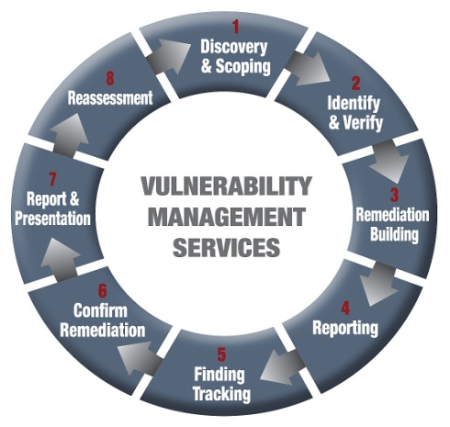
Vulnerability Assessment – Our Service
Our vulnerability assessment services offer a complete solution for finding vulnerabilities and tracking the remediation within the client enterprise.
Vulnerability Management Process:
1. System and Service Discovery/Scoping
2. Vulnerability Identification & Manual Verification
3. Remediation Building Development
4. Reporting
5. Tracking of Findings
6. Testing to Confirm Remediation
7. Report & Presentation
8. Reassessment

Slide 7

Network Penetration Testing - Overview
A network penetration test simulates the actions of an external and/or internal cyber attacker that aims to breach the information security of the organization. Using many tools and techniques, the penetration tester (ethical hacker) attempts to exploit critical systems and gain access to sensitive data.
A penetration test doesn’t stop at simply uncovering vulnerabilities: it goes the next step to actively exploit those vulnerabilities in order to prove (or disprove) a real-world attack would be successful and what systems and data that attacker could gain access to.

Slide 8
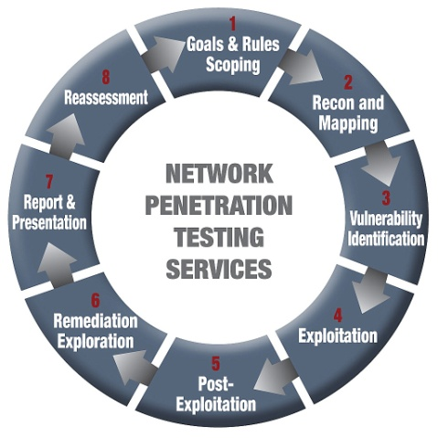
Network Penetration Testing – Our Service
Our network penetration test services follows the Penetration Testing Execution Standard (PTES) framework which provides the most comprehensive and dependable results and mitigation guidance.
Network Penetration Testing Process:
1. Goals and Rules Scoping
2. Intelligence Gathering – Recon and Mapping
3. Vulnerability Analysis and Identification
4. Exploitation
5. Post Exploitation
6. Remediation Exploration
7. Report and Presentation
8. Reassessment

Slide 9
Vulnerability Assessment vs Network Pentest
Simply said, a vulnerability assessment identifies vulnerabilities in an external (web facing) and internal network as well as instructions on how to fix these vulnerabilities. It would be like getting an opinion from your home security company on where a robber would potentially break in your home and how to secure it.
A penetration test is the next step after you have had a good vulnerability assessment(s). The penetration test finds any remaining external (web facing) and internal network vulnerabilities, but the test also exploits these vulnerabilities to access systems and data, which helps to display your actual risk. Using the home security example, it would then be like getting a “ethical robber” to try to break into your home and if a break in is successful, what the robber could destroy or steal…hence how much you would lose.

Slide 10
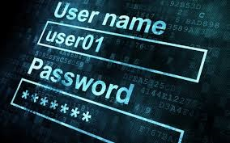
Web/Mobile Application Security Testing - Overview
A web or mobile application security test is broken down into Dynamic (app facing and most common) or Static (code based) tests. The primary objective is to identify exploitable vulnerabilities in applications before hackers are able to discover and exploit them. Web application testing will reveal real-world opportunities for hackers to be able to compromise applications in such a way that allows for unauthorized access to sensitive data or even take-over systems for malicious/non-business purposes.
This type of security testing helps clients:
Identify application security flaws present in the environment
Understand the level of risk for your organization
Help address and fix identified application flaws

Slide 11
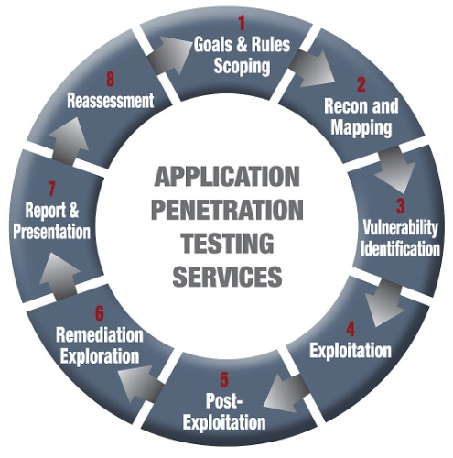
Web/Mobile Application Security Testing – Our Service A
Our web and mobile application security testing provides services follows the Penetration Testing Execution Standard (PTES) framework which provides the most comprehensive and dependable results and mitigation guidance.
Web/Mobile Application Security Assessment Process:
1. Goals and Rules Scoping
2. Intelligence Gathering – Recon and Mapping
3. Vulnerability Analysis and Identification
4. Exploitation
5. Post Exploitation
6. Remediation Exploration
7. Report and Presentation
8. Reassessment

Slide 12
Web/Mobile Application Security Testing – Our Service B
Dynamic Testing: We identify software vulnerabilities, demonstrates the impact of the weaknesses, and provides recommendations for mitigation. During a web application security test, we have two primary objectives: the obtainment of unauthorized access and/or the retrieval of sensitive information. Our security assessors use a combination of commercial and custom-built tools to test the target application, using manual and automated methods to ensure complete coverage of test cases.
Static Testing: By conducting a Static code testing, we can pinpoint root causes of security vulnerabilities in source code, receive prioritized results sorted by severity of risk, and get guidance on how to fix vulnerabilities in line-of-code detail. As a result you can ensure your software is trustworthy, reduce the costs of finding and fixing application vulnerabilities, and establish the foundation for secure coding best practices.
Deliverable: We identify the root causes for security flaws, perform hardening to secure the environment and provide a detailed report with recommendations for reasonable and practical steps to mitigate future risks. During the hand-off, our security assessors will fully brief your designated representative on all the details of the test, walk them through the results, and provide any necessary work artifacts. Your representative will be fully knowledgeable in the details of the testing, and will have all the information necessary to recreate the findings.

Slide 13

Email Phishing Campaign - Overview
Email phishing is a form of fraud in which the attacker tries to learn information such as login credentials or account information by masquerading as a reputable entity or person in an email. Typically a victim receives a message that appears to have been sent by a known contact or organization. An attachment or links in the message may install malware on the user’s device or direct them to a malicious website set up to trick them into divulging personal and financial information, such as passwords, account IDs or credit card details.
An email phishing campaign simulates such an attack to help a company see which employees are opening suspicious emails, what they are clicking on and what information they are providing. This service creates employee awareness and promotes a more defensive posture when handling inbound emails.

Slide 14

Email Phishing Campaign
What we do: Our team crafts and implements phishing campaigns that mirror the types of messages used by attackers. We track every aspect from delivery to receipt as well as all activity actions taken by your employee. We provide easy to understand reports to show which employees and departments are practicing safe email handling and which need additional training.
End Result: Our Phishing campaign will boost your employee’s ability to handle phishing email attempts thereby protecting your corporate data, client’s information and overall businesses stability.

Slide 15

Why Use Our Security Services?
Mobile & Fast Service – Our proprietary remote security testing process provides security testing anywhere in the nation (& world) within days of an engagement. This not only makes our service more efficient and affordable, but also less intrusive to our clients day-to-day business. Mobile, Noninvasive & Affordable.
Affordable Rates – Because we are not onsite and due to our efficient testing process, our security services are extremely competitive and often less expensive than normal market rates. Premium Value at Competitive Price.
High Quality Testing – Our testing teams have 7 years minimum applicable experience with a strong history of providing premium testing and reliable results. Superior Testing with Reliable Results.
Premium Results Reporting - All results and remediation reporting are provided in a client friendly easy-to-import format.
Vulnerability Management Dashboard – Our proprietary client facing dashboard provides all test results in an understandable and actionable format. Whether you are the remediation team or the CEO, our portal provides results in a graphical and digestible layout for management and executives alike. See Vulnerability Management Dashboard for more.
Plug & Play or Plug & Extend – Our security services can be plugged into your company as your primary testers or simply to extend your security testing bandwidth. Regardless, we make it easier for our clients to manage the larger picture of testing results and remediation recommendations which are critical for cyber security success. Testing Solutions for your Environment.

Slide 16
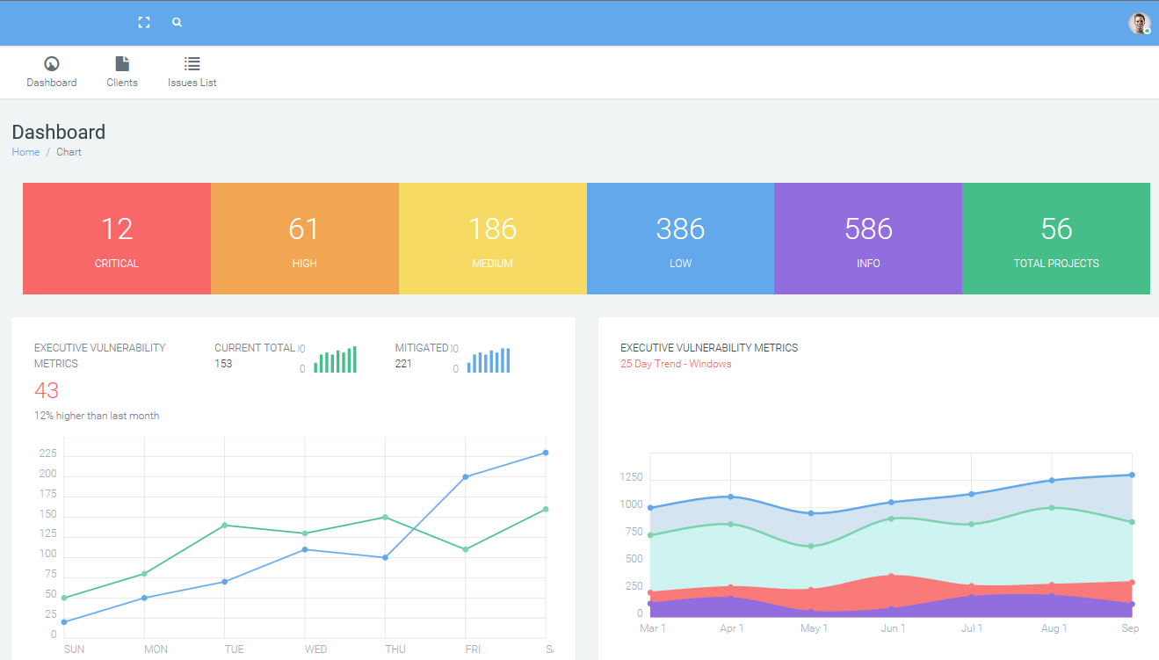
Vulnerability Management Dashboard
We help you find your vulnerabilities.
Our dashboard automatically logs all of your systems vulnerabilities and prioritizes them based on risk.
You give your internal or external IT staff access to fix the issues.
They can start fixing the issues downstream based on your budget.
Dashboard provides easy to understand “big picture” graphics so you can see & report progress.

Slide 17





Our Testing Team
Our security team has a combined 40 years of executive IT experience with a team of over 150 highly skilled and seasoned security professionals. All security assessment and testing employees have a minimum of 7 years of experience within the information security industry. Each has a Bachelor’s degree in Computer Science or Software Development or comparable work experience and hold certifications such as EC-Council Certified Ethical Hacker (CEH) and Offensive Security Certified Professional (OSCP). Our employees are encouraged to be active members of their local information security community and present at various conferences and events on security related topics. Additionally, our team members are encouraged to participate in vulnerability research contests and bug bounty programs, to further develop their skills and broaden their experiences.
We provide advanced training for all its testers, and such training is an integral component of the employee review process. We host internal training sessions where team members share knowledge and techniques, and also sponsor “hackathons” where testers get the opportunity to work exclusively on solving a problem to make them more effective, whether building a new tool, integrating new methods into the process or extending the platform to improve the effectiveness of our services. These events often generate ideas that we bring into production as part of the formal process to ensure our processes and tools are driven by the quality of the testing they enable.

Slide 18
Thank you
We look forward to providing our seasoned IT expertise and proven security methodologies to assist your company in reducing its exposed IT surface area while improving your overall security posture.

