Slide 1
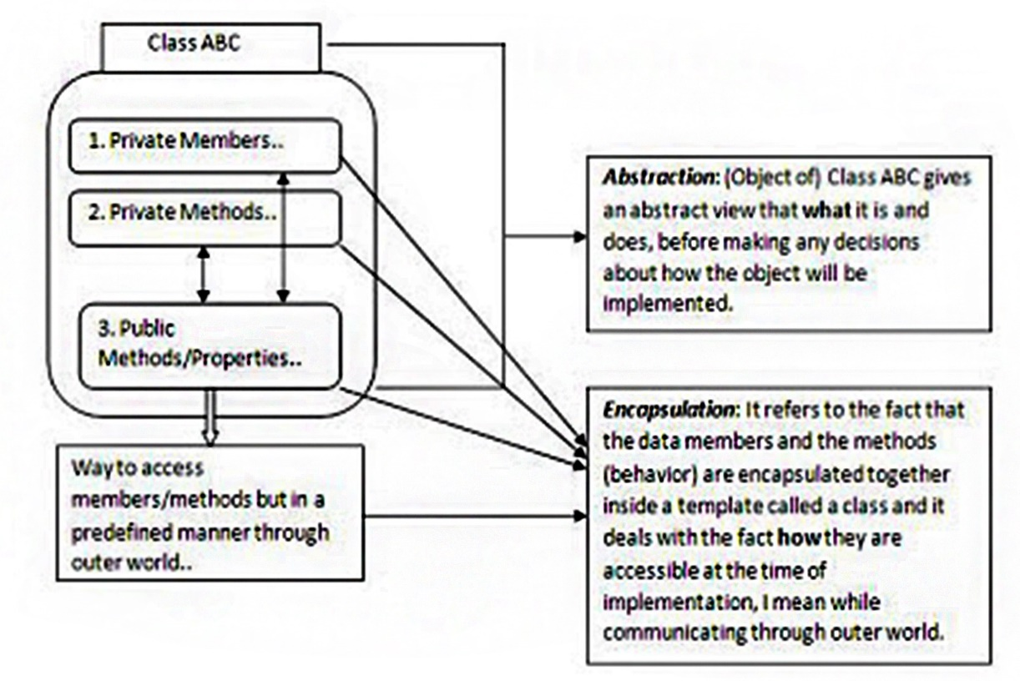

Slide 2
Abstraction
•
Abstraction is a process by which concepts are derived from the usage and classification of literal ("real" or "concrete") concepts.
Abstraction is a concept that acts as a super-categorical noun for all subordinate concepts, and connects any related concepts as a group, field, or category.
Abstractions may be formed by reducing the information
content of a concept or an observable phenomenon, typically
to retain only information which is relevant for a particular
purpose.
For example, abstracting a leather soccer ball to the more
general idea of a ball retains only the information on general
ball attributes and behavior, eliminating the other
characteristics of that particular ball.
•
•
•

Slide 3
Abstract class
•
Abstract classes
abstract.
Abstract class is
when it is being
Abstract classes
interfaces.
are special classes defined with the keyword
•
a concept and implementation gets completed
realized by a subclass.
provide elements of both inheritance and
•
•
An abstract class is a class that cannot be instantiated itself;
it must be inherited.
Some or all members of the class might be unimplemented,
and it is up to the inheriting class to provide that
implementation.
Members that are implemented might still be overridden, and
the inheriting class can still implement additional interfaces or
other functionality.
•
•

Slide 4





Abstract class
Example
•
Here we have two classes
Checking Account and Saving Account.
Bank Account
•
What are the common properties and
behavior between them? And what can be the abstract class for these entities?
owner : String balance : Dollar
deposit(amount : Dollar)
withdraw(amount : Dollar)
Checking Account
Saving Account
owner : String balance : Dollar insufficientFundsFee : Dollar
owner : String balance : Dollar annualInterestRate : Percentage
deposit(amount : Dollar) processCheck(checkToProcess : Check) withdraw(amount : Dollar)
deposit(amount : Dollar) depositMonthlyInterest() withdraw(amount : Dollar)

Slide 5
When to use abstract class?
•
•
•
•
Abstract class provides a template for future specific classes.
Use an abstract class to provide default behaviors (Code reusability).
Abstract class defines common interface for its subclasses. Abstract operations (methods) can be declared and their
implementation can be provided later in the concrete classes.
Abstract classes are useful when creating components because they
allow us to specify an invariant level of functionality in some
methods, but leave the implementation of other methods until a
specific implementation of that class is needed.
When creating a class library which will be widely distributed or
reused especially to clients, use an abstract class in preference to
an interface; because it simplifies versioning. This is the practice
used by the Microsoft team which developed the Base Class Library.
•
•

Slide 6
Interface
•
Every method declared by an object specifies the method's name,
the object/value it takes as parameters, and the method's return
value. This is known as the operation signature.
The set of all signatures defined by an object's methods is called the interface to the object. An object's interface characterizes the complete set of requests that can be sent to the object.
An interface is like an abstract class that cannot be instantiated.
Interfaces are better suited to situations in which your applications
require many possibly unrelated object types to provide certain
functionality.
Explicitly implementing interface in a class enables us to define a
set of methods that are mandatory for that class.
Interface definition begins with the keyword interface.
•
•
•
•

Slide 7






Interface
Example
•
Fountain pen and ball point pen are used
for writings, they are related entities. What should be the abstract class fo these entities?
<<IWritable>>
draw()
r
also is and
•
We can write using pen but we can
write with charcoal. Over here what the common behavior between pen charcoal that can be abstracted?
Pen
color : String draw()
Charcoal
Ball point pen
Fountain pen
burn()
draw()
draw()
draw()
refill()
Person
write(IWritable : instrument)

Slide 8
When to use Interface?
•
Use an interface when an immutable contract is really
intended.
Interfaces are better suited in situations when your applications require many possibly unrelated object types to provide certain functionality.
Interfaces are better in situations in which you do not
need to inherit implementation from a base class.
Interfaces can be used for multiple inheritance.
•
•
•

Slide 9
Difference between abstract
class and interface
Feature Interface Abstract class
Multiple Inheritance A class may implement several A class may inherit only one interfaces. abstract class.
Default implementation An interface is purely abstract, it An abstract class can provide cannot provide any code, just the complete, default code and/or signature. just the details that have to be
overridden.
Access modifiers An interface cannot have access An abstract class can contain modifiers for the method, properties access modifiers for the
etc. Everything is assumed as public. methods, properties etc.
Core vs. Peripheral Interfaces are used to define the An abstract class defines the peripheral abilities of a class. In other core identity of a class and there words both Human and Vehicle can it is used for related objects. inherit from a IMovable interface.
Homogeneity If various implementations only share If various implementations are method signatures then it is better to of the same kind and use
use Interfaces. common behavior or status then abstract class is better to use.

Slide 10
Difference between abstract
class and interface
Feature Interface Abstract class
Adding functionality If we add a new method to an Interface If we add a new method to an
(Versioning) then we have to track down all the abstract class then we have the implementations of the interface and option of providing default
define implementation for the new implementation and therefore all method. the existing code might work
properly.
Fields and Constants No fields can be defined in interfaces An abstract class can have
fields and constants defined

Slide 11
Is-a, can-do analogy
•
•
Abstract classes are classes that can be purely abstract.
It serves as a base for other classes. When a class is derived
from a base class, that derived class has an "is-a" relationship
with the base.
For example an Employee is a person and a Triangle is a shape so these cases could easily justify a base class and “is-a” relationship.
Interfaces are purely abstract and guarantee member invariance. They represent "can-do" or an invariant contract that specifies "can do and will always do as expected to do“.
Its appropriate to use an interface when it will be used by
many, unrelated types or in situations when multiple
inheritance is required.
•
•
•

