Slide 1
Eccentricity Fault Diagnosis of an Axial-Flux PMSM Using Machine Learning and Deep Learning
Fault-type classification and severity estimation from three-phase stator currents, evaluated on held-out test files
Signal processing · 5 ML + 5 DL models · soft-voting ensemble · severity regression
Notes:
Title. The work diagnoses eccentricity faults of an axial-flux PMSM from stator currents only: it classifies the fault type (healthy, tilt eccentricity, radial x-displacement) and estimates the fault severity in percent, using classical machine learning, deep learning and an ensemble of both.

Slide 2




Objective and approach
Problem
Rotor eccentricity in an axial-flux machine makes the air gap uneven. It distorts the magnetic field, adds vibration and noise, and can grow into rotor–stator rub.
Idea
The uneven air gap leaves a signature in the stator currents. Learn that signature with data-driven models, so the fault can be found without extra sensors (motor current signature analysis).
1. Classify the fault type
Healthy, tilt eccentricity, or radial (x) displacement
2. Estimate the severity
Eccentricity level in %, with an uncertainty band
3. Use stator currents only
Three phase currents i_A, i_B, i_C; non-invasive
4. Evaluate fairly
File-level held-out test set, no data leakage
Notes:
Objective: classify the eccentricity type and estimate its severity from the three stator currents. The evaluation uses whole files that were never seen in training.

Slide 3
Dataset: simulated three-phase stator currents
Split | Class | Severity (%) | Samples | Windows
Train | healthy | 0 | 10 231 | 72
Train | tilt | 7.5 | 11 843 | 85
Train | tilt | 10 | 11 223 | 80
Train | tilt | 20 | 11 987 | 86
Train | tilt | 30 | 11 832 | 85
Train | x-displacement | 4 | 12 073 | 87
Train | x-displacement | 20 | 11 995 | 86
Test | x-displacement | 10 | 12 864 | 93
Test | tilt | 17.5 | 11 859 | 85
526 kHz
Sampling rate (time step 1.9 µs)
≈ 22 ms
Length of each record (10 000 – 12 900 samples)
7 / 2
Labels come from the file names (fault type + severity %). Both test severities (10 % and 17.5 %) do not occur in training.
Training files / held-out test files (no validation files)
Classes in training: healthy, tilt, x-displacement. The test set contains no healthy file.
Notes:
Nine simulated records. Seven are used for training and two are held out for testing. The test severities 10 % (x-displacement) and 17.5 % (tilt) are not present in the training data, so the severity results measure interpolation to unseen levels.

Slide 4
Diagnosis pipeline
Feature extraction
224 features
time + log-spectrum
5 ML models
RF, LS-SVM, KNN,
BPNN, ELM
Soft-voting ensemble
→ fault type
Stator currents
i_A, i_B, i_C
526 kHz
Windowing
1024 samples
hop 128
Severity regressors
→ severity % ± sd
Raw waveform
average of 4 samples
3 × 256
5 DL models
1D-CNN, LSTM, BiLSTM,
GRU, CNN-LSTM
Each file is cut into windows; every window is classified, and the file verdict is the average over all its windows.
Notes:
Pipeline: currents are windowed. Two branches: hand-crafted features feed five classical ML models; the raw waveform feeds five deep models. Their class probabilities are averaged (soft voting) to give the fault type. Severity regressors for that fault type then estimate the severity.

Slide 5





Signal preprocessing
Read and label
Time column → sampling rate fs. Next three columns → phases A, B, C. File name → class + severity %.
Segmentation
Windows of 1024 samples (1.95 ms at 526 kHz), hop 128 samples (87.5 % overlap), at most 300 windows per file.
Four channels
A, B, C and the sum A+B+C. A balanced machine gives a sum near zero; eccentricity unbalances the phases.
Normalisation
One global amplitude scale, then z-score per feature. Both are fitted on the training windows only.
Deep-learning input
Raw window averaged over every 4 samples (light low-pass + decimation): 3 channels × 256 samples.
Notes:
Preprocessing. Windowing gives many training examples per file and a per-window vote. The sum channel highlights phase unbalance. All scaling parameters come from the training data only, so nothing from the test files leaks into the models.

Slide 6
Feature extraction: 224 features per window
Time domain — 8 per channel
Frequency domain — 48 per channel
Mean (DC offset)
Standard deviation and RMS
Skewness (waveform asymmetry)
Kurtosis (peakiness)
Peak value and peak-to-peak
Crest factor = peak / RMS
Hann window (limits spectral leakage)
FFT magnitude spectrum of the window
Keep 0 – fs/8 (0 – 65.8 kHz), bin width 514 Hz
Split into 48 bands (≈ 1.4 kHz each)
Strongest line in each band
log₁₀ to compress the dynamic range
4 channels (A, B, C, A+B+C) × (8 time + 48 spectral) = 224 features per window
Notes:
Feature vector. Time statistics describe waveform shape and distortion. The log-spectrum bands describe harmonic content. With 1024-sample windows at 526 kHz the bin width is 514 Hz, so the spectral features capture broad harmonic content rather than closely spaced sidebands.

Slide 7

Classical machine-learning classifiers
Model | Configuration | Principle
Random Forest | 100 trees, max depth 12, √d features per split, balanced class weights | Votes of decorrelated decision trees
LS-SVM (RBF) | RBF kernel, σ² = median distance, γ = 60, one-vs-rest | Kernel classifier solved as one linear system
KNN | k = 7, distance-weighted | Label of the nearest training windows
BPNN (MLP) | 1 hidden layer, 48 ReLU, Adam (lr 0.002), 70 epochs | Back-propagation neural network
ELM | 400 random sigmoid neurons, ridge output (C = 1000) | Only output weights are trained
Input: the 224 standardised features of each window. Output: a probability for each class (healthy, tilt, x-displacement).
Notes:
Five classical models, all trained on the same standardised feature vectors. Random Forest and KNN are robust non-parametric models; LS-SVM is a kernel method; the MLP is the classical BPNN; ELM trains only its output layer.

Slide 8
Deep-learning models on the raw waveform
Model | Architecture | Parameters | Training acc. | Votes
1D-CNN | Conv(8, k9) → pool 4 → Conv(16, k7) → pool 4 → FC 32 | 9 492 | 87.8 % | Yes
LSTM | 32 time steps × 24 values → LSTM(16) | 2 756 | 98.8 % | Yes
BiLSTM | 32 time steps × 24 values → BiLSTM(12 + 12) | 3 748 | 98.0 % | Yes
GRU | 32 time steps × 24 values → GRU(16) | 2 084 | 97.8 % | Yes
CNN-LSTM | Conv(8, k9) → pool 4 → LSTM(16) | 1 956 | 65.6 % | No
Two outputs per network (multi-task): class scores and a severity value. Loss = class-weighted cross-entropy + MSE on severity. Adam optimiser, batch 16, gradient clipping.
Voting gate: a deep model joins the ensemble only if its training accuracy reaches 70 %. CNN-LSTM (65.6 %) was therefore evaluated but did not vote.
Notes:
Five small deep networks read the waveform directly. Each predicts both class and severity. The 70 % gate uses training accuracy only, never test data.

Slide 9


Ensemble decision and severity estimation
Fault type: soft voting
Severity: regression ensemble
9 voting models: 5 ML + 4 DL
Per window: average of the class probabilities
Per file: average over all windows, highest class wins
Confidence = winning probability
Also reported: model agreement and window agreement
Separate regressors for each fault type (trained on that fault + healthy = 0 %)
RF regressor, kernel ridge (RBF), KNN regressor, ELM regressor + 4 DL severity heads
Equal weights (no validation set, test set not used)
File value = median over windows; ± = window spread
Health index (0 – 100)
100 · [P(healthy) + (1 − P(healthy)) · (1 − 0.9 · s / s_max)], s_max = 30 %
Novelty check
Nearest-neighbour distance to the training data; > 1 means the record looks unfamiliar.
Notes:
The type decision averages probabilities across models and windows. Severity is estimated only after the type is known, with regressors trained for that fault type. Weights would normally be tuned on a validation set; with none available, all eight severity estimators get the same weight.

Slide 10




Evaluation protocol
File-level split
Whole files are held out. No window of a test file is used in training.
Training-only fitting
Scaling, feature normalisation and novelty threshold come from training data.
Test set untouched
Not used for model selection, voting gate or severity weights.
Clean data
Duplicate files removed; a test file identical to a training file would be dropped.
Two levels
File level (one verdict per test file) and window level (every window).
Valid metrics only
Macro averages over classes present in the test set; undefined values = N/A.
Notes:
These rules make the reported numbers honest: no leakage between training and test files, and no tuning on test data.

Slide 11
Fault-type classification results
2 / 2
98.88 %
0.9887
0.9777
0.9994
Test files classified correctly
Window accuracy (178 windows)
Macro-F1 (windows)
Matthews corr. coeff. (MCC)
Macro AUC, one-vs-rest
Level | Accuracy | Macro precision | Macro recall | Macro-F1 | Balanced acc. | MCC | Cohen's κ
File level (2 files) | 1.0000 | 1.0000 | 1.0000 | 1.0000 | 1.0000 | 1.0000 | 1.0000
Window level (178) | 0.9888 | 0.9895 | 0.9882 | 0.9887 | 0.9882 | 0.9777 | 0.9775
Ensemble of 9 models; scores are on held-out test files only.
Window-level: 2 of 85 tilt windows were called x-displacement; all 93 x-displacement windows were correct.
File level is perfect, but with only 2 test files it carries little statistical weight.
Notes:
Main classification result. Both test files are classified correctly; at window level 176 of 178 windows are correct. MCC and kappa near 0.98 show agreement far beyond chance. The file-level 100 % must be read with the small number of test files in mind.

Slide 12
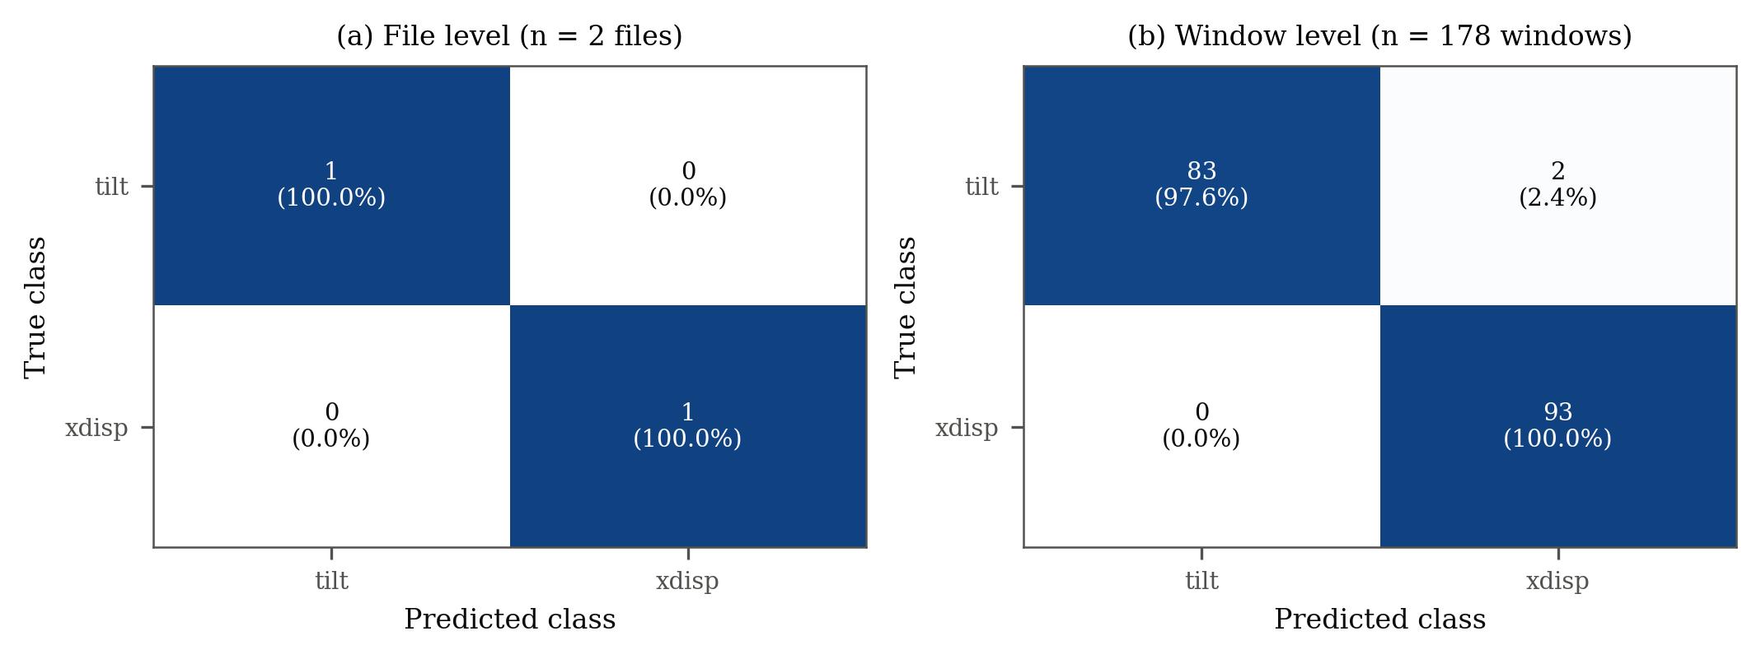
Confusion matrix
Reading the matrix
Rows = true class, columns = predicted class. Diagonal = correct.
Only errors: 2 tilt windows predicted as x-displacement.
No window was predicted healthy.
Level | Class | Precision | Recall | F1-score | Specificity | Support
File | tilt | 1.0000 | 1.0000 | 1.0000 | 1.0000 | 1
File | x-disp. | 1.0000 | 1.0000 | 1.0000 | 1.0000 | 1
Window | tilt | 1.0000 | 0.9765 | 0.9881 | 1.0000 | 85
Window | x-disp. | 0.9789 | 1.0000 | 0.9894 | 0.9765 | 93
Notes:
Confusion matrices. The only errors are two tilt windows predicted as x-displacement. Precision, recall and specificity per class are all at or above 0.976. Healthy is not shown because there was no healthy test file and no window was predicted healthy.

Slide 13
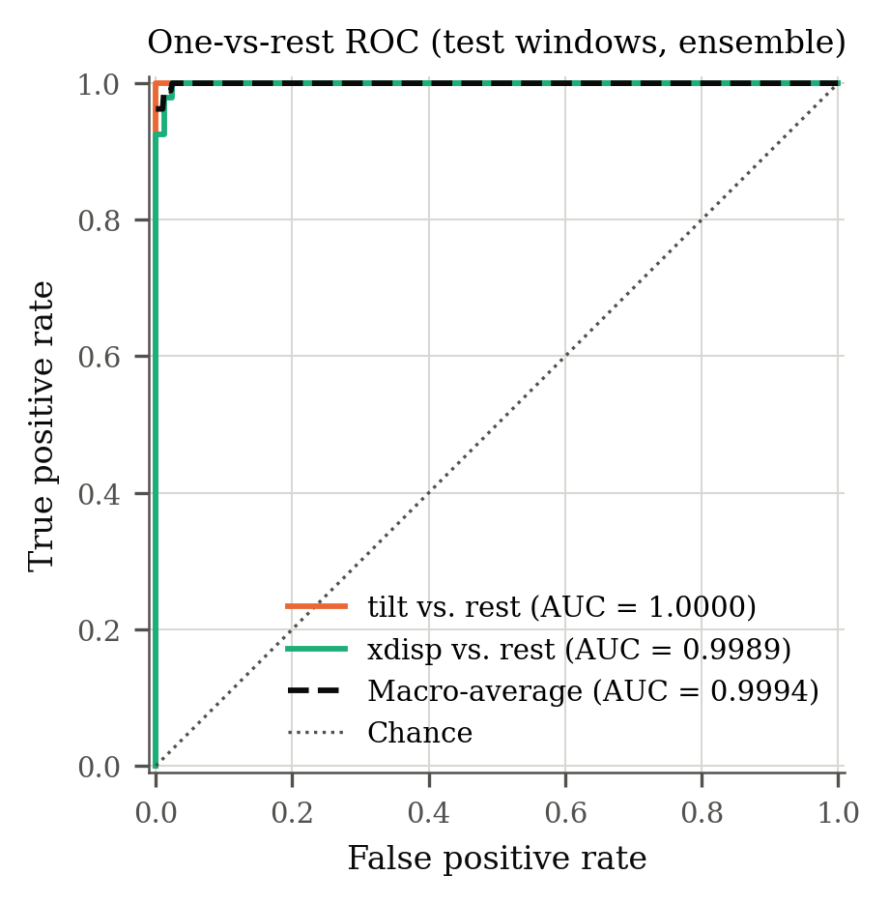
ROC curves and AUC
1.0000
0.9989
AUC, tilt vs. rest
AUC, x-displacement vs. rest
One-vs-rest ROC on the ensemble probabilities of all 178 test windows.
Macro-average AUC = 0.9994: the probabilities almost perfectly rank the true class first.
Healthy has no ROC curve because the test set has no healthy file.
Windows overlap and come from only 2 files, so they are not independent samples.
Notes:
ROC/AUC measures ranking quality independent of a decision threshold. Both classes reach AUC ≥ 0.999.

Slide 14
Comparison of the ten models and the ensemble
Key findings
Best single model: KNN (accuracy 0.9944).
Ensemble: 0.9888, close to the best and more robust than relying on one model.
ML models (0.89 – 0.99) clearly beat DL models (0.36 – 0.74).
Inference: 0.49 – 1.00 ms per window per model; 2.58 ms for the ensemble.
Notes:
All models were scored on the same held-out windows. The feature-based models are clearly stronger. The DL models reach 88–99 % on training windows but only 36–74 % on test windows: with seven training records they overfit. Inference times include feature extraction for the ML models.

Slide 15
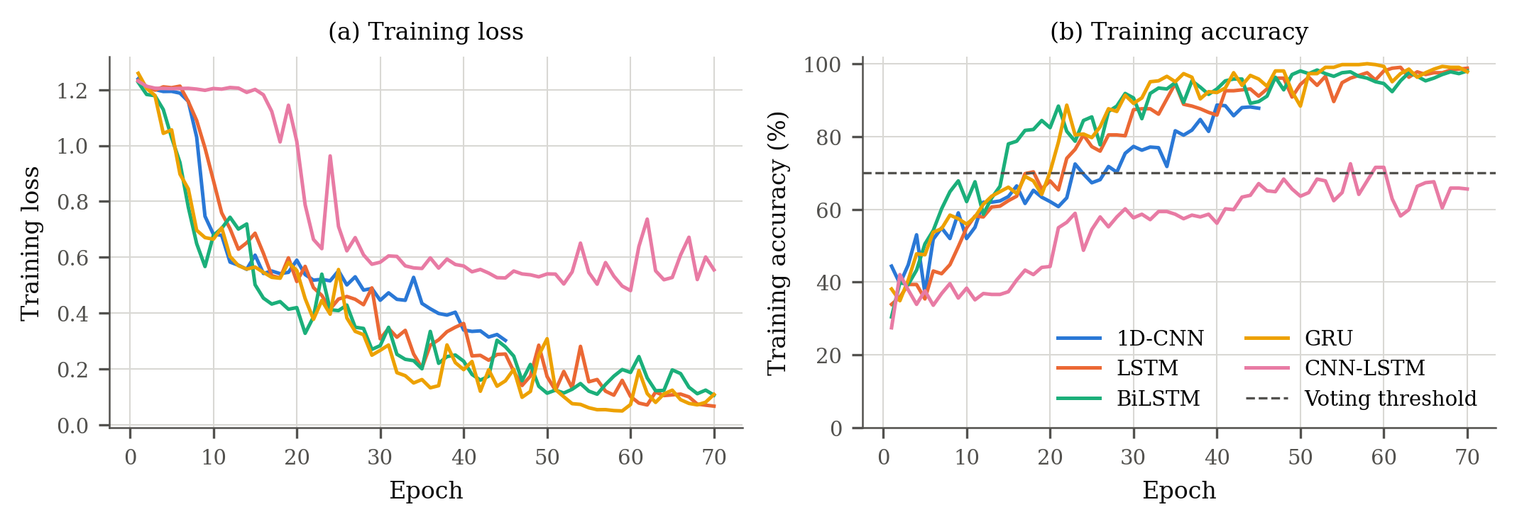
Deep-learning training behaviour
Large gap between training and test accuracy → overfitting on 7 training records
Model | 1D-CNN | LSTM | BiLSTM | GRU | CNN-LSTM
Training acc. | 87.8 % | 98.8 % | 98.0 % | 97.8 % | 65.6 %
Test acc. (window) | 36.0 % | 74.2 % | 56.7 % | 52.8 % | 60.7 %
Notes:
Loss falls and training accuracy rises to about 98 % for LSTM, BiLSTM and GRU, but test accuracy stays far lower. More recordings, longer records or data augmentation are needed before the deep models generalise.

Slide 16
Eccentricity severity estimation
Test file | True type / % | Predicted type / % | Type OK | |Error| (pts) | Conf.
Stator Currents-x(disp)-10% | x-disp. / 10.00 | x-disp. / 6.54 | Yes | 3.46 | 0.78
Stator current-tilt-17.5% | tilt / 17.50 | tilt / 15.78 | Yes | 1.72 | 0.65
2.59
2.73
3.46
MAE (% points)
RMSE (% points)
Max. abs. error
Both test severities were never seen in training → estimates of unseen levels (interpolation).
Both are underestimated (−3.46 and −1.72 points). R² is N/A: it needs at least 3 fault test files.
Evaluated on the 2 fault test files only; end-to-end and given-true-type results are identical because both types were correct.
Notes:
Severity results on the two fault test files. Average error 2.6 percentage points, worst 3.5. Both values are lower than the truth, consistent with the coarse grid of training severities.

Slide 17
Comparison of severity estimators
Key findings
The equal-weight ensemble has the lowest error (MAE 2.59).
Best single estimator: RF regressor (3.48).
ELM regressor is least reliable (9.63, max 16.6).
Individual estimators use the true fault type, so they are compared on equal terms.
Notes:
Combining the eight severity estimators reduces the error compared to any single one. With only two test files these rankings are indicative, not conclusive.

Slide 18


Limitations of this evaluation
Very small test set
2 independent test files; one wrong file changes file accuracy by 50 points.
No healthy test file
False-alarm rate on healthy machines is not measured.
Correlated windows
178 windows overlap by 87.5 % and come from 2 files.
Short windows
1.95 ms windows and 514 Hz FFT bins cannot resolve closely spaced fault sidebands.
No validation set
Severity weights are equal; no tuned weighting was possible.
Few severity levels
Tilt: 4 levels, x-displacement: 2 levels in training; R² not computable.
Notes:
These limitations come from the size of the dataset, not from the method. They define what the results can and cannot claim.

Slide 19
Conclusion and future work
2 / 2
test files correct
98.88 %
window accuracy
0.9994
macro AUC
2.59 pts
severity MAE
Stator-current features + an ML/DL soft-voting ensemble classified both held-out eccentricity files correctly (98.88 % of windows, macro-F1 0.9887, AUC 0.9994).
Unseen severities were estimated with MAE 2.59 points; the ensemble beat every single estimator.
Feature-based ML models generalised far better than the deep models, which overfit the small dataset.
Next: more and longer simulations (incl. healthy test files and more severity levels), a validation set, and leave-one-file-out cross-validation.
Notes:
Summary of results and the concrete next steps needed to turn this proof of concept into a statistically solid study.

