Slide 1
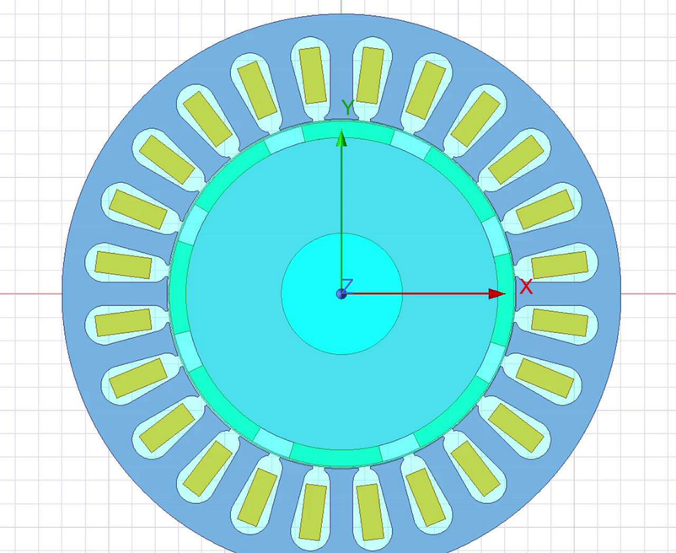
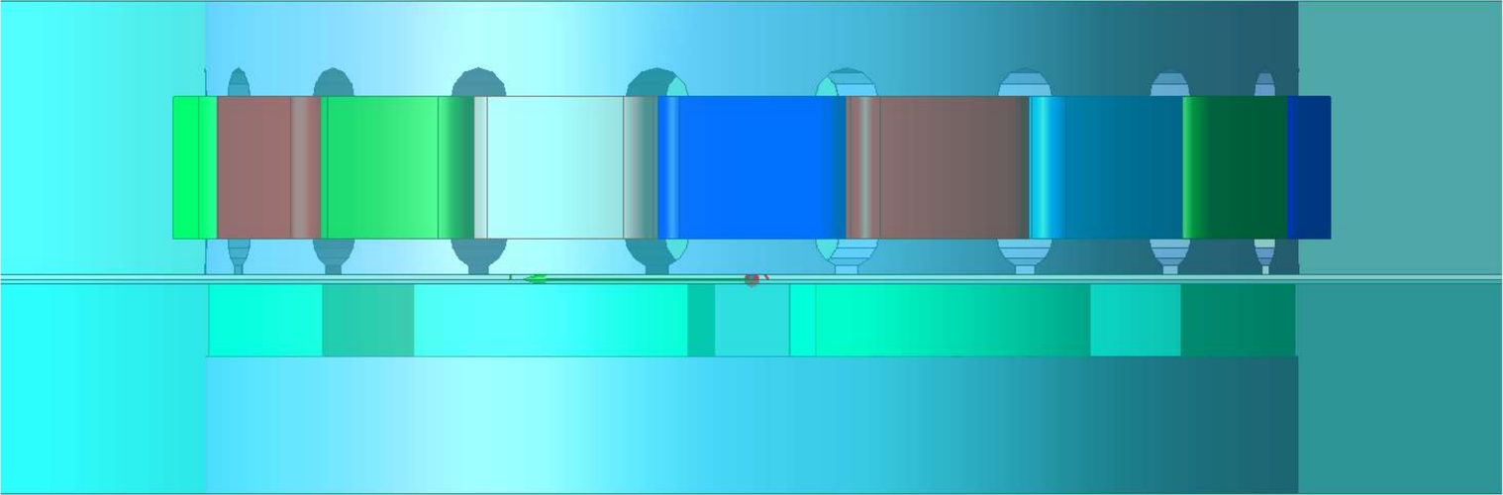
TWIN-ELECTRA 2026
Engineer's Day · Digital Twin Machine ARENA
Team Name: SHM VOLTRIX
AI-Based Digital Twin for Eccentricity Fault Diagnosis in Axial and Radial Flux PMSMs
Radial Flux PMSM (ANSYS Maxwell Model)
N Harikrishnan (CB.EN.U4EEE23110)
P Manish (CB.EN.U4EEE23125)
Srivarshan P (CB.EN.U4EEE23152)
Axial Flux PMSM (ANSYS Maxwell Model)
Mentor: Dr. Praveen Kumar N
Amrita Vishwa Vidyapeetham
6 October, 2026

Slide 2

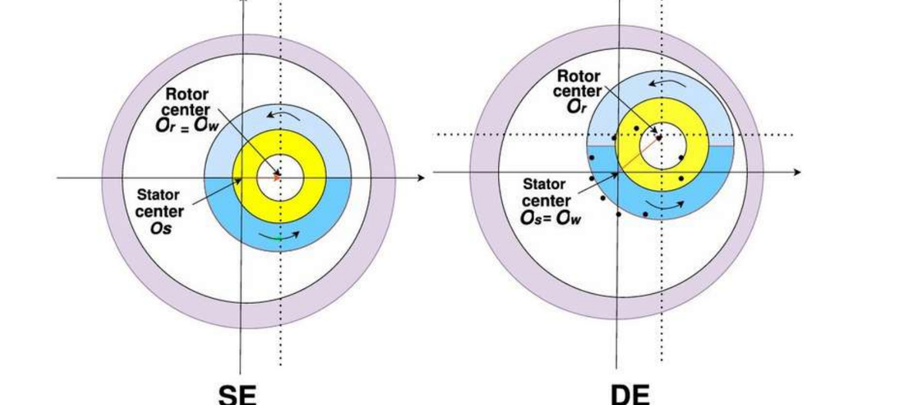
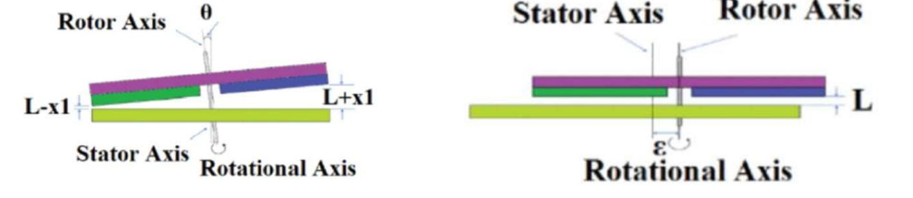
Problem Statement
1
The fault - The rotor sits off-centre, so the air gap is uneven. The stator current gains harmonics, torque ripple and vibration rise, and the rotor may touch the stator.
2
The gap - Axial and radial flux machines are rarely compared with one current-only method, and many methods need extra sensors.
Static (SE) and Dynamic (DE) Eccentricity in RFPMSM
3
Objective - A digital twin that reads the stator current and reports the fault type, the severity in %, and how far the answer can be trusted.
AFPMSM: Rotor Tilt and displacement
AI-Based Digital Twin for Eccentricity Diagnosis in Axial and Radial Flux PMSMs
2

Slide 3
Machines under Study
Common Rating
Parameter | Axial flux PMSM | Radial flux PMSM
Rated torque | 3.502 N·m | 3.511 N·m
Total losses | 81.04 W | 101.64 W
Efficiency | 89.91 % | 84.44 %
Total weight | 7.12 kg | 11.14 kg
Power: 0.55 kW
Voltage: 220 V, PWM drive
Speed: 1500 rpm
Frequency: 100 Hz, 8 poles
Tools Used: ANSYS Maxwell and converter circuit
Switching Frequency: 4500 Hz
The axial machine is lighter (7.1 vs 11.1 kg) and more efficient, but it is the less studied topology for fault diagnosis.
AI-Based Digital Twin for Eccentricity Diagnosis in Axial and Radial Flux PMSMs
3

Slide 4
Literature and Research gap
What is known
The gap
Effects: eccentricity changes flux density, back-EMF, torque ripple, vibration and noise [3]–[9], [18].
Method: current signature analysis with FFT features is a standard route [14]–[16].
AI: SVM, trees, XGBoost and CNN-LSTM classify faults with high accuracy [13]–[17].
1. Axial and radial machines are rarely compared with the same current-based method.
2. Severity (how much) is studied less than detection (whether).
3. Many methods need extra sensors, and few report trust on severity levels not seen in training.
AI-Based Digital Twin for Eccentricity Diagnosis in Axial and Radial Flux PMSMs
4

Slide 5
Objectives
1
Model healthy and eccentric axial and radial flux PMSMs with FEM (ANSYS Maxwell) and a PWM drive.
2
Extract fault-sensitive features from the three-phase stator current.
3
Build an AI model that gives fault type and severity (%) for both topologies.
4
Deliver it as an interactive digital twin that runs in any browser.
5
Validate on severity levels and files the models have never seen.
AI-Based Digital Twin for Eccentricity Diagnosis in Axial and Radial Flux PMSMs
5

Slide 6
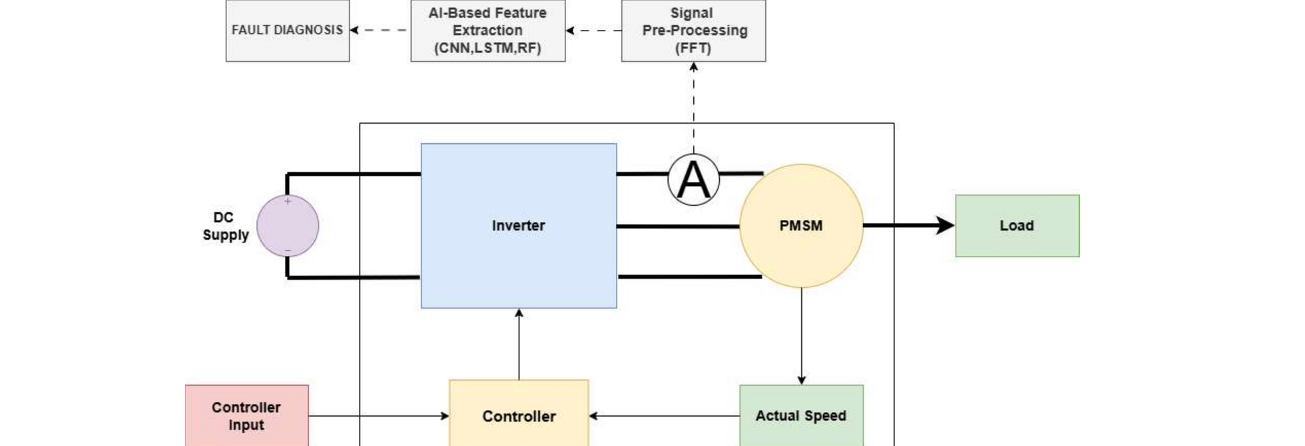
System and Workflow
1
Simulate ANSYS Maxwell and PWM drive give the currents.
2
Export CSV files; the file name is the label.
3
Teach Upload the train zip; the twin learns in the browser.
Drive and signal acquisition
Only the stator current is used.
No vibration or flux sensor is needed.
4
Diagnose A new file gives verdict, severity, confidence.
AI-Based Digital Twin for Eccentricity Diagnosis in Axial and Radial Flux PMSMs
6

Slide 7
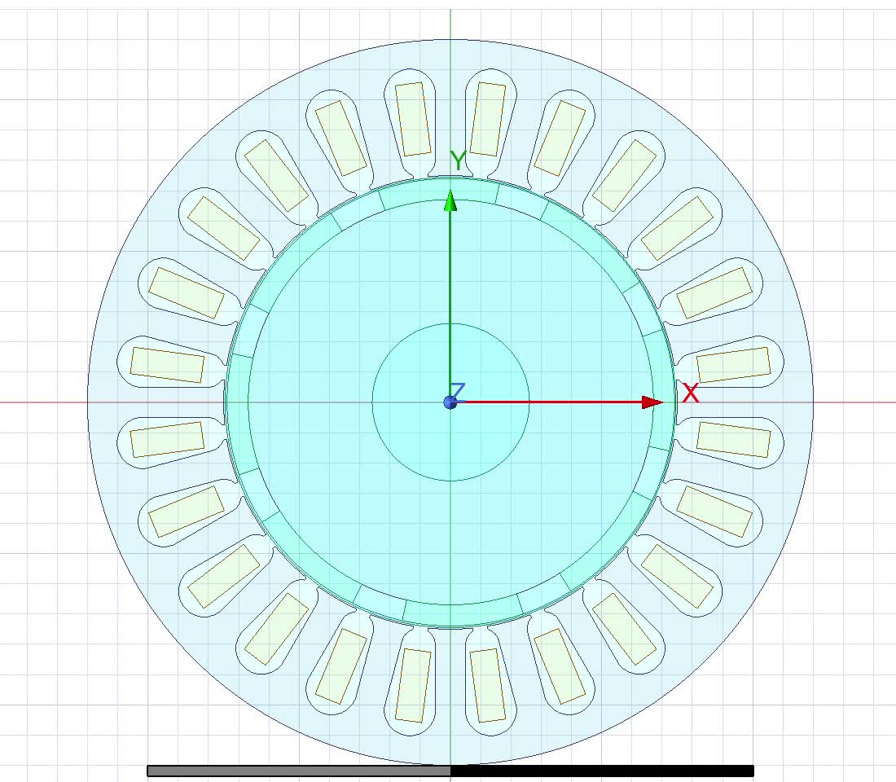
Eccentricity Modelling: RFPMSM
Dynamic eccentricity: rotor rotates about the stator axis, centre displaced
Eccentricity ratio ε = e / g · air gap g = 0.5 mm · example: ε = 20 % → e = 0.1 mm
AI-Based Digital Twin for Eccentricity Diagnosis in Axial and Radial Flux PMSMs
7

Slide 8
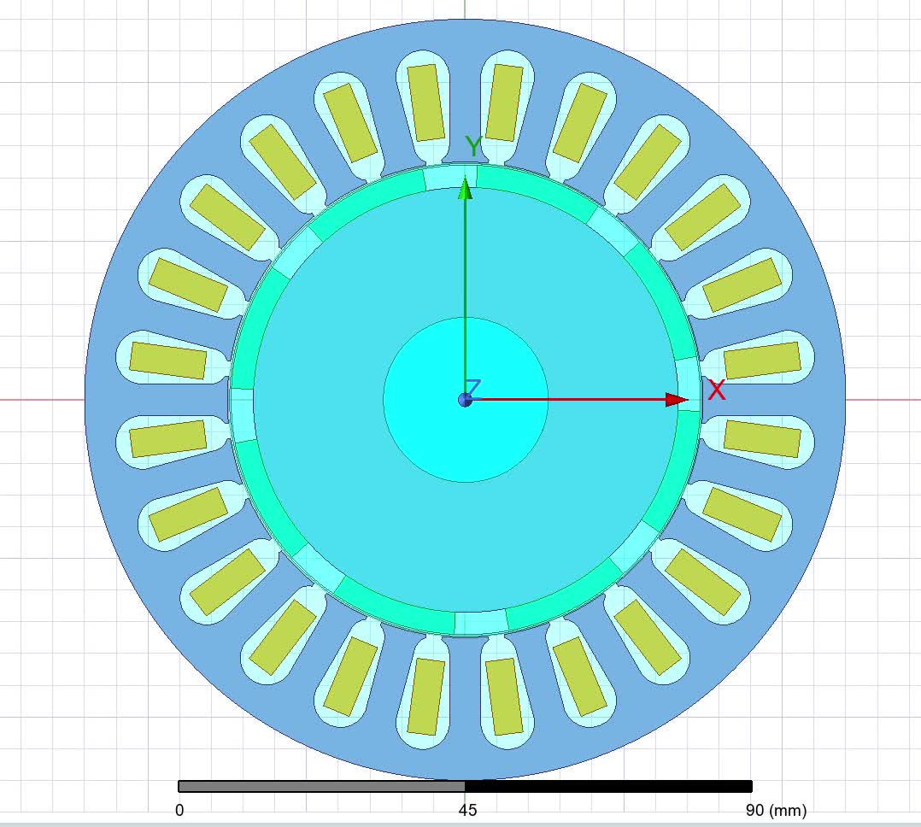
Eccentricity Modelling: RFPMSM
Static eccentricity: rotor shifted, rotates about its own shifted axis
Eccentricity ratio ε = e / g · air gap g = 0.5 mm · example: ε = 20 % → e = 0.1 mm
AI-Based Digital Twin for Eccentricity Diagnosis in Axial and Radial Flux PMSMs
7

Slide 9
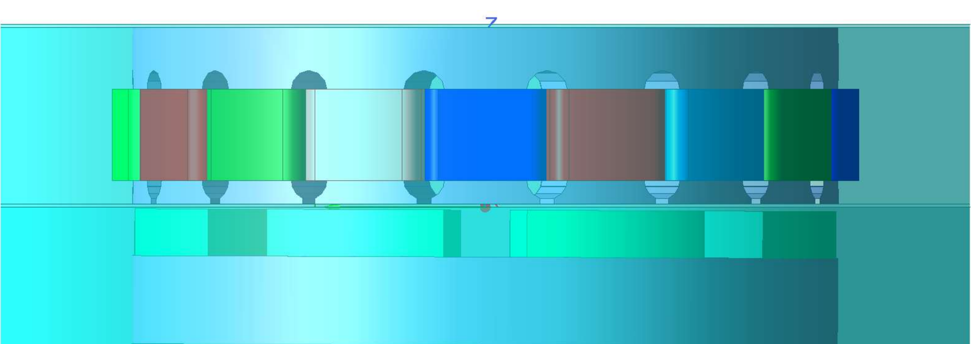
Eccentricity Modelling: AFPMSM
Tilt calculation (20 %)
Air gap g 1 mm
Mean radius 47.5 mm
Displacement 20 % × 1 mm = 0.2 mm
Healthy rotor
β ≈ 0.24°
Fault families used: rotor tilt and rotor X-displacement.
20 % rotor tilt
AI-Based Digital Twin for Eccentricity Diagnosis in Axial and Radial Flux PMSMs
8

Slide 10
Datasets
Machine | Training files | Unseen test files
Axial flux PMSM | 5 files: healthy; tilt 10, 30 %; X-disp. 4, 20 % | 2 files: tilt 20 %; X-disp. 10 %
Radial flux PMSM | 11 files: healthy; static and dynamic at 10, 20, 35, 40, 60 % | 5 files: static 15, 25 %; dynamic 15, 25, 50 %
Every test file has a severity level that is not in the training set.
Files: Time and Phase A, B, C currents from the FEM and drive simulation.
Samples: axial, 410 windows from 5 files; radial, one sample per recording (11 samples).
AI-Based Digital Twin for Eccentricity Diagnosis in Axial and Radial Flux PMSMs
9

Slide 11
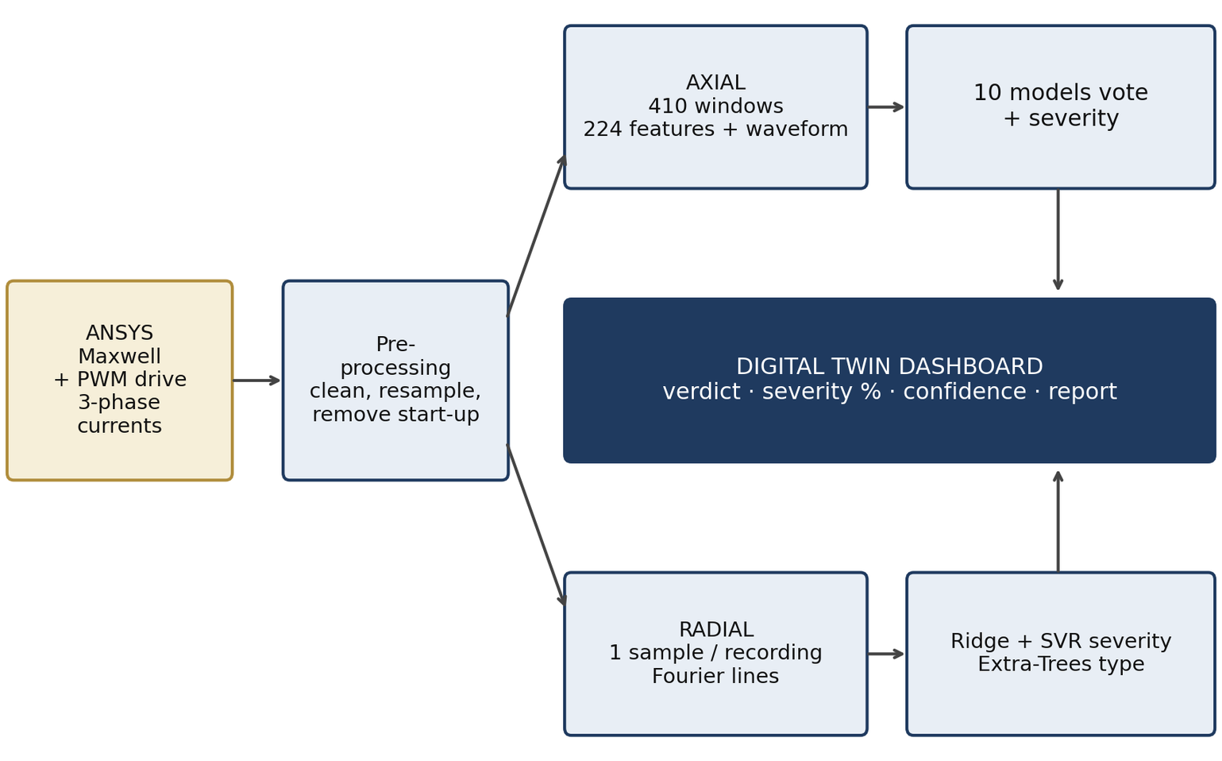
Digital Twin Architecture
1
Browser only. Files never leave the computer.
2
Teach. Upload a train zip once; the twin is kept in the browser.
3
Feed. Drop new files; answer in seconds.
4
Output. Verdict, severity, confidence, report.
AI-Based Digital Twin for Eccentricity Diagnosis in Axial and Radial Flux PMSMs
10

Slide 12
Axial pipeline: Window-Based Ensemble
1
Windows
2
Features
3
Fault class
4
Severity
5
Trust
1024-sample windows, step 128: 410 training windows.
224 per window: time statistics and a 48-band log spectrum, per phase and for A+B+C.
10 models vote: RF, LS-SVM, KNN, BPNN, ELM and 1D-CNN, LSTM, BiLSTM, GRU, CNN-LSTM.
Regressors and deep models; weighted median, weights from hold-out error.
Agreement of models and windows; warning if the data is outside the training range.
A deep model under 70 % training accuracy cannot vote. Training takes about 90 s in the browser.
AI-Based Digital Twin for Eccentricity Diagnosis in Axial and Radial Flux PMSMs
11

Slide 13
Radial Pipeline: One sample per recording
1
Resample
2
Park vector
3
Fourier lines
4
Severity
5
Type and trust
Irregular time axis to a 400 kHz grid, then 20 kHz with an anti-alias filter.
Drop first 20 ms and last 1 ms; lock the supply frequency f0 = 100 Hz.
Fundamental, 5th to 13th harmonics, asymmetry and phases. One recording = one sample.
Ridge and linear SVR averaged, tuned by an inner leave-one-level-out loop.
Extra-Trees decides static or dynamic; 80 % interval; reliable only if p ≤ 0.05.
11 training samples. Training takes about 3 s in the browser.
AI-Based Digital Twin for Eccentricity Diagnosis in Axial and Radial Flux PMSMs
12

Slide 14
How the results are validated
1
Leave-one-level-out
2
Bootstrap
All files of one severity level are held out together; the models are fitted on the rest and asked about them.
95 % intervals on every metric.
3
Permutation test
4
Unseen test files
100 label shuffles: is the result better than chance? A type result is reliable only if p ≤ 0.05 and accuracy beats the majority guess.
Analysed last and reported file by file.
AI-Based Digital Twin for Eccentricity Diagnosis in Axial and Radial Flux PMSMs
13

Slide 15
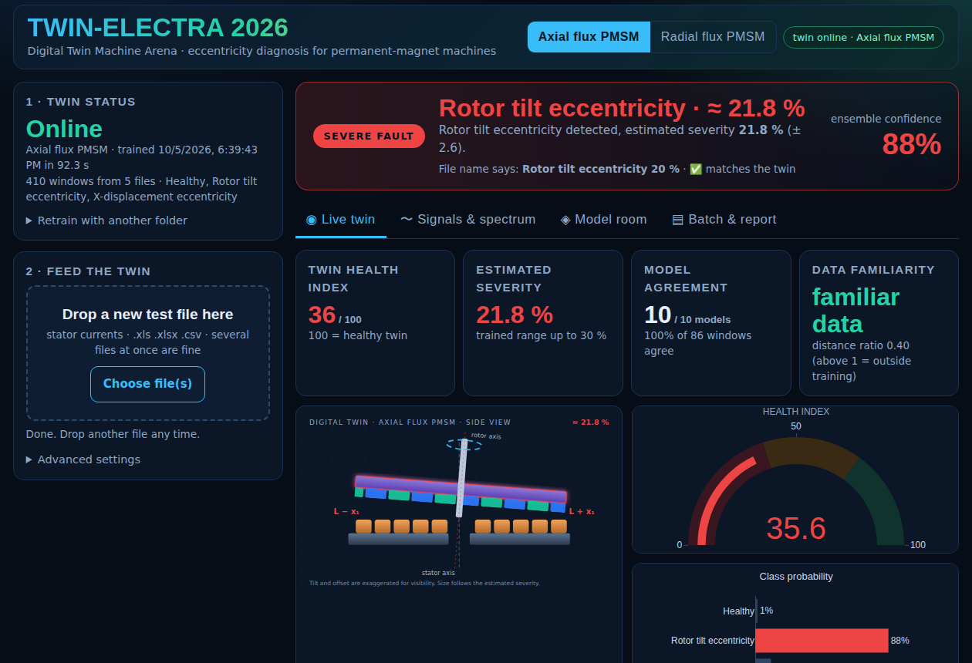
Results: AFPMSM
 | Tilt 20 % | X-disp 10 %
True label | Rotor tilt | X-displacement
Twin verdict | Tilt ✔ | X-displ. ✔
Severity | 21.8 % | 7.1 %
± band | 2.6 | 2.2
Confidence | 88 % | 81 %
Both fault families recognised.
Errors of 1.8 and 2.9 points.
Spread of single models on the 10 % case: 2.6 % to 9.1 %, so the dashboard shows a weighted median with a band.
Dashboard result for the unseen file "tilt 20 %"
AI-Based Digital Twin for Eccentricity Diagnosis in Axial and Radial Flux PMSMs
14

Slide 16
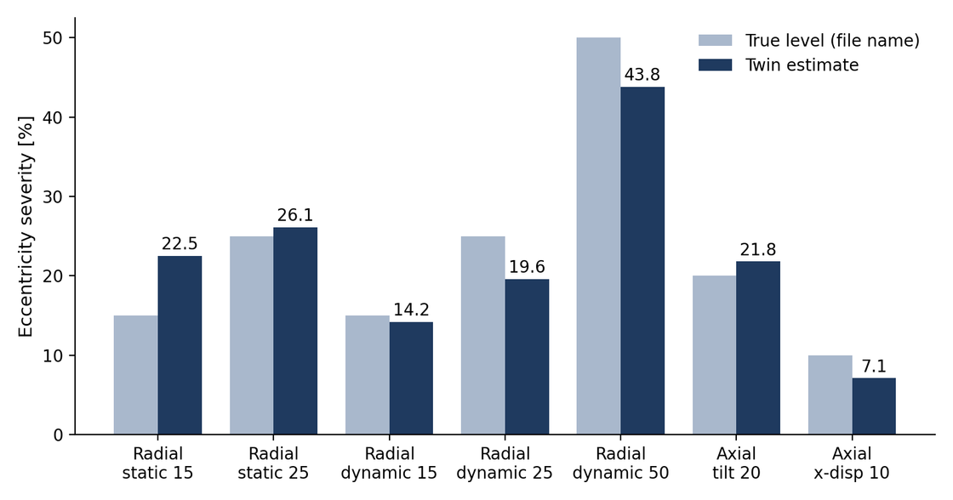
Results: RFPMSM
Test file | Type | Estimate | Error
static 15 | SE ✔ | 22.5 % | +7.5
static 25 | SE ✔ | 26.1 % | +1.1
dynamic 15 | DE ✔ | 14.2 % | −0.8
dynamic 25 | DE ✔ | 19.6 % | −5.4
dynamic 50 | DE ✔ | 43.8 % | −6.2
True level vs twin estimate, all seven unseen files
4.2 pts
5 of 5
3.7 pts
mean severity error, 5 radial files
fault type correct
mean error, all 7 unseen files
AI-Based Digital Twin for Eccentricity Diagnosis in Axial and Radial Flux PMSMs
15

Slide 17
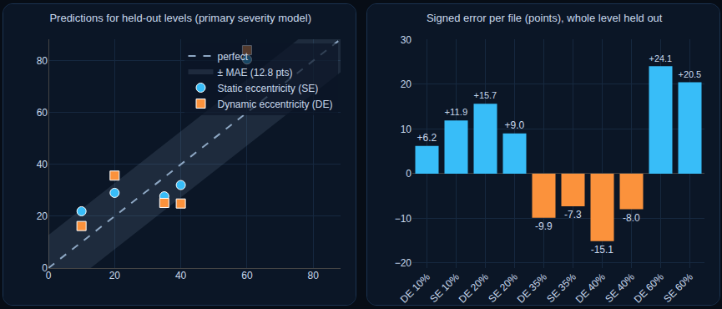
How far can the radial twin be trusted?
Check | Result | Meaning
Severity error, all levels | 12.8 pts vs 18.3 for the mean guess | 30 % better (p = 0.05)
Severity error, interior levels | 10.8 pts | Lowest and highest levels are extrapolated
SE vs DE accuracy | 50 % (majority guess 50 %), p = 0.55 | Not proven with 10 faulty files
→ The dashboard labels the SE/DE answer "tentative" and shows an 80 % interval for severity.
→ Eccentricity leaves only a tiny trace in the simulated current, so type is hard to prove from 10 faulty files.
AI-Based Digital Twin for Eccentricity Diagnosis in Axial and Radial Flux PMSMs
16

Slide 18
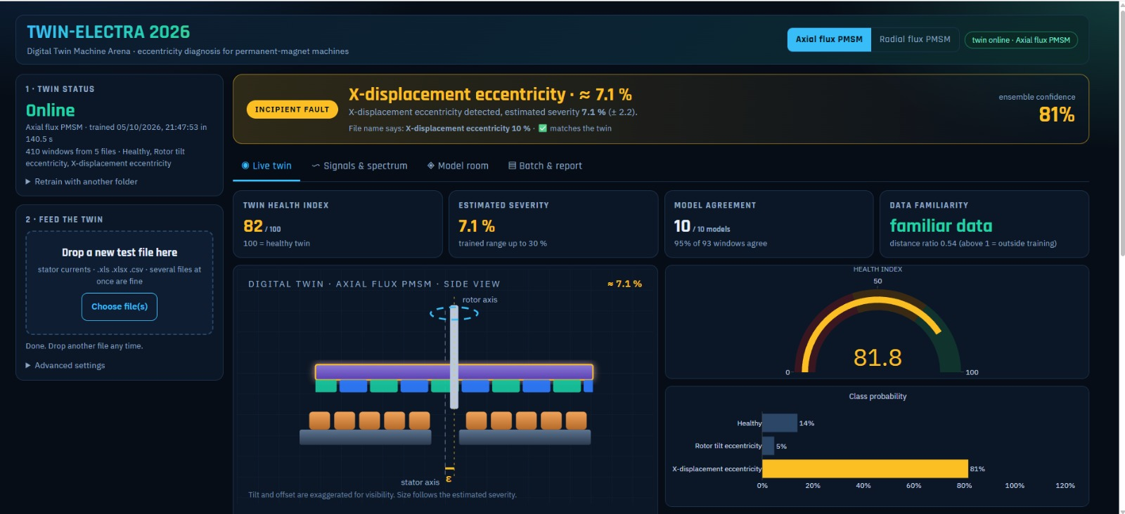
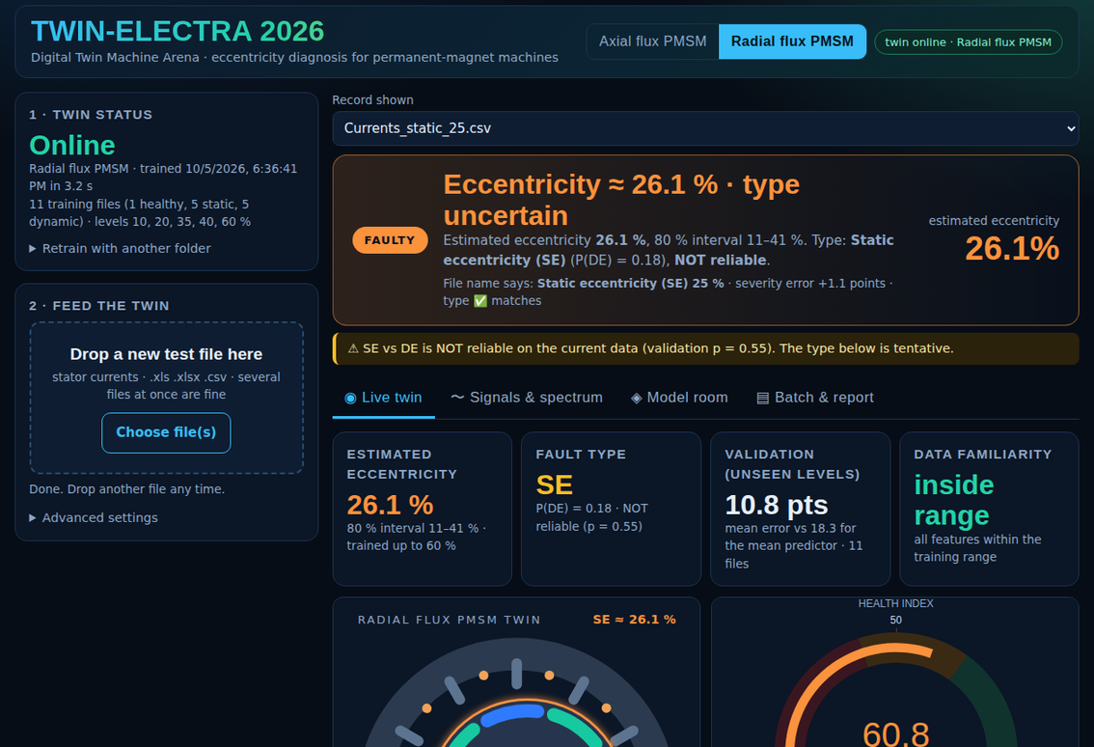
The Digital Twin in use
Axial: x axis 10% → 7.1% Predicted
Radial: static 25 % → 26.1 % Predicted
Animated machine · health index · class probabilities · per-model votes · model room · batch report
AI-Based Digital Twin for Eccentricity Diagnosis in Axial and Radial Flux PMSMs
17

Slide 19
Assumptions and Limitations
Assumptions
Limitations
Simulated data. Currents come from the FEM and PWM-drive model; file-name labels are correct.
One operating point. 1500 rpm, 100 Hz, one load.
Pure faults only. Static or dynamic (radial); tilt or X-displacement (axial).
One recording = one sample (radial), because the simulated cycles repeat.
Small training sets. 5 axial and 11 radial files.
Radial SE vs DE not proven. Validation p = 0.55, so the type is tentative.
Extrapolation. Severity outside the training range is only an estimate.
Axial ± band is model spread, not a statistical interval.
No measured data yet. Simulation only; mixed eccentricity is not covered.
AI-Based Digital Twin for Eccentricity Diagnosis in Axial and Radial Flux PMSMs
18

Slide 20
Conclusion
1
One twin, two machines. A browser-based digital twin diagnoses eccentricity in axial and radial flux PMSMs from the stator current alone.
2
Axial flux: both unseen files classified correctly; severity errors of 1.8 and 2.9 points.
3
Radial flux: severity error 4.2 points on five unseen files; type correct on 5 of 5, but not statistically proven (p = 0.55).
4
Overall: 3.7 points mean severity error on seven unseen files.
The twin tells how severe an eccentricity fault is from the current alone, and how far each answer can be trusted.
AI-Based Digital Twin for Eccentricity Diagnosis in Axial and Radial Flux PMSMs
19

Slide 21
References
[3] W. Deng et al., Eccentricity impact on electromagnetic forces in internal- and external-rotor PMSMs, IEEE Trans. Transport. Electrific., 2022.
[9] S. R. Mortezaei et al., Eccentricity fault detection in surface-mounted PMSMs, J. Magn. Magn. Mater., 2024.
[13] L. Yusuf et al., Eccentricity classification and severity estimation using deep learning, IEEE Trans. Ind. Appl., 2025.
[15] K. S. K. Chu et al., Eccentricity fault diagnosis in three-phase PMSM based on deep learning, Sensors, 2025.
[16] J. Xu et al., Fault diagnosis of PMSM based on CNN-LSTM-Attention, 2025.
[18] L. Jia and M. Lin, Asymmetric rotor eccentricities in double-rotor single-stator axial-flux PM machines, IEEE Trans. Transport. Electrific., 2025.
[30] K. Kumar et al., PMSM fault detection using current harmonics and k-means clustering, IEEE JESTIE, 2026.
[33] P. Zheng et al., Review of fault diagnosis and fault-tolerant control for PMSM, CES Trans. Electr. Mach. Syst., 2025.
AI-Based Digital Twin for Eccentricity Diagnosis in Axial and Radial Flux PMSMs
20

Slide 22
Thank
you!

