Slide 1
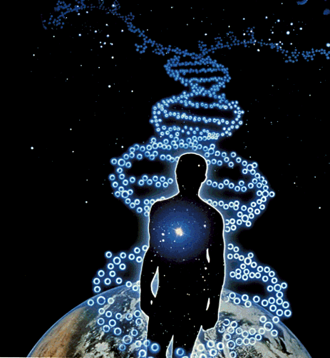


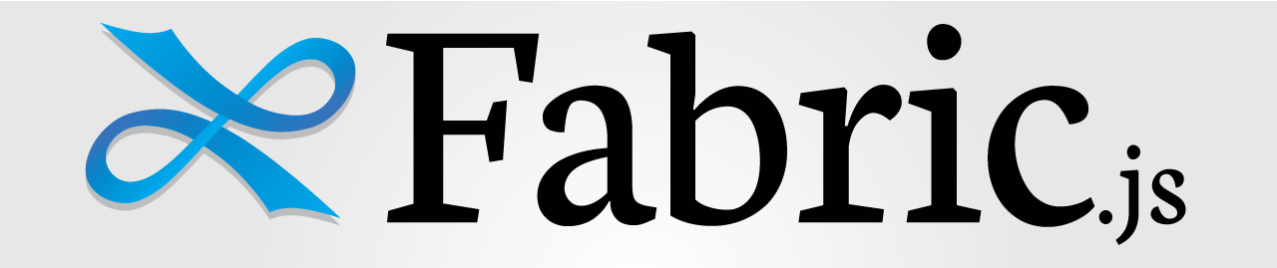
Exploring the Origins of Life
with HTML5 Canvas, Typescript & FabricJS
http://harindaka.github.io/GameOfLife/

Slide 2
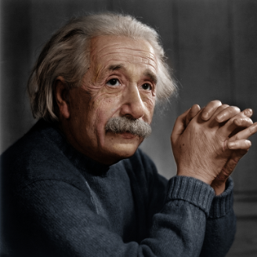
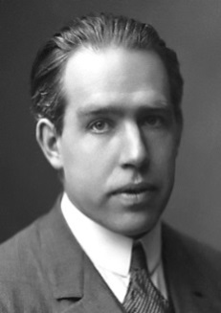
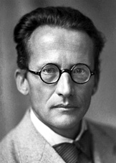
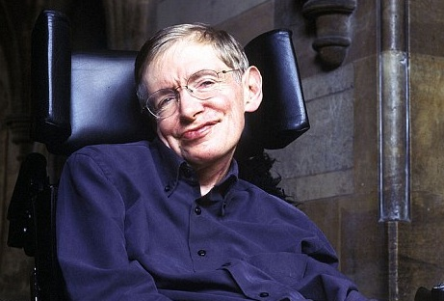
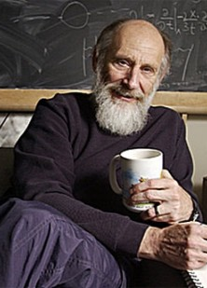

A Theoretical Physics Primer
The Big Bang
Holographic Universe
Multiverse
Quantum Physics
General Relativity
String Theory
Digital Physics

Slide 3
Physics & Mobility
Global Positioning System (GPS)
Without applying General / Special Relativity, your GPS accuracy would be off by around 11kms.
Clocks on satellites are set to tick slower (5 parts in 10 to the tenth) than their counterparts on earth
http://www.wolframalpha.com/input/?i=5+parts+in+10+to+the+tenth+
Neutrino-based communication
A Neutrino can pass through almost everything and interacts with virtually nothing
i.e. a neutrino could easily pass through 1000 light-years of lead.
Possible to communicate between any two points on Earth without using satellites or cables
First communication done by researchers from the University of Rochester and North Carolina State University in 2012

Slide 4
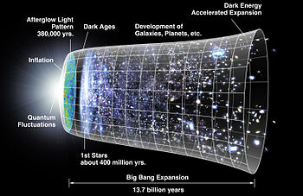
The Universe
Holographic Universe
(Projection)
Digital Physics
(Simulation)
“Mathematics - How we prove what we can’t comprehend”

Slide 5


A Game of Life (Flash Version)
http://www.emergentuniverse.org/#/life

Slide 6
A Game of Life
Created by British Mathematician John Horton Conway in 1970
Attempts to prove that complex patterns can emerge from the implementation of very simple rules.
A zero-player game - evolution is determined by its initial state, requiring no further input
One interacts by creating an initial configuration and observing how it evolves
Implies "design" and "organization" can spontaneously emerge in the absence of a designer.

Slide 7




Random… or is it?
Block |  | Blinker |  | Glider
Beehive |  | Toad |  | Spaceship
Loaf |  | Beacon
Boat |  | Pulsar

Slide 8
The Rules
Played on a grid of square cells (can extend infinitely in every direction)
A cell can be live or dead (indicated by a color)
Each cell in has a neighborhood consisting of the eight cells in every direction
A dead cell with exactly three live neighbors becomes a live cell (birth).
A live cell with two or three live neighbors stays alive (survival).
In all other cases, a cell dies or remains dead (overcrowding or loneliness).
The number of live neighbors is always based on the cells before the rule was applied.

Slide 9
Developing a HTML5 Canvas Version

Slide 10
FabricJS
Powerful yet simple Javascript HTML5 canvas library
Provides an interactive object model on top of the canvas element (dragging, resizing, selecting)
Allows creation and population of objects on canvas
Geometrical shapes
Images
Text
Animation Support
Extensive event system
Freestyle drawing
Flipping, Scaling and many other inbuilt features…
Try it @ http://fabricjs.com

Slide 11
Best Random Internet Comment Ever!
<QUOTE>
"Absolutely, its what separates professional quality languages from the 'happy time' languages such as JavaScript (from the likes of Java, C++, C# etc.) JavaScript was great for its original simple usage to help web page buttons etc., but its now being used for very large and complex applications where its original benefits are now its greatest weakness! its like going back to the stone age......without a chisel!”
<UNQUOTE>

Slide 12
Typescript
Created by Microsoft.
Adds features to ECMAScript 5.
A typed superset of JavaScript that compiles to plain JavaScript
Open source from the start, using the Apache License
Extensive type inference, hence retains lot of the dynamism of Javascript, while benefiting from type checking.
Classes, interfaces, visibility are first class citizens.
Nice syntactic sugar reduces boilerplate code to explicit constructs (class definitions for example).
TypeScript is distributed as a Node.JS package, and it can be trivially installed on Linux and MacOS.
The adoption can be done entirely server-side, or at compile time, and requires no changes to existing browsers or runtimes to run the resulting code.
Try it @ http://www.typescriptlang.org/Playground/

Slide 13
Typescript
Type annotations and compile-time type checking
Type inference
Classes
Interfaces
Enumerated type
Generics
Modules
Arrow / Lambda functions
Optional parameters and default parameters
Tuple
Support for third party JS libs via Definitely Typed files (*.d.ts).
http://definitelytyped.org/

Slide 14
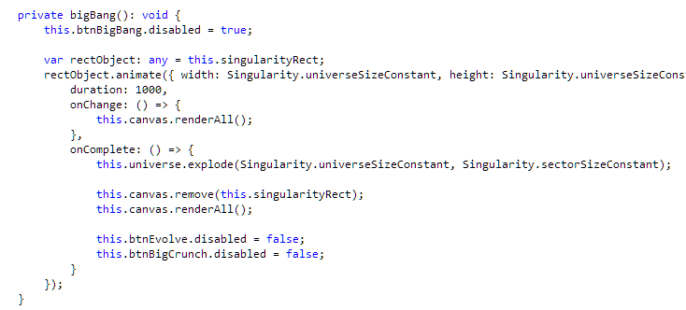
The Code: Hands On
http://harindaka.github.io/GameOfLife/

Slide 15

Honorable Mentions
CoffeeScript
http://coffeescript.org
Compiles into JavaScript
Similar to TypeScript, different syntax.
AtScript
https://docs.google.com/document/d/11YUzC-1d0V1-Q3V0fQ7KSit97HnZoKVygDxpWzEYW0U/edit#
Announced in October 2014
Created by Google’s AngularJS team to be used by AngularJS v2.0
Targets ECMA 6
Superset of TypeScript with types, annotations and introspection
KineticJS
http://kineticjs.com
EaselJS
http://www.createjs.com/EaselJS
PaperJS
http://paperjs.org
bHiveJS
http://www.bhivecanvas.com

Slide 16
