Slide 1
Project Presentation of COOP-II
On
AI-Powered Mental Health Analysis Using Speech and Text
Harinder Singh Dhanoa (2210990361)
Thirza Behal (2210990912)
Alisha Bilandi (2210991241)
Romani Gupta (2210992181)
Supervised By
Dr. Anshu Singla
Department of Computer Science and Engineering,
Chitkara University, Punjab

Slide 2

Introduction
Mental health issues are rapidly increasing in today’s fast-paced world, especially among students and working professionals. However, early detection remains a challenge due to lack of awareness and hesitation in seeking help.
AI can play a key role by enabling fast and accessible emotion analysis.
2

Slide 3

Problem Statement
Emotional state is difficult to identify manually
People often hesitate to express their feelings
Existing systems mainly focus on text-based analysis only
No integrated solution for speech + text emotion detection
Lack of real-time and scalable systems
There is a need for a system that can accurately detect human emotions
from both speech and text in real time.

Slide 4
Research Gap
Current research lacks comprehensive systems that combine multimodal inputs and real-time processing.
Most models focus only on text-based emotion detection
Speech-based emotion analysis is often ignored
Lack of real-time and interactive systems
Limited focus on user-friendly applications
Inefficient models with higher computational cost

Slide 5
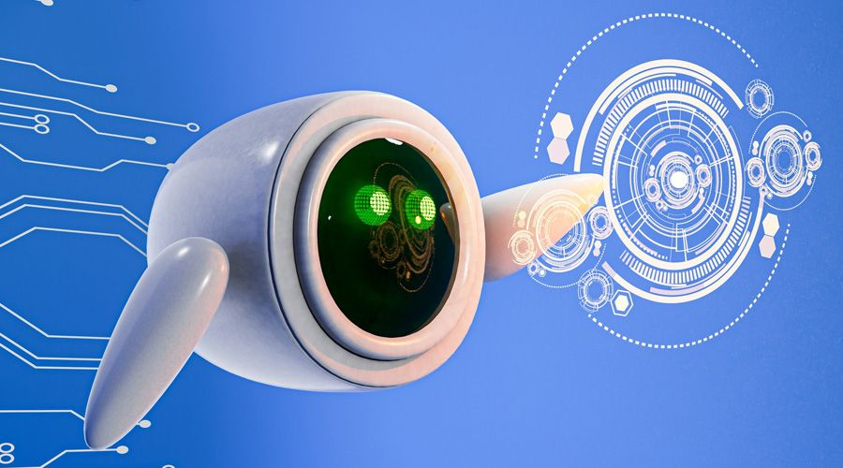
Objective
The primary objective of this system is to develop an AI-based solution that can accurately detect human emotions. It aims to provide real-time analysis using both speech and text inputs.
Develop an AI-based emotion detection system
Analyze both:
Text input
Speech input (converted into text)
Provide real-time results
Offer basic mental well-being suggestions

Slide 6
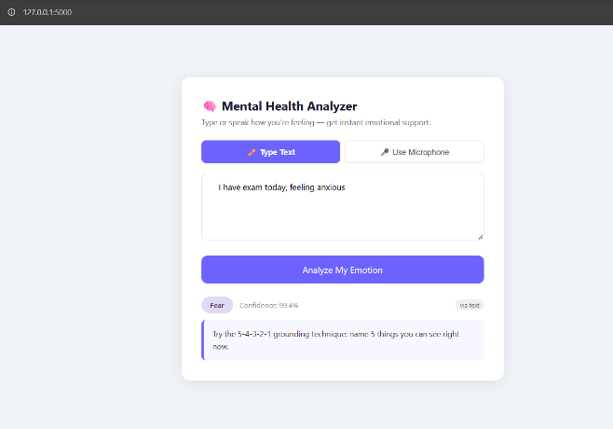
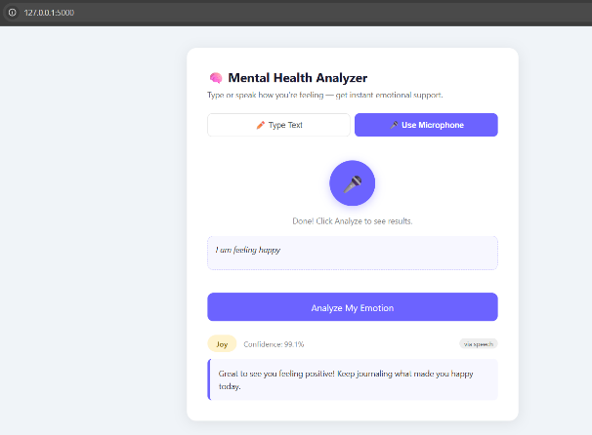
Proposed Solution
The proposed system uses Artificial Intelligence to analyze user emotions from both speech and text inputs.
It processes the input in real time and provides meaningful emotional insights along with suggestions.

Slide 7
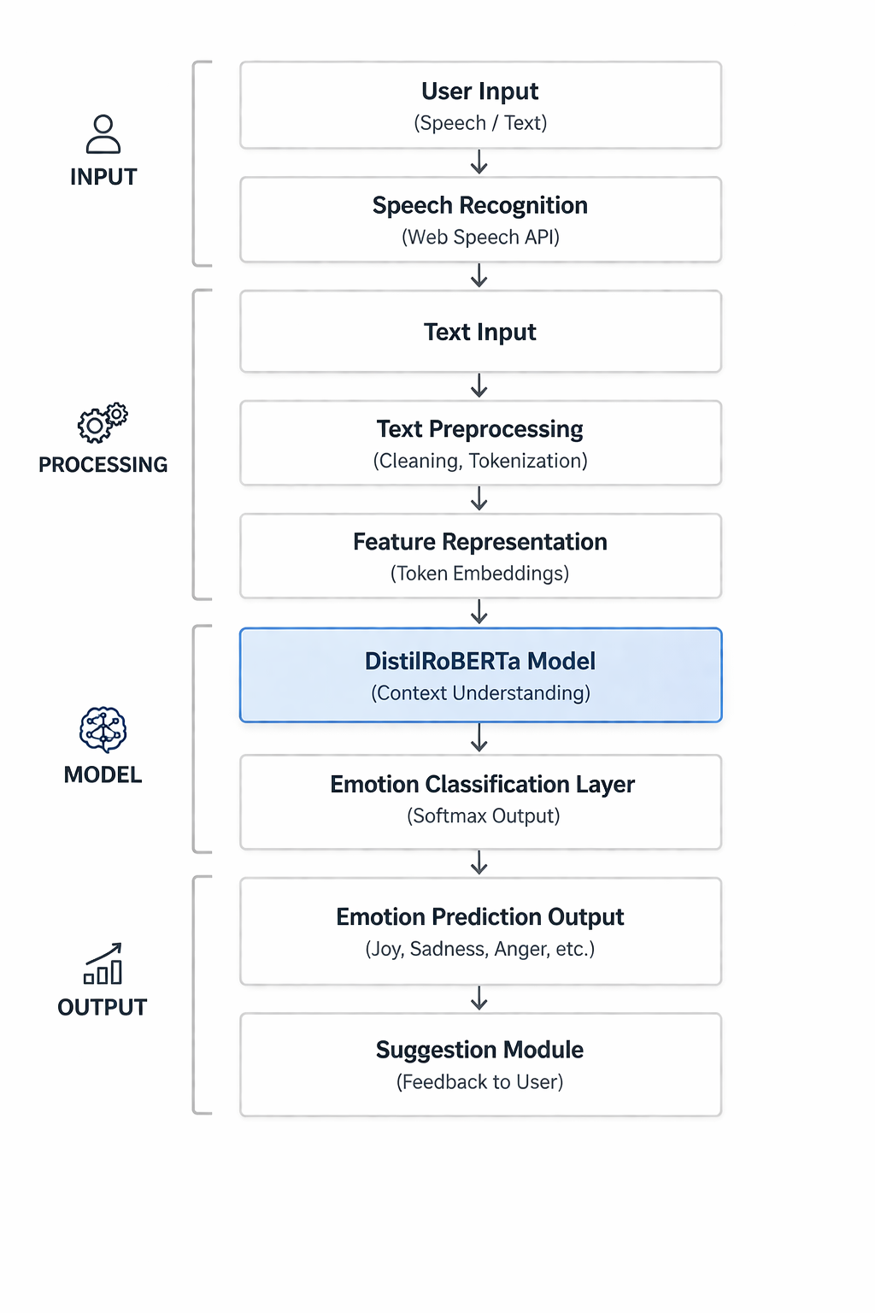
Workflow of the Proposed System
The system processes user input through multiple stages, converting speech to text and analyzing it using an AI model. Each step ensures accurate emotion detection and meaningful output generation.
Accepts input as speech or text
Converts speech into text using Web Speech API
Preprocesses text for analysis
Uses Fine-Tuned DistilRoBERTa Model for emotion detection
Displays detected emotion with suggestions
Multi-stage pipeline ensures accurate and real-time emotion detection
7

Slide 8
Methodology
The system follows a structured machine learning pipeline to ensure accurate predictions.
Data preprocessing (cleaning and normalization)
Tokenization of input text
Conversion into embeddings
Fine-tuning of DistilRoBERTa model
Prediction using trained model

Slide 9

Model
DistilRoBERTa is a transformer-based model used for efficient and accurate emotion classification.
Lightweight version of RoBERTa
Faster training and inference
Captures contextual meaning of text
Pretrained and fine-tuned on emotion dataset
Provides high accuracy with lower computational cost

Slide 10

Dataset
The model is evaluated using two publicly available datasets for emotion classification tasks.
Contains multiple emotion categories
Includes labelled text samples
Balanced dataset for training accuracy
Widely used in NLP-based emotion detection
DAIR-AI Emotion Dataset — English-language annotated tweets across 6 emotion classes
GoEmotions Dataset— used as an additional test set to evaluate cross-dataset generalization

Slide 11
Baseline Models
The proposed model is evaluated against traditional and advanced baseline models.
Naive Bayes (TF-IDF based)
Support Vector Machine (SVM)
BERT (baseline transformer model)
Comparison helps validate model performance

Slide 12
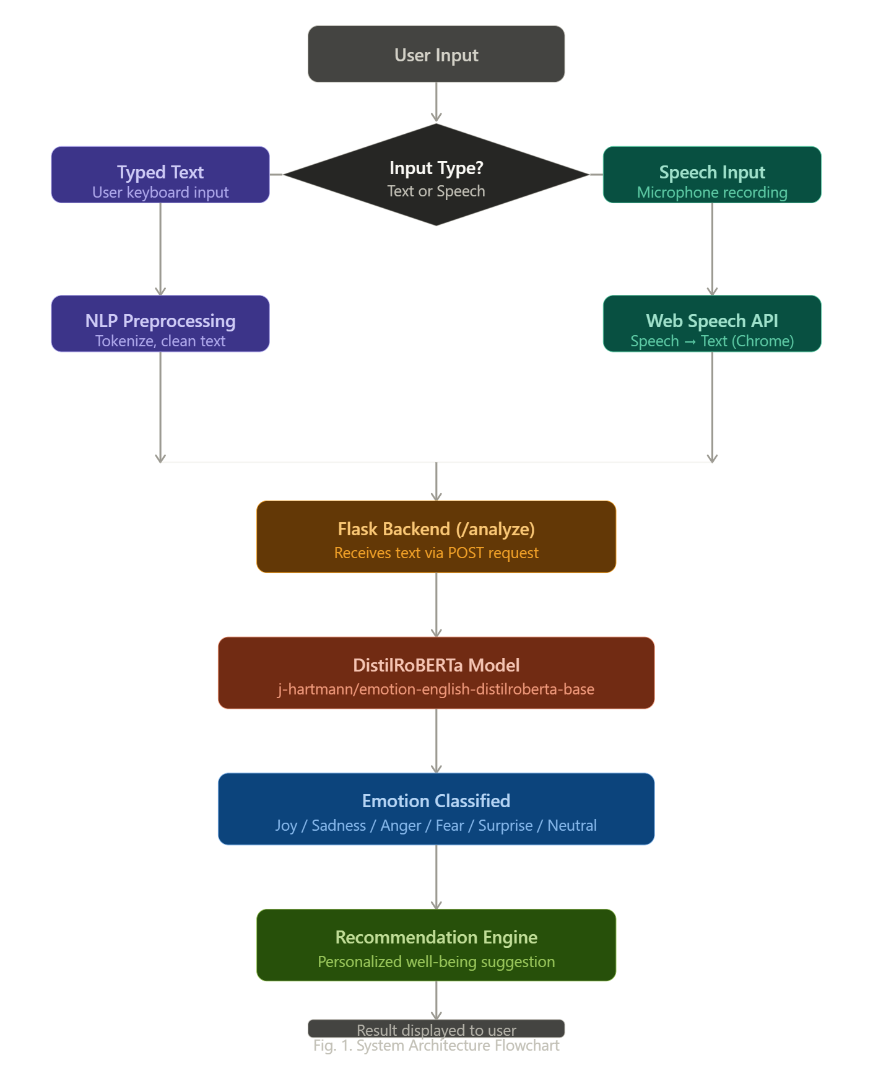
System Architecture

Slide 13
Results — Our System
Tables I and II present the evaluation results of our system on the full DAIR-AI Emotion test split
Metric | Score
Accuracy | 89.85%
Precision (weighted) | 90.78%
Recall (weighted) | 89.85%
F1-Score (weighted) | 0.9016
Test Samples | 2,000
Dataset | DAIR-AI Emotion (full test split)
TABLE I. Overall Evaluation Results
Emotion | Precision | Recall | F1-Score | Support
Joy | 0.98 | 0.90 | 0.94 | 854
Sadness | 0.90 | 0.91 | 0.91 | 581
Anger | 0.83 | 0.91 | 0.87 | 275
Fear | 0.85 | 0.87 | 0.86 | 224
Surprise | 0.59 | 0.80 | 0.68 | 66
Disgust | 0.00 | 0.00 | 0.00 | 0
Neutral | 0.00 | 0.00 | 0.00 | 0
TABLE II. Per-Emotion Classification Results

Slide 14
Baseline Comparison on DAIR-AI Emotion Test Set
Model | Accuracy | Precision | Recall | F1-Score
SVM + TF-IDF | 73.81% | 72.82% | 73.81% | 0.7215
BERT-base Emotion ‡ | 63.43% | 63.80% | 63.43% | 0.6250
Proposed: DistilRoBERTa (fine-tuned) | 82.03% | 81.51% | 82.03% | 0.8170
TABLE III. Cross-Dataset Evaluation on GoEmotions Test Set.

Slide 15

Key Features & Applications
The system provides real-time emotion detection with an intuitive interface, making it accessible for various real-world applications. It combines efficiency, accuracy, and usability in a single solution.
Key Features
Real-time emotion detection
Supports both speech and text input
High accuracy and reliability
Simple and user-friendly interface
Applications
Mental health monitoring systems
AI-based chatbots and virtual assistants
Educational support systems
Workplace well-being tools
Therapy assistance platforms

Slide 16

Conclusion
The proposed system demonstrates how AI can assist in early detection of emotional states. By combining speech and text analysis, it improves accuracy and usability. This approach can contribute to accessible and scalable mental health support solutions.
Future Scope :
Multilingual emotion detection
Voice tone analysis
Mobile application development
Integration with healthcare platforms

Slide 17
Thank You

