Slide 1
Django Basics
Django is a Python-based web framework which allows you to quickly create web
application without all of the installation or dependency problems that you normally
will find with other frameworks.
When you’re building a website, you always need a similar set of components: a way to
handle user authentication (signing up, signing in, signing out), a management panel for
your website, forms, a way to upload files, etc. Django gives you ready-made
components to use.
Why Django?
Django is a rapid web development framework that can be used to develop fully fleshed web applications in a short period of time.
It’s very easy to switch database in Django framework.
It has built-in admin interface which makes easy to work with it.
Django is fully functional framework that requires nothing else.
It has thousands of additional packages available.
It is very scalable.

Slide 2
Django architecture
Django is based on MVT (Model-View-Template) architecture. MVT is a software design pattern for developing a web application.
MVT Structure has the following three parts –
Model: Model is going to act as the interface of your data. It is responsible for maintaining data. It is the logical data structure behind the entire application and is represented by a database (generally relational databases such as MySql, Postgres).
View: The View is the user interface — what you see in your browser when you render a website. It is represented by HTML/CSS/Javascript and Jinja files.
Template: A template consists of static parts of the desired HTML output as well as some special syntax describing how dynamic content will be inserted.

Slide 3
Popularity of Django
Django is used in many popular sites like as: Disqus, Instagram, Knight Foundation, MacArthur Foundation, Mozilla, National Geographic etc. There are more than 5k online sites based on the Django framework.
Features of Django
Versatility of Django Django can build almost any type of website. It can also work with any client-side framework and can deliver content in any format such as HTML, JSON, XML etc. Some sites which can be built using Django are wikis, social networks, new sites etc.
Security Since Django framework is made for making web development easy, it has been engineered in such a way that it automatically do the right things to protect the website. For example, In the Django framework instead of putting a password in cookies, the hashed password is stored in it so that it can’t be fetched easily by hackers.
Scalability Django web nodes have no stored state, they scale horizontally – just fire up more of then when you need them. Being able to do this is the essence of good scalability

Slide 4
Portability All the codes of the Django framework are written in Python, which runs on many platforms. Which leads to run Django too in many platforms such as Linux, Windows and Mac OS.
MVC Pattern
When talking about applications that provides UI (web or desktop), we usually talk about MVC architecture. And as the name suggests, MVC pattern is based on three components: Model, View, and Controller.
DJANGO MVC - MVT Pattern
The Model-View-Template (MVT) is slightly different from MVC. In fact the main difference between the two patterns is that Django itself takes care of the Controller part (Software Code that controls the interactions between the Model and View), leaving us with the template. The template is a HTML file mixed with Django Template Language (DTL).
The following diagram illustrates how each of the components of the MVT pattern interacts with each other to serve a user request −

Slide 5
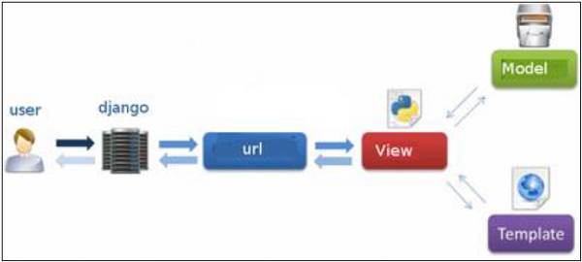
The developer provides the Model, the view and the template then just maps it to a URL and Django does the magic to serve it to the user.
Django - Creating a Project
Whether you are on Windows or Linux, just get a terminal or a cmd prompt
and navigate to the place you want your project to be created, then use this
code −
$ django-admin startproject myproject

Slide 6
This will create a "myproject" folder with the following structure −
myproject/
manage.py
myproject/
__init__.py
settings.py
urls.py
wsgi.py
The Project Structure
The “myproject” folder is just your project container, it actually contains two elements −
manage.py − This file is kind of your project local django-admin for interacting with your project via command line (start the development server, sync db...). To get a full list of command accessible via manage.py you can use the code −

Slide 7
$ python manage.py help The “myproject” subfolder − This folder is the actual python package of your project. It contains four files −
__init__.py − Just for python, treat this folder as package.
settings.py − As the name indicates, your project settings.
urls.py − All links of your project and the function to call. A kind of ToC of your project.
wsgi.py − If you need to deploy your project over WSGI.
Setting Up Your Project
Your project is set up in the subfolder myproject/settings.py. Following are some important options you might need to set −
DEBUG = True
This option lets you set if your project is in debug mode or not. Debug mode
lets you get more information about your project's error. Never set it to ‘True’
for a live project. However, this has to be set to ‘True’ if you want the Django
light server to serve static files. Do it only in the development mode.

Slide 8
DATABASES = {
'default': {
'ENGINE': 'django.db.backends.sqlite3',
'NAME': 'database.sql',
'USER': '',
'PASSWORD': '',
'HOST': '',
'PORT': '',
}
}
Database is set in the ‘Database’ dictionary. The example above is for SQLite engine. As stated earlier, Django also supports −
MySQL (django.db.backends.mysql)
PostGreSQL (django.db.backends.postgresql_psycopg2)
Oracle (django.db.backends.oracle) and NoSQL DB
MongoDB (django_mongodb_engine)

Slide 9
Before setting any new engine, make sure you
have the correct db driver installed.
You can also set others options like: TIME_ZONE, LANGUAGE_CODE, TEMPLATE…
Now that your project is created and configured make sure it's working −
python manage.py runserver
You will get something like the following on running the above code −
Performing system checks...
System check identified no issues (0 silenced).
You have 13 unapplied migration(s). Your project may not work properly until you apply the migrations for app(s): admin, auth, contenttypes, sessions.
Run 'python manage.py migrate' to apply them.
June 16, 2020 - 17:50:05
Django version 1.11.29, using settings 'myproject.settings'
Starting development server at http://127.0.0.1:8000/
Quit the server with CTRL-BREAK.
[16/Jun/2020 17:50:27] "GET / HTTP/1.1" 200 1716
Not Found: /favicon.ico
[16/Jun/2020 17:50:27] "GET /favicon.ico HTTP/1.1" 404 1965

Slide 10
Django - Apps Life Cycle
A project is a sum of many applications. Every application has an objective and can be reused into another project, like the contact form on a website can be an application, and can be reused for others. See it as a module of your project.
Create an Application
We assume you are in your project folder. In our main “myproject” folder, the same folder then manage.py −
python manage.py startapp myapp
You just created myapp application and like project, Django create a “myapp” folder with the application structure −
myapp/
__init__.py
admin.py
models.py
tests.py
views.py

Slide 11
Get the Project to Know About Your Application
At this stage we have our "myapp" application, now we need to register it with our Django project "myproject". To do so, update INSTALLED_APPS tuple in the settings.py file of your project (add your app name) −
INSTALLED_APPS = (
'django.contrib.admin',
'django.contrib.auth',
'django.contrib.contenttypes',
'django.contrib.sessions',
'django.contrib.messages',
'django.contrib.staticfiles',
'myapp', )

Slide 12
Django - Admin Interface
Django provides a ready-to-use user interface for administrative activities. We all know how an admin interface is important for a web project. Django automatically generates admin UI based on your project models.
Starting the Admin Interface
The Admin interface depends on the django.countrib module. To have it working you need to make sure some modules are imported in the INSTALLED_APPS and MIDDLEWARE_CLASSES tuples of the myproject/settings.py file.
For INSTALLED_APPS make sure you have −
INSTALLED_APPS = (
'django.contrib.admin',
'django.contrib.auth',
'django.contrib.contenttypes',
'django.contrib.sessions',
'django.contrib.messages',
'django.contrib.staticfiles',
'myapp', )

Slide 13
For MIDDLEWARE_CLASSES −
MIDDLEWARE_CLASSES = ( 'django.contrib.sessions.middleware.SessionMiddleware', 'django.middleware.common.CommonMiddleware', 'django.middleware.csrf.CsrfViewMiddleware', 'django.contrib.auth.middleware.AuthenticationMiddleware', 'django.contrib.messages.middleware.MessageMiddleware', 'django.middleware.clickjacking.XFrameOptionsMiddleware',
)
Before launching your server, to access your Admin Interface, you need to
initiate the database −
$ python manage.py migrate
syncdb will create necessary tables or collections depending on your db type,
necessary for the admin interface to run. Even if you don't have a superuser,
you will be prompted to create one.
If you already have a superuser or have forgotten it, you can always create
one using the following code −

Slide 14
If you already have a superuser or have forgotten it, you
can always create one using the following code −
python manage.py createsuperuser
Now to start the Admin Interface, we need to make sure we have configured a URL for our admin interface. Open the myproject/url.py and you should have something like −
from django.conf.urls import patterns, include, url
from django.contrib import admin
admin.autodiscover()
urlpatterns = patterns('',
# Examples:
# url(r'^$', 'myproject.views.home', name = 'home'),
# url(r'^blog/', include('blog.urls')),
url(r'^admin/', include(admin.site.urls)),
)
Now just run the server.
$ python manage.py runserver

Slide 15
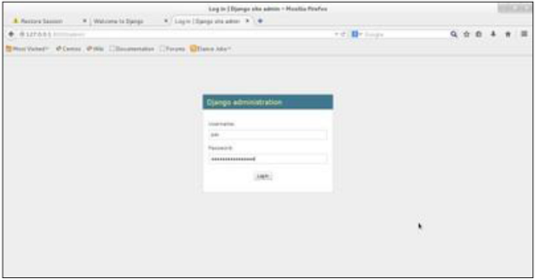
And your admin interface is accessible at: http://127.0.0.1:8000/admin/

Slide 16
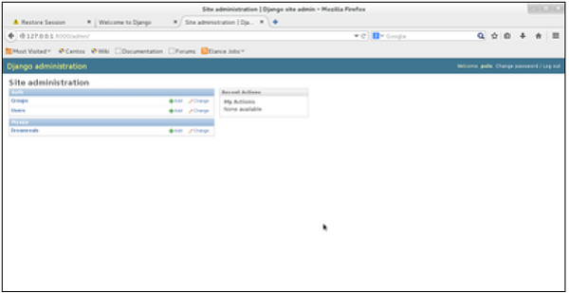
Once connected with your superuser account, you will see the following screen −
That interface will let you administrate Django groups and users, and all registered models in your app. The interface gives you the ability to do at least the "CRUD" (Create, Read, Update, Delete) operations on your models.

Slide 17
Django - Creating Views
A view function, or “view” for short, is simply a Python function that takes a web
request and returns a web response. This response can be the HTML contents of a
Web page, or a redirect, or a 404 error, or an XML document, or an image, etc.
Example: You use view to create web pages, note that you need to associate a view
to a URL to see it as a web page.In Django, views have to be created in the app
views.py file.
Simple View
We will create a simple view in myapp to say "welcome to my app!"
See the following view −
from django.http import HttpResponse
def hello(request):
text = """<h1>welcome to my app !</h1>"""
return HttpResponse(text)

Slide 18
In this view, we use HttpResponse to render the HTML (as you have probably
noticed we have the HTML hard coded in the view). To see this view as a
page we just need to map it to a URL (this will be discussed in an upcoming
chapter).We used HttpResponse to render the HTML in the view before. This is not
the best way to render pages. Django supports the MVT pattern so to make
the precedent view, Django - MVT like, we will need −
A template: myapp/templates/hello.html
And now our view will look like −
from django.shortcuts import render
def hello(request):
return render(request, "myapp/template/hello.html", {})
Views can also accept parameters −
from django.http import HttpResponse
def hello(request, number):
text = "<h1>welcome to my app number %s!</h1>"% number
return HttpResponse(text)

Slide 19
When linked to a URL, the page will display the number passed as a parameter. Note that the parameters will be passed via the URL
Django - URL Mapping
Now that we have a working view as explained in the previous chapters. We want to access that view via a URL. Django has his own way for URL mapping and it's done by editing your project url.py file (myproject/url.py). The url.py file looks like −
from django.conf.urls import patterns,
include, url from django.contrib
import admin
admin.autodiscover()
urlpatterns = patterns(‘ ',
#Examples
#url(r'^$', 'myproject.view.home', name = 'home'),
#url(r'^blog/', include('blog.urls')),
url(r'^admin‘,include(admin.site.urls)),)
When a user makes a request for a page on your web app, Django controller takes over to look for the corresponding view via the url.py file, and then return the HTML response or a 404 not found error, if not found. In url.py, the most important thing is the "urlpatterns" tuple. It’s where you define the mapping between URLs and views. A mapping is a tuple in URL patterns like −

Slide 20
from django.conf.urls import patterns, include, url
from django.contrib import admin
admin.autodiscover()
urlpatterns = patterns(‘ ',
#Examples
#url(r'^$', 'myproject.view.home', name = 'home'),
#url(r'^blog/', include('blog.urls')),
url(r'^admin', include(admin.site.urls)),
url(r'^hello/', 'myapp.views.hello', name = 'hello'), )
The marked line maps the URL "/home" to the hello view created in
myapp/view.py file. As you can see above a mapping is composed of three
elements −
The pattern − A regexp matching the URL you want to be resolved and map. Everything that can work with the python 're' module is eligible for the pattern (useful when you want to pass parameters via url).
The python path to the view − Same as when you are importing a module.
The name − In order to perform URL reversing, you’ll need to use named URL patterns as done in the examples above. Once done, just start the server to access your view via :http://127.0.0.1/hello

Slide 21
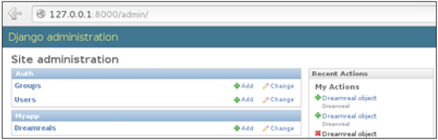
Organizing Your URLs
So far, we have created the URLs in “myprojects/url.py” file, however as stated earlier about Django and creating an app, the best point was to be able to reuse applications in different projects. You can easily see what the problem is, if you are saving all your URLs in the “projecturl.py” file. So best practice is to create an “url.py” per application and to include it in our main projects url.py file (we included admin URLs for admin interface before).

Slide 22
How is it Done?
We need to create an url.py file in myapp using the following code −
from django.conf.urls import patterns, include, url
urlpatterns = patterns('', url(r'^hello/', 'myapp.views.hello', name = 'hello'),)
Then myproject/url.py will change to the following −
from django.conf.urls import patterns, include, url
from django.contrib import admin
admin.autodiscover()
urlpatterns = patterns('',
#Examples
#url(r'^$', 'myproject.view.home', name = 'home'),
#url(r'^blog/', include('blog.urls')),
url(r'^admin', include(admin.site.urls)),
url(r'^myapp/', include('myapp.urls')), )

Slide 23
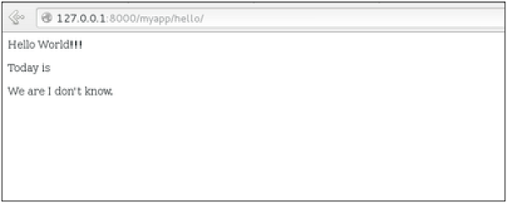
We have included all URLs from myapp application. The home.html that was accessed through “/hello” is now “/myapp/hello” which is a better and more understandable structure for the web app.
Now let's imagine we have another view in myapp “morning” and we want to map it
in myapp/url.py, we will then change our myapp/url.py to −
from django.conf.urls import patterns, include, url
urlpatterns = patterns(‘ ',
url(r'^hello/', 'myapp.views.hello', name = 'hello'),
url(r'^morning/', 'myapp.views.morning', name = 'morning'), )

Slide 24
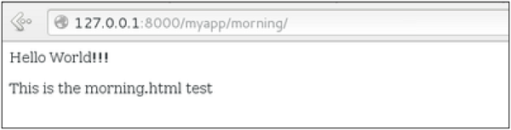
This can be re-factored to −
from django.conf.urls import patterns, include,
url urlpatterns = patterns('myapp.views', url(r'^hello/', 'hello', name = 'hello'), url(r'^morning/', 'morning', name = 'morning'),)
As you can see, we now use the first element of our urlpatterns tuple. This can be useful when you want to change your app name

Slide 25
Sending Parameters to Views
We now know how to map URL, how to organize them, now let us see how to send parameters to views. A classic sample is the article example (you want to access an article via “/articles/article_id”).
Passing parameters is done by capturing them with the regexp in the URL pattern. If we have a view like the following one in “myapp/view.py”
from django.shortcuts import render
from django.http import HttpResponse
def hello(request):
return render(request, "hello.html", {})
def viewArticle(request, articleId):
text = "Displaying article Number : %s"%articleId
return HttpResponse(text)
We want to map it in myapp/url.py so we can access it via “/myapp/article/articleId”, we need the following in “myapp/url.py” −

Slide 26
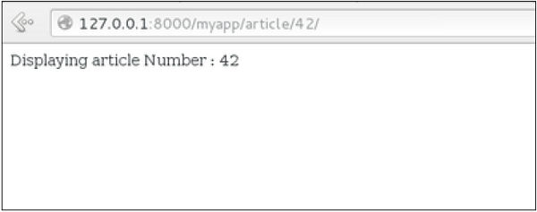
from django.conf.urls import patterns, include, url
urlpatterns = patterns('myapp.views', url(r'^hello/', 'hello', name = 'hello'), url(r'^morning/', 'morning', name = 'morning'), url(r'^article/(\d+)/', 'viewArticle', name = 'article'),)
When Django will see the url: “/myapp/article/42” it will pass the parameters '42' to the viewArticle view, and in your browser you should get the following result −
Note that the order of parameters is important here. Suppose we want the list of articles of a month of a year, let's add a viewArticles view. Our view.py becomes −

Slide 27
from django.shortcuts import render
from django.http import HttpResponse
def hello(request):
return render(request, "hello.html", {})
def viewArticle(request, articleId):
text = "Displaying article Number : %s"%articleId
return HttpResponse(text)
def viewArticle(request, month, year):
text = "Displaying articles of : %s/%s"%(year, month)
return HttpResponse(text)
The corresponding url.py file will look like −
from django.conf.urls import patterns, include, url
urlpatterns = patterns('myapp.views', url(r'^hello/', 'hello', name = 'hello'), url(r'^morning/', 'morning', name = 'morning'), url(r'^article/(\d+)/', 'viewArticle', name = 'article'), url(r'^articles/(\d{2})/(\d{4})', 'viewArticles', name = 'articles'),)

Slide 28
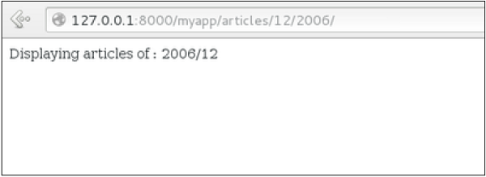
Now when you go to “/myapp/articles/12/2006/” you will get 'Displaying articles of: 2006/12' but if you reverse the parameters you won’t get the same result.
To avoid that, it is possible to link a URL parameter to the view parameter. For that,
our url.py will become −
from django.conf.urls import patterns, include, url
urlpatterns = patterns('myapp.views', url(r'^hello/', 'hello', name = 'hello'), url(r'^morning/', 'morning', name = 'morning'), url(r'^article/(\d+)/', 'viewArticle', name = 'article'), url(r'^articles/(?P\d{2})/(?P\d{4})', 'viewArticles', name = 'articles'),)

Slide 29
Django - Template System
Django makes it possible to separate python and HTML, the python goes in views and HTML goes in templates. To link the two, Django relies on the render function and the Django Template language.
The Render Function :
This function takes three parameters −
Request − The initial request.
The path to the template − This is the path relative to the TEMPLATE_DIRS option in the project settings.py variables.
Dictionary of parameters − A dictionary that contains all variables needed in the template. This variable can be created or you can use locals() to pass all local variable declared in the view.
Django Template Language (DTL) :
Django’s template engine offers a mini-language to define the user-facing layer of the application.

Slide 30
Displaying Variables
A variable looks like this: {{variable}}. The template replaces the variable by the variable sent by the view in the third parameter of the render function. Let's change our hello.html to display today’s date −
hello.html
<html>
<body> Hello World!!!<p>Today is {{today}}</p> </body>
</html>
Then our view will change to −
def hello(request):
today = datetime.datetime.now().date()
return render(request, "hello.html", {"today" : today})
We will now get the following output after accessing the URL/myapp/hello −
Hello World!!! Today is Sept. 11, 2015 As you have probably noticed, if the
variable is not a string, Django will use the __str__ method to display it; and with
the same principle you can access an object attribute just like you do it in Python.
For example: if we wanted to display the date year, my variable would be:
{{today.year}}.

Slide 31
Filters
They help you modify variables at display time. Filters structure looks like the following: {{var|filters}}.
Some examples −
{{string|truncatewords:80}} − This filter will truncate the string, so you will see only the first 80 words.
{{string|lower}} − Converts the string to lowercase.
{{string|escape|linebreaks}} − Escapes string contents, then converts line breaks to tags.
You can also set the default for a variable.
Tags
Tags lets you perform the following operations: if condition, for loop, template inheritance and more.
Tag if
Just like in Python you can use if, else and elif in your template −

Slide 32
<html>
<body>
Hello World!!!<p>Today is {{today}}</p>
We are
{% if today.day == 1 %}
the first day of month.
{% elif today.day == 30 %}
the last day of month.
{% else %}
I don't know.
{%endif%}
</body>
</html>
In this new template, depending on the date of the day, the template will render a certain value.
Tag for
Just like 'if', we have the 'for' tag, that works exactly like in Python. Let's change our hello view to transmit a list to our template −

Slide 33
def hello(request):
today = datetime.datetime.now().date()
daysOfWeek = ['Mon', 'Tue', 'Wed', 'Thu', 'Fri', 'Sat', 'Sun']
return render(request, "hello.html", {"today" : today, "days_of_week" : daysOfWeek})
The template to display that list using {{ for }} −
<html>
<body> Hello World!!!<p>Today is {{today}}</p>
We are
{% if today.day == 1 %}
the first day of month.
{% elif today.day == 30 %}
the last day of month.
{% else %}
I don't know.
{%endif%}
<p>
{% for day in days_of_week %} {{day}}
</p>
{% endfor %}
</body>
</html>

Slide 34
And we should get something like −
Hello World!!!
Today is Sept. 11, 2015
We are I don't know.
Mon
Tue
Wed
Thu
Fri
Sat
Sun
Block and Extend Tags
A template system cannot be complete without template inheritance. Meaning when you are designing your templates, you should have a main template with holes that the child's template will fill according to his own need, like a page might need a special css for the selected tab.
Let’s change the hello.html template to inherit from a main_template.html.

Slide 35
Let’s change the hello.html template to inherit from a main_template.html.
main_template.html
<html>
<head>
<title>
{% block title %}Page Title{% endblock %}
</title>
</head>
<body>
{% block content %} Body content {% endblock %}
</body>
</html>
hello.html
{% extends "main_template.html" %}
{% block title %}My Hello Page{% endblock %}
{% block content %}

Slide 36
Hello World!!!<p>Today is {{today}}</p>
We are
{% if today.day == 1 %}
the first day of month.
{% elif today.day == 30 %}
the last day of month.
{% else %}
I don't know.
{%endif%}
<p>
{% for day in days_of_week %} {{day}}
</p>
{% endfor %}
{% endblock %}

Slide 37
In the above example, on calling /myapp/hello we will still get the same result as before but now we rely on extends and block to refactor our code −
In the main_template.html we define blocks using the tag block. The title block will contain the page title and the content block will have the page main content. In home.html we use extends to inherit from the main_template.html then we fill the block define above (content and title).
Comment Tag
The comment tag helps to define comments into templates, not HTML comments, they won’t appear in HTML page. It can be useful for documentation or just commenting a line of code
Django - Models
A model is a class that represents table or collection in our DB, and where every attribute of the class is a field of the table or collection. Models are defined in the app/models.py (in our example: myapp/models.py)
Creating a Model
Following is a Dreamreal model created as an example −

Slide 38
from django.db import models
class Dreamreal(models.Model):
website = models.CharField(max_length = 50)
mail = models.CharField(max_length = 50)
name = models.CharField(max_length = 50)
phonenumber = models.IntegerField()
class Meta:
db_table = "dreamreal“
Every model inherits from django.db.models.Model.
Our class has 4 attributes (3 CharField and 1 Integer), those will be the table fields.
The Meta class with the db_table attribute lets us define the actual table or collection name. Django names the table or collection automatically: myapp_modelName. This class will let you force the name of the table to what you like.

Slide 39
After creating your model, you will need Django to generate the actual database −
$python manage.py syncdb Manipulating Data (CRUD)
Let's create a "crudops" view to see how we can do CRUD operations on models. Our myapp/views.py will then look like −
myapp/views.py
from myapp.models import Dreamreal
from django.http import HttpResponse
def crudops(request): #Creating an entry
dreamreal = Dreamreal( website = "www.polo.com", mail = "sorex@polo.com", name = "sorex", phonenumber = "002376970" )
dreamreal.save() #Read ALL entries
objects = Dreamreal.objects.all()
res ='Printing all Dreamreal entries in the DB : <br>'
for elt in objects:
res += elt.name+"<br>“

Slide 40
#Read a specific entry:
sorex = Dreamreal.objects.get(name = "sorex")
res += 'Printing One entry <br>'
res += sorex.name
#Delete an entry
res += '<br> Deleting an entry <br>'
sorex.delete()
#Update
dreamreal = Dreamreal( website = "www.polo.com", mail = "sorex@polo.com", name = "sorex", phonenumber = "002376970"
)
dreamreal.save()
res += 'Updating entry<br>'
dreamreal = Dreamreal.objects.get(name = 'sorex')
dreamreal.name = 'thierry' dreamreal.save()
return HttpResponse(res)

Slide 41
Other Data Manipulation
Let's explore other manipulations we can do on Models. Note that the CRUD operations were done on instances of our model, now we will be working directly with the class representing our model.
Let's create a 'datamanipulation' view in myapp/views.py
from myapp.models import Dreamreal
from django.http import HttpResponse
def datamanipulation(request):
res = ''
#Filtering data:
qs = Dreamreal.objects.filter(name = "paul") res += "Found : %s results<br>"%len(qs)
#Ordering results
qs = Dreamreal.objects.order_by("name")
for elt in qs:
res += elt.name + '<br>'
return HttpResponse(res)

Slide 42
Linking Models
Django ORM offers 3 ways to link models −
One of the first case we will see here is the one-to-many relationships. As you can see in the above example, Dreamreal company can have multiple online websites. Defining that relation is done by using django.db.models.ForeignKey −
myapp/models.py
from django.db import models
class Dreamreal(models.Model):
website = models.CharField(max_length = 50)
mail = models.CharField(max_length = 50)
name = models.CharField(max_length = 50)
phonenumber = models.IntegerField()
online = models.ForeignKey('Online', default = 1)
class Meta:
db_table = "dreamreal"

Slide 43
As you can see in our update dmyapp/models.py, we added the online model and linked it to our Dreamreal model.
Let's check how all of this is working via manage.py shell −
First let’s create some companies (Dreamreal entries) for testing in our Django shell −
$python manage.py shell
>>> from myapp.models import Dreamreal, Online
>>> dr1 = Dreamreal()
>>> dr1.website = 'company1.com‘
>>> dr1.name = 'company1'
>>> dr1.mail = 'contact@company1'
>>> dr1.phonenumber = '12345'
>>> dr1.save()
>>> dr2 = Dreamreal()
>>> dr1.website = 'company2.com'
>>> dr2.website = 'company2.com'
>>> dr2.name = 'company2'
>>> dr2.mail = 'contact@company2'
>>> dr2.phonenumber = '56789'
>>> dr2.save()

Slide 44
Now some hosted domains −
>>> on1 = Online()
>>> on1.company = dr1
>>> on1.domain = "site1.com"
>>> on2 = Online()
>>> on2.company = dr1
>>> on2.domain = "site2.com"
>>> on3 = Online()
>>> on3.domain = "site3.com“
>>> dr2 = Dreamreal.objects.all()[2]
>>> on3.company = dr2
>>> on1.save()
>>> on2.save()
>>> on3.save()

Slide 45
Accessing attribute of the hosting company (Dreamreal entry) from an online
domain is simple −
>>> on1.company.name
And if we want to know all the online domain hosted by a Company in
Dreamreal we will use the code −
>>> dr1.online_set.all()
To get a QuerySet, note that all manipulating method we have seen before (filter, all, exclude, order_by....)
You can also access the linked model attributes for filtering operations, let's say you want to get all online domains where the Dreamreal name contains 'company' −
>>> Online.objects.filter(company__name__contains = 'company'

Slide 46
Django - Page Redirection : Page redirection is needed for many reasons in web application. You might want to redirect a user to another page when a specific action occurs, or basically in case of error. For example, when a user logs in to your website, he is often redirected either to the main home page or to his personal dashboard. In Django, redirection is accomplished using the 'redirect' method.
The 'redirect' method takes as argument: The URL you want to be redirected
to as string A view's name.
The myapp/views looks like the following so far −
def hello(request):
today = datetime.datetime.now().date()
daysOfWeek = ['Mon', 'Tue', 'Wed', 'Thu', 'Fri', 'Sat', 'Sun']
return render(request, "hello.html", {"today" : today, "days_of_week" : daysOfWeek})
def viewArticle(request, articleId):
""" A view that display an article based on his ID"""
text = "Displaying article Number : %s" %articleId
return HttpResponse(text)

Slide 47
def viewArticles(request, year, month):
text = "Displaying articles of : %s/%s"%(year, month)
return HttpResponse(text)
Let's change the hello view to redirect to djangoproject.com and our viewArticle to redirect to our internal '/myapp/articles'. To do so the myapp/view.py will change to −
from django.shortcuts import render, redirect
from django.http import HttpResponse
import datetime
# Create your views here.
def hello(request):
today = datetime.datetime.now().date()
daysOfWeek = ['Mon', 'Tue', 'Wed', 'Thu', 'Fri', 'Sat', 'Sun']
return redirect("https://www.djangoproject.com")
def viewArticle(request, articleId):
""" A view that display an article based on his ID"""
text = "Displaying article Number : %s" %articleId
return redirect(viewArticles, year = "2045", month = "02")

Slide 48
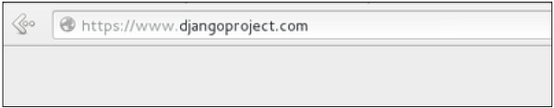
def viewArticles(request, year, month):
text = "Displaying articles of : %s/%s"%(year, month)
return HttpResponse(text)
In the above example, first we imported redirect from django.shortcuts and
for redirection to the Django official website we just pass the full URL to the
'redirect' method as string, and for the second example (the viewArticle view)
the 'redirect' method takes the view name and his parameters as arguments.
Accessing /myapp/hello, will give you the following screen −

Slide 49
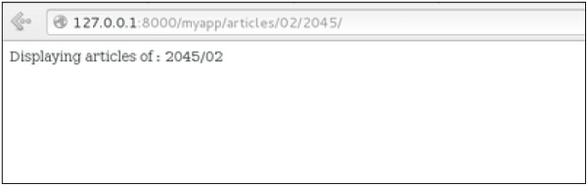
And accessing /myapp/article/42, will give you the following screen −
It is also possible to specify whether the 'redirect' is temporary or permanent by
adding permanent = True parameter. The user will see no difference, but these are
details that search engines take into account when ranking of your website.
Also remember that 'name' parameter we defined in our url.py while mapping the URLs −
url(r'^articles/(?P\d{2})/(?P\d{4})/', 'viewArticles', name = 'articles'),
That name (here article) can be used as argument for the 'redirect' method, then our viewArticle redirection can be changed from −

Slide 50
def viewArticle(request, articleId):
""" A view that display an article based on his ID"""
text = "Displaying article Number : %s" %articleId
return redirect(viewArticles, year = "2045", month = "02")
To −
def viewArticle(request, articleId):
""" A view that display an article based on his ID"""
text = "Displaying article Number : %s" %articleId
return redirect(articles, year = "2045", month = "02")
Note − There is also a function to generate URLs; it is used in the same way as redirect; the 'reverse' method (django.core.urlresolvers.reverse). This function does not return a HttpResponseRedirect object, but simply a string containing the URL to the view compiled with any passed argument.

Slide 51
Django - Sending E-mails
Django comes with a ready and easy-to-use light engine
to send e-mail. Similar to Python you just need an import
of smtplib. In Django you just need to import
django.core.mail. To start sending e-mail, edit your
project settings.py file and set the following options −
EMAIL_HOST − smtp server.
EMAIL_HOST_USER − Login credential for the smtp server.
EMAIL_HOST_PASSWORD − Password credential for the smtp server.
EMAIL_PORT − smtp server port.
EMAIL_USE_TLS or _SSL − True if secure connection.
Sending a Simple E-mail
Let's create a "sendSimpleEmail" view to send a simple e-mail.
from django.core.mail import send_mail
from django.http import HttpResponse

Slide 52
def sendSimpleEmail(request,emailto):
res = send_mail("hello paul", "comment tu vas?", "paul@polo.com", [emailto])
return HttpResponse('%s'%res)
Here is the details of the parameters of send_mail −
subject − E-mail subject.
message − E-mail body.
from_email − E-mail from.
recipient_list − List of receivers’ e-mail address.
fail_silently − Bool, if false send_mail will raise an exception in case of error.
auth_user − User login if not set in settings.py.
auth_password − User password if not set in settings.py.
connection − E-mail backend.
html_message − (new in Django 1.7) if present, the e-mail will be multipart/alternative.

Slide 53
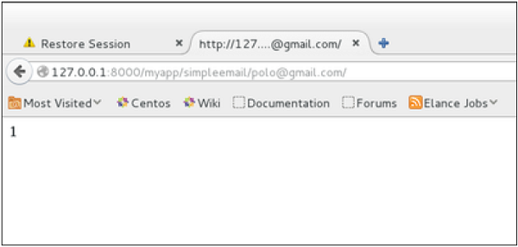
Let's create a URL to access our view −
from django.conf.urls import patterns, url
urlpatterns = paterns('myapp.views',
url(r'^simpleemail/(?P<emailto> [\w.%+-]+@[A-Za-z0-9.-]+\.[A-Za-z]{2,4})/', 'sendSimpleEmail' , name ='sendSimpleEmail'),)
So when accessing /myapp/simpleemail/polo@gmail.com, you will get the following page −

Slide 54
Sending Multiple Mails with send_mass_mail
The method returns the number of messages successfully delivered. This is same as send_mail but takes an extra parameter; datatuple, our sendMassEmail view will then be −
from django.core.mail import send_mass_mail
from django.http import HttpResponse
def sendMassEmail(request,emailto):
msg1 = ('subject 1', 'message 1', 'polo@polo.com', [emailto1])
msg2 = ('subject 2', 'message 2', 'polo@polo.com', [emailto2])
res = send_mass_mail((msg1, msg2), fail_silently = False)
return HttpResponse('%s'%res)
Let's create a URL to access our view −
from django.conf.urls import patterns, url
urlpatterns = paterns('myapp.views', url(r'^massEmail/(?P<emailto1> [\w.%+-]+@[A-Za-z0-9.-]+\.[A-Za-z]{2,4})/(?P<emailto2> [\w.%+-]+@[A-Za-z0-9.-]+\.[A-Za-z]{2,4})', 'sendMassEmail' , name = 'sendMassEmail'),)

Slide 55
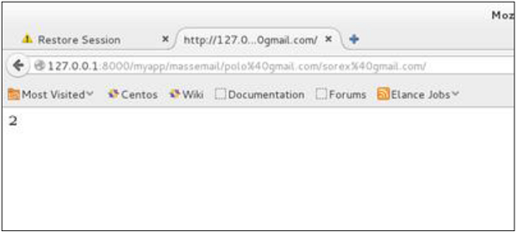
When accessing /myapp/massemail/polo@gmail.com/sorex@gmail.com/, we get −
send_mass_mail parameters details are −
datatuples − A tuple where each element is like (subject, message, from_email, recipient_list).
fail_silently − Bool, if false send_mail will raise an exception in case of error.
auth_user − User login if not set in settings.py.
auth_password − User password if not set in settings.py.
connection − E-mail backend.

Slide 56
As you can see in the above image, two messages were sent successfully.
Note − In this example we are using Python smtp debuggingserver, that you can launch using −
$python -m smtpd -n -c DebuggingServer localhost:1025
This means all your sent e-mails will be printed on stdout, and the dummy server is
running on localhost:1025.
Sending e-mails to admins and managers using mail_admins and mail_managers methods
These methods send e-mails to site administrators as defined in the ADMINS option of the settings.py file, and to site managers as defined in MANAGERS option of the settings.py file. Let's assume our ADMINS and MANAGERS options look like −
ADMINS = (('polo', 'polo@polo.com'),)
MANAGERS = (('popoli', 'popoli@polo.com'),)

Slide 57
from django.core.mail import mail_admins
from django.http import HttpResponse
def sendAdminsEmail(request):
res = mail_admins('my subject', 'site is going down.')
return HttpResponse('%s'%res)
The above code will send an e-mail to every admin defined in the ADMINS section.
from django.core.mail import mail_managers
from django.http import HttpResponse
def sendManagersEmail(request):
res = mail_managers('my subject 2', 'Change date on the site.')
return HttpResponse('%s'%res)
The above code will send an e-mail to every manager defined in the MANAGERS
section.
Parameters details −
Subject − E-mail subject.
message − E-mail body.

Slide 58
fail_silently − Bool, if false send_mail will raise an exception in case of error.
connection − E-mail backend.
html_message − (new in Django 1.7) if present, the e-mail will be multipart/alternative.
Sending HTML E-mail
Sending HTML message in Django >= 1.7 is as easy as −
from django.core.mail import send_mail
from django.http import HttpResponse
res = send_mail("hello paul", "comment tu vas?", "paul@polo.com", ["polo@gmail.com"], html_message=")
This will produce a multipart/alternative e-mail.
But for Django < 1.7 sending HTML messages is done via the
django.core.mail.EmailMessage class then calling 'send' on the object −
Let's create a "sendHTMLEmail" view to send an HTML e-mail.

Slide 59
from django.core.mail import EmailMessage
from django.http import HttpResponse
def sendHTMLEmail(request , emailto):
html_content = "<strong>Comment tu vas?</strong>" email = EmailMessage("my subject", html_content, "paul@polo.com", [emailto]) email.content_subtype = "html" res = email.send()
return HttpResponse('%s'%res)
Parameters details for the EmailMessage class creation −
Subject − E-mail subject.
message − E-mail body in HTML.
from_email − E-mail from.
to − List of receivers’ e-mail address.
bcc − List of “Bcc” receivers’ e-mail address.
connection − E-mail backend.
from django.conf.urls import patterns, url
urlpatterns = paterns('myapp.views', url(r'^htmlemail/(?P<emailto> [\w.%+-]+@[A-Za-z0-9.-]+\.[A-Za-z]{2,4})/', 'sendHTMLEmail' , name = 'sendHTMLEmail'),)

Slide 60
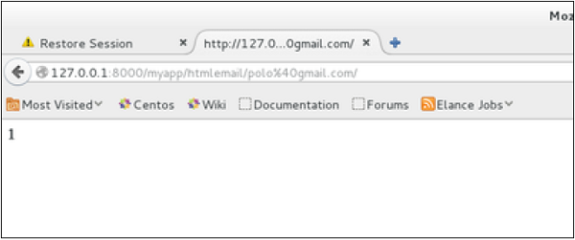
When accessing /myapp/htmlemail/polo@gmail.com, we get −
Sending E-mail with Attachment
This is done by using the 'attach' method on the EmailMessage object.
A view to send an e-mail with attachment will be −
from django.core.mail import EmailMessage
from django.http import HttpResponse

Slide 61
def sendEmailWithAttach(request, emailto):
html_content = "Comment tu vas?" email = EmailMessage("my subject", html_content, "paul@polo.com", emailto]) email.content_subtype = "html" fd = open('manage.py', 'r') email.attach('manage.py', fd.read(), 'text/plain') res = email.send()
return HttpResponse('%s'%res)
Details on attach arguments −
filename − The name of the file to attach.
content − The content of the file to attach.
mimetype − The attachment's content mime type.

Slide 62
Django - Generic Views
Unlike classic views, generic views are classes not functions. Django offers a set of classes for generic views in django.views.generic, and every generic view is one of those classes or a class that inherits from one of them.
There are 10+ generic classes −
>>> import django.views.generic
>>> dir(django.views.generic)
['ArchiveIndexView', 'CreateView', 'DateDetailView', 'DayArchiveView', 'DeleteView', 'DetailView',
'FormView', 'GenericViewError', 'ListView', 'MonthArchiveView', 'RedirectView', 'TemplateView',
'TodayArchiveView', 'UpdateView', 'View', 'WeekArchiveView', 'YearArchiveView', '__builtins__',
'__doc__', '__file__', '__name__', '__package__', '__path__', 'base', 'dates', 'detail', 'edit', 'list']
This you can use for your generic view. Let's look at some example to see how it works.
Static Pages
Let's publish a static page from the “static.html” template.
Our static.html −

Slide 63
<html>
<body>
This is a static page!!!
</body>
</html>
If we did that the way we learned before, we would have to change the myapp/views.py to be −
from django.shortcuts import render
def static(request):
return render(request, 'static.html', {})
and myapp/urls.py to be −
from django.conf.urls import patterns, url
urlpatterns = patterns("myapp.views", url(r'^static/', 'static', name = 'static'),)
The best way is to use generic views. For that, our myapp/views.py will become −
from django.views.generic import TemplateView
class StaticView(TemplateView):
template_name = "static.html"

Slide 64
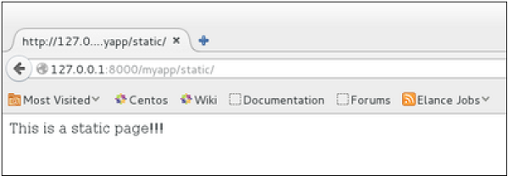
And our myapp/urls.py we will be −
from myapp.views import StaticView
from django.conf.urls import patterns
urlpatterns = patterns("myapp.views", (r'^static/$', StaticView.as_view()),)
When accessing /myapp/static you get −
For the same result we can also, do the following −
No change in the views.py
Change the url.py file to be −

Slide 65
from django.views.generic import TemplateView
from django.conf.urls import patterns, url
urlpatterns = patterns("myapp.views", url(r'^static/',TemplateView.as_view(template_name = 'static.html')),)
As you can see, you just need to change the url.py file in the second method.
List and Display Data from DB
We are going to list all entries in our Dreamreal model. Doing so is made easy by using the ListView generic view class. Edit the url.py file and update it as −
from django.views.generic import ListView
from django.conf.urls import patterns, url
urlpatterns = patterns(
"myapp.views", url(r'^dreamreals/', ListView.as_view(model = Dreamreal, template_name = "dreamreal_list.html")),
)
Important to note at this point is that the variable pass by the generic view to the template is object_list. If you want to name it yourself, you will need to add a context_object_name argument to the as_view method. Then the url.py will become −

Slide 66
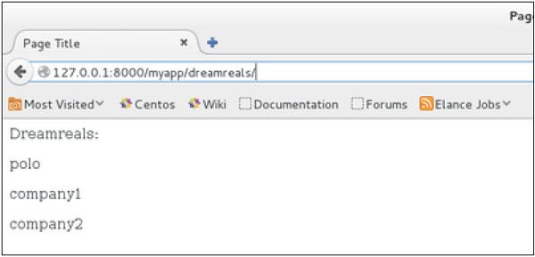
from django.views.generic import ListView f
rom django.conf.urls import patterns, url
urlpatterns = patterns("myapp.views", url(r'^dreamreals/', ListView.as_view( template_name = "dreamreal_list.html")), model = Dreamreal, context_object_name = ”dreamreals_objects” ,)
The associated template will then be −
{% extends "main_template.html" %}
{% block content %} Dreamreals:<p>
{% for dr in object_list %}
{{dr.name}}</p>
{% endfor %} {% endblock %}
Accessing /myapp/dreamreals/ will produce the following page −

Slide 67
Django - Form Processing
Creating forms in Django, is really similar to creating a model. Here again, we just need to inherit from Django class and the class attributes will be the form fields. Let's add a forms.py file in myapp folder to contain our app forms. We will create a login form.
myapp/forms.py
#-*- coding: utf-8 -*-
from django import forms
class LoginForm(forms.Form):
user = forms.CharField(max_length = 100)
password = forms.CharField(widget = forms.PasswordInput())
As seen above, the field type can take "widget" argument for html rendering;
in our case, we want the password to be hidden, not displayed. Many others
widget are present in Django: DateInput for dates, CheckboxInput for
checkboxes, etc.

Slide 68
Using Form in a View
There are two kinds of HTTP requests, GET and POST. In Django, the request object passed as parameter to your view has an attribute called "method" where the type of the request is set, and all data passed via POST can be accessed via the request.POST dictionary.
Let's create a login view in our myapp/views.py −
#-*- coding: utf-8 -*-
from myapp.forms import LoginForm
def login(request):
username = "not logged in"
if request.method == "POST":
#Get the posted form
MyLoginForm = LoginForm(request.POST)
if MyLoginForm.is_valid():
username = MyLoginForm.cleaned_data['username']
else:
MyLoginForm = Loginform() return render(request, 'loggedin.html', {"username" : username})

Slide 69
The view will display the result of the login form posted through the loggedin.html. To test it, we will first need the login form template. Let's call it login.html.
<html>
<body>
<form name = "form" action = "{% url "myapp.views.login" %}"
method = "POST" >{% csrf_token %}
<div style = "max-width:470px;">
<center> <input type = "text" style = "margin-left:20%;" placeholder = "Identifiant" name = "username" />
</center>
</div>
<br>
<div style = "max-width:470px;">
<center> <input type = "password" style = "margin-left:20%;" placeholder = "password" name = "password" /> </center>

Slide 70
</div> <br> <div style = "max-width:470px;">
<center> <button style = "border:0px; background-color:#4285F4; margin-top:8%; height:35px; width:80%;margin-left:19%;" type = "submit" value = "Login" > <strong>Login</strong>
</button>
</center>
</div>
</form>
</body>
</html>
The template will display a login form and post the result to our login view above. You
have probably noticed the tag in the template, which is just to prevent Cross-site
Request Forgery (CSRF) attack on your site.
{% csrf_token %}

Slide 71
Once we have the login template, we need the
loggedin.html template that will be rendered
after form treatment.
<html>
<body>
You are : <strong>{{username}}</strong>
</body>
</html>
Now, we just need our pair of URLs to get started: myapp/urls.py
from django.conf.urls import patterns, url
from django.views.generic import TemplateView
urlpatterns = patterns('myapp.views', url(r'^connection/',TemplateView.as_view(template_name = 'login.html')), url(r'^login/', 'login', name = 'login'))
When accessing "/myapp/connection", we will get the following login.html template rendered

Slide 72
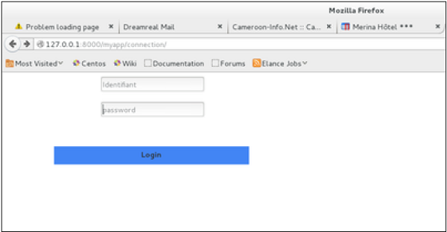
</div> <br> <div style = "max-width:470px;"> <center> <button style = "border:0px; background-color:#4285F4; margin-top:8%; height:35px; width:80%;margin-left:19%;" type = "submit" value = "Login" > <strong>Login</strong> </button> </center> </div> </form> </body> </html>

Slide 73
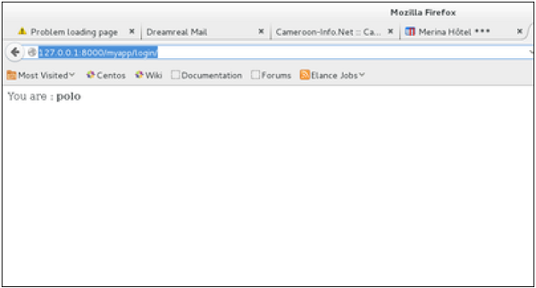
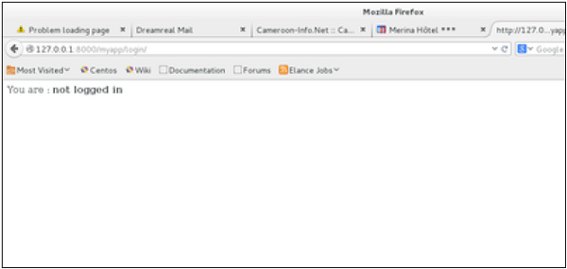
On the form post, the form is valid. In our case make sure to fill the two fields and you will get −
In case your username is polo, and you forgot the password. You will get the following message −

Slide 74
Using Our Own Form Validation
In the above example, when validating the form −
MyLoginForm.is_valid() We only used Django self-form validation engine, in our case just making sure the fields are required. Now let’s try to make sure the user trying to login is present in our DB as Dreamreal entry. For this, change the myapp/forms.py to −
#-*- coding: utf-8 -*-
from django import forms
from myapp.models import Dreamreal
class LoginForm(forms.Form):
user = forms.CharField(max_length = 100)
password = forms.CharField(widget = forms.PasswordInput())
def clean_message(self):
username = self.cleaned_data.get("username")
dbuser = Dreamreal.objects.filter(name = username)
if not dbuser:
raise forms.ValidationError("User does not exist in our db!")
return username

Slide 75
Now, after calling the "is_valid" method, we will get the correct output, only if the user is in our database. If you want to check a field of your form, just add a method starting by "clean_" then your field name to your form class. Raising a forms.ValidationError is important.
Django - File Uploading :
It is generally useful for a web app to be able to upload files (profile picture, songs, pdf, words.....). Let's discuss how to upload files in this chapter.
Uploading an Image
Before starting to play with an image, make sure you have the Python Image Library (PIL) installed. Now to illustrate uploading an image, let's create a profile form, in our myapp/forms.py −
#-*- coding: utf-8 -*-
from django import forms
class ProfileForm(forms.Form):
name = forms.CharField(max_length = 100)
picture = forms.ImageFields()

Slide 76
As you can see, the main difference here is just the forms.ImageField.
ImageField will make sure the uploaded file is an image. If not, the form
validation will fail. Now let's create a "Profile" model to save our
uploaded profile. This is done in myapp/models.py −
from django.db import models
class Profile(models.Model):
name = models.CharField(max_length = 50)
picture = models.ImageField(upload_to = 'pictures')
class Meta:
db_table = "profile“
As you can see for the model, the ImageField takes a compulsory
argument: upload_to. This represents the place on the hard drive where your
images will be saved. Note that the parameter will be added to the
MEDIA_ROOT option defined in your settings.py file.
Now that we have the Form and the Model, let's create the view, in
myapp/views.py −

Slide 77
#-*- coding: utf-8 -*-
from myapp.forms import ProfileForm
from myapp.models import Profile
def SaveProfile(request):
saved = False
if request.method == "POST":
#Get the posted form
MyProfileForm = ProfileForm(request.POST, request.FILES)
if MyProfileForm.is_valid():
profile = Profile()
profile.name = MyProfileForm.cleaned_data["name"] profile.picture = MyProfileForm.cleaned_data["picture"] profile.save()
saved = True
else:
MyProfileForm = Profileform()
return render(request, 'saved.html', locals())

Slide 78
The part not to miss is, there is a change when creating a ProfileForm, we added a second parameters: request.FILES. If not passed the form validation will fail, giving a message that says the picture is empty.
Now, we just need the saved.html template and the profile.html template, for the form and the redirection page −
myapp/templates/saved.html −
<html>
<body>
{% if saved %}
<strong>Your profile was saved.</strong>
{% endif %}
{% if not saved %}
<strong>Your profile was not saved.</strong>
{% endif %}
</body>
</html>

Slide 79
myapp/templates/profile.html −
<html>
<body>
<form name = "form" enctype = "multipart/form-data" action = "{% url "myapp.views.SaveProfile" %}" method = "POST" >{% csrf_token %}
<div style = "max-width:470px;"> <center>
<input type = "text" style = "margin-left:20%;" placeholder = "Name" name = "name" />
</center> </div>
<br>
<div style = "max-width:470px;">
<center> <input type = "file" style = "margin-left:20%;" placeholder = "Picture" name = "picture" />
</center>
</div>
<br>

Slide 80
<div style = "max-width:470px;">
<center> <button style = "border:0px;background-color:#4285F4; margin-top:8%; height:35px; width:80%; margin-left:19%;" type = "submit" value = "Login" > <strong>Login</strong>
</button> </center> </div> </form> </body> </html>
Next, we need our pair of URLs to get started: myapp/urls.py
from django.conf.urls import patterns, url
from django.views.generic import TemplateView
urlpatterns = patterns( 'myapp.views', url(r'^profile/',TemplateView.as_view( template_name = 'profile.html')), url(r'^saved/', 'SaveProfile', name = 'saved') )

Slide 81
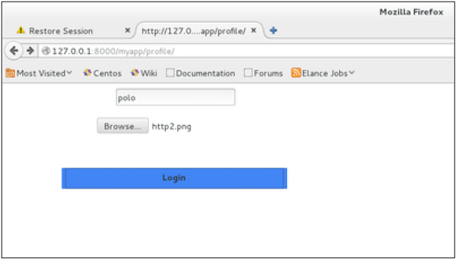
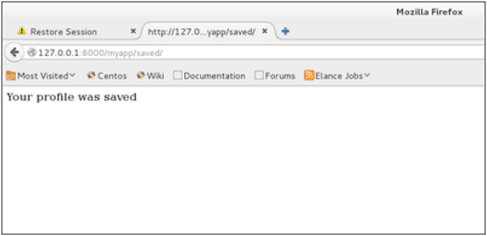
When accessing "/myapp/profile", we will get the following profile.html template rendered −
And on form post, the saved template will be rendered −

Slide 82
Django - Cookies Handling
To illustrate cookies handling in Django, let's create a system using the login system we created before. The system will keep you logged in for X minute of time, and beyond that time, you will be out of the app.
For this, you will need to set up two cookies, last_connection and username.
At first, let's change our login view to store our username and last_connection cookies −
from django.template import RequestContext
def login(request):
username = "not logged in"
if request.method == "POST":
#Get the posted form
MyLoginForm = LoginForm(request.POST)
if MyLoginForm.is_valid():
username = MyLoginForm.cleaned_data['username']
else:
MyLoginForm = LoginForm()

Slide 83
response = render_to_response(request, 'loggedin.html', {"username" : username}, context_instance = RequestContext(request)) response.set_cookie('last_connection', datetime.datetime.now()) response.set_cookie('username', datetime.datetime.now())
return response
As seen in the view above, setting cookie is done by the set_cookie method
called on the response not the request, and also note that all cookies values
are returned as string.
Let’s now create a formView for the login form, where we won’t display the
form if cookie is set and is not older than 10 second −
def formView(request):
if 'username' in request.COOKIES and 'last_connection' in request.COOKIES: username = request.COOKIES['username']
last_connection = request.COOKIES['last_connection']
last_connection_time = datetime.datetime.strptime(last_connection[:-7], "%Y-%m-%d %H:%M:%S")

Slide 84
if (datetime.datetime.now() - last_connection_time).seconds < 10:
return render(request, 'loggedin.html', {"username" : username})
else:
return render(request, 'login.html', {})
else: return render(request, 'login.html', {})
As you can see in the formView above accessing the cookie you set, is done via the
COOKIES attribute (dict) of the request.
Now let’s change the url.py file to change the URL so it pairs with our new view −
from django.conf.urls import patterns, url
from django.views.generic import TemplateView
urlpatterns = patterns('myapp.views', url(r'^connection/','formView', name = 'loginform'), url(r'^login/', 'login', name = 'login'))

Slide 85
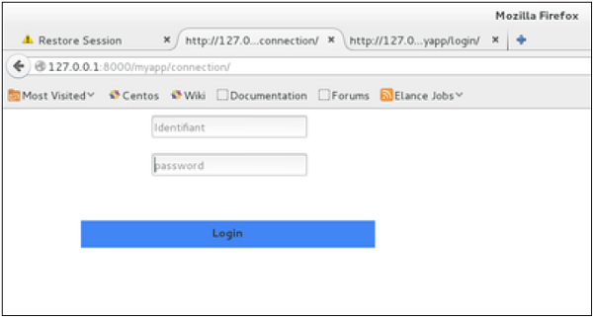
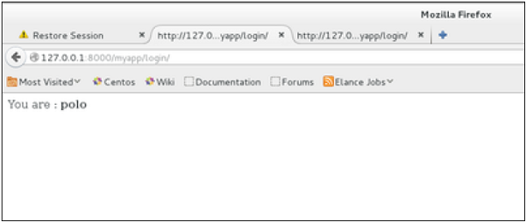
When accessing /myapp/connection, you will get the following page −
And you will get redirected to the following screen on submit −

Slide 86
Now, if you try to access /myapp/connection again in the 10 seconds range, you will get redirected to the second screen directly. And if you access /myapp/connection again out of this range you will get the login form (screen 1).
Django – Sessions
we can use client side cookies to store a lot of useful data for the web app.
We have seen before that we can use client side cookies to store various data
useful for our web app. This leads to lot of security holes depending on the
importance of the data you want to save.
For security reasons, Django has a session framework for cookies handling.
Sessions are used to abstract the receiving and sending of cookies, data is
saved on server side (like in database), and the client side cookie just has a
session ID for identification. Sessions are also useful to avoid cases where the
user browser is set to ‘not accept’ cookies.

Slide 87
Setting Up Sessions
In Django, enabling session is done in your project settings.py, by adding some lines to
the MIDDLEWARE_CLASSES and the INSTALLED_APPS options. This should
be done while creating the project, but it's always good to know,
so MIDDLEWARE_CLASSES should have −
'django.contrib.sessions.middleware.SessionMiddleware' And INSTALLED_APPS should have −
'django.contrib.sessions‘
By default, Django saves session information in database (django_session table or
collection), but you can configure the engine to store information using other ways like:
in file or in cache.
When session is enabled, every request (first argument of any view in Django) has a
session (dict) attribute.
Let's create a simple sample to see how to create and save sessions. We have built a
simple login system before (see Django form processing chapter and Django Cookies
Handling chapter).

Slide 88
Let us save the username in a cookie so, if not signed out, when
accessing our login page you won’t see the login form. Basically, let's make our login system
we used in Django Cookies handling more secure, by saving cookies server side.
For this, first lets change our login view to save our username cookie server side −
For this, first lets change our login view to save our username cookie server side −
def login(request):
username = 'not logged in'
if request.method == 'POST':
MyLoginForm = LoginForm(request.POST)
if MyLoginForm.is_valid():
username = MyLoginForm.cleaned_data['username'] request.session['username'] = username
else:
MyLoginForm = LoginForm()
return render(request, 'loggedin.html', {"username" : username}

Slide 89
Then let us create formView view for the login form, where we won’t display the form
if cookie is set −
def formView(request):
if request.session.has_key('username'):
username = request.session['username']
return render(request, 'loggedin.html', {"username" : username})
else:
return render(request, 'login.html', {})
Now let us change the url.py file to change the url so it pairs with our new view −
from django.conf.urls import patterns, url
from django.views.generic import TemplateView
urlpatterns = patterns('myapp.views', url(r'^connection/','formView', name = 'loginform'), url(r'^login/', 'login', name = 'login'))

Slide 90
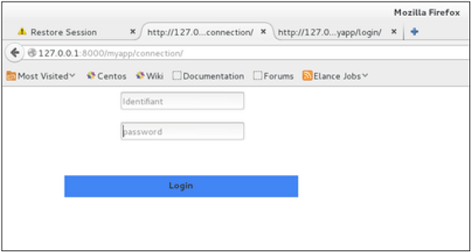
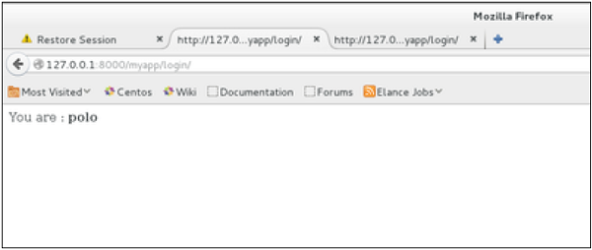
When accessing /myapp/connection, you will get to see the following page −
And you will get redirected to the following page −

Slide 91
Now if you try to access /myapp/connection again, you will get redirected to the second screen directly.
Let's create a simple logout view that erases our cookie.
def logout(request):
try:
del request.session['username']
except: pass
return HttpResponse("<strong>You are logged out.</strong>")
And pair it with a logout URL in myapp/url.py
url(r'^logout/', 'logout', name = 'logout'),

Slide 92
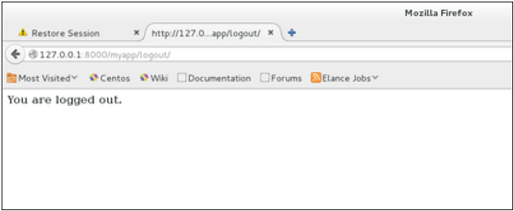
Now, if you access /myapp/logout, you will get the following page −
if you access /myapp/connection again, you will get the login form (screen 1).
Some More Possible Actions Using Sessions
We have seen how to store and access a session, but it's good to know that the session attribute of the request have some other useful actions like −
set_expiry (value) − Sets the expiration time for the session.
get_expiry_age() − Returns the number of seconds until this session expires.
get_expiry_date() − Returns the date this session will expire.

Slide 93
clear_expired() − Removes expired sessions from the session store.
get_expire_at_browser_close() − Returns either True or False, depending on whether the user’s session cookies have expired when the user’s web browser is closed.

