Slide 1

What is JMeter? Why it is used?
You can use JMeter to analyze and measure the performance of web application or a variety of services. Performance Testing means testing a web application against heavy load, multiple and concurrent user traffic. JMeter originally is used for testing Web Application or FTP application. Nowadays, it is used for a functional test, database server test etc.
Why Jmeter

Slide 2
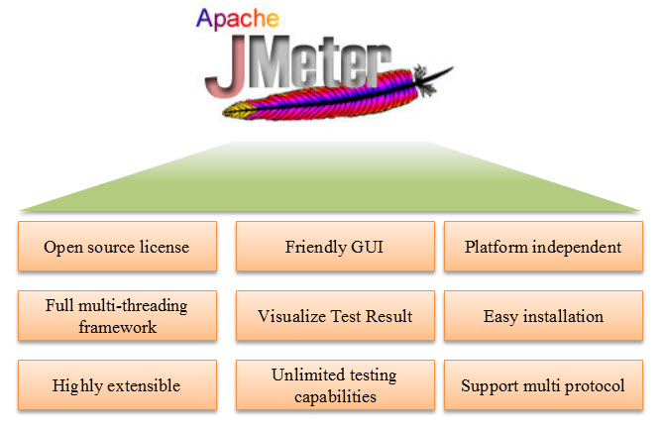
JMeter Advantages

Slide 3
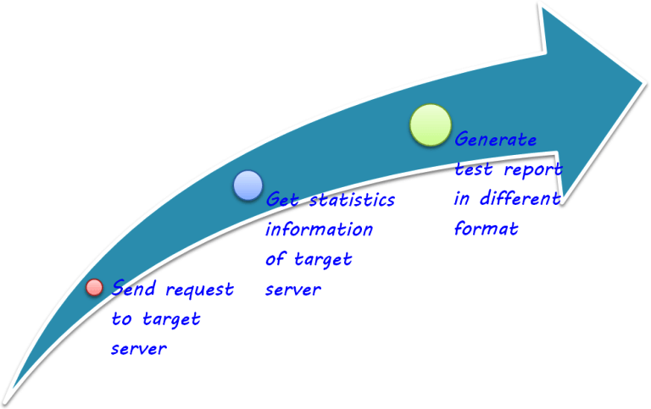
How does JMeter work?
JMeter simulates a group of users sending requests to a target server, and return statistics information of target server through graphical diagrams

Slide 4
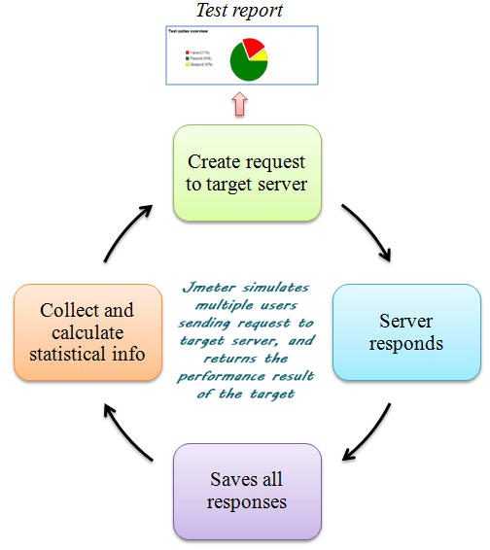
The completed workflow of JMeter as shown in the figure below

Slide 5
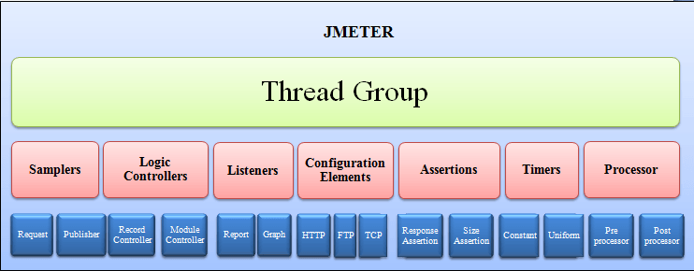
JMeter Elements:

Slide 6
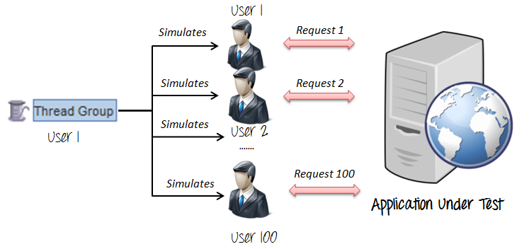
1. Thread Group

Slide 7
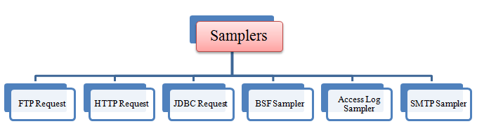
2. Samplers
As we know already that JMeter supports testing HTTP, FTP, JDBC and many other protocols.
We already know that Thread Groups simulate user request to the server
But how does a Thread Group know which type of requests (HTTP, FTP etc.) it needs to make?
The answer is Samplers

Slide 8

FTP request: Let imagine you want to performance test an FTP server. You can use an FTP request sampler in JMeter to do this task. This controller lets you send an FTP "download file" or "upload file" request to an FTP server.
For example, if you want to download a file "Test.txt" from an FTP server under test, you need to configure some parameters in JMeter as the figure below

Slide 9
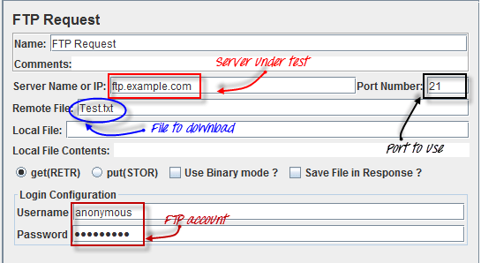

Slide 10

HTTP request:
This sampler lets you send an HTTP/HTTPS request to a web server.
Consider the example below. JMeter sends an HTTP request to Google website and retrieve HTML files or image from this website.

Slide 11

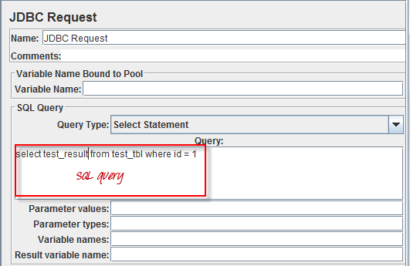
JDBC request:
This sampler lets you execute Database Performance Testing. It sends a JDBC Request (an SQL query) to a database.
For example, a database server has a field test_result stored in a table name test_tbl. You want to query this data from the database server; you can configure JMeter to send a SQL query to this server to retrieve data.

Slide 12
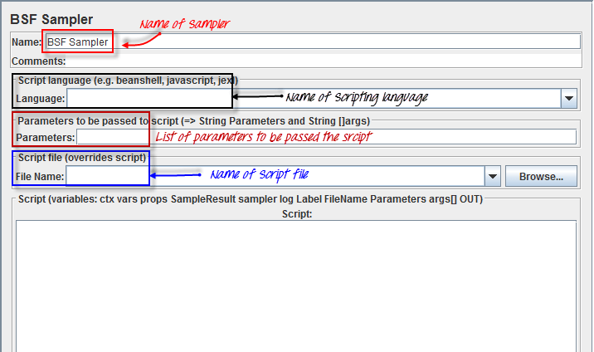
BSF Sampler:
This sampler allows you to write a sampler using a BSF scripting language. Here is an example of BSF Sampler in Jmeter

Slide 13
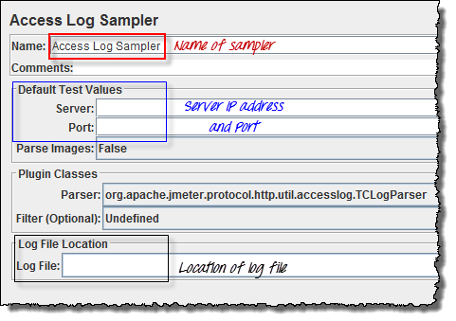
Access Log Sampler:
This sampler allows you to read access logs and generate HTTP requests. The log could be image, Html, CSS...

Slide 14
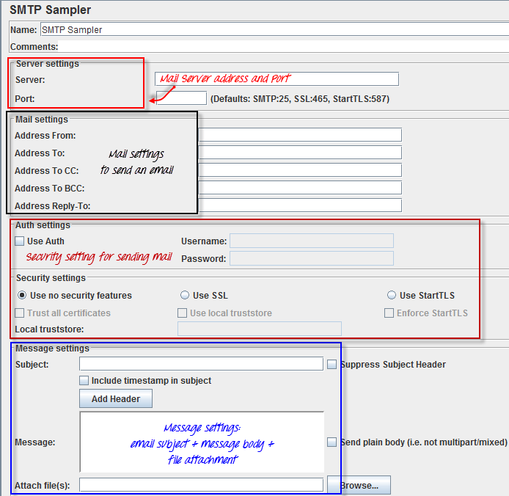
SMTP Sampler:
If you want to test a mail server, you can use SMTP sampler. This sampler is used to send email messages using the SMTP protocol.

Slide 15
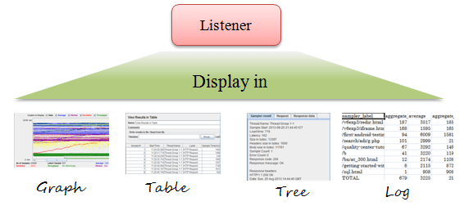
Listeners
Listeners: shows the results of the test execution. They can show results in a different format such as a tree, table, graph or log file
Graph result listeners display the server response times on a Graph

Slide 16
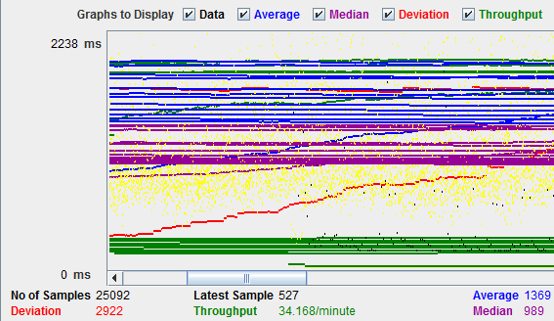

Slide 17
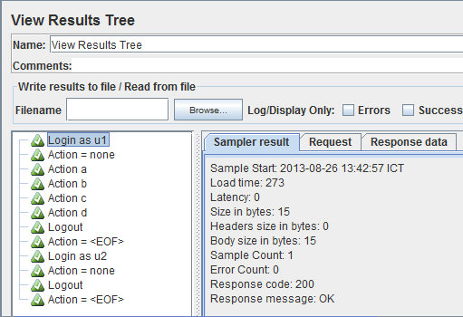
View Result Tree show results of the user request in basic HTML format

Slide 18
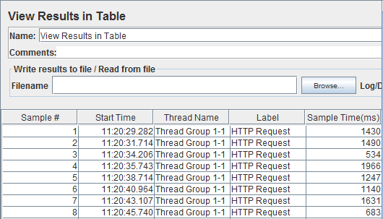
Table Result show summary of a test result in table format

Slide 19
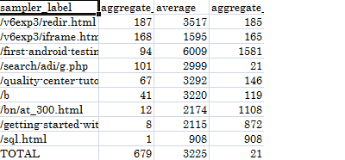
Log show summary of a test results in the text file

Slide 20
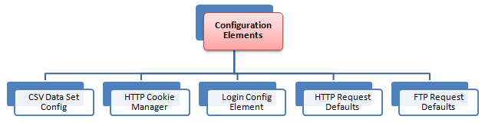
Configuration Elements
set up defaults and variables for later use by samplers.
The figure below shows some commonly used configuration elements in JMeter

Slide 21
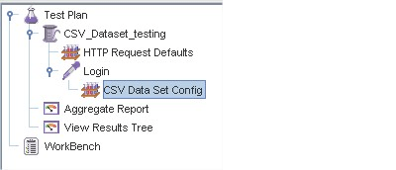
CSV Data Set Config:
Suppose you want to test a website for 100 users signing-in with different credentials. You do not need to record the script 100 times! You can parameterization the script to enter different login credentials. This login information (e.g. Username, password) could be stored in a text file. JMeter has an element that allows you to read different parameters from that text file. It is "CSV Data Set Config", which is used to read lines from a file, and split them into variables

Slide 22
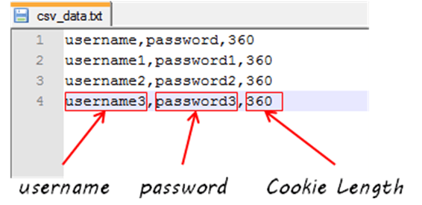
This is an example of CSV Data. It's a text file which contains user and password to login your target website

Slide 23
HTTP Cookie Manager
Let's understand this with an example -
You used your browser (Firefox, IE...Etc) to browse www.google.com
You log in with your user and password.
Your username and password will be stored in your computer as cookies.
Next time, when you visit www.google.com, you don't need to do log in again because your browser will use your cookies as user data to log in.
HTTP Cookie Manager also has the same feature as a web browser. If you have an HTTP Request and the response contains a cookie, the Cookie Manager automatically stores that cookie and will use it for all future requests to that particular website

Slide 24
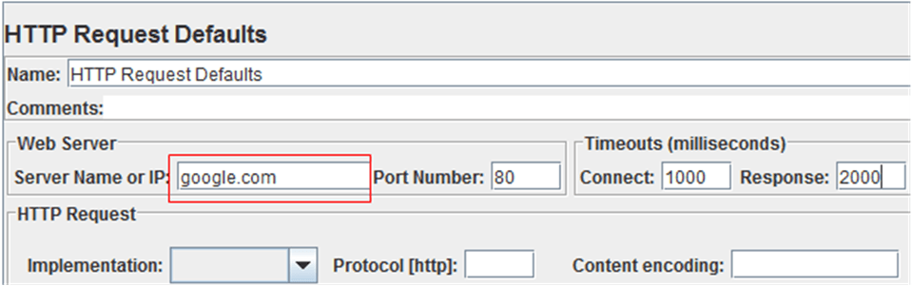
HTTP request default
This element lets you set default values that your HTTP Request controllers use.
For example,
You are sending 100 HTTP requests to the server google.com
You would have to manually enter server name = google.com for all these 100 requests
Instead, you could add a single HTTP request defaults with the "Server Name or IP" field = google.com
No need to type 100 times!

Slide 25
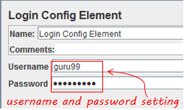
Login Config Element
The Login Config Element lets you add or override username and password settings in samplers.
For example, you want to simulate one user login to website www.facebook.com with user and password. You can use the Login Config Element to add this user and password setting in a user request

Slide 26
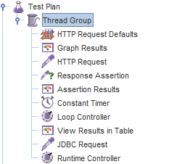
JMeter GUI: Test Plan & Workbench
As soon as you launch JMeter, you will see 2 elements
Test Plan
Workbench
What is a Test Plan?
Test Plan is where you add elements required for your JMeter Test.
It stores all the elements (like ThreadGroup, Timers etc) and their corresponding settings required to run your desired Tests.

Slide 27
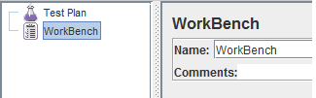
What is WorkBench?
The WorkBench simply provides a place to store test elements temporarily. WorkBench has no relation with Test Plan. JMeter will not save the contents of the WorkBench. It only saves the contents of the Test Plan branch
How to add Elements?
You can add an element to test plan by right-clicking on a Test Plan and choose new elements from "Add" list.
Suppose, you want to add 2 elements to Test Plan BeanShell Assertion and Java Request Default
Right click Test Plan -> Add -> Assertion-> Bean Shell Assertion
Right click Test Plan -> Add -> Config Element -> Java Request Default

Slide 28
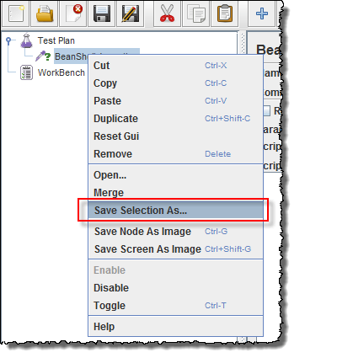
Loading and Saving Elements
How to Create JMX file
Suppose you have already added an element name "BeanShell Assertion". Now you want to save it.
Right-click BeanShell Assertion -> select Save Selection As

Slide 29
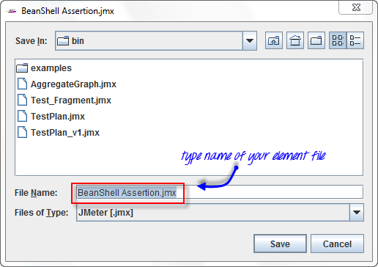
A dialog box display, click Save button to save your elements under default name BeanShell Assertion.jmx. You can choose other names if you want

Slide 30
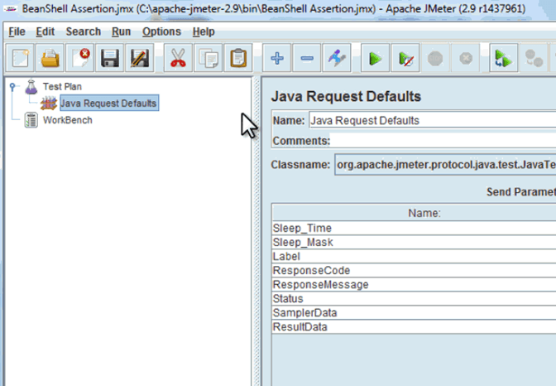
How to Run JMX file
Loading exist element helps you save your time required to create & configure new elements
Let's say, that you have an existing element in Test Plan: Java Request Default
Right-click Java Request Defaults-> select Merge
Choose the Elements (BeanShell Assertion.jmx.) file in the directory. This element will be added to your current test plan.

Slide 31
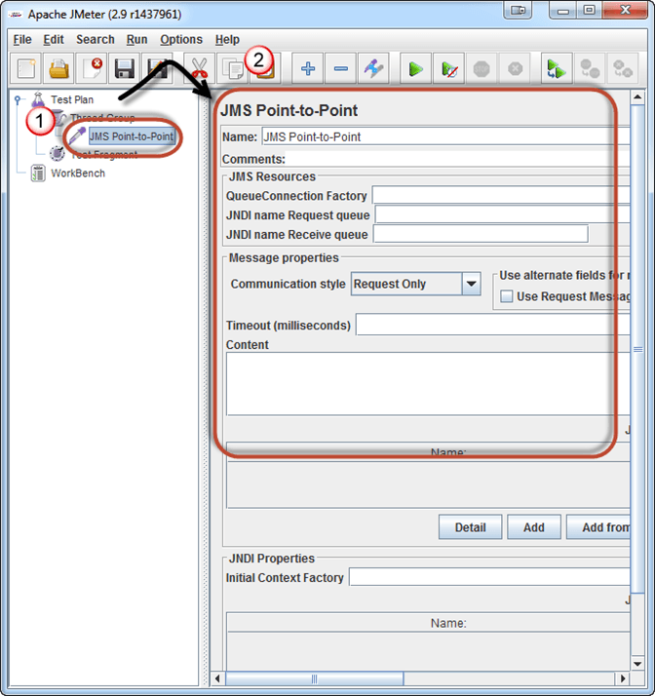
How to Configure Elements
In order to configure any Element
Select the element in the Tree on Left Pane
Enter configuration settings on the Right Pane

Slide 32
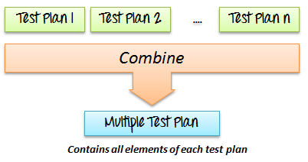
How to Save a Test Plan
Before running a test, you should save your Test Plan first. Saving your Test Plan helps you avoid unexpected error when running the test plan. Steps to saving Test plan -
File -> Save Test Plan as-> a Dialog box display
Enter a filename of Test Plan ->click Save
Create a Combo Test Plan
You can merge one or many Test Plans to create a combo Test Plan as shown in below figure

Slide 33
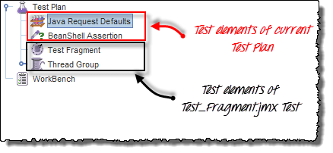
Suppose you already have an existing Test Plan name Test_Fragment.jmx on your computer (This article includes this file). You can merge this test plan to current Test Plan on JMeter to create a new Test Plan.
Now all the test elements in file Test_Fragment.jmx are added to your current test plan as shown in the figure below

Slide 34
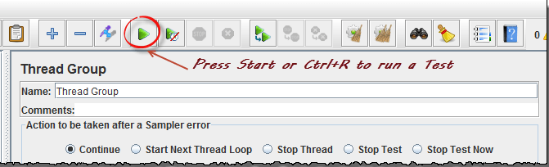

How to Run Test Plan
To run your single or multiple test plans, choose Start (Control + R) from the Run menu item.
When JMeter is running, it shows a small green box at the right-hand end of the menu bar.
The numbers to the left of the green box are the number of active threads / total number of threads.

Slide 35

How to Use JMeter for Performance & Load Testing
Performance Testing is crucial to determine that the web application under test will satisfy high load requirements. It can be used to analyze overall server performance under heavy load.

Slide 36
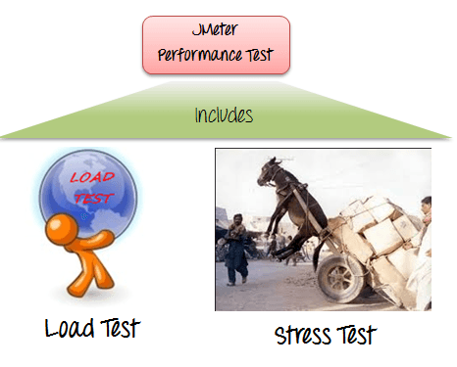
Apache JMeter testing tool offers following benefit in Performance Testing
JMeter can be used to test the performance of both static resources such as JavaScript and HTML, as well as dynamic resources, such as JSP, Servlets, and AJAX.
JMeter can discover maximum number of concurrent users that your website can handle
JMeter provides a variety of graphical analyses of performance reports.
JMeter Performance Testing includes:

Slide 37
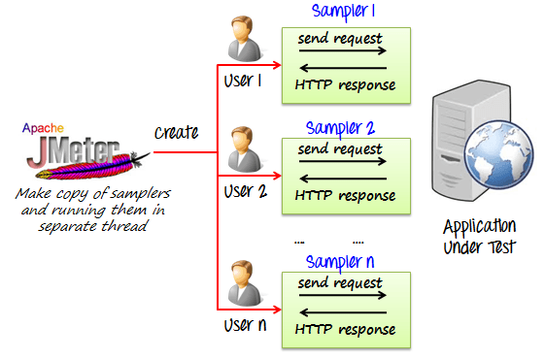
Load Testing: Modeling the expected usage by simulating multiple user access the Web services concurrently.
Stress Testing: Every web server has a maximum load capacity. When the load goes beyond the limit, the web server starts responding slowly and produce errors. The purpose of the Stress Testing is to find the maximum load the web server can handle.
The figure below shows how JMeter load Testing simulates the heavy load:

Slide 38
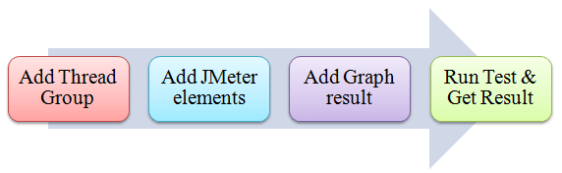
Create a Performance Test Plan in JMeter
In this tutorial, we are doing a performance analysis of Google.com for 1000 users
Before testing the performance of target web application, we should determine-
Normal Load: Average number of users visit your website
Heavy Load: The maximum number of users visit your website
What is your target in this test?
Here is the roadmap of this practical example

Slide 39
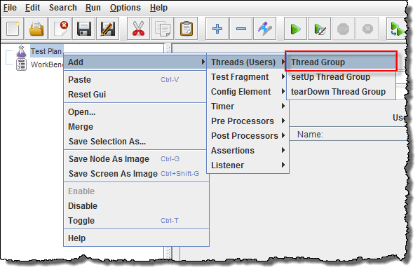
Step 1) Add Thread Group
Start JMeter
Select Test Plan on the tree
Add Thread Group
Right click on the "Test Plan" and add a new thread group: Add -> Threads (Users) -> Thread Group

Slide 40
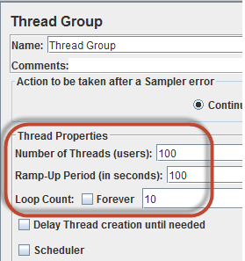
In the Thread Group control panel, enter Thread Properties as follows:
Number of Threads: 100 (Number of users connects to the target website: 100)
Loop Count: 10 (Number of time to execute testing)
Ramp-Up Period: 100

Slide 41
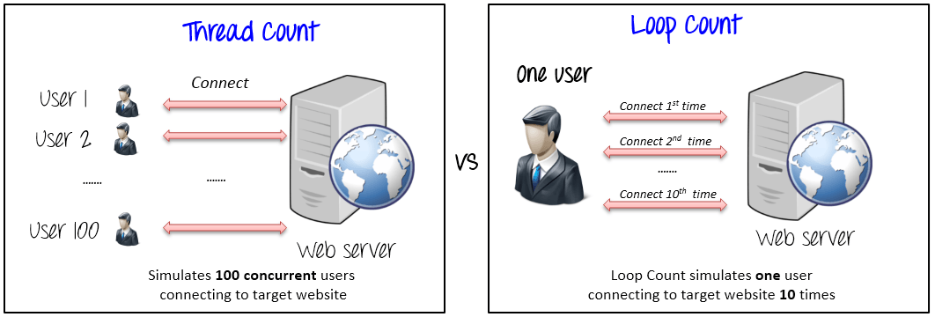
The Thread Count and The Loop Counts are different.

Slide 42
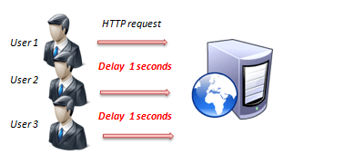
Ramp-Up Period tells JMeter how long to delay before starting the next user. For example, if we have 100 users and a 100-second Ramp-Up period, then the delay between starting users would be 1 second (100 seconds /100 users)
Step 2) Adding JMeter elements
Now we determine what JMeter elements in this test. The elements are
HTTP request Default
This element can be added by right-clicking on the Thread Group and selecting: Add -> Config Element -> HTTP Request Defaults.

Slide 43
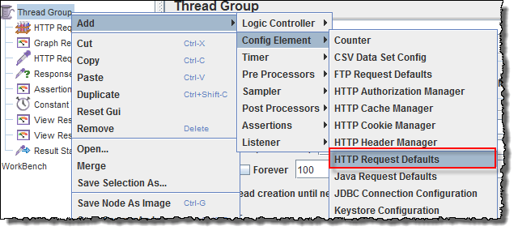
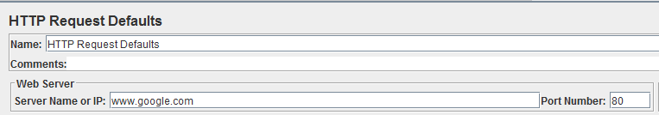
In the HTTP Request Defaults control panel, enter the Website name under test (http://www.google.com)

Slide 44
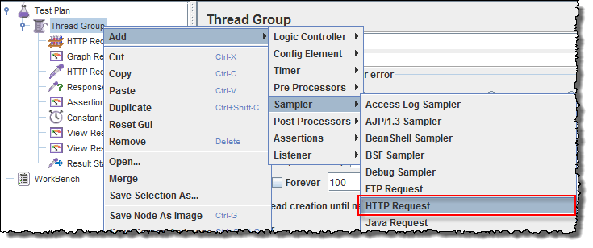
HTTP Request
Right-click on Thread Group and select: Add -> Sampler -> HTTP Request.

Slide 45
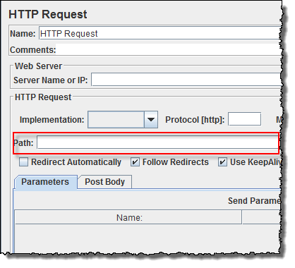
In HTTP Request Control Panel, the Path field indicates which URL request you want to send to Google server.

Slide 46
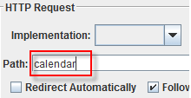
For example, if you enter "calendar" in Path field. JMeter will create the URL request http://www.google.com/calendar to Google server
Step 3) Adding Graph result
JMeter can show the test result in Graph format.
Right click Test Plan, Add -> Listener -> Graph Results

Slide 47
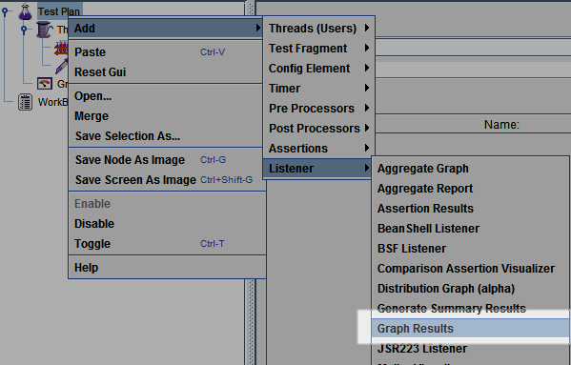

Slide 48
Step 4) Run Test and get the test result
Press the Run button (Ctrl + R) on the Toolbar to start the software testing process. You will see the test result display on Graph in the real time.
The picture below presents a graph of a test plan, where we simulated 100 users who accessed on website www.google.com.

Slide 49
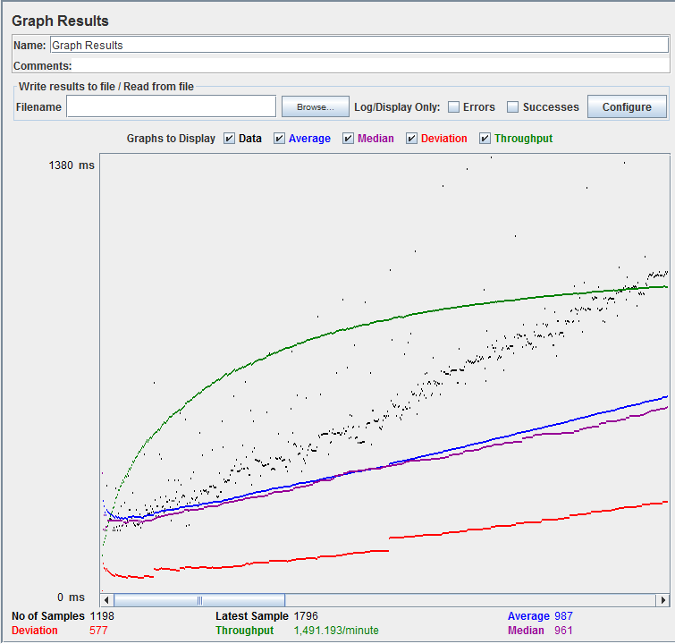
At the bottom of the picture, there are the following statistics, represented in colors:
Black: The total number of current samples sent.
Blue: The current average of all samples sent.
Red: The current standard deviation.
Green: Throughput rate that represents the number of requests per minute the server handled

Slide 50
To analyze the performance of the web server under test, you should focus on 2 parameters
Throughput
Deviation
The Throughput is the most important parameter. It represents the ability of the server to handle a heavy load. The higher the Throughput is, the better is the server performance.
In this test, the throughput of Google server is 1,491.193/minute. It means Google server can handle 1,491.193 requests per minute. This value is quite high so we can conclude that Google server has good performance
The deviation is shown in red - it indicates the deviation from the average. The smaller the better

Slide 51
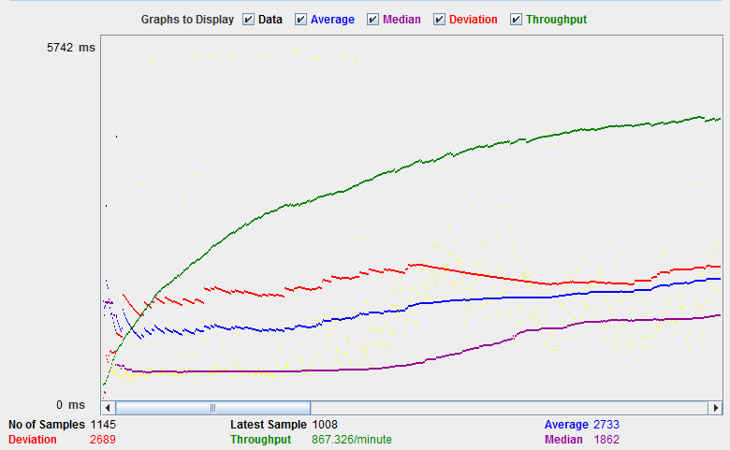

Slide 52
The throughput of a website under test http://www.yahoo.com is 867.326/minutes. It means this server handle 867.326 requests per minute, lower than Google.
The deviation is 2689, much higher than Google (577). So we can determine the performance of this website is less than a Google server.
NOTE: The above values depend on several factors like current server load at Google, your internet speed, your CPU power etc. Hence, it's very unlikely that you will get the same results as above. So don't panic!

Slide 53

Jmeter Timers: Constant, Gaussian Random, Uniform [Example]
What are Timers?
By default, JMeter sends the request without pausing between each request. In that case, JMeter could overwhelm your test server by making too many requests in a short amount of times.
Let imagine that you send thousands request to a web server under test in a few seconds. This is what happens!

Slide 54
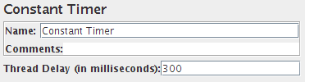
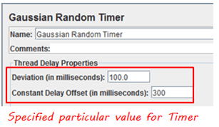
Timers allow JMeter to delay between each request which a thread makes. A timer can solve the server overload problem.
Also, in real life visitors do not arrive at a website all at the same time, but at different time intervals. So Timer will help mimic the real-time behavior.
Constant Timer:
Constant timer delays each user request for the same amount of time.
Gaussian Random Timer:
Gaussian random timer delays each user request for a random amount of time.

Slide 55
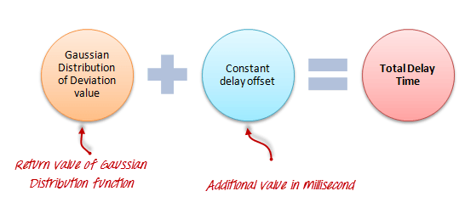
Parameters:
Attribute Description
Name Descriptive name for this timer that is shown in the tree
Deviations (milliseconds) A parameter of Gaussian Distribution Function
Constant Delay Offset (milliseconds) Additional value in milliseconds

Slide 56
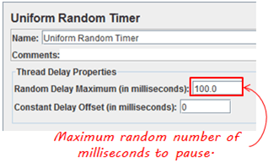
Uniform Random Timer:
Uniform random timer delays each user request for a random amount of time
Parameters:
Attribute Description
Name Descriptive name for this timer that is shown in the tree
Random Delay Maximum Maximum random number of milliseconds to delay.
Constant Delay Offset (milliseconds) Additional value in milliseconds
The total delay is the sum of the random value and the offset value

Slide 57
BeanShell Timer
The BeanShell Timer can be used to generate a delay time between each user request.
BSF Timer
The BSF Timer can be used to generate a delay between each user request using a BSF scripting language.
JSR223 Timer
The JSR223 Timer can be used to generate a delay between each user request using a JSR223 scripting language
How to Use Constant Timer :
In this example, you will use Constant Timer to set a fixed delay between user requests to google.com.
Let start with a simple test script :
JMeter creates one user request to http://www.google.com 100 times
Delay between each user request is 5000 ms

Slide 58
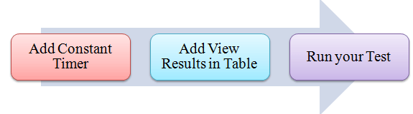

Pre-condition:
We re-use the Step 1 and Step 2
Step 1) Add Thread Group
Right click on the Test Plan and add a new thread group: Add-> Threads (Users) ->Thread Group

Slide 59

Step 2) Add JMeter elements
Add HTTP request default
Add HTTP request
Step 3) Add Constant Timer
Right-click Thread Group -> Timer -> Constant Timer

Slide 60

Configuring Thread Delay of 5000 milliseconds
Step 4) Add View Results in Table
View Results in Table displays the test result in table format.
Right click Add -> Listener -> View Result in Table

Slide 61


Slide 62

View Results in Table displays as below figure
Step 5) Run your test
When you ready to run a test, click the Run button on the menu bar, or short key Ctrl+R
This is the result of this test

Slide 63


Slide 64

For example, in the above figure, let analyze the Sample 2
Start time is 22:05:01.866
Sample Time of Sample 2 is 172 ms
Constant Timer: 5000 ms (as configured)
End Time of this sample is = 22:05:01.866 + 172 + 5000 = 22:05:07.038
So the Sample 3 should start at the time is 22:05:07.039 ( As shown in the above figure)
The delay of each sample is 5000 ms
If you change the Constant Timer is zero, you will see the result is changed

Slide 65
Let analyze the Sample 1
Start time is 22:17:39.141
Sample Time of Sample 2 is 370 ms
Constant Timer : 0 ms (as configured)
End Time of this sample is = 22:17:39.141+ 370 + 0 = 22:17:39.511
So the Sample 2 should start at the time is 22:17:39.512 (Shown in the above figure)
How to use Assertions in JMeter (Response Example) :
What is an Assertion?
Assertion help verifies that your server under test returns the expected results.
Types of Assertions
Following are some commonly used Assertion in Jmeter :
Response Assertion
Duration Assertion
Size Assertion
XML Assertion
HTML Assertion
Steps to use Response Assertion

Slide 66

Response Assertion :
The response assertion lets you add pattern strings to be compared against various fields of the server response.
For example, you send a user request to the website http://www.google.com and get the server response. You can use Response Assertion to verify if the server response contains expected pattern string (e.g. "OK").

Slide 67

Duration Assertion :
The Duration Assertion tests that each server response was received within a given amount of time. Any response that takes longer than the given number of milliseconds (specified by the user) is marked as a failed response.
For example, a user request is sent to www.google.com by JMeter and get a response within expected time 5 ms then Test Case pass, else, test case failed.
Size Assertion
The Size Assertion tests that each server response contains the expected number of byte in it. You can specify that the size be equal to, greater than, less than, or not equal to a given number of bytes.
JMeter sends a user request to www.google.com and gets response packet with size less than expected byte 5000 bytes a test case pass. If else, test case failed.

Slide 68


XML Assertion :
The XML Assertion tests that the response data consists of a formally correct XML document.
HTML Assertion :
The HTML Assertion allows the user to check the HTML syntax of the response data. It means the response data must be met the HTML syntax.

Slide 69

Steps to use Response Assertion :
In this test, we are using Response Assertion to compare the response packet from www.google.com matches your expected string.
Here is the roadmap for this test:
The response assertion control panel lets you add pattern strings to be compared against various fields of the response.
Step 1) Add Response Assertion
Right-Click Thread Group -> Add -> Assertions -> Response Assertion

Slide 70

Response Assertion Pane displays as below figure :

Slide 71

Step 2) Add Pattern to test
When you send a request to Google server, it may return some response code as below:
404: Server error
200: Server OK
302: Web server redirects to other pages. This usually happens when you access google.com from the outside USA. Google re-directs to country-specific website. As shown below, google.com redirects to google.co.in for Indian Users.

Slide 72
Assume that you want to verify that the web server google.com responses code contains pattern 302,
On Response Field To Test, choose Response Code,
On Response Assertion Panel, click Add -> a new blank entry display -> enter 302 in Pattern to Test.

Slide 73


Slide 74

Step 3) Add Assertion Results
Right click Thread Group, Add -> Listener -> Assertion Results

Slide 75


Slide 76

Step 4) Run your test
Click on Thread Group -> Assertion Result
When you ready to run a test, click the Run button on the menu bar, or short key Ctrl+R.
The test result will display on the Assertion Results pane. If Google server response code contains the pattern 302, the test case is passed. You will see the message displayed as follows:

Slide 77

Now back to the Response Assertion Panel, you change the Pattern to test to from 302 to 500.
Because Google server response code doesn't contain this pattern, you will see the test case Failedas following:

Slide 78

Controllers in JMeter: Loop, Simple, Transaction, Module, Random :
What is the Logic Controller?
Logic Controllers let you define the order of processing request in a Thread. It lets you control "when" to send a user request to a web server. For example, you can use Random Controllers to send HTTP requests to the server randomly
Logic Controllers determine the order in which user request is executed.

Slide 79


Recording Controller: JMeter can record your Testing steps; a recording controller is a placeholder to store these recording steps.

Slide 80

Simple Controller: Simple Controller is just a container for user request.
Loop Controller : Loop Controller makes the user request run a specified number of times or run forever as shown in figure:

Slide 81


Slide 82

Random Controller:
Random Controller makes all the user requests run in the random order in each loop period.
For example, you have 3 user requests to website http://www.google.com in following order:
HTTP request
FTP request
JDBC request
These 3 requests should run 5 times; Total 5 user requests will be sent to Google server by JMeter.
In sequential order, requests are sent sequentially in following order:
HTTP request ->FTP request->JDBC request
for each loop.

Slide 83

In random order, requests are sent as randomly,
FTP request ->HTTP request->JDBC request
Or
JDBC request ->FTP request->HTTP request
For each loop.
Module Controller: The goal of Module Controller is to add modularity to JMeter. The general idea is that web applications consist of small units of functionality (i.e. Logon, Create Account, Logoff...). This functionality can be stored in Simple Controller as "modules". Module Controller will choose which module needs to run.

Slide 84

Consider the following scenario -
You want to simulate:
50 users logging out,
100 users logging in
30 users search www.google.com
You can use JMeter to create 3 modules. Each module simulates each user activity: Login, Logout, and Search.

Slide 85

The Module controller chooses which module needs to run.

Slide 86

Other Important Controllers:
Interleave Controller: picks up and makes one of user request run in each loop of the thread.
Runtime Controller: controls how long its children are allowed to run.
For example, if you specified Runtime Controller 10 seconds, JMeter will run your test for 10 seconds.

Slide 87
Transaction Controller: measures the overall time taken to finish a test execution
Include Controller: is designed to use an external test plan. This controller allows you to use multiple test plans in JMeter. See detail in JMeter Performance Testing.
Loop Controller Example
This section shows you step-by-step instruction to add Loop Controller set to your current performance test plan.
The Loop Controller makes the samplers run as a certain number of times, in addition to the loop value you specified for the Thread Group. For example, if you
Add one HTTP Request to a Loop Controller with a loop count 50
Configure the Thread Group loop count to 2
Then, JMeter will send a total of 50 * 2 = 100 HTTP Requests.

Slide 88

Step 1) Configuring Thread Group
We re-use the Step 1, 2 in tutorial JMeter Performance Testing.
Add Thread Group
Right click on the Test Plan and add a new thread group: Add-> Threads (Users) ->Thread Group
But in Thread Group control panel, enter Thread Properties as follows:

Slide 89

It will make one user request to the web server google.com and run it 2 times.
Add JMeter elements
Add HTTP request default to www.google.com.
Adding Loop Controller
Right Click Thread Group -> Logic Controller -> Loop Controller

Slide 90

Step 2) Configuring Loop Controller :
Add value 50 to Loop Count field as below figure. It will make one user request to the web server google.com run it 50 times, in addition to the loop value =2, you specified for the Thread Group above.So JMeter will send a total of 2 * 50 = 100 HTTP Requests.

Slide 91

Right click Loop Controller, Add -> Sampler -> HTTP request

Slide 92

Step 3) Add View Results in Table
We re-use Step 2 in Timer to add View Results in Table
So the test plan is shown in below figure

Slide 93

Step 4) Run your test
Now return View Results in Table, click Start button on the Menu bar (Ctrl+R) to run a test
As shown in the figure below, JMeter simulates one user request, which is sent 100 times, to the web server http://www.google.com/. The Test is stopped after a user request was sent in 100 times.

Slide 94


Slide 95

Processor in JMeter: PreProcessor & PostProcessor
A processor is used to modify the Samplers in their scope.
There are 2 Types of processors:
Pre-processor
Post-processor
Pre-processor:
Pre-processor executes some action before making Sampler Request.
Consider a simple example: let's say you wanted JMeter to "spider" through the website under test, parse link(check all links on the page) and return the HTML. You would add some action such as "HTML link parser" to your controller before creating an HTTP request.

Slide 96

Post-processor:
Post-processor executes some action after making a Sampler Request. Consider a simple example: JMeter sends an HTTP request to the web server under test (etc www.google.com) and get the response. You want JMeter to stop the test if the server response is an error. You can use the post-processor to do above task as follows:

Slide 97

Post Processor Example
JMeter sends an HTTP request to the web server under test www.google.com.
JMeter gets a response from the Google server.
If server response is an error, JMeter will stop the test.
If server response OK (no error), JMeter will continue the test.
Here is the roadmap of this example:

Slide 98

Pre-condition:
We re-use the Step 1 and Step 2 in article JMeter Performance Testing.
Step 1) Add Thread Group
Right click on the Test Plan and add a new thread group: Add -> Threads (Users) -> Thread Group
But in Thread Group control panel, enter Thread Properties as follows:
This setting lets JMeter create 10 user request to http://www.google.com 10 times.

Slide 99

Step 2) Add JMeter elements
Add HTTP request default
Add HTTP request
We still make JMeter send request http://www.google.com to Google server.
Step 3) Add Post-Processor Element
Right Click Thread Group -> Add -> Post Processor -> Result Status Action Handler
Result Status Action Handler allows the user to stop the thread or the whole test if the user request failed

Slide 100

In Result Status Action Handle Pane, choose Stop Test Now. This selection will stop the test if JMeter get the error from server response.
Step 4) Config the HTTP Request
Open the HTTP Request Panel. Enter "abc" to the Path field.

Slide 101

When you enter "abc" to the path, JMeter will create a URL request to Google server: http://www.google.com/abc. This URL doesn't exist on Google server. It is wrong URL request so Google server will return an error.

Slide 102

Step 5) Add View Result Tree
Right Click Thread Group -> Add -> Listener -> View Result Tree

Slide 103
Step 6) Run Test
Select View Result Tree, press Run button on Menu bar. You will see the error response from Google server and the test will stop with out completing 100 threads.
Now return to step 4, open the HTTP Request pane, enter "calendar" to the pane. It makes JMeter create URL request http://www.google.com/calendar to the Google server. This is correct URL request so Google server will return OK (no error).

Slide 104

Select View Result Tree, press Run button on Menu bar. You will see the OK response from Google server and the test will continue until all 100 threads are complete.

Slide 106
Jmeter Distributed (Remote) Testing: Master Slave Configuration
What is Distributed Testing
Distributed Testing is a kind of testing which use multiple systems to perform Stress Testing. Distributed testing is applied for testing websites and server applications when they are working with multiple clients simultaneously.
Distributes testing uses client-server model as the figure below:

Slide 107


Slide 108
Master: the system running JMeter GUI, control each slave.
Slave: the system running JMeter-server, receive a command from the master and send a request to a server under test.
Target: the web server under test, get a request from slaves.
Remote Test Example:
Precondition:
The firewalls on the systems are turned off. In some cases, the firewall may still be blocking the traffic. You should disable the Window firewall or Linux firewall.
All the machines should be on the same subnet. If machines are not on the same subnet, maybe they will not recognize each other in the network.
Use the same version of JMeter to avoid unanticipated errors/issues.

Slide 109


Step 1) System configuration
Setup slave systems, go to jmeter/bin directory and execute file "jmeter-server.bat".
Assume that a slave machine has IP address: 192.168.0.10. On windows, you should see a window appear like the following figure:
On the master systems, go to /bin directory and edit file jmeter.properites, add IP slave machine as below

Slide 110

Step 2) Run the test
At this point, you are ready to start load testing. On the master machine, run JMeter GUI and open the test plan.
Click Run on the menu bar; select Remote start -> select the IP address of slave machine

Slide 111

Step 3) Troubleshooting
If you are unable to run test form the above machine and see below error, simply ask an owner of a slave machine to run the JMeter-server.bat File.
Disable Firewall on both master and slave machines to fix this error.

Slide 112
Limitation:
There are some basic limitations for distributed testing. Here's list of the known items:
Server and all clients must be on the same subnet.
Distributed testing required target server to have the large processing power. The target Server could be easily overloaded in case it gets too many requests by distributed JMeter tests.
A single JMeter can only handle a limited number of threads (100- 300 threads).
The distributed JMeter tests are complex, difficult for a beginner to build.

Slide 113
HTTP Proxy Server in JMeter: Record Example Script :
Record Testing help tester to record & run their activity against test target. It is a type of automated testing but for multiple users. This tutorial guides you how to use Proxy Server to record your test.
The Proxy Server allows JMeter to watch and record user activity while they are browsing web application with a normal browser.
HTTP Proxy Server in JMeter: Record Example Script
The Proxy Server allows JMeter to watch and record user activity while they are browsing web application with a normal browser.
Step 1) Setting HTTP Proxy server
Step 2) Record your activity
Step 3) Run your Test Plan
Step 4) Save your test result

Slide 114

Step 1) Setting the HTTP Proxy server
This is a Step-by-step guide to setup proxy
Start JMeter
Select Test Plan on the tree
Add Thread Group
Right click on the Test Plan and add a new thread group: Add => Threads (Users) =>Thread Group

Slide 115

Add HTTP Request :Select the Thread Group; right click Add => Config Element => HTTP Request Defaults

Slide 116


Slide 117

In new HTTP Request Defaults element: In Server name or IP, enter "google.com". You should keep the others fields blank
Add Recording Controller : Right click on the "Thread Group" and add a recording controller: Add => Logic Controller =>

Slide 118


Slide 119


Add Proxy Server to WorkBench
Right click on the Workbench and add the http proxy: Add => Non-Test Elements => HTTP Proxy Server
Set Target Controller where your recorded scripts will be added

Slide 120

Start Proxy Server
Return to HTTP Proxy Server, and click the Start button at the bottom. Now your JMeter proxy server start

Slide 121

Start your Browser (I used Firefox), choose Tool => Option => Advanced => Network => Setting => Enter HTTP proxy as figure below

Slide 122

Step 2) Record your activity
Now Launch http://www.google.com in your web browser (JMeter still open)
Do activities search the keyword "guru99".
Back to JMeter, in HTTP Proxy Server, click Stop when finished

Slide 123

After finishing recording, you will see JMeter automatically created a new HTTP request as the figure below

Slide 124

JMeter has already recorded a user request to the Home Page of Google website. Http://www.google.com/
The other HTTP requests display in above figure, you should remove them. Because sometime JMeter also records some advertising links while you are searching keyword on Google. We should ignore them in our Test Plan
Click File => Save your Test Plan as

Slide 125

A Dialog box display => enter a name of your test plan at File Name field => Click Save
Now your Test Plan is saved under name RecordingTestPlan.jmx

Slide 126

Step 3) Run your Test Plan
Select Thread Group => Add => Listener=> Summary Report

Slide 127

The Summary Report will show some basic statics

Slide 128

Select Thread Group, enter information as the figure below

Slide 129

You can refer the article 5 JMeter Performance Testing.doc to know the detail about Thread Group configuring You can refer the article 5 JMeter Performance Testing.doc to know the detail about Thread Group configuring
Before you start the test, select "Summary Report". When you ready to run a test, select Run => Start (Ctrl+R). JMeter will playback your activity in 100 times
As the test runs, the statistics will change until the test is done.

Slide 130

Step 4) Save your test result
Click Save Table Data to save test result to file

Slide 131

Enter the name of the test result and click Save. Test Result in JMeter is saved in *.csv format as default

