Slide 1
Jmeter
Performance Test − This test sets the best possible performance expectation under a given configuration of infrastructure. It also highlights early in the testing process if any changes need to be made before the application goes into production.
Load Test − This test is basically used for testing the system under the top load it was designed to operate under.
Stress Test − This test is an attempt to break the system by overwhelming its resources.
What is JMeter?
JMeter is a software that can perform load test, performance-oriented business (functional) test, regression test, etc., on different protocols or technologies.
JMeter is a Java desktop application with a graphical interface that uses the Swing graphical API.

Slide 2
The protocols supported by JMeter are −
Web − HTTP, HTTPS sites 'web 1.0' web 2.0 (ajax, flex and flex-ws-amf)
Web Services − SOAP / XML-RPC
Database via JDBC drivers
Directory − LDAP
Messaging Oriented service via JMS
Service − POP3, IMAP, SMTP
FTP Service
JMeter Features
Following are some of the features of JMeter −
Being an open source software, it is freely available.
It has a simple and intuitive GUI.
JMeter can conduct load and performance test for many different server types − Web - HTTP, HTTPS, SOAP, Database via JDBC, LDAP, JMS, Mail - POP3, etc.
It is a platform-independent tool. On Linux/Unix, JMeter can be invoked by clicking on JMeter shell script. On Windows, it can be invoked by starting the jmeter.bat file.

Slide 3
It has full Swing and lightweight component support (precompiled JAR uses packages javax.swing.* ).
JMeter store its test plans in XML format. This means you can generate a test plan using a text editor.
Its full multi-threading framework allows concurrent sampling by many threads and simultaneous sampling of different functions by separate thread groups.
It is highly extensible.
It can also be used to perform automated and functional testing of the applications.
How JMeter Works?
JMeter simulates a group of users sending requests to a target server, and returns statistics that show the performance/functionality of the target server/application via tables, graphs, etc.
Take a look at the following figure that depicts how JMeter works −

Slide 4
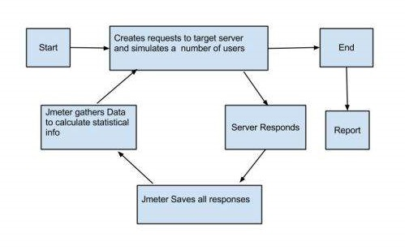

Slide 5
jMeter - Build Test Plan
What is a Test Plan?
A Test Plan can be viewed as a container for running tests. It defines what to test and how to go about it. A complete test plan consists of one or more elements such as thread groups, logic controllers, sample-generating controllers, listeners, timers, assertions, and configuration elements. A test plan must have at least one thread group
Writing a Test Plan
Follow the steps given below to write a test plan −
Step 1: Start the JMeter Window
Open the JMeter window by clicking /home/manisha/apache-jmeter-2.9/bin/jmeter.sh. The JMeter window will appear as below −

Slide 6
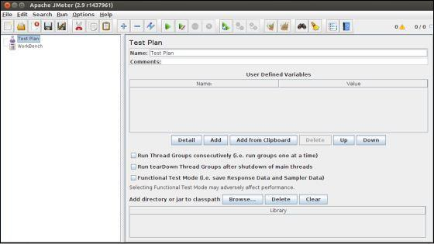

Slide 7
This is a plain and blank JMeter window without any additional elements added to it. It contains two nodes −
Test Plan node − is where the real test plan is kept.
Workbench node − It simply provides a place to temporarily store test elements while not in use, for copy/paste purposes. When you save your test plan, Workbench items are not saved with it.
Step 2: Add/Remove Elements
Elements (which will be discussed in the next chapter Test Plan Elements) can be added to a test plan by right-clicking on the Test Plan node and choosing a new element from the "add" list.
Alternatively, you can load an element from a file and add it by choosing the "merge" or "open" option.
For example, let us add a Thread Group element to a Test Plan as shown below −

Slide 8
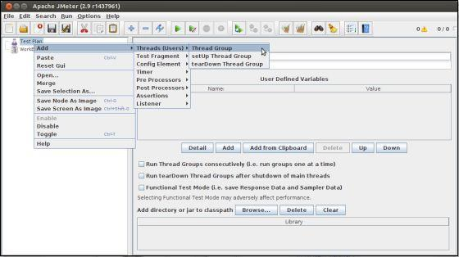

Slide 9
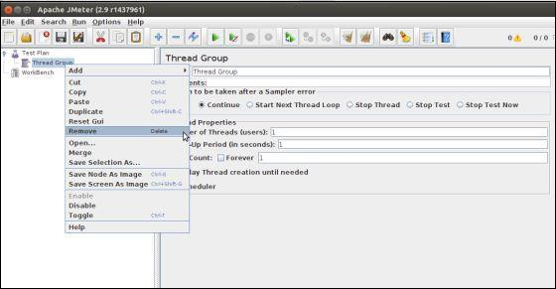
To remove an element, make sure the element is selected, right-click on the element, and choose the "remove" option.
Step 3: Load and Save the Elements
To load an element from file −
Right-click on the existing tree element to which you want to add the loaded element.
Select Merge.
Choose the file where you saved the elements.
JMeter will merge the elements into the tree.
By default, JMeter does not save the element, you need to explicitly save it.

Slide 10
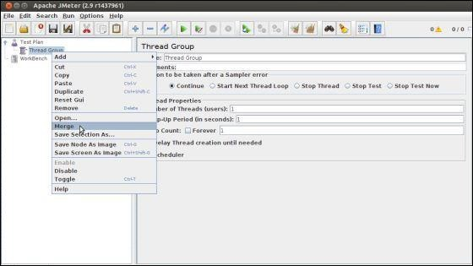
To save tree elements −
Right-click on the element.
Choose the Save Selection As ... option.
JMeter will save the element selected, plus all the child elements beneath it. By default, JMeter doesn't save the elements, you need to explicitly save it as mentioned earlier.

Slide 11
Step 4: Configuring the Tree Elements
Any element in the Test Plan can be configured using the controls present in JMeter's right-hand side frame. These controls allow you to configure the behavior of that particular test element. For example, the Thread Group can be configured for a number of users, ramp up periods, etc., as shown below −

Slide 12
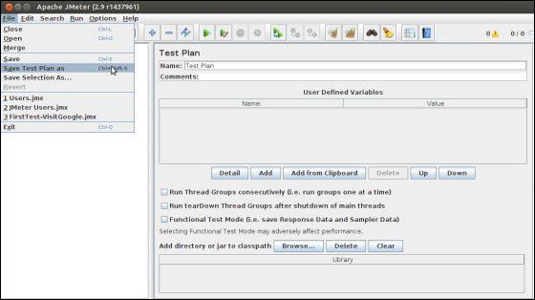
Step 5: Saving the Test Plan
You can save an entire Test Plan by using either Save or "Save Test Plan As ..." from the File menu.

Slide 13
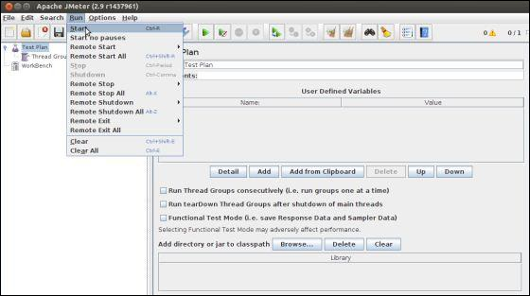
Step 6: Run the Test Plan
You can run the Test Plan by clicking Start(Control + r) from the Run menu item. When JMeter starts running, it shows a small green box at the right-hand end of the section just under the menubar.

Slide 14
Step 7: Stop the Test Plan
You can stop your test in two ways −
Using Stop (Control + '.'). It stops the threads immediately if possible.
Using Shutdown (Control + ','). It requests the threads to stop at the end of any current work.
jMeter - Test Plan Elements
A JMeter Test Plan comprises of test elements discussed below. A Test Plan comprises of at least one Thread Group. Within each Thread Group, we may place a combination of one or more of other elements − Sampler, Logic Controller, Configuration Element, Listener, and Timer. Each Sampler can be preceded by one or more Pre-processor element, followed by Post-processor element, and/or Assertion element. Let us see each of these elements in detail −
Thread Group
Thread Group elements are the beginning points of your test plan. As the name suggests, the thread group elements control the number of threads JMeter will use during the test. We can also control the following via the Thread Group −

Slide 15
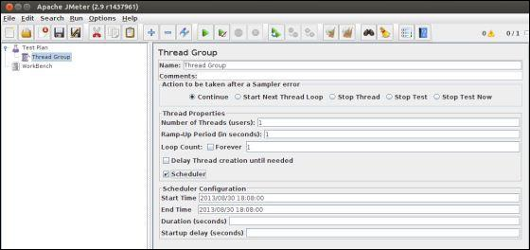
Setting the number of threads
Setting the ramp-up time
Setting the number of test iterations
The Thread Group Control Panel looks like this −

Slide 16
The Thread Group Panel holds the following components −
Action to be taken after a Sampler error − In case any error occurs during test execution, you may let the test either −
Continue to the next element in the test
Stop Thread to stop the current Thread.
Stop Test completely, in case you want to inspect the error before it continues running.
Number of Threads − Simulates the number of users or connections to your server application.
Ramp-Up Period Defines how long it will take JMeter to get all threads running.
Loop Count − Defines the number of times to execute the test.
Scheduler checkbox − Once selected, the Scheduler Configuration section appears at the bottom of the control panel.
Scheduler Configuration − You can configure the start and end time of running the test.

Slide 17
Controllers
JMeter has two types of Controllers − Samplers and Logic Controllers.
Samplers
Samplers allow JMeter to send specific types of requests to a server. They simulate a user request for a page from the target server. For example, you can add a HTTP Request sampler if you need to perform a POST, GET, or DELETE on a HTTP service.
Some useful samplers are −
HTTP Request
FTP Request
JDBC Request
Java Request
SOAP/XML Request
RPC Requests

Slide 18
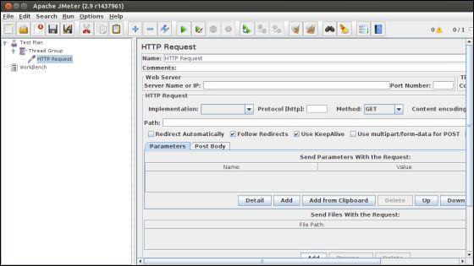
The following screenshot shows an HTTP Request Sampler Control Panel −

Slide 19
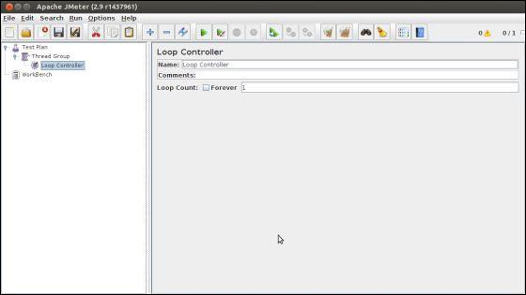
Logic Controllers
Logic Controllers let you control the order of processing of Samplers in a Thread. Logic controllers can change the order of a request coming from any of their child elements. Some examples are − ForEach Controller, While Controller, Loop Controller, IF Controller, Run Time Controller, Interleave Controller, Throughput Controller, and Run Once Controller.
The following screenshot shows a Loop Controller Control Panel −

Slide 20
The following list consists of all the Logic Controllers JMeter provides −
Simple Controller
Loop Controller
Once Only Controller
Interleave Controller
Random Controller
Random Order Controller
Throughput Controller
Runtime Controller
If Controller
While Controller
Switch Controller
ForEach Controller
Module Controller
Include Controller
Transaction Controller
Recording Controller

Slide 21
Test Fragments
A Test Fragment is a special type of element placed at the same level as the Thread Group element. It is distinguished from a Thread Group in that it is not executed unless it is referenced by either a Module Controller or an Include_Controller. This element is purely for code re-use within Test Plans.
Listeners
Listeners let you view the results of Samplers in the form of tables, graphs, trees, or simple text in some log files. They provide visual access to the data gathered by JMeter about the test cases as a Sampler component of JMeter is executed.
Listeners can be added anywhere in the test, including directly under the test plan. They will collect data only from elements at or below their level. The following list consists of all the Listeners JMeter provides −
Sample Result Save Configuration
Graph Full Results
Graph Results
Spline Visualizer
Assertion Results
View Results Tree

Slide 22
Aggregate Report
View Results in Table
Simple Data Writer
Monitor Results
Distribution Graph (alpha)
Aggregate Graph
Mailer Visualizer
BeanShell Listener
Summary Report

Slide 23
Timers
By default, a JMeter thread sends requests without pausing between each sampler. This may not be what you want. You can add a timer element which allows you to define a period to wait between each request.
The following list shows all the timers that JMeter provides −
Constant Timer
Gaussian Random Timer
Uniform Random Timer
Constant Throughput Timer
Synchronizing Timer
JSR223 Time
BeanShell Time
BSF Time
Poisson Random Time

Slide 24
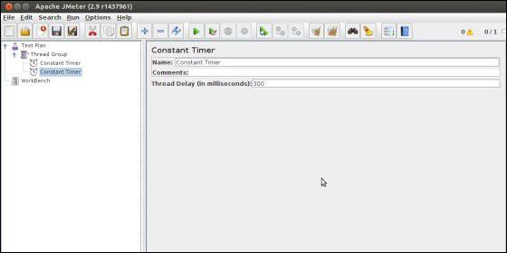

Slide 25
Assertions
Assertions allow you to include some validation test on the response of your request made using a Sampler. Using assertions you can prove that your application is returning the correct data. JMeter highlights when an assertion fails.
The following list consists of all the assertions JMeter provides −
Beanshell Assertion
BSF Assertion
Compare Assertion
JSR223 Assertion
Response Assertion
Duration Assertion
Size Assertion
XML Assertion
BeanShell Assertion
MD5Hex Assertion
HTML Assertion
XPath Assertion
XML Schema Assertion

Slide 26
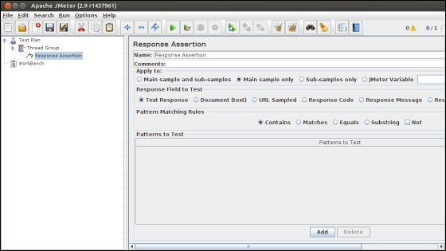
The following screenshot shows a Response Assertion Control Panel −

Slide 27
Configuration Elements
Configuration Elements allow you to create defaults and variables to be used by Samplers. They are used to add or modify requests made by Samplers.
They are executed at the start of the scope of which they are part, before any Samplers that are located in the same scope. Therefore, a Configuration Element is accessed only from inside the branch where it is placed.
The following list consists of all the Configuration Elements that JMeter provides −
Counter
CSV Data Set Config
FTP Request Defaults
HTTP Authorization Manager
HTTP Cache Manager
HTTP Cookie Manager
HTTP Proxy Server
HTTP Request Defaults
HTTP Header Manager

Slide 28
Java Request Defaults
Keystore Configuration
JDBC Connection Configuration
Login Config Element
LDAP Request Defaults
LDAP Extended Request Defaults
TCP Sampler Config
User Defined Variables
Simple Config Element
Random Variable

Slide 29
Pre-processor Elements
A pre-processor element is something that runs just before a sampler executes. They are often used to modify the settings of a Sample Request just before it runs, or to update variables that are not extracted from response text.
The following list consists of all the pre-processor elements that JMeter provides −
HTML Link Parser
HTTP URL Re-writing Modifier
HTTP User Parameter Modifier
User Parameters
JDBC PreProcessor
JSR223 PreProcessor
RegEx User Parameters
BeanShell PreProcessor
BSF PreProcessor

Slide 30
Post-processor Elements
A post-processor executes after a sampler finishes its execution. This element is most often used to process the response data, for example, to retrieve a particular value for later use.
The following list consists of all the Post-Processor Elements JMeter provides −
Regular Expression Extractor
XPath Extractor
Result Status Action Handler
JSR223 PostProcessor
JDBC PostProcessor
BSF PostProcessor
CSS/JQuery Extractor
BeanShell PostProcessor
Debug PostProcessor

Slide 31
Execution Order of Test Elements
Following is the execution order of the test plan elements −
Configuration elements
Pre-Processors
Timers
Sampler
Post-Processors (unless SampleResult is null)
Assertions (unless SampleResult is null)
Listeners (unless SampleResult is null)

Slide 32
jMeter - Web Test Plan
Let us build a simple test plan which tests a web page. We write a test plan in Apache JMeter so that we can test the performance of the web page shown by the URL − www.tutorialspoint.com
Start JMeter
Open the JMeter window by clicking on /home/manisha/apache-jmeter-2.9/bin/jmeter.sh. The JMeter window appear as below −

Slide 33
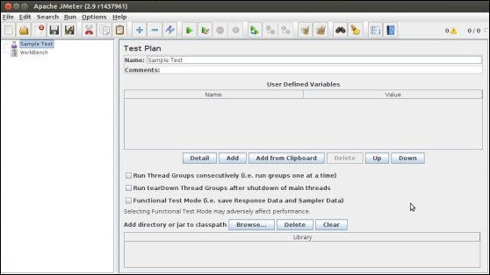
Rename the Test Plan
Change the name of test plan node to Sample Test in the Name text box. You need to change the focus to workbench node and back to the Test Plan node to see the name getting reflected.

Slide 34
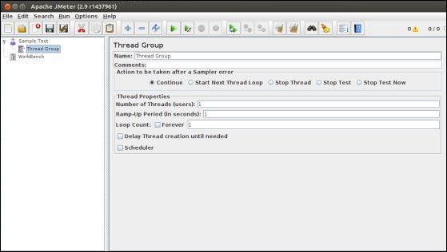
Add Thread Group
Now we add our first element in the window. We add one Thread Group, which is a placeholder for all other elements like Samplers, Controllers, and Listeners. We need one so we can configure number of users to simulate.
In JMeter, all the node elements are added by using the context menu.
Right-click the element where you want to add a child element node.
Choose the appropriate option to add.
Right-click on the Sample Test (our Test Plan) → Add → Threads (Users) → Thread Group. Thus, the Thread Group gets added under the Test Plan (Sample Test) node

Slide 35
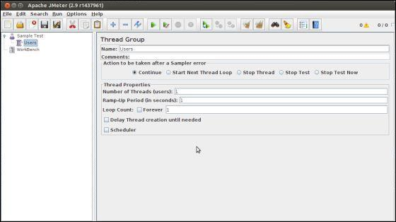
Name the Thread Group as Users. For us, this element means users visiting the TutorialsPoint Home Page.

Slide 36
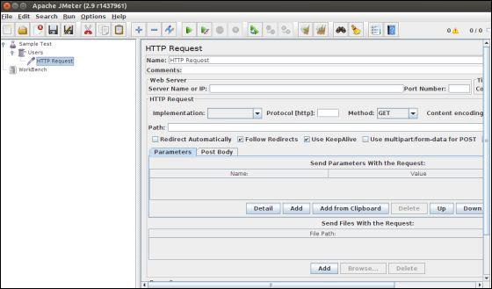
Add Sampler
We need to add one Sampler in our Thread Group (Users). As done earlier for adding Thread group, this time we will open the context menu of the Thread Group (Users) node by right-clicking and we will add HTTP Request Sampler by choosing Add → Sampler → HTTP request option.

Slide 37
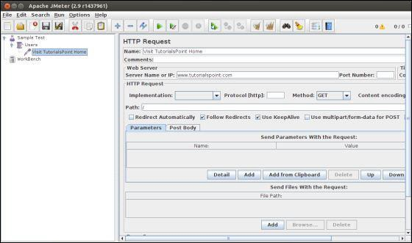
It will add one empty HTTP Request Sampler under the Thread Group (Users) node. Let us configure this node element −

Slide 38
Name − We will change the name to reflect the action what we want to achieve. We will name it as Visit TutorialsPoint Home Page
Server Name or IP − Here, we have to type the web server name. In our case it is www.tutorialspoint.com. (http:// part is not written this is only the name of the server or its IP)
Protocol − We will keep this blank, which means we want HTTP as the protocol.
Path − We will type path as / (slash). It means we want the root page of the server.
Add Listener
We will now add a listener. Let us add View Results Tree Listener under the Thread Group (User) node. It will ensure that the results of the Sampler will be available to view in this Listener node element.
To add a listener −
Open the context menu
Right-click the Thread Group (Users)
Choose Add → Listener → View Results Tree option

Slide 39
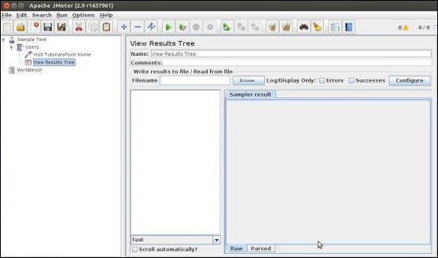

Slide 40
Run the Test Plan
Now with all the setup, let us execute the test plan. With the configuration of the Thread Group (Users), we keep all the default values. It means JMeter will execute the sampler only once. It is similar to a single user, only once.
This is similar to a user visiting a web page through browser, with JMeter sampler. To execute the test plan, Select Run from the menu and select Start option.
Apache JMeter asks us to save the test plan in a disk file before actually starting the test. This is important if you want to run the test plan multiple times. You can opt for running it without saving too.

Slide 41
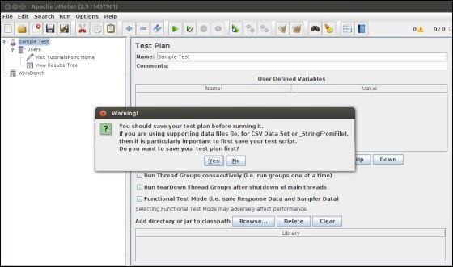

Slide 42
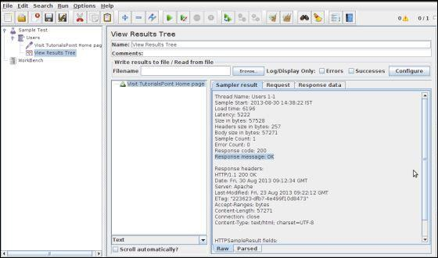
View the Output
We have kept the setting of the thread group as single thread (one user only) and loop for 1 time (run only one time), hence we will get the result of one single transaction in the View Result Tree Listener.

Slide 43
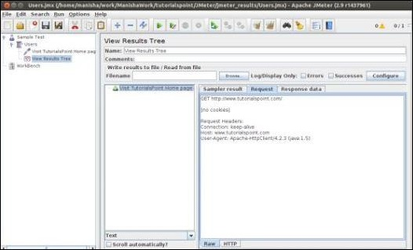
Details of the above result are −
Green color against the name Visit TutorialsPoint Home Page indicates success.
JMeter has stored all the headers and the responses sent by the web server and ready to show us the result in many ways.
The first tab is Sampler Results. It shows JMeter data as well as data returned by the web server.
The second tab is Request, which shows all the data sent to the web server as part of the request

Slide 44
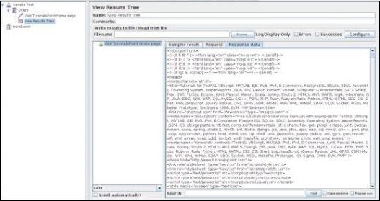
The last tab is Response data. In this tab, the listener shows the data received from server in text format.

Slide 45
jMeter - Database Test Plan
Once MYSQL is installed, follow the steps below to setup the database −
Create a database with name "tutorial".
Create a table tutorials_tbl.
Insert records into tutorials_tbl as shown below −
mysql> use TUTORIALS;
Database changed
mysql> INSERT INTO tutorials_tbl
->(tutorial_title, tutorial_author, submission_date)
->VALUES ->("Learn PHP", "John Poul", NOW());
Query OK, 1 row affected (0.01 sec)
mysql> INSERT INTO tutorials_tbl
->(tutorial_title, tutorial_author, submission_date)
->VALUES ->("Learn MySQL", "Abdul S", NOW());

Slide 46
Query OK, 1 row affected (0.01 sec)
mysql> INSERT INTO tutorials_tbl
->(tutorial_title, tutorial_author, submission_date)
->VALUES
->("JAVA Tutorial", "Sanjay", '2007-05-06');
Query OK, 1 row affected (0.01 sec)
mysql>
Copy the appropriate JDBC driver to /home/manisha/apache-jmeter-2.9/lib.
Create JMeter Test Plan
Let us start the JMeter from /home/manisha/apache-jmeter-2.9/bin/jmeter.sh.
Add Users

Slide 47
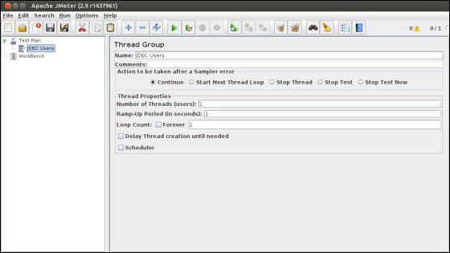
To create a Thread group,
Right-click on Test Plan.
Select Add → Threads (Users) → Thread Group.
Thus, thread group gets added under the Test Plan node.
Rename this Thread Group as JDBC Users.
We will not change the default properties of the Thread Group

Slide 48
Adding JDBC Requests
Now that we defined our users, it is time to define the tasks that they will be performing. In this section, specify the JDBC requests to perform.
Right-click on the JDBC Users element.
Select Add → Config Element → JDBC Connection Configuration.
Set up the following fields (we are using MySQL database called tutorial) −
Variable name bound to pool. This needs to identify the configuration uniquely. It is used by the JDBC Sampler to identify the configuration to be used. We have named it as test.
Database URL − jdbc:mysql://localhost:3306/tutorial.
JDBC Driver class: com.mysql.jdbc.Driver.
Username: root.
Password: password for root.

Slide 49
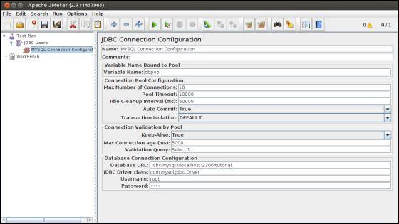

Slide 50
Now add a JDBC Request which refers to the JDBC Configuration pool defined above. Select JDBC Users element.
Click your right mouse button to get the Add menu
Select Add → Sampler → JDBC Request.
Select this new element to view its Control Panel.
Edit the properties as shown below −
Variable name bound to pool. This needs to uniquely identify the configuration. It is used by the JDBC Sampler to identify the configuration to be used. Named it as test.
Name − Learn.
Enter the Pool Name − test (same as in the configuration element).
Query Type − Select statement.
Enter the SQL Query String field

Slide 51
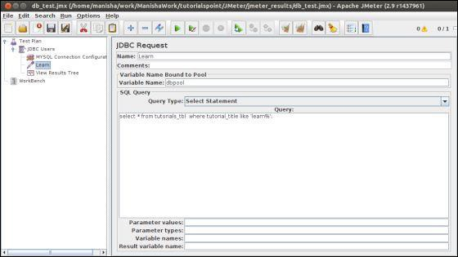

Slide 52
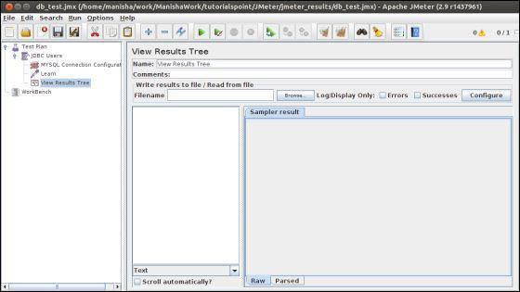
Create Listener
Now add the Listener element. This element is responsible for storing all of the results of your JDBC requests in a file and presenting a visual model of the data.
Select the JDBC Users element
Add a View Results Tree listener (Add → Listener → View Results Tree).

Slide 53
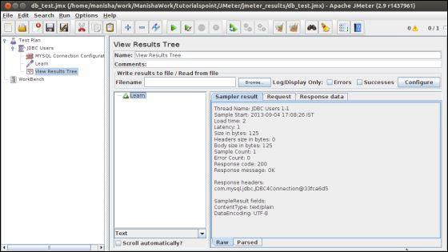
Save and Execute Test Plan
Now save the above test plan as db_test.jmx. Execute this test plan using Run → Start option.
Verify the Output :

Slide 54
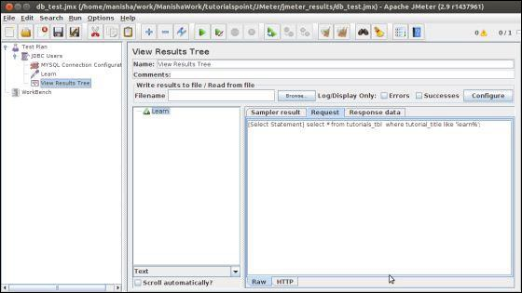
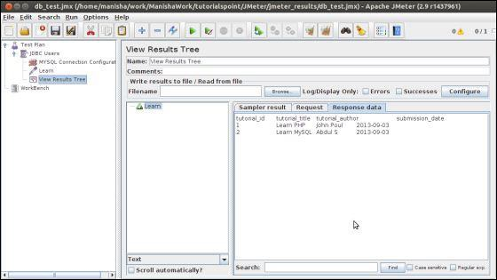

Slide 55
jMeter - FTP Test Plan
In this chapter, we will see how to test a FTP site using JMeter. Let us create a Test Plan to test the FTP site.
Rename Test Plan
Open the JMeter window by clicking /home/manisha/apache-jmeter-2.9/bin/jmeter.sh
Click on the Test Plan node.
Rename this Test Plan node as TestFTPSite.
Add Thread Group
Add one Thread Group, which is placeholder for all other elements like Samplers, Controllers, and Listeners.
Right click on TestFTPSite (our Test Plan)
Select Add → Threads(Users) → Thread Group. Thread Group will get added under the Test Plan (TestFTPSite) node.

Slide 56
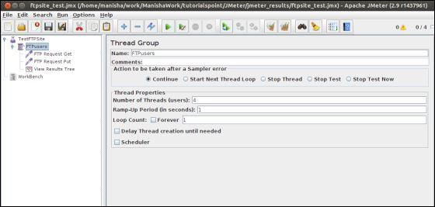
Modify the default properties of the Thread Group to suit our testing as follows −
Name − FTPusers
Number of Threads (Users) − 4
Ramp-Up Period − leave the the default value of 0 seconds.
Loop Count − 1

Slide 57
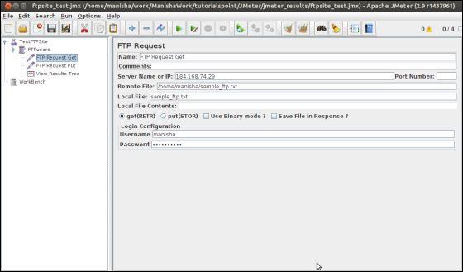
Add Sampler − FTP Request
Now that we have defined our users, it is time to define the tasks that they will be performing. Add FTP Request elements. We add two FTP request elements, one which retrieves a file and the other which puts a file on the ftp site.
Select the FTP users element.
Right-click the mouse button to get the Add menu
Select Add → Sampler → FTP Request.
Select the FTP Request element in the tree.
Edit the following properties as shown below −

Slide 58
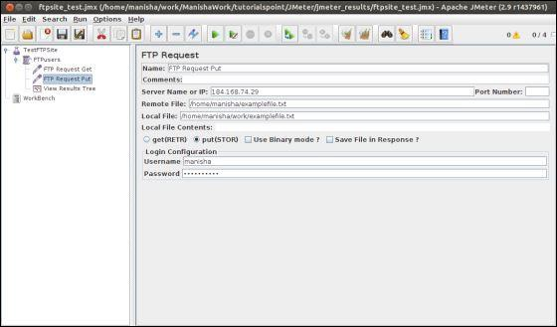
The following details are entered in this element −
Name − FTP Request Get
Server Name or IP − 184.168.74.29
Remote File − /home/manisha/sample_ftp.txt
Local File − sample_ftp.txt
Select get(RETR)
Username − manisha
Password − manisha123
Now add another FTP request as above and edit the properties as shown in the following
screenshot −

Slide 59
The following details are entered in this element −
Name − FTP Request Put
Server Name or IP − 184.168.74.29
Remote File − /home/manisha/examplefile.txt
Local File − /home/manisha/work/examplefile.txt
Select put(STOR)
Username − manisha
Password − manisha123
Add Listener
The final element you need to add to your Test Plan is a Listener. This element is responsible for storing all of the results of your FTP requests in a file and presenting a visual model of the data.
Select the FTP users element.
Add a View Results Tree listener by selecting Add > Listener > View Results Tree.

Slide 60
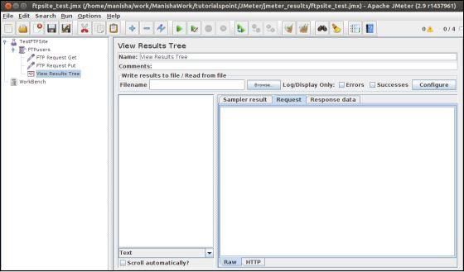
Run the Test Plan
Now save the above test plan as ftpsite_test.jmx. Execute this test plan using Run → Start option.
View the Output
The following output can be seen in the listener.

Slide 61
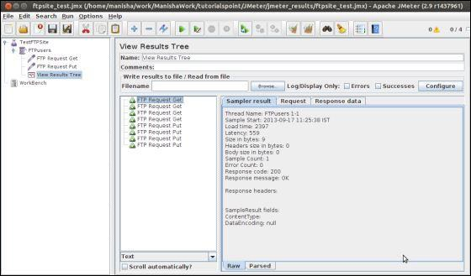
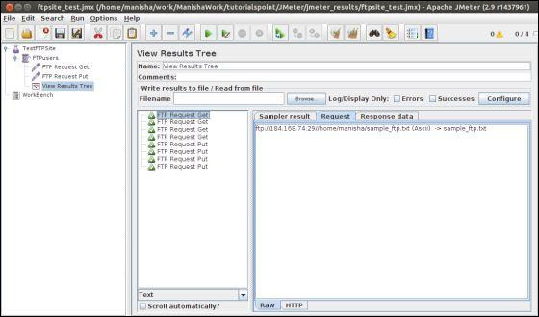

Slide 62
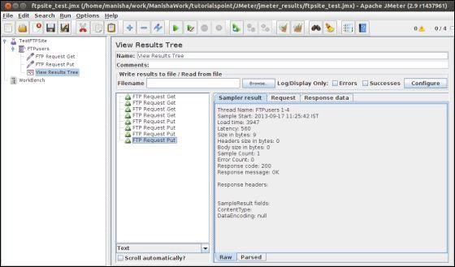

Slide 63
You can see that four requests are made for each FTP request and the test is successful. The retrieved file for GET request is stored in the /bin folder. In our case, it is /home/manisha/apache-jmeter-2.9/bin/. For PUT request, the file is uploaded at the path /home/manisha/.
jMeter - Webservice Test Plan
we will learn how to create a Test Plan to test a WebService. For our test purpose, we have created a simple webservice project and deployed it on the Tomcat server locally
Create Webservice Project
To create a webservice project, we have used Eclipse IDE. First write the Service Endpoint Interface HelloWorld under the package com.tutorialspoint.ws. The contents of the HelloWorld.java are as follows −
package com.tutorialspoint.ws;
import javax.jws.WebMethod;
import javax.jws.WebService;
import javax.jws.soap.SOAPBinding;
import javax.jws.soap.SOAPBinding.Style;

Slide 64
//Service Endpoint Interface
@WebService
@SOAPBinding(style = Style.RPC)
public interface HelloWorld {
@WebMethod String getHelloWorldMessage(String string);
}
This service has a method getHelloWorldMessage which takes a String parameter.
Next, create the implementation class HelloWorldImpl.java under the package com.tutorialspoint.ws.
package com.tutorialspoint.ws;
import javax.jws.WebService;
@WebService(endpointInterface="com.tutorialspoint.ws.HelloWorld")
public class HelloWorldImpl implements HelloWorld {
@Override
public String getHelloWorldMessage(String myName) {
return("Hello "+myName+" to JAX WS world");
}
}

Slide 65
Let us now publish this web service locally by creating the Endpoint publisher and expose the service on the server.
The publish method takes two parameters −
Endpoint URL String.
Implementor object, in this case the HelloWorld implementation class, which is exposed as a Web Service at the endpoint identified by the URL mentioned in the parameter above.
The contents of HelloWorldPublisher.java are as follows −
package com.tutorialspoint.endpoint;
import javax.xml.ws.Endpoint;
import com.tutorialspoint.ws.HelloWorldImpl;
public class HelloWorldPublisher {
public static void main(String[] args) {
Endpoint.publish("http://localhost:9000/ws/hello", new HelloWorldImpl());
}
}
Modify the web.xml contents as shown below −
<?xml version = "1.0" encoding = "UTF-8"?> <!DOCTYPE web-app PUBLIC "-//Sun Microsystems, Inc.//DTD Web Application 2.3//EN" "http://java.sun.com/j2ee/dtds/web-app_2_3.dtd">

Slide 66
<web-app> <listener> <listener-class> com.sun.xml.ws.transport.http.servlet.WSServletContextListener </listener-class> </listener> <servlet> <servlet-name>hello</servlet-name> <servlet-class>com.sun.xml.ws.transport.http.servlet.WSServlet</servlet-class> <load-on-startup>1</load-on-startup> </servlet> <servlet-mapping> <servlet-name>hello</servlet-name> <url-pattern>/hello</url-pattern> </servlet-mapping> <session-config> <session-timeout>120</session-timeout> </session-config> </web-app>
To deploy this application as a webservice, we would need another configuration file sun-jaxws.xml. The contents of this file are as follows −
<?xml version = "1.0" encoding = "UTF-8"?>
<endpoints xmlns = "http://java.sun.com/xml/ns/jax-ws/ri/runtime" version = "2.0">
<endpoint name = "HelloWorld"
implementation = "com.tutorialspoint.ws.HelloWorldImpl" url-pattern = "/hello"/>
</endpoints>

Slide 67
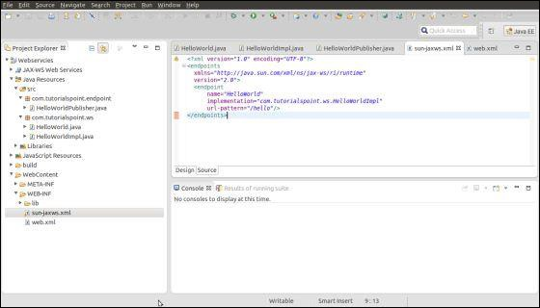
Now that all the files are ready, the directory structure would look as shown in the following screenshot −
Now create a WAR file of this application.
Choose the project → right click → Export → WAR file.
Save this as hello.war file under the webapps folder of Tomcat server.
Now start the Tomcat server.
Once the server is started, you should be able to access the webservice with the URL − http://localhost:8080/hello/hello

Slide 68
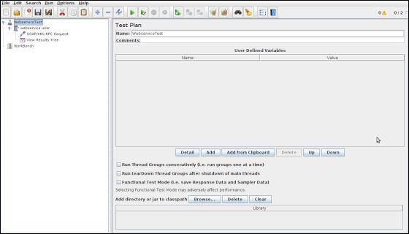
Create JMeter Test plan
Now let us create a test plan to test the above webservice.
Rename the Test Plan
Open the JMeter window by clicking /home/manisha/apache-jmeter2.9/bin/jmeter.sh.
Click the Test Plan node.
Rename this Test Plan node as WebserviceTest.

Slide 69
Add Thread Group
Add one Thread Group, which is placeholder for all other elements like Samplers, Controllers, and Listeners.
Right click on WebserviceTest (our Test Plan) → Add → Threads (Users) → Thread Group. Thread Group will get added under the Test Plan (WebserviceTest) node.
Next, let us modify the default properties of the Thread Group to suit our testing. Following properties are changed −
Name − webservice user
Number of Threads (Users) − 2
Ramp-Up Period − leave the the default value of 0 seconds.
Loop Count − 2

Slide 70
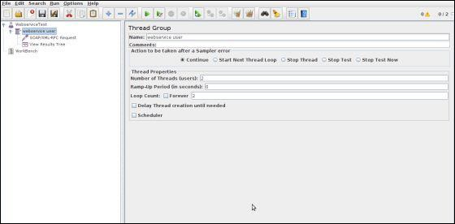
Add Sampler - SOAP/XML-RPC Request
Now that we have defined the users, it is time to define the tasks that they will be performing.
We will add SOAP/XML-RPC Request element −
Right-click mouse button to get the Add menu.
Select Add → Sampler → SOAP/XML-RPC Request.
Select the SOAP/XML-RPC Request element in the tree

Slide 71
Edit the following properties as in the image below −
The following details are entered in this element −
Name − SOAP/XML-RPC Request
URL − http://localhost:8080/hello/hello?wsdl
Soap/XML-RPC Data − Enter the below contents
<soapenv:Envelope xmlns:soapenv = "http://schemas.xmlsoap.org/soap/envelope/" xmlns:web = "http://ws.tutorialspoint.com/"> <soapenv:Header/> <soapenv:Body> <web:getHelloWorldMessage> <arg0>Manisha</arg0> </web:getHelloWorldMessage> </soapenv:Body> </soapenv:Envelope>

Slide 72
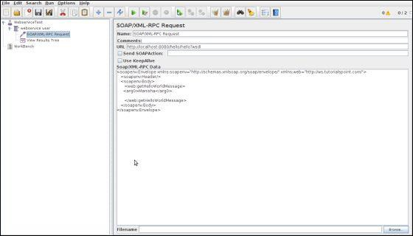
Add Listener
The final element you need to add to your Test Plan is a Listener. This element is responsible for storing all of the results of your HTTP requests in a file and presenting a visual model of the data.
Select the webservice user element.
Add a View Results Tree listener by selecting Add → Listener → View Results Tree.

Slide 73
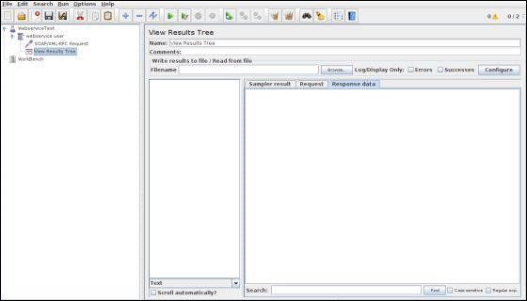
Run the Test Plan
Now save the above test plan as test_webservice.jmx. Execute this test plan using Run → Start option.
View the Output
The following output can be seen in the listener.

Slide 74
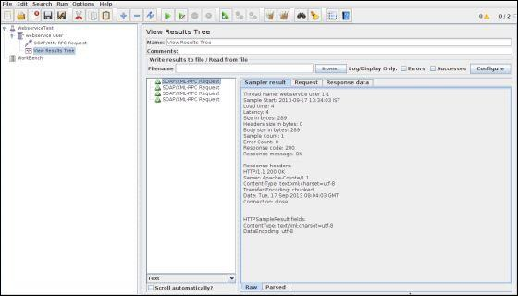
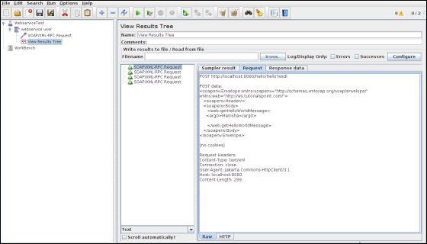

Slide 75
jMeter - JMS Test Plan
we will learn how to write a simple test plan to test Java Messaging Service (JMS). JMS supports two types of messaging −
Point-to-Point messaging − Queue messaging is generally used for transactions where the sender expects a response. Messaging systems are quite different from normal HTTP requests. In HTTP, a single user sends a request and gets a response.
Topic messaging − Topic messages are commonly known as pub/sub messaging. Topic messaging is generally used in cases where a message is published by a producer and consumed by multiple subscribers.
Let us see a test example for each of these. The pre-requisites for testing JMS are −
We use Apache ActiveMQ in the example. There are various JMS servers like IBM WebSphere MQ (formerly MQSeries), Tibco, etc. Download it from the binaries from the Apache ActiveMQ website.

Slide 76
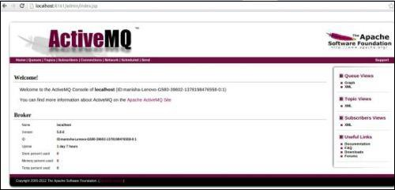
Unzip the archive, go to the decompressed directory, and run the following command from the command console to start the ActiveMQ server −
.\bin\activemq start You can verify if the ActiveMQ server has started by visiting the admin interface at the following address http://localhost:8161/admin/. If it asks for authentication, then enter the userid and password as admin. The screen is similar as shown below −
Now copy the activemq-all-x.x.x.jar (XXX depending on the version) from the ActiveMQ unzipped directory to /home/manisha/apache-jmeter-2.9/lib.
With the above setup, let us build the test plan for −
JMS Point-to-Point Test Plan
JMS Topic Test Plan

