Slide 1
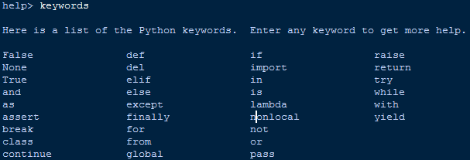
Python Keywords
Keywords are special words which are reserved and have a specific meaning. Python has a set of keywords that cannot be used as variables in programs.
All keywords in Python are case sensitive. So, you must be careful while using them in your code. We’ve just captured here a snapshot of the possible Python keywords

Slide 2
you can use Python’s keyword module, import it straight from the shell and run the below commands to view the supported keywords
>>> import keyword
>>> keyword.kwlist
['False', 'None', 'True', 'and', 'as', 'assert', 'break', 'class', 'continue', 'def', 'del', 'elif',
'else', 'except', 'finally', 'for', 'from', 'global', 'if',
'import', 'in', 'is', 'lambda', 'nonlocal', 'not', 'or', 'pass', 'raise', 'return', 'try', 'while',
'with', 'yield']
>>>

Slide 3
Python Identifiers
Python Identifiers are user-defined names to represent a variable, function, class, module or any other object. If you assign some name to a programmable entity in Python, then it is nothing but technically called an identifier
Guidelines For Creating Identifiers In Python
1. To form an identifier, use a sequence of letters either in lowercase (a to z) or uppercase (A to Z). However, you can also mix up digits (0 to 9) or an underscore (_) while writing an identifier.
For example – Names like shapeClass, shape_1, and upload_shape_to_db are all valid identifiers.
2. You can’t use digits to begin an identifier name. It’ll lead to the syntax error.
For example – The name, 0Shape is incorrect, but shape1 is a valid identifier.
3. Also, the Keywords are reserved, so you should not use them as identifiers.
>>> for=1
SyntaxError: invalid syntax

Slide 4
4. Python Identifiers can also not have special characters [‘.’, ‘!’, ‘@’, ‘#’, ‘$’, ‘%’] in their formation. These symbols are forbidden.
>>> @index=0
SyntaxError: invalid syntax
>>> isPython?=True
SyntaxError: invalid syntax
Best Practices For Identifier Naming.
Better have class names starting with a capital letter. All other identifiers should begin with a lowercase letter.
Declare private identifiers by using the (‘_’) underscore as their first letter.
Don’t use ‘_’ as the leading and trailing character in an identifier. As Python built-in types already use this notation.
Avoid using names with only one character. Instead, make meaningful names.
For example – While i = 1 is valid, but writing iter = 1 or index = 1 would make more sense.
You can use underscore to combine multiple words to form a sensible name.
For example – count_no_of_letters.

Slide 5
Python Variables
A variable in Python represents an entity whose value can change as and when required. Conceptually, it is a memory location which holds the actual value. And we can retrieve the value from our code by querying the entity.
1. Variables don’t require declaration. However, you must initialize them before use
test = 10
2. The above expression will lead to the following actions.
Creation of an object to represent the value 10.
If the variable (test) doesn’t exist, then it’ll get created.
Association of the variable with the object, so that it can refer the value.
3. Whenever the expression changes, Python associates a new object (a chunk of memory) to the variable for referencing that value. And the old one goes to the garbage collector.
>>> test = 10
>>> id(test)
1716585200
>>> test = 11
>>> id(test)
1716585232

Slide 6
4. It’s the object which has a type, not the variable. However, a variable can hold objects of different types as and when required.
>>> test = 10
>>> type(test)
<class 'int'>
>>> test = 'techbeamers‘
>>> type(test)
<class 'str'>
>>> test = {'Python', 'C', 'C++'}
>>> type(test)
<class 'set'> >>>

