Slide 1

Causes of Alcoholism
Dean Daley
Harinee Madhusudhan
Craig Taflin

Slide 2
Executive Summary
Problem
Alcohol is a major problem in the US and is classified as on of 7 Chronic diseases that an important public health problem.
The chronic disease indicators (CDIs) are a set of surveillance indicators developed by consensus among CDC and tracked on a yearly basis.
Questions
1.) What is the Definition of Alcoholism?
2.) Who is affected by Alcoholism?
3.) What are the underlying causes of Alcoholism?
Notes:
1.) Harinee will discuss the definition of Alcholism
2.) I will talk about who is affected by this Disease
3.) Dean will then discuss the underlying causes

Slide 3
Data Collection & Cleansing
Data Sources
1.) CDC U.S. Cancer Statistics Technical Notes
2.) Eater.com- Number of people per bar in each state
3.) [income source of data]
Data Cleaning
Isolated Alcoholism in CDC report and merged other sources
Concatenate and Divide columns into multiple columns
Break out Age, Sex, Drinking Categories (binge, heavy)
Grouping, Mean , Conditional, Filtering, & Change Data Types
Notes:
Why we used Age-adjusted????

Slide 4
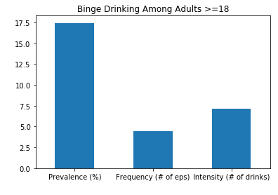
Definition of Alcoholism
a.) Binge Drinking:
Prevalence (%): Drinks at an occasion / Last 30 days (M- 5+, W- 4+)
Intensity: Largest Number at an Occasion / Last 30 days
Frequency: Binge episodes / Last 30 days
b.) Heavy Drinking: Total drinks per week / Last 30 days (M-14+ W-7+)
Notes:
Revised

Slide 5
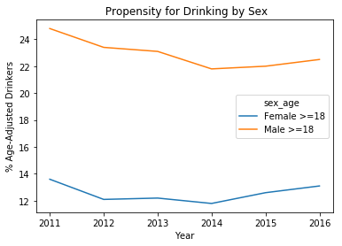
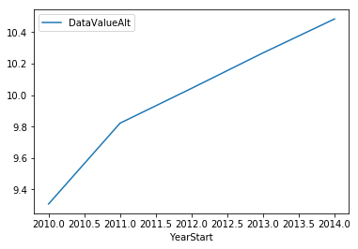
Propensity to Drink ➔ Chronic Liver Disease
Notes:
(add overall_age) to first chart
Add title, legend, and labels to both charts
Limitation of Chronic Liver Disease
Limitations of indicator Because alcohol-related disease can have a long latency, changes in behavior or clinical practice affecting population mortality might not be apparent for years. Not all chronic liver disease deaths are alcohol-attributable. However, in 2009, almost 70% of cirrhosis deaths in the United States were alcohol-attributable (5), and the proportion of cirrhosis deaths coded as 100% alcoholattributable has increased dramatically during 1970–2009 among United States adults aged 25–64 years (5)

Slide 6
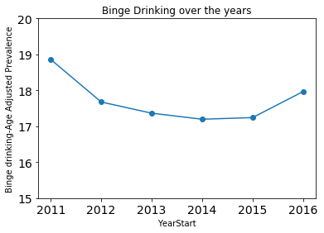
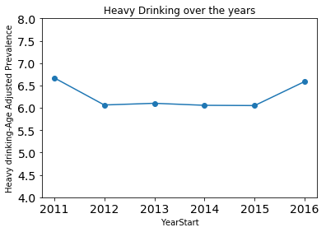
Binge vs. Heavy
Notes:
Revised

Slide 7
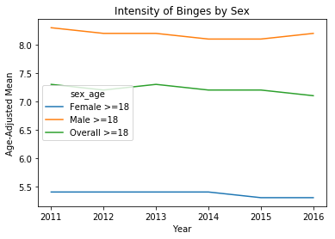
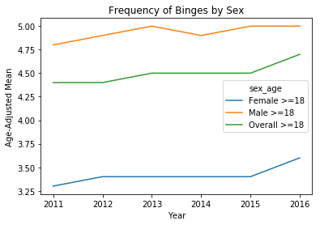
Intensity vs. Frequency

Slide 8
Underlying Factors
Several Obvious Hypotheses
Gather Data External to the Target Dataset
Looking for Correlations and Empirical Data
Indicators for Next Steps

Slide 9
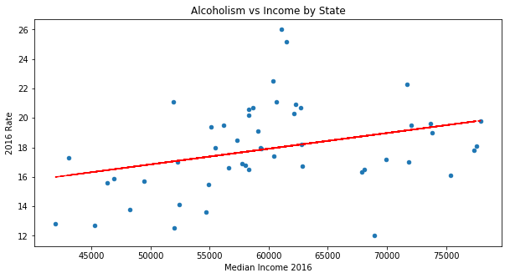
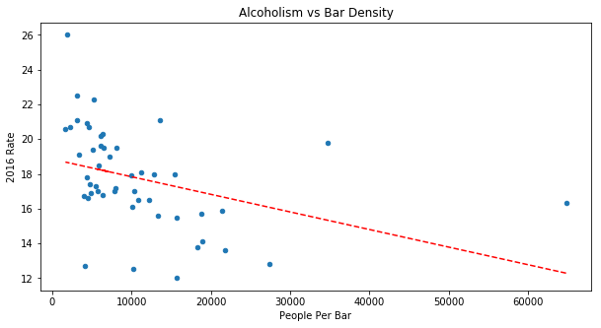
Challenges / Open Questions Remaining

Slide 10
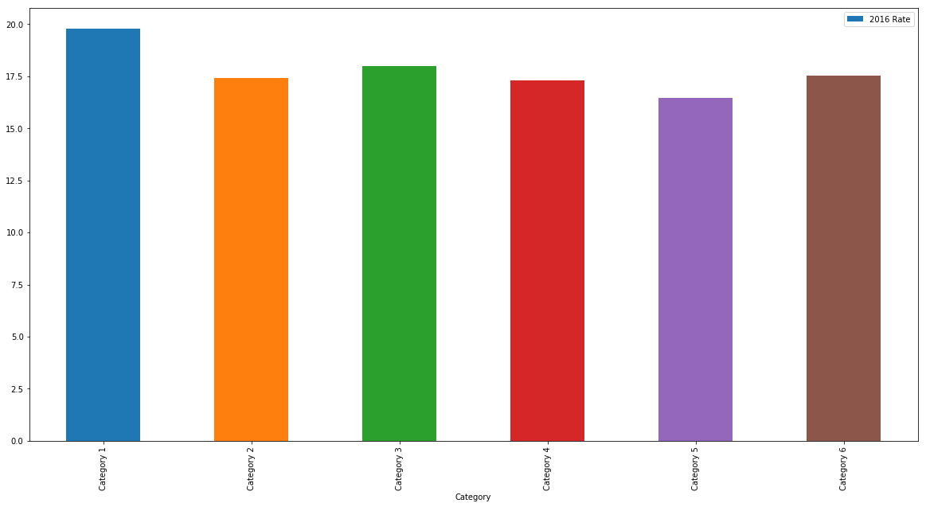
Effects of Regulation
Category 1 - State had exclusive local alcohol retail licensing | 8
Category 2 - State had joint local and state alcohol retail licensing | 10
Category 3 - State had exclusive state alcohol retail licensing but with local zoning authority | 16
Category 4 - State had mixed alcohol retail licensing policiesÂ | 8
Category 5 - State had nearly exclusive state alcohol retail licensing | 2
Category 6 - State had exclusive state alcohol retail licensing | 6

Slide 11
Challenges / Open Questions Remaining
Unaccounted Mortality
DUIs are actually also being caused by Alcoholism
Suicides
Gateway Drug
Figuring out the lag between drinking and chronic diseases
Would be great to see urban consumption vs rural
Need for zip code level data
Stereo Types of ghettos with corner/liquor store
Are people drinking at home or in the bars?

Slide 12
Backup/Alternative Sides
State | Regulation
Hawaii | Category 1 - State had exclusive local alcohol retail licensing
Minnesota | Category 1 - State had exclusive local alcohol retail licensing
Nevada | Category 1 - State had exclusive local alcohol retail licensing
New Jersey | Category 1 - State had exclusive local alcohol retail licensing
Rhode Island | Category 1 - State had exclusive local alcohol retail licensing
South Dakota | Category 1 - State had exclusive local alcohol retail licensing
Wisconsin | Category 1 - State had exclusive local alcohol retail licensing
Wyoming | Category 1 - State had exclusive local alcohol retail licensing
Arkansas | Category 2 - State had joint local and state alcohol retail licensing
Colorado | Category 2 - State had joint local and state alcohol retail licensing
Georgia | Category 2 - State had joint local and state alcohol retail licensing
Idaho | Category 2 - State had joint local and state alcohol retail licensing
Illinois | Category 2 - State had joint local and state alcohol retail licensing
Louisiana | Category 2 - State had joint local and state alcohol retail licensing
Massachusetts | Category 2 - State had joint local and state alcohol retail licensing
North Dakota | Category 2 - State had joint local and state alcohol retail licensing
Tennessee | Category 2 - State had joint local and state alcohol retail licensing
Utah | Category 2 - State had joint local and state alcohol retail licensing
Alaska | Category 3 - State had exclusive state alcohol retail licensing but with local zoning authority
California | Category 3 - State had exclusive state alcohol retail licensing but with local zoning authority
Connecticut | Category 3 - State had exclusive state alcohol retail licensing but with local zoning authority
Florida | Category 3 - State had exclusive state alcohol retail licensing but with local zoning authority
Indiana | Category 3 - State had exclusive state alcohol retail licensing but with local zoning authority
Iowa | Category 3 - State had exclusive state alcohol retail licensing but with local zoning authority
Kansas | Category 3 - State had exclusive state alcohol retail licensing but with local zoning authority
Maryland | Category 3 - State had exclusive state alcohol retail licensing but with local zoning authority
Montana | Category 3 - State had exclusive state alcohol retail licensing but with local zoning authority
Nebraska | Category 3 - State had exclusive state alcohol retail licensing but with local zoning authority
New Mexico | Category 3 - State had exclusive state alcohol retail licensing but with local zoning authority
Ohio | Category 3 - State had exclusive state alcohol retail licensing but with local zoning authority
Oklahoma | Category 3 - State had exclusive state alcohol retail licensing but with local zoning authority
Pennsylvania | Category 3 - State had exclusive state alcohol retail licensing but with local zoning authority
South Carolina | Category 3 - State had exclusive state alcohol retail licensing but with local zoning authority
Virginia | Category 3 - State had exclusive state alcohol retail licensing but with local zoning authority
Alabama | Category 4 - State had mixed alcohol retail licensing policiesÂ
Maine | Category 4 - State had mixed alcohol retail licensing policiesÂ
Michigan | Category 4 - State had mixed alcohol retail licensing policiesÂ
Mississippi | Category 4 - State had mixed alcohol retail licensing policiesÂ
Missouri | Category 4 - State had mixed alcohol retail licensing policiesÂ
Texas | Category 4 - State had mixed alcohol retail licensing policiesÂ
Vermont | Category 4 - State had mixed alcohol retail licensing policiesÂ
West Virginia | Category 4 - State had mixed alcohol retail licensing policiesÂ
North Carolina | Category 5 - State had nearly exclusive state alcohol retail licensing
Oregon | Category 5 - State had nearly exclusive state alcohol retail licensing
Arizona | Category 6 - State had exclusive state alcohol retail licensing
Delaware | Category 6 - State had exclusive state alcohol retail licensing
Kentucky | Category 6 - State had exclusive state alcohol retail licensing
New Hampshire | Category 6 - State had exclusive state alcohol retail licensing
New York | Category 6 - State had exclusive state alcohol retail licensing
Washington | Category 6 - State had exclusive state alcohol retail licensing
District of Columbia
Guam
Puerto Rico
Virgin Islands

Slide 13
Thank you!
Any Questions?

