Slide 1
Independent Studies
Harichandana Neralla

Slide 2
Open Source tools for security detection
Kube-hunter – for discovering security issues in Kubernetes clusters. This can be only used on cloud clusters.
Censys - is a platform that helps information security practitioners discover, monitor, and analyze devices that are accessible from the Internet.
They regularly probe every public IP address and popular domain names, curate and enrich the resulting data, and make it intelligible through an interactive search engine and API.
One way that Censys finds publicly-reachable devices is by using Internet-wide scanning. We make a small number of harmless connection attempts to every IPv4 address worldwide each day. When we discover that a computer or device is configured to accept connections, we follow up by completing protocol handshakes to learn more about the running services.
Shodan - (Sentient Hyper-Optimised Data Access Network) is a search engine designed to map and gather information about internet-connected devices and systems.
Port scanning, it possible to detect devices that are connected to the internet at any given time, the locations of those devices and their current users.
Such devices could be in almost any type of system, including business networks, surveillance cameras, industrial control systems (ICS) and smart homes.
What is the difference between CVE and a wild vulnerability?

Slide 3
VulChecker: Graph-based Vulnerability Localization in Source Code
VulChecker:
A deep learning framework for detecting the precise manifestation point, of software vulnerabilities in source code.
To accomplish this, VulChecker first passes the program’s source code through a custom LLVM compiler toolchain to generate a GNN-optimized program representation, which we refer to as an enriched program dependency graph (ePDG).

Slide 4
VulChecker: Graph-based Vulnerability Localization in Source Code
Prior Works: Limitations of SAST ( static application security testing) tools incomplete pattern matching algorithms which results in more false positives and cannot reach the vunerabilities that exist in unreachable code.
Explored applications of convolutional (CNN), recurrent (RNN), and graph neural networks (GNN).
This is accomplished by representing the software as an annotated graph (G) to encode its data-flow (DFG), control-flow (CFG), and/or abstract syntax (AST).
(1) these methods make predictions over entire functions or code regions and/or
(2) cannot classify the type of vulnerability found.

Slide 5
VulChecker: Graph-based Vulnerability Localization in Source Code
Insights:
1. Broad Program Slicing - To localize a vulnerability, the current approach is to take a subgraph Gi from G as an observation for making a prediction. Gi is either an entire function or a contiguous region extracted from G with a point of interest (PoI) at the center (a.k.a., a
program slice).
To increase the precision of a prediction, the observation must relate directly to the location of the vulnerability.

Slide 6
VulChecker: Graph-based Vulnerability Localization in Source Code
Insights:
2. Incomplete Code Representations: To convert Gi into a for-
mat that machine learning can understand, symbols derived
from the AST and/or functions are either compressed or embedded using methods like Word2Vec as a preprocessing step.
To enable effective graph-based learning in this task, a new code representation that properly incorporates the flow of AST information is required. Furthermore, instruction level semantics should be explicitly provided in G to enable efficient and effective learning.

Slide 7
VulChecker: Graph-based Vulnerability Localization in Source Code
Insights:
3. Manifestation Distance: Current GNN approaches use models that can only propagate a node’s information one or two steps away. These models are limited to identifying local patterns around either point.
To increase the model’s ability to identify vulnerabilities, the model must be able to identify causality across the entirety of Gi.

Slide 8
VulChecker: Graph-based Vulnerability Localization in Source Code
Insights:
4. The Lack of Labeled Data: Current work must either: (1) use synthetic datasets which do not generalize to large projects or real world code, or (2) use datasets that only label code regions (program slices) or entire functions.
To enable cost effective high precision detection in source code, there is a need to develop data augmentation techniques to efficiently expand existing datasets.

Slide 9
VulChecker: Graph-based Vulnerability Localization in Source Code
Insights:
5. Level of Program Representation: Current work must either: (1) use synthetic datasets which do not generalize to large projects or real world code, or (2) use datasets that only label code regions (program slices) or entire functions.
To improve the model’s ability to reason about vulnerabilities that have atomic machine-level characteristics, G should capture instruction semantics at lower levels rather than at source code.

Slide 10
VulChecker: Graph-based Vulnerability Localization in Source Code
VulChecker:
A deep learning framework for detecting the precise manifestation point, of software vulnerabilities in source code.
To accomplish this, VulChecker first passes the program’s source code through a custom LLVM compiler toolchain to generate a GNN-optimized program representation, which we refer to as an enriched program dependency graph (ePDG).

Slide 11
VulChecker: Graph-based Vulnerability Localization in Source Code
ePDGs are graph structures in which nodes represent atomic machine-level instructions and edges represent control- and data-flow dependencies between instructions.
ePDGs are well-conditioned for graph-based machine learning models since they more accurately capture the flow of the software.
VulChecker searches the ePDG for potential vulnerability manifestation points, such as calls to a free()function for double free vulnerabilities (i.e.,CWE-415).
During deployment, when a subgraph is predicted to be vulnerable with respect to a specific CWEVulChecker alerts the developer to the exact location (line and instruction) of the manifestation point in source code and indicates the CWE type.

Slide 12
VulChecker: Graph-based Vulnerability Localization in Source Code
Model : based on a message passing GNN – S2V.
Dataset: Injecting synthetic traces from Juliet C/C++ test suite. It’s effective because they injected root causes at random distance away from the manifestation point. This improves generalization by forcing the model to search deeper into Gi over real code.
Evaluated on 5 distinct CWEs: (cover both spatial and temporal memory safety issues)
Integer overflow
Stack overflow
Heap overflow
Double free
Use-after-free

Slide 13
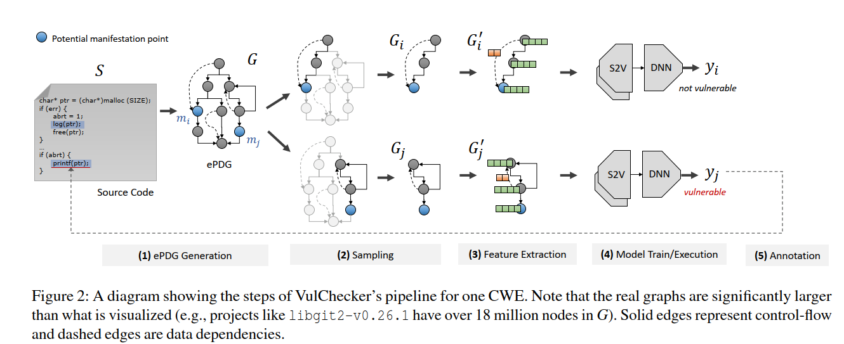
VulChecker: Graph-based Vulnerability Localization in Source Code

Slide 14
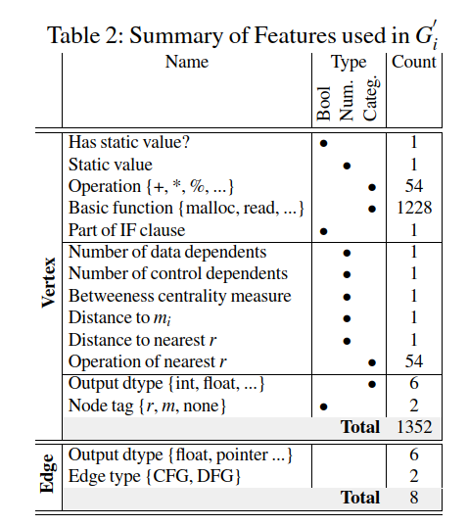
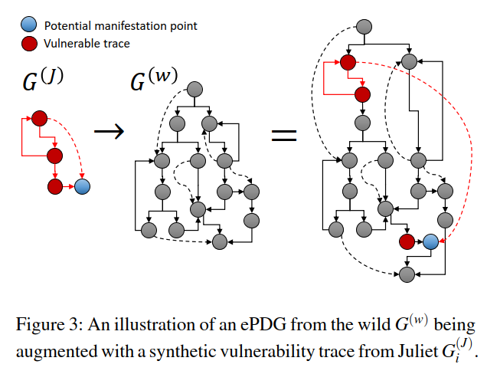
VulChecker: Graph-based Vulnerability Localization in Source Code

Slide 15
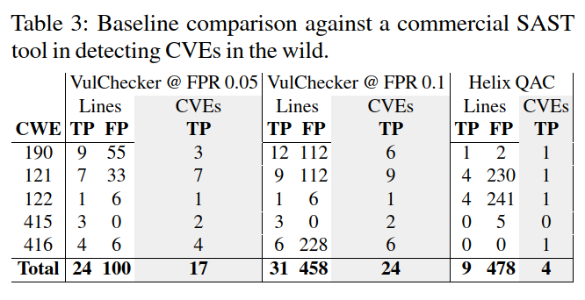
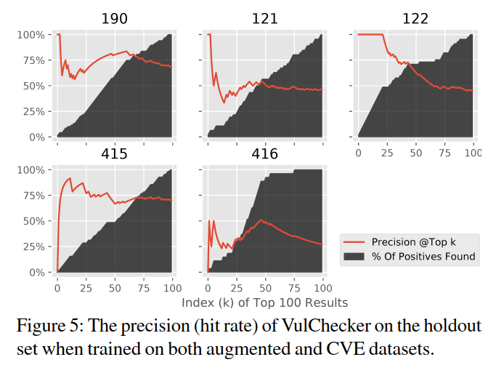
VulChecker: Graph-based Vulnerability Localization in Source Code

Slide 16
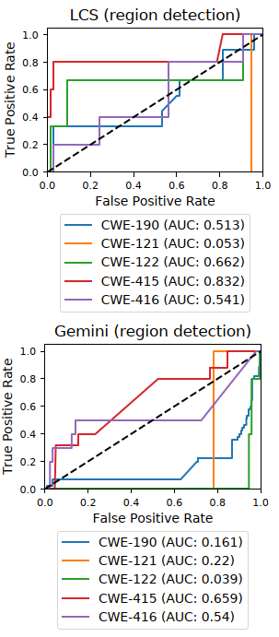
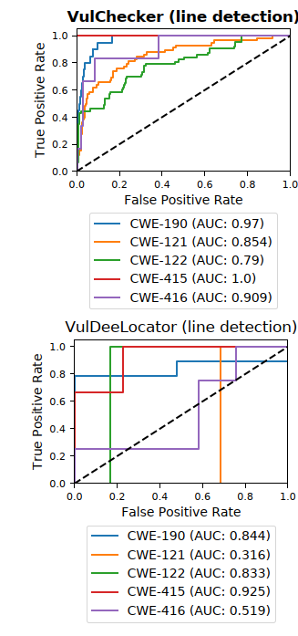
VulChecker: Graph-based Vulnerability Localization in Source Code

