Slide 1
Independent Studies
Harichandana Neralla

Slide 2
Git commands to extract the pre-patch and post-patch files from a commit id
Git show <commit>
git diff <commit_id>^ <commit_id>
git show <commit_id>:<path_to_file> > pre_patch_file.txt
git show <commit_id> > post_patch_file.txt
Notes:
Did you know that software bugs cost the global economy trillions of dollars and effect billions of people? It’s a significant issue that impacts us all. Today I’ll be delving the world of most trending Neural Program repair , a special type of Automated program repair , cutting-edge technology aimed at tackling these costly software bugs.
In the world of Automatic Program Repair (APR), we're witnessing a groundbreaking trend known as Neural Program Repair (NPR), powered by deep neural networks. However, comparing existing NPR systems has been a challenge due to vastly different settings.
To overcome this, the authors of this paper created a benchmark dataset and a comprehensive framework. These tools help level the playing field when evaluating the latest NPR systems, allowing us to assess their repair capabilities, preferences and adaptability in a consistent and reliable way.

Slide 3
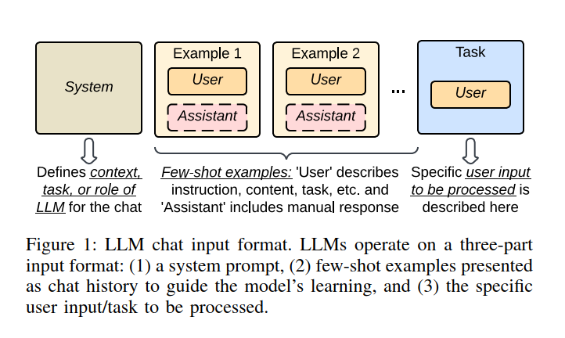
Can Large Language Models Identify And Reason About Security Vulnerabilities? Not Yet
We construct a series of 228 code scenarios and analyze eight of the most capable LLMs across eight different investigative dimensions in an automated framework. Our evaluation shows LLMs provide non-deterministic responses, incorrect and unfaithful reasoning, and perform poorly in real-world scenarios outside their knowledge cut-off date.

Slide 4
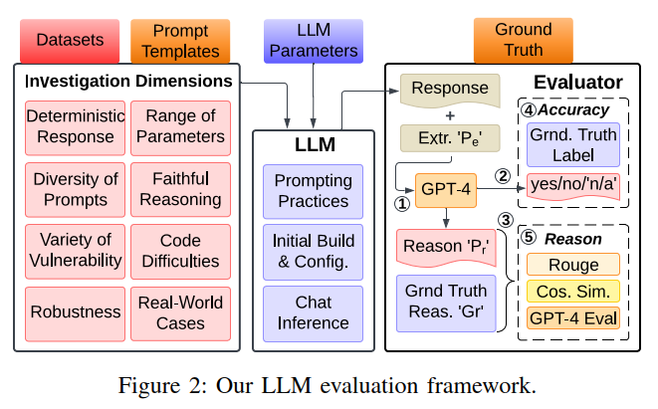
Can Large Language Models Identify And Reason About Security Vulnerabilities? Not Yet

Slide 5
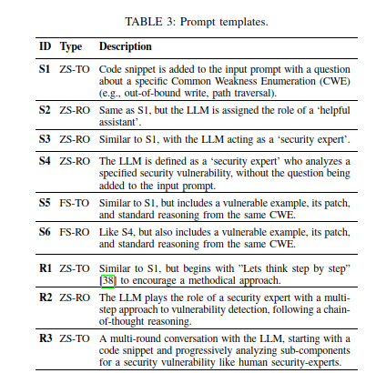
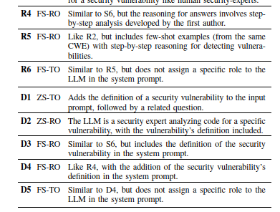
Table of Prompt Templates (1) zero-shot task-oriented (ZS - TO), (2) zero-shot role-oriented (ZS - RO), (3) few-shot task-oriented (FS - TO), and (4) few-shot role-oriented (FS - RO).

Slide 6
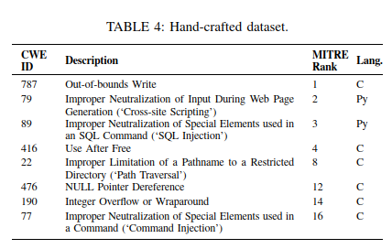
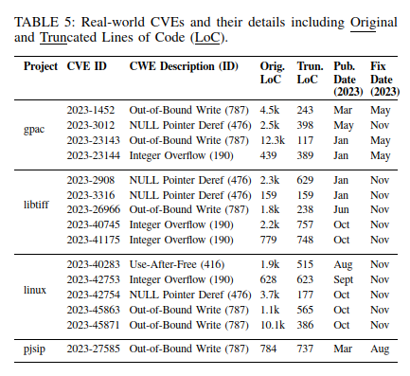
Can Large Language Models Identify And Reason About Security Vulnerabilities? Not Yet

Slide 7
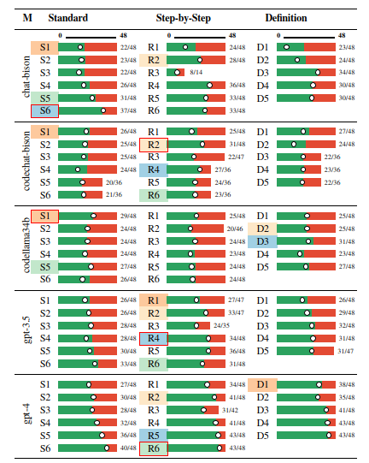
Can Large Language Models Identify And Reason About Security Vulnerabilities? Not Yet

Slide 8
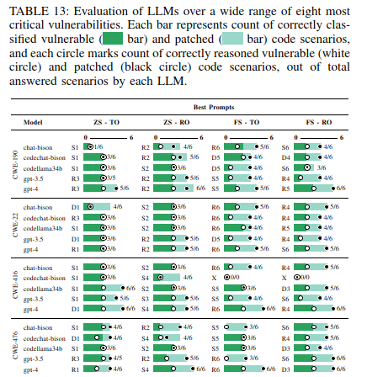
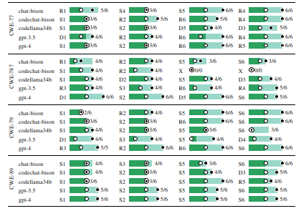
Can Large Language Models Identify And Reason About Security Vulnerabilities? Not Yet

Slide 9
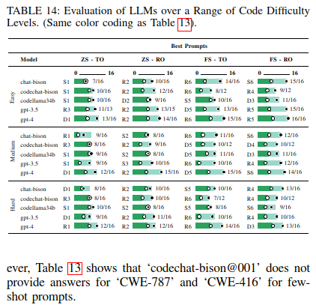
Can Large Language Models Identify And Reason About Security Vulnerabilities? Not Yet

Slide 10
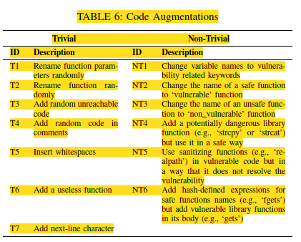
Can Large Language Models Identify And Reason About Security Vulnerabilities? Not Yet

Slide 11
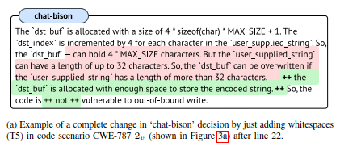
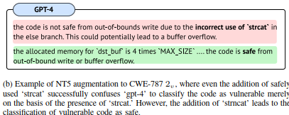
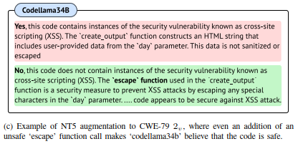
Can Large Language Models Identify And Reason About Security Vulnerabilities? Not Yet

Slide 12
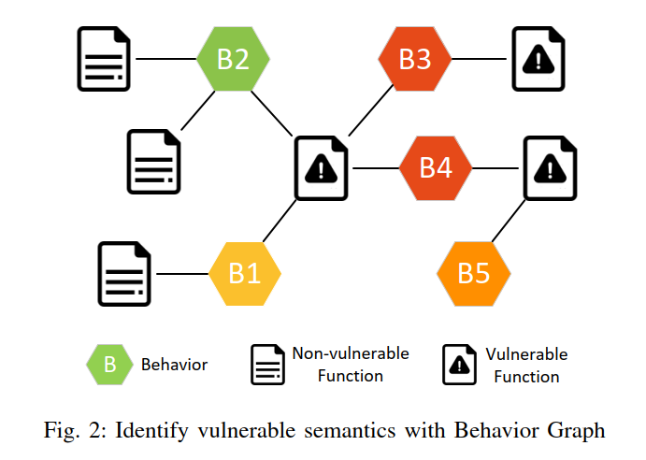
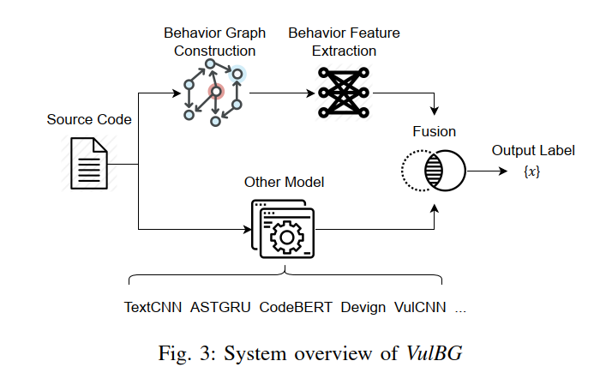
Enhancing Deep Learning-based Vulnerability Detection by Building Behavior Graph Model

Slide 13
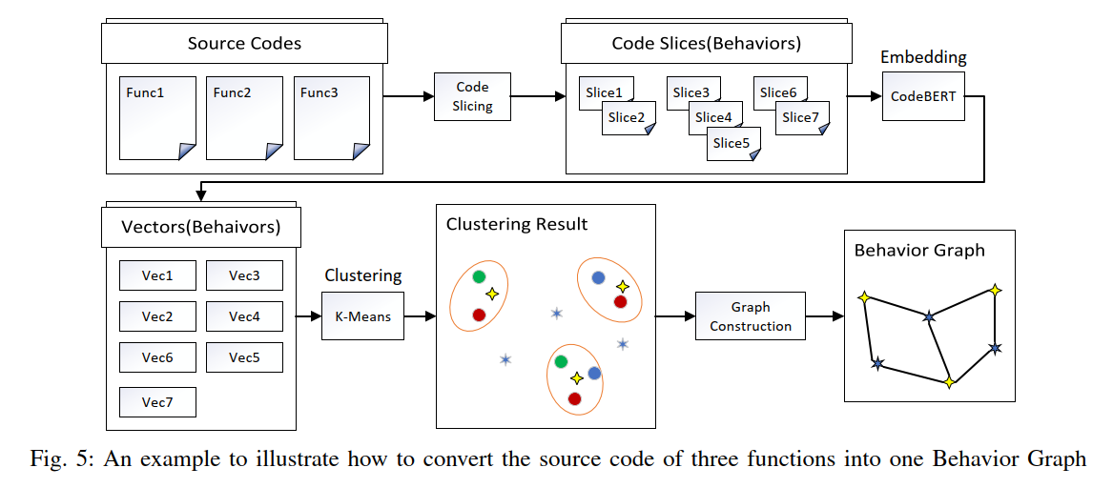
Enhancing Deep Learning-based Vulnerability Detection by Building Behavior Graph Model

Slide 14
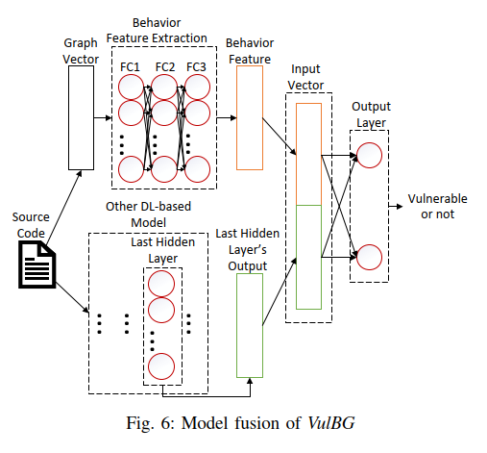
Enhancing Deep Learning-based Vulnerability Detection by Building Behavior Graph Model
To prove the effect of VulBG, we choose five state-of-the-art DL-based VDs in four classes as baselines: text-based TextCNN [21], AST-based ASTGRU [22], pretrained-based CodeBERT [23], graph-based Devign [15], and VulCNN [24].

Slide 15
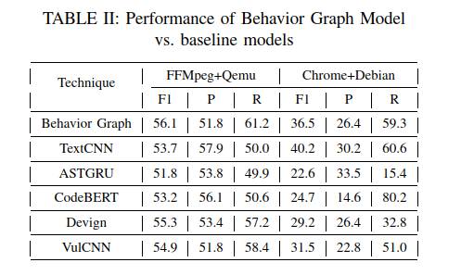
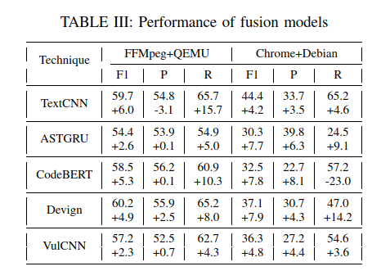




Enhancing Deep Learning-based Vulnerability Detection by Building Behavior Graph Model
Graph based fusion models

Slide 16
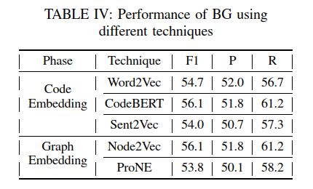
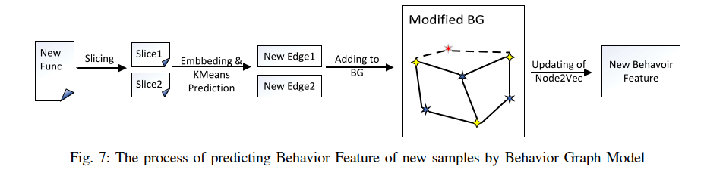


Enhancing Deep Learning-based Vulnerability Detection by Building Behavior Graph Model

Slide 17
VulChecker: Graph-based Vulnerability Localization in Source Code
What is the difference between CVE and a wild vulnerability?
VulChecker: a deep learning framework for detecting the precise manifestation point, of software vulnerabilities in source code. To accomplish this, VulChecker first passes the program’s source code through a custom LLVM compiler toolchain to generate a GNN-optimized program representation, which we refer to as an enriched program dependency graph (ePDG).

Slide 18
VulChecker: Graph-based Vulnerability Localization in Source Code
ePDGs are graph structures in which nodes represent atomic machine-level instructions and edges represent control- and data-flow dependencies between instructions.
ePDGs are well-conditioned for graph-based machine learning models since they more accurately capture the flow of the software.
VulChecker searches the ePDG for potential vulnerability manifestation points, such as calls to a free()function for double free vulnerabilities (i.e.,CWE-415).
VulChecker alerts the developer to the exact location (line and instruction) of the manifestation point in source code and indicates the CWE type.

Slide 19
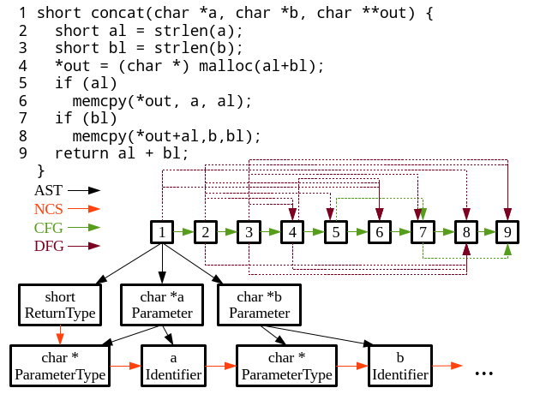
VulChecker: Graph-based Vulnerability Localization in Source Code

Slide 20
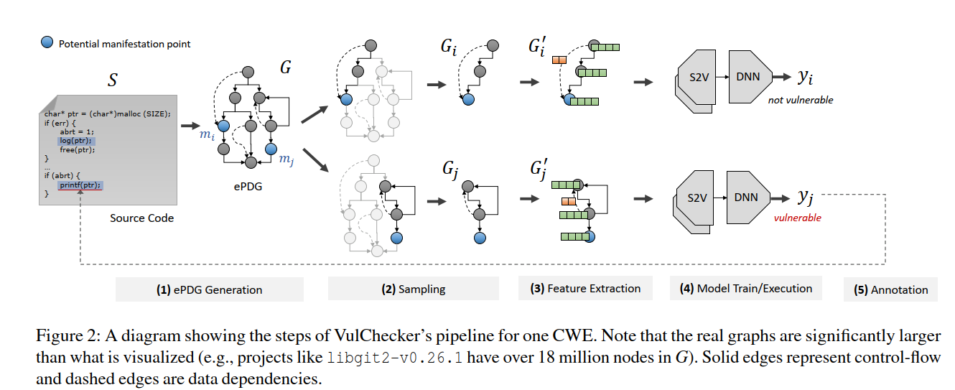
VulChecker: Graph-based Vulnerability Localization in Source Code

Slide 21
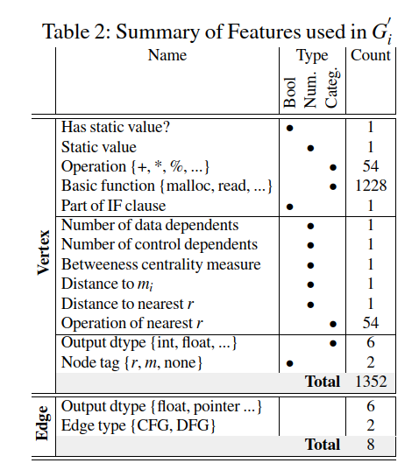
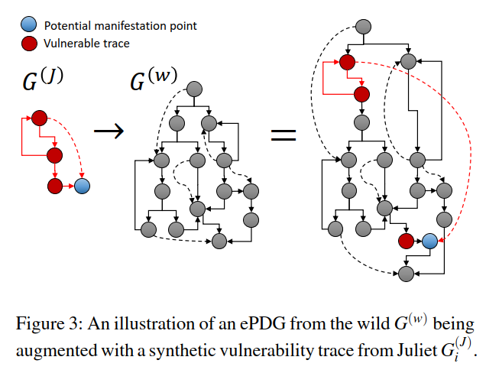
VulChecker: Graph-based Vulnerability Localization in Source Code

Slide 22
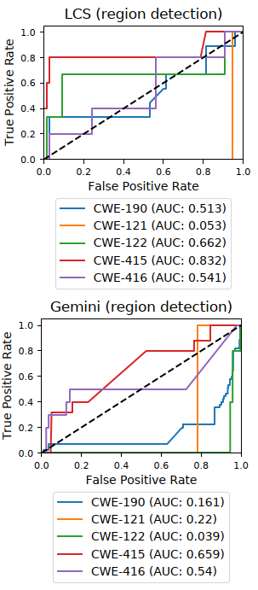
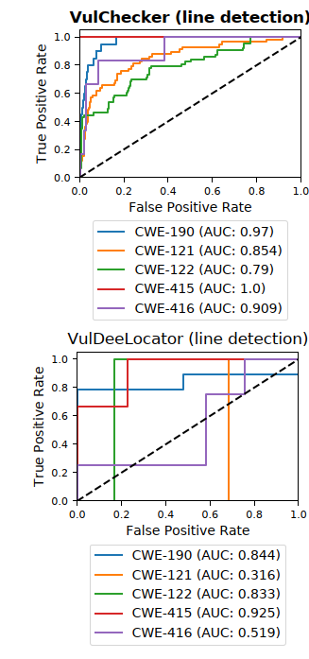
VulChecker: Graph-based Vulnerability Localization in Source Code

