Slide 1
Comparative Analysis
Harichandana Neralla

Slide 2
BLEU-Bilingual Evaluation Understudy Score
BLEU: Bi-Lingual Evaluation of Understanding:
BLEU score is a widely used performance measure for NMT.
It calculates the similarity/n-gram overlap between auto-generated and reference sequences in terms of their n-grams precision as follows.
Precision focused metric.
n-gram overlap means the evaluation scheme is word-position independent.
Brevity penalty - a penalty applied when the generated text is too small compared to the target text.
Doesn’t take meaning of the text into consideration.

Slide 3
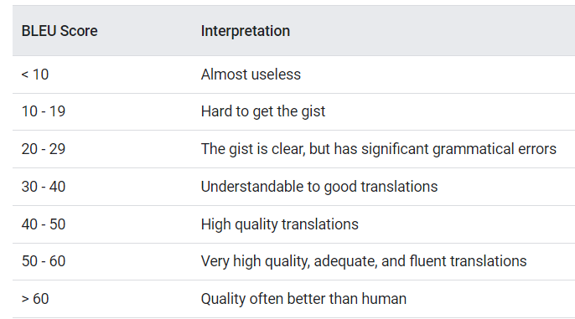
Bugsplainer explanations – BLEU Score
They used case-insensitive BLEU score with add one smoothing which aligns the most with human judgement.
The measurement is – “Understandable” to “Good” according to Google AutoML translation.

Slide 4
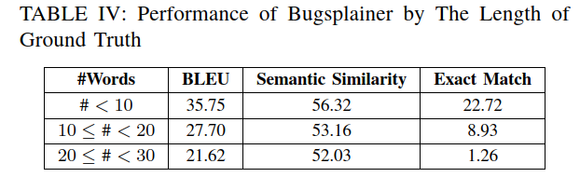
Bugsplainer explanations – BLEU Score

Slide 5
Rouge Score - Recall-Oriented Understudy for Gisting Evaluation.
measures the number of matching n-grams between the model-generated text and a human-produced reference.
It works by comparing a produced summary(System-generated summary) against a reference summary (human-produced).
Rouge – Recall focused. But Recall + Precision

Slide 6
Rouge Score N - Recall-Oriented Understudy for Gisting Evaluation.
Rouge1
measures ROUGE-1 by considering 1-grams only.
Rouge2
measures ROUGE-1 by considering 2-grams only.
RougeL
the longest sequence of words (not necessarily consecutive, but still in order) that is shared between both
RougeLSum or Average Summary
allows to search for consecutive words from the reference text that appear in the model output but are separated by one-or-more other words.

Slide 7
Bert Score - CodeBERT
metric that quantifies the semantic similarity between model-generated text and reference text by leveraging contextual embeddings from BERT.
A higher BertScore indicates a more significant similarity between the generated text and the reference, suggesting that the model produces outputs closely aligned with the expected content.
BERTScore outputs a dictionary with the following values:
precision: The precision for each sentence from the predictions + references lists, which ranges from 0.0 to 1.0.
recall: The recall for each sentence from the predictions + references lists, which ranges from 0.0 to 1.0.
f1: The F1 score for each sentence from the predictions + references lists, which ranges from 0.0 to 1.0

Slide 8
TF-IDF
Won’t be able to perform well or even to apply because the shortest lengths of the reference texts and the generated texts.

Slide 9
Cosine Similarity
a measure of similarity between two non-zero vectors in an n-dimensional space.
Measuring the cosine of the angle between two vectors.

