Slide 1
Explaining Software Bugs Leveraging Code Structures in Neural Machine Translation And Bugsplainer: Leveraging Code Structures to Explain Software Bugs with Neural Machine Translation
Harichandana Neralla

Slide 2
Motivation behind bugsplainer
Bugsplainer, a novel web-based debugging solution that generates natural language explanations for software bugs by learning from a large corpus of bug- fix commits.
Bugsplainer leverages code structures to reason about a bug and employs the  fine-tuned version of a text generation model CodeT5 to generate the explanations.
Unfortunately, the static analysis tools’ utility could be limited due to their high false-positive results and the lack of actionable insights in their explanations. In particular, their explanations are often too generic and unaware of the context due to their pre-deﬁned, templated nature
Notes:
Did you know that software bugs cost the global economy trillions of dollars and effect billions of people? It’s a significant issue that impacts us all. Today I’ll be delving the world of most trending Neural Program repair , a special type of Automated program repair , cutting-edge technology aimed at tackling these costly software bugs.
In the world of Automatic Program Repair (APR), we're witnessing a groundbreaking trend known as Neural Program Repair (NPR), powered by deep neural networks. However, comparing existing NPR systems has been a challenge due to vastly different settings.
To overcome this, the authors of this paper created a benchmark dataset and a comprehensive framework. These tools help level the playing field when evaluating the latest NPR systems, allowing us to assess their repair capabilities, preferences and adaptability in a consistent and reliable way.

Slide 3
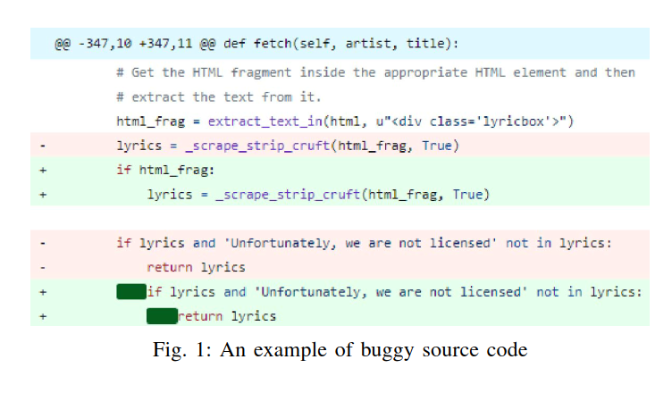
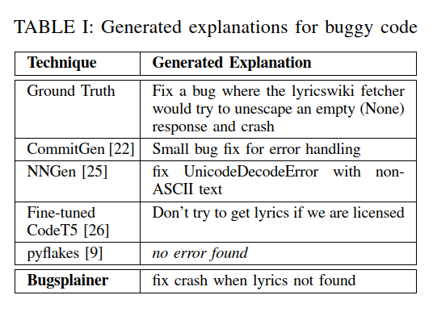
Notes:
Did you know that software bugs cost the global economy trillions of dollars and effect billions of people? It’s a significant issue that impacts us all. Today I’ll be delving the world of most trending Neural Program repair , a special type of Automated program repair , cutting-edge technology aimed at tackling these costly software bugs.
In the world of Automatic Program Repair (APR), we're witnessing a groundbreaking trend known as Neural Program Repair (NPR), powered by deep neural networks. However, comparing existing NPR systems has been a challenge due to vastly different settings.
To overcome this, the authors of this paper created a benchmark dataset and a comprehensive framework. These tools help level the playing field when evaluating the latest NPR systems, allowing us to assess their repair capabilities, preferences and adaptability in a consistent and reliable way.

Slide 4
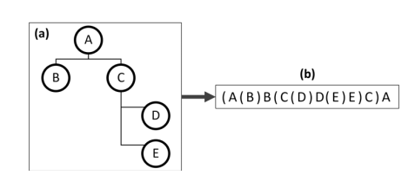
Paper-1 Extracting buggy nodes for both steps
In their research, they have use Transformer [17], [33], the state-of-the-art NMT model along with the attention mechanism, as a part of Bugsplainer, to generate explanations for the buggy source code.
How the SBT is used to convert a node of AST to a token sequence?? – study
The authors have used the SBT algorithm of Hu et al. to generate the sequence.
Explain how we can convert SBT to corresponsiding token sequence (a)-> (b)
Authors have used both steps 1. discriminatory pretraining 2. fine tuning
Notes:
Did you know that software bugs cost the global economy trillions of dollars and effect billions of people? It’s a significant issue that impacts us all. Today I’ll be delving the world of most trending Neural Program repair , a special type of Automated program repair , cutting-edge technology aimed at tackling these costly software bugs.
In the world of Automatic Program Repair (APR), we're witnessing a groundbreaking trend known as Neural Program Repair (NPR), powered by deep neural networks. However, comparing existing NPR systems has been a challenge due to vastly different settings.
To overcome this, the authors of this paper created a benchmark dataset and a comprehensive framework. These tools help level the playing field when evaluating the latest NPR systems, allowing us to assess their repair capabilities, preferences and adaptability in a consistent and reliable way.

Slide 5
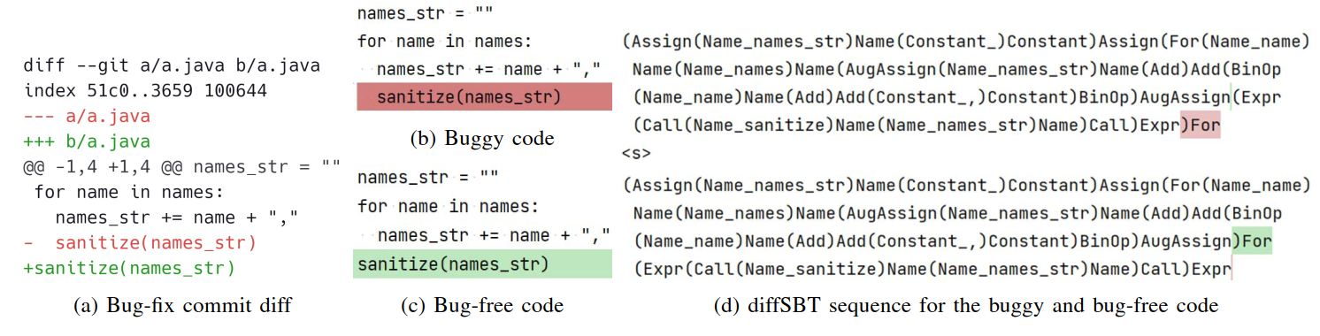


if the source code is simply considered as a sequence of tokens without the struc- tural information the bug is really hard to understand.
diffSBT – for structure-preserving sequence generation from commit diff, which is an adaptation of SBT algorithm by Hu et al.
Thus, with the help of diffSBT, Bugsplainer can
identify the difference in the structure of code, which could
be useful to explain the bug.

Slide 6
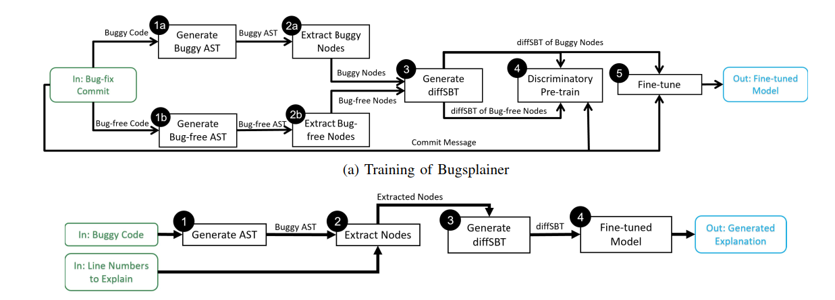

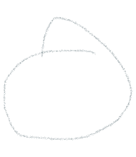
The output of the ﬁne-tuning step is the Bugsplainer model for bug explanation generation.
Training
Discriminatory pre-training
Fine tuning
Generating Explanation

Slide 7
Training phase – step I – Discriminatory pre-training
RoBERTa tokenizer has common code elements in its vocabulary, which can reduce the length of tokenized code sequence by 30%-45% [26].
We use this tokenizer to tokenize and encode the inputs (e.g., diffSBT sequence) and decode the outputs (e.g., commit message).
Bugsplainer uses both unsupervised and supervised pre-training to equip the model with a comprehensive understanding of the programming language and its bugs.
We use a pre-trained model – CodeT5 [26] – to perform our discriminatory pre-training with buggy and bug-free code
We refer to this pre-training step as discriminatory pre-training since Bugsplainer learns to discriminate between buggy and bug-free code.

Slide 8
Training phase – step II – Fine Tuning
RoBERTa tokenizer has common code elements in its vocabulary, which can reduce the length of tokenized code sequence by 30%-45% [26].
We use this tokenizer to tokenize and encode the inputs (e.g., diffSBT sequence) and decode the outputs (e.g., commit message).
Bugsplainer uses both unsupervised and supervised pre-training to equip the model with a comprehensive understanding of the programming language and its bugs.
We use a pre-trained model – CodeT5 [26] – to perform our discriminatory pre-training with buggy and bug-free code
We refer to this pre-training step as discriminatory pre-training since Bugsplainer learns to discriminate between buggy and bug-free code.

Slide 9
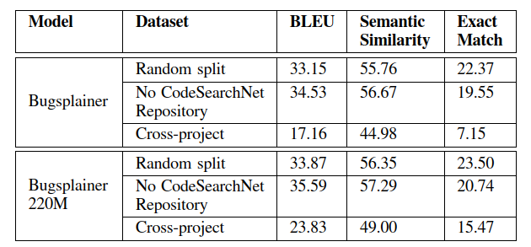
Experimental Analysis and Evaluation
we train a 220M parameter variant of Bugsplainer and call it Bugsplainer 220M. Both variants share the same architecture (i.e., T5) but they have different hyperparameters.
Because the increase in the model’s size results better performance derived by the recent studies in deep learning.

Slide 10
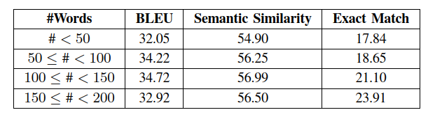
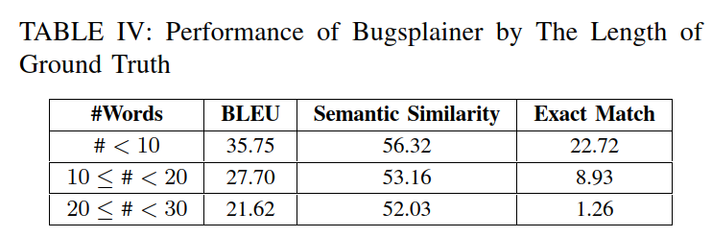
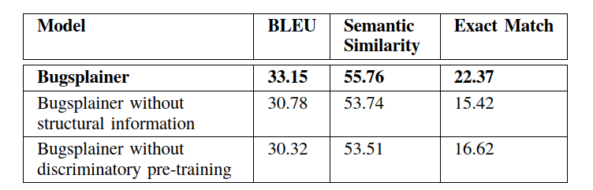



RQ1 and RQ2 explanations
This
suggests that even with increasing output length, Bugsplainer
can provide explanations that are semantically coherent with
the ground truth.
In the pre- train dataset, we keep the commit diff as is, while in the ﬁne- tuning dataset, we remove the added lines (i.e., bug-free lines) from the commit diff

Slide 11
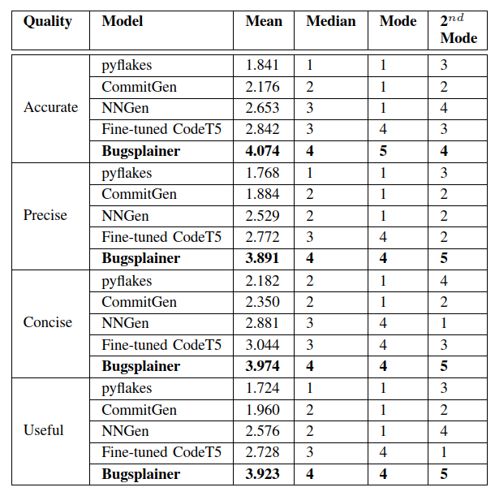
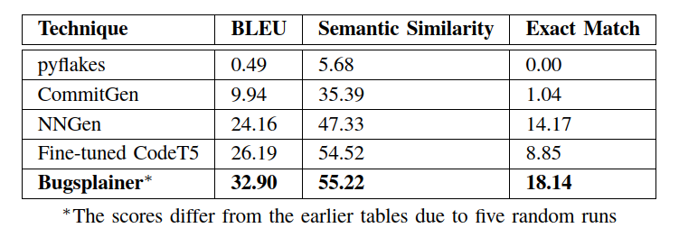
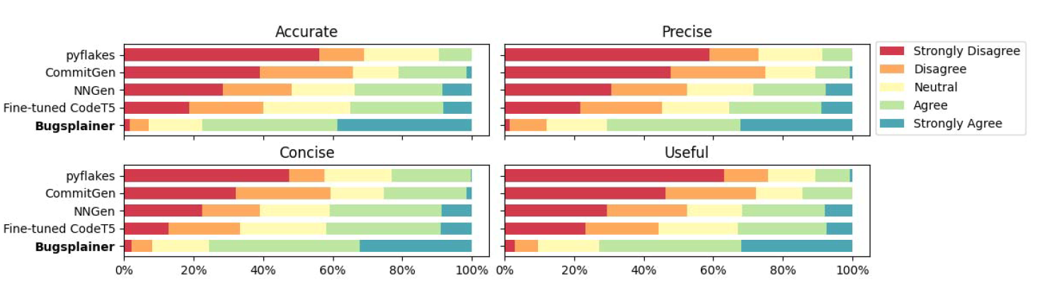
RQ3 and RQ4 explanations

Slide 12
Conclusion and threats to validate
Threats caused by the replication of models used for comparative analysis might be mitigated.
The use of metric-based evaluation might also pose threat to the real-world usability.
Future work: investigate how to encode the structural information from source code in a more compact and efﬁcient format and how to better leverage the structural differences between buggy and bug-free code.

Slide 13
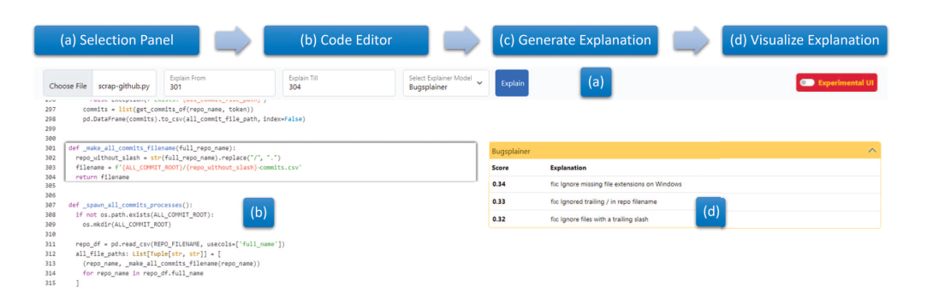
User interface of Bugsplainer
Notes:
APR or Automated Program Repair , is likely a handy tool for developers. It’s designed to automatically find and fix errors in computer programs without them having to manually go through lines of code.
The main goal of APR is to make software more reliable by finding and fixing the code defects or bugs.
So, how does the APR do this? It follows a series of steps. First, it scans the codebase to identify the bugs. Once a bug is detected, an APR works to pinpoint where it is in the code.
After localization, it starts generating the patches or fixes for the identified bugs. But it doesn't stop there. These patches need to be validated. They're tested to make sure they solve the problem without causing new issues.
Of course, there are challenges in this process. Sometimes APR systems struggle with accurately detecting bugs or generating the right fixes. There's always a risk of introducing incorrect fixes too.
Now let’s talk about Neural Program Repair or NOR. It’s like a smart upgrade to APR because it is powered by deep learning techniques specifically neural networks to repair software bugs automatically.
The best thing about NPR and the cool difference that it has with APR is it treats the code repair as a translation task. It uses neural machine translation models inspired by natural language processing.
It’s like teaching a computer to understand and speak code.
Unlike APR, NPR doesn’t rely heavily on domain-specific knowledge or resources like test suites. It can handle various types of bugs which makes it unique.
How ever NPR systems need a lot of training data, including both defective and correct code to get good at what they do.
Evaluating NPR is all about checking if it can generate the correct patches for known defects. When an NPR system encounters a bug, it doesn’t just come up with one solution. It generates multiple candidate patches, ranks them, and picks the best one.
But when comparing few or several comparing systems, we need to be careful. We must consider things like training data, how they evaluate their fixes and how they generate those candidates.
It’s a bit like comparing apples and oranges unless you use a consistent scale or setting.

