Slide 1
Altium Tutorial v15.1
EGR 643 - PCB Design and EMC
Dimitri Häring

Slide 2

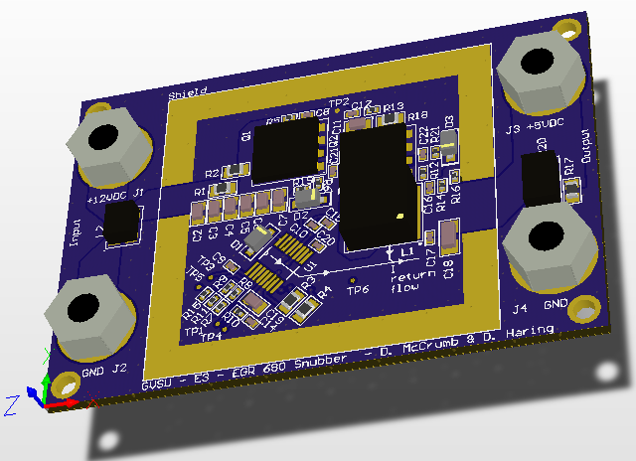
Overview
Mechanical drawings
Layer stack up
Cost approximation
Snubber
Schematic
Layout
Q&A
[1]

Slide 3
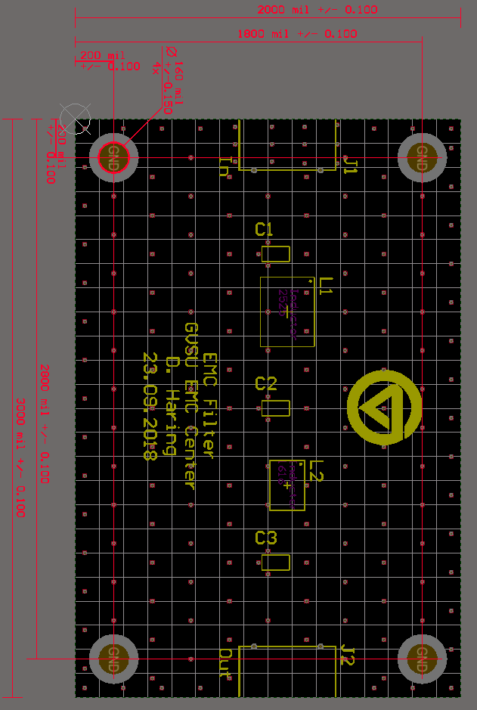
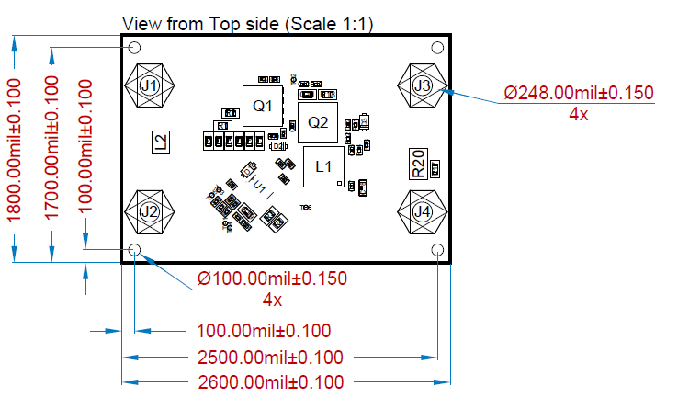
Mechanical drawings
Draftsman in Altium v17
DrillDrawing Layer v15

Slide 4
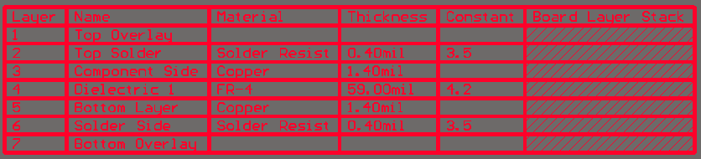
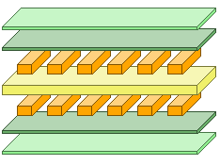
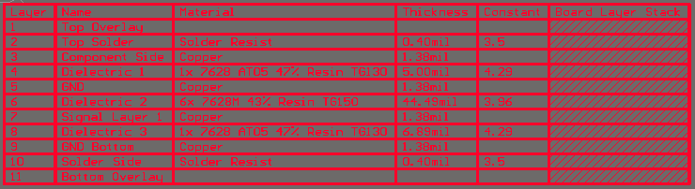
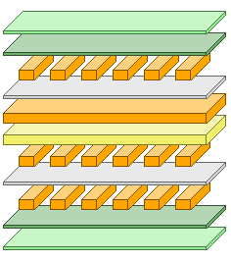
Layer stack up

Slide 5
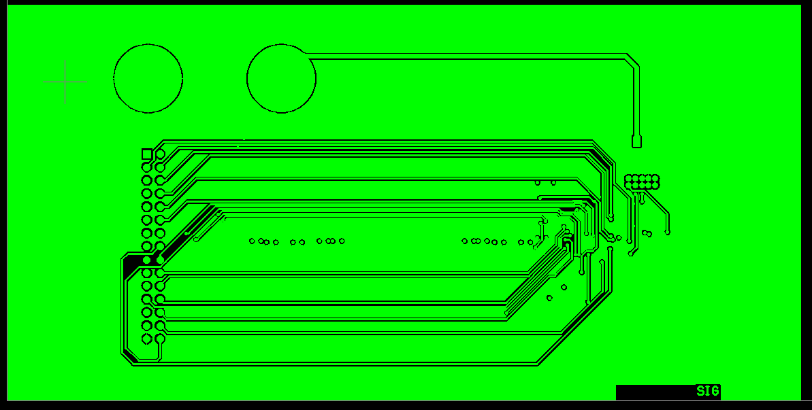
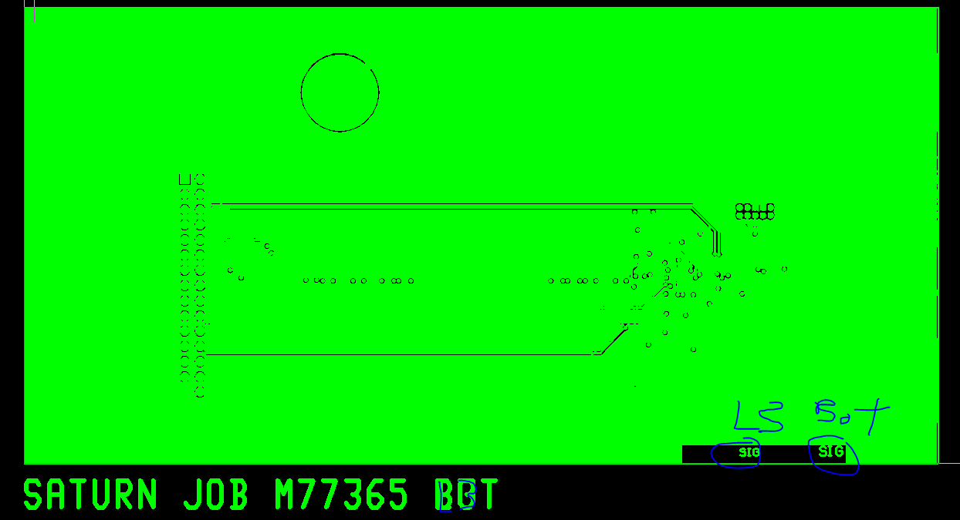
Layer stack up
Check Gerbers from Manufacturer
Wrong
Right

Slide 6
RF Grounded Microstrip or Coplanar Waveguide (CW)
spacing for impedance control
3h
1h
2h (not used for CW)
h
~50mil
CW Coplanar Waveguide

Slide 7
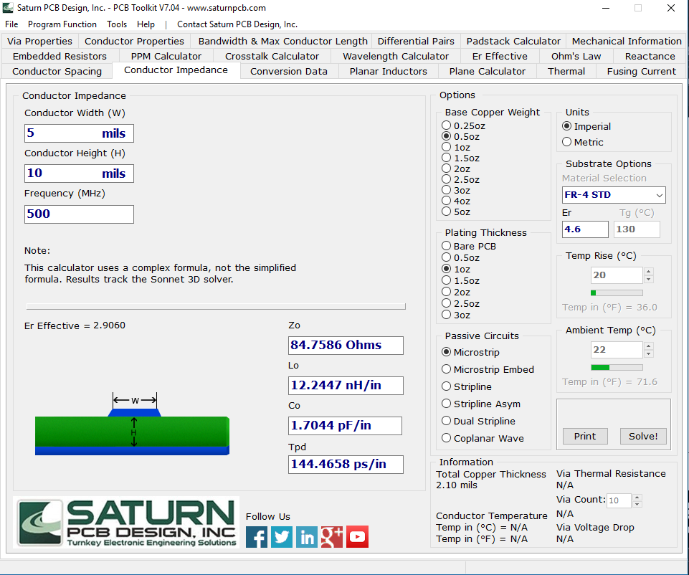
Saturn PCB Design Toolkit
A microstrip line with 50 Ohm impedance and a dielectric height of 10 mil, fc = 866 MHz, BW = 2 MHz, and 70 um copper, calculate;
Width:
Calculate the width and distance of CW for the same properties mentioned above:
Width:
Distance:
Link Saturn PCB Toolkit

Slide 8
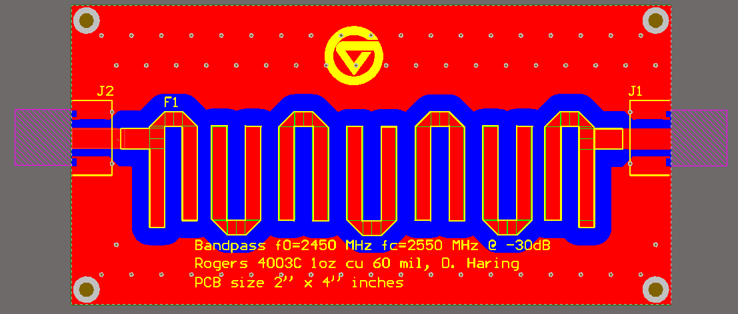
Filter with Microstrip design
Distance between coupled elements is the same as the 2h distance for the microstrip line. In this case, the distance rule of 2h is not valid.

Slide 9
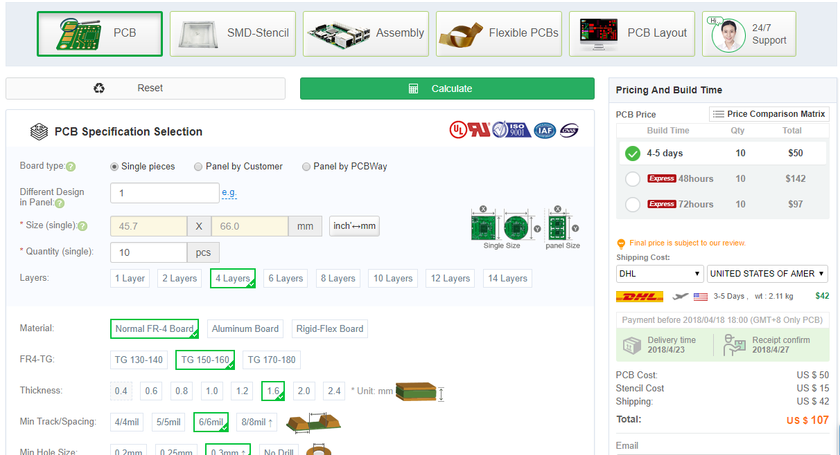
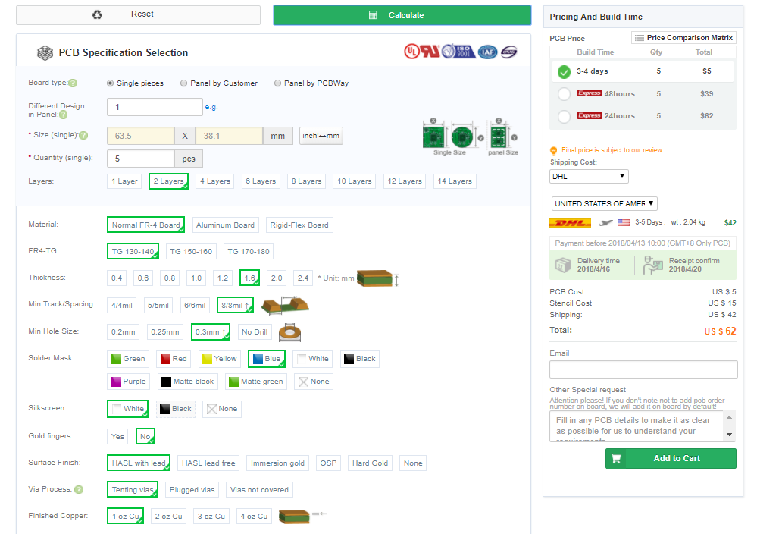
Cost approximation $62 -> $107

Slide 10
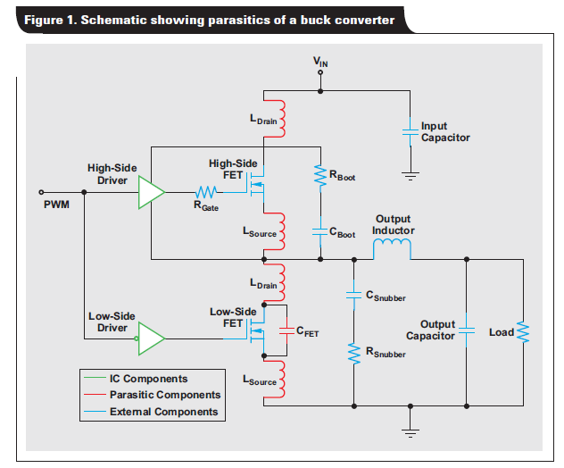
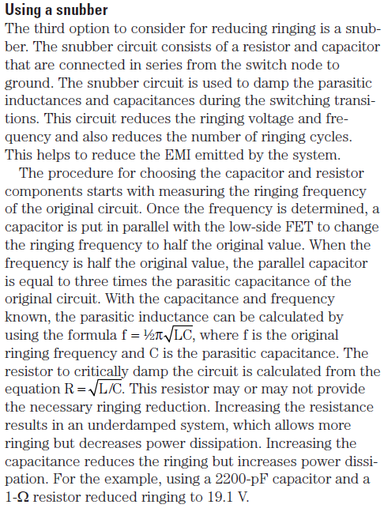
Snubber

Slide 11
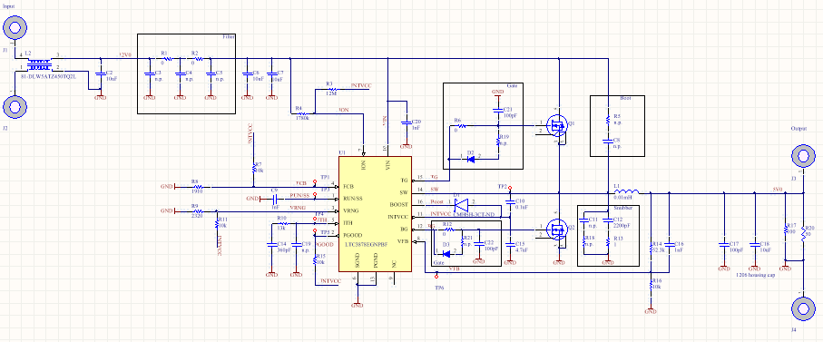
Schematic
Global Net,
shown on PCB
Local Net,
used multiple times
output
Local Net,
shown on PCB
supply
Test Points
Ground,
NC
input
Lines to mark the Snubber circuit
Notes as Text String
IC, pins are numbered counter clock wise in the footprint!

Slide 12
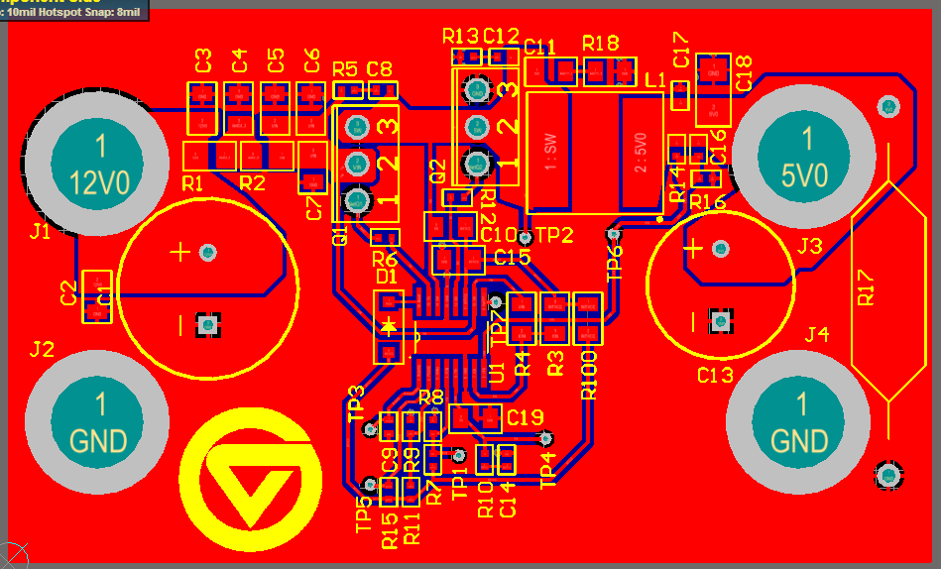
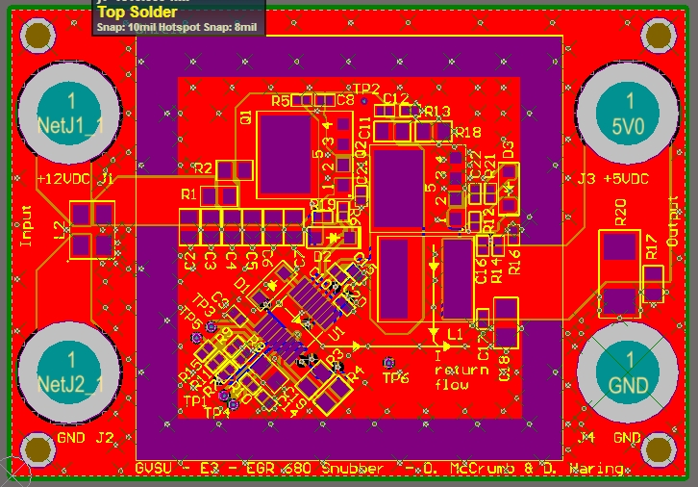
SMPS
Switched Mode Power Supply
Shielding, Top Paste
45° degree angel safes space
Flat packages
Improv: Reverse Bias Protection
CHOKE
bulk
bulk
shielding
POWER
SIG
GND
Feedback and digital switching
SIG
GND

Slide 13
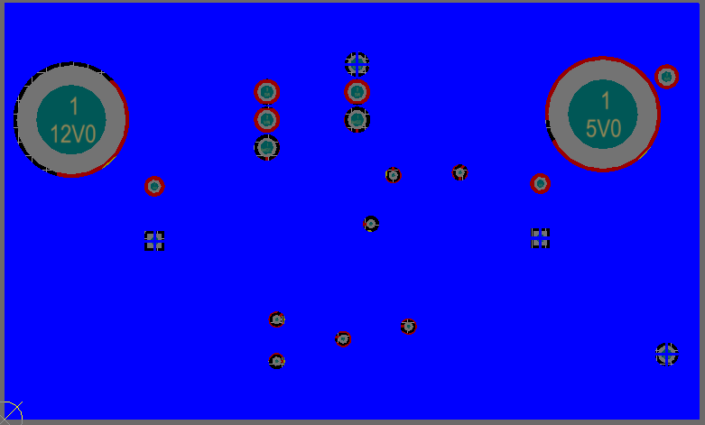
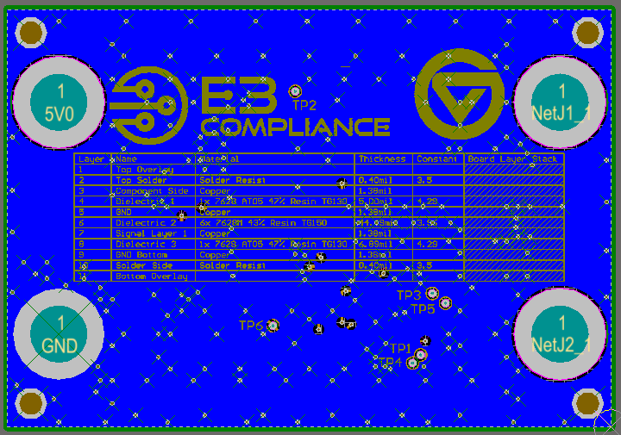
Bottom Layer
The bottom overlay can be used for additional information or to safe space on the top layer.

Slide 14
Questions
?

Slide 15
Thank you for your attention.

Slide 16
References
[1] “File:Overview icon.svg - Wikimedia Commons.” [Online]. Available: https://commons.wikimedia.org/wiki/File:Overview_icon.svg. [Accessed: 10-Apr-2018].

