Slide 1


K.RAMAKRISHNAN COLLEGE OF TECHNOLOGY
(AUTONOMOUS), TRICHY.
BUDGET CALCULATOR
PRESENTED
HARINI S
2303811710422055
SUPERVISOR
Mr. M. Saravanan, M.E.,
AP/CSE.
Notes:
‹#›

Slide 2
PRESENTATION OVERVIEW
Objective
Project Introduction
Problem Statement
Methodologies (Programming concepts relevant to problem statement)
Architecture of the proposed system
List of Modules
Merits
Results and Discussion
Queries
Notes:
‹#›

Slide 3
OBJECTIVE
The objective of the Budget Calculator application is to provide users with a simple and interactive tool for managing their finances. It enables users to record and track various expense items along with their corresponding amounts through a user-friendly graphical interface.
The application offers functionalities to add new expense items, edit existing entries to update or correct details, and delete items that are no longer relevant. Additionally, it allows users to quickly calculate and display the total expenditure based on the listed items, helping them to monitor their spending effectively. Overall, this tool serves as a convenient way for individuals or small organizations to organize and manage their budget efficiently.
Notes:
‹#›

Slide 4
PROJECT INTRODUCTION
A budget calculator project is designed to help individuals or businesses manage their finances by tracking income, expenses, and savings. The tool allows users to input various categories of income and expenditures, offering a clear overview of their financial situation. It enables users to create realistic budgets, set financial goals, and make informed decisions about spending and saving.
By using this calculator, users can identify areas where they can cut costs, track monthly or annual financial trends, and ensure they stay within their financial limits. This project can be implemented as a web-based application, mobile app, or desktop software, providing a user-friendly interface for financial management.
Notes:
‹#›

Slide 5
PROBLEM STATEMENT
It helps the user effectively manage their finances by tracking income and expenses.
It allows users to set budgets for different categories, monitor their spending against these budgets.
With features for adding, editing, and deleting transactions, the application empowers users to make informed financial decisions, achieve their savings goals.
Notes:
‹#›

Slide 6
METHODOLOGIES
The program uses the following Methodologies :
Event-Driven Programming: The flow of the program is determined by user interactions with the GUI.
Model-View-Controller (MVC): Separates data management (model), user interface (view), and user actions (controller).
Swing GUI: Utilizes Java's Swing library for creating the graphical interface.
Input Validation: Ensures user input is correct and handles errors appropriately.
Notes:
‹#›

Slide 7
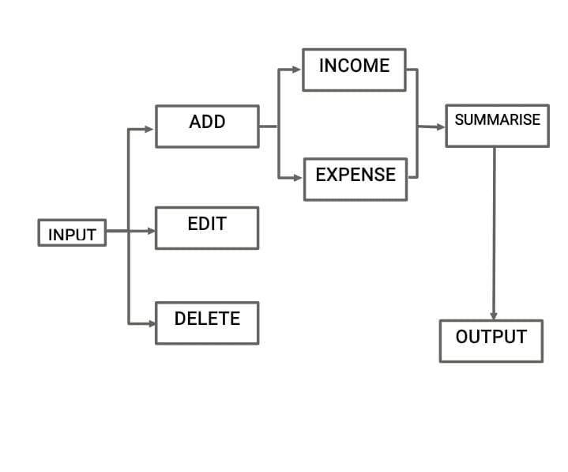
ARCHITECTURE OF THE PROPOSED SYSTEM
Notes:
‹#›

Slide 8
LIST OF MODULES
MODULE DESCRIPTION
The program uses the following modules :
ADD : To add income and expenses.
DELETE : Delete income and expenses.
EDIT : Edit income and expenses.
SUMMARISE : Summarise income and expenses for savings and manage expenses.
Notes:
‹#›

Slide 9
MERITS
A budget calculator project offers several key merits:
Improved Financial Management: It helps individuals and businesses track income and expenses, providing a clear overview of their financial situation and enabling better decision-making.
Promotes Saving: By allowing users to set financial goals and budget allocations, it encourages saving and prioritizing necessary expenses over luxuries.
Enhanced Financial Awareness: Regular use of the calculator can raise awareness about spending habits and highlight areas where unnecessary expenditures can be reduced.
Customizable Budgeting: Users can tailor the calculator to their specific needs by creating categories for income, fixed and variable expenses, and setting limits for each category.
Notes:
‹#›

Slide 10
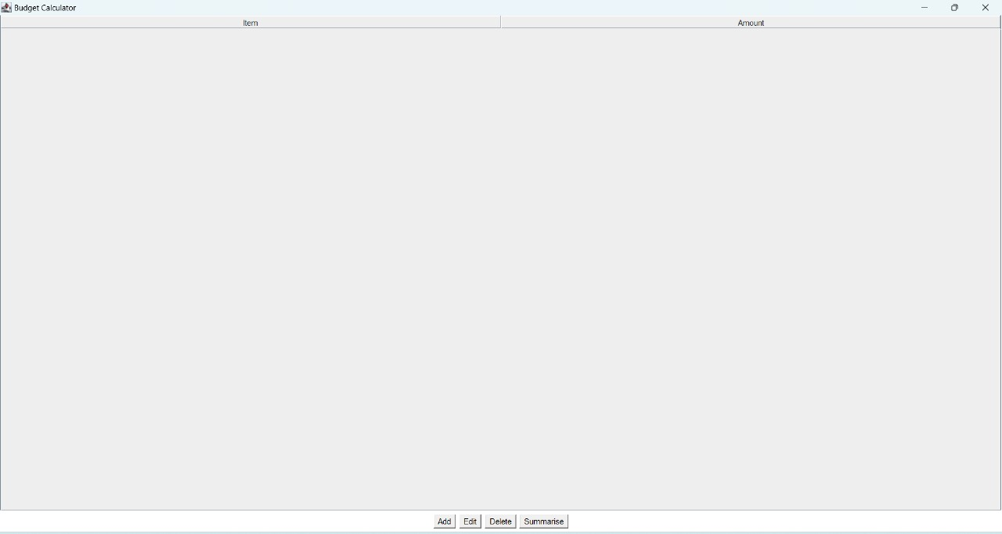
RESULTS AND DISCUSSION
Notes:
‹#›

Slide 11
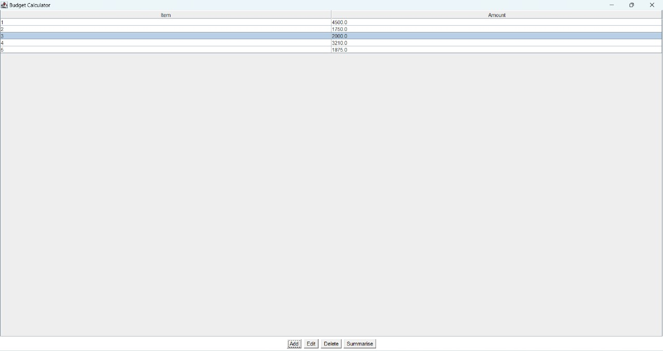
RESULTS AND DISCUSSION
Notes:
‹#›

Slide 12
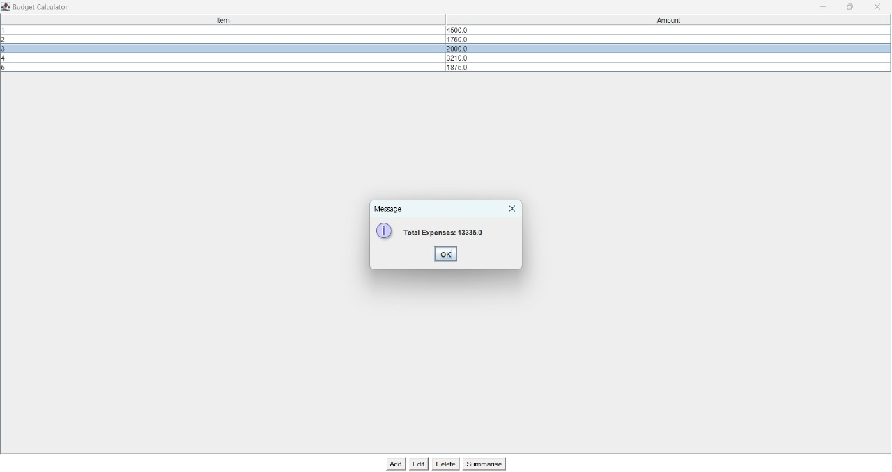
RESULTS AND DISCUSSION
Notes:
‹#›

Slide 13
QUERIES ?
Notes:
‹#›

