Slide 1

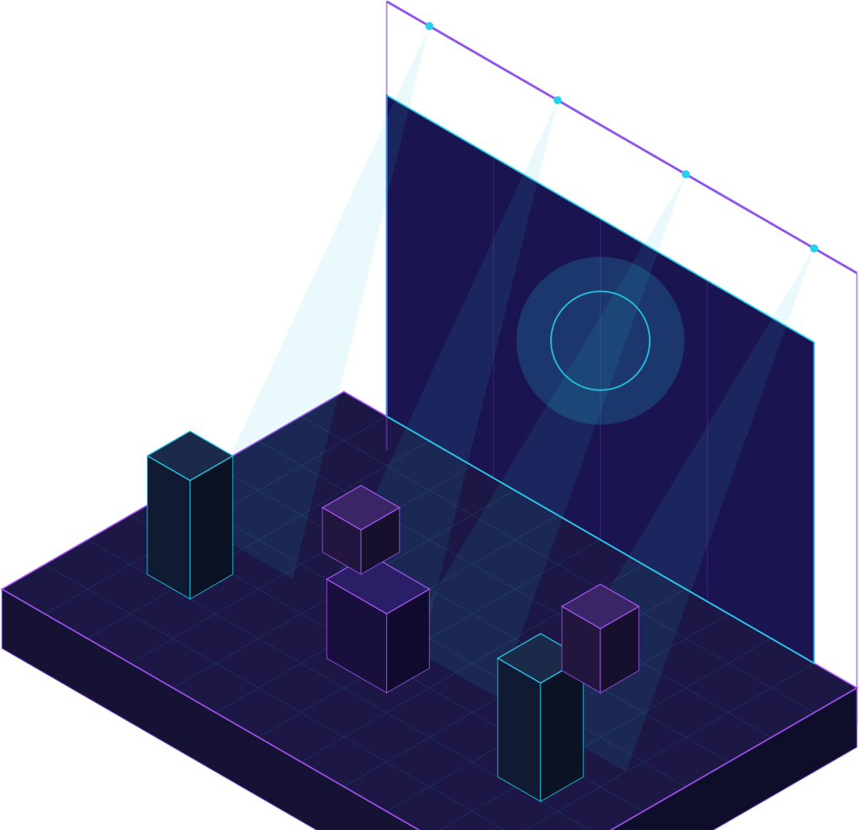
DESIGN THINKING & INNOVATION · REVIEW 1
StageSync
Empathize & Define — Understanding the Real Stage Planning Problem
Department of Computer Science and Design · Rajalakshmi Engineering College
Academic Year 2026 – 2027 · Review 1 Report
TEAM MEMBERS
Abhishek R Harini M Mohamed Ashwaaq Rafi
STAGESYNC · REVIEW 1
01 / 15

Slide 2







REVIEW 1 · WHY THIS REVIEW MATTERS
Proving We Understand the Problem
Before We Solve It
Review 1 evaluates whether we truly understood the people, context and evidence behind StageSync — before any solution is proposed. Every slide that follows traces back to real interviews and field research, not assumptions.
Problem Context
Research Methodology
Voices from the Field
Where and why the coordination problem occurs
Who we studied, how, and for how long
Empathy maps built from real interviews
Existing Workflow Study
Insights & Problem Framing
Research Integrity
What teams use today, and where it fails
POV and How-Might-We statements
Privacy, bias, accessibility & feasibility
STAGESYNC · REVIEW 1
02 / 15

Slide 3





DEFINE · PROBLEM CONTEXT
Where and Why This Problem Happens
During event preparation, teams handling stage design, props, lighting and sound coordinate through separate messages, documents, sketches and verbal discussions — commonly in college events, cultural programs and other live productions.
DOMAIN
EventTech
Collaboration & Production Planning
Fragmented Channels
Unclear Ownership
Time-Pressured Fixes
Stage, props, lighting & sound coordinate separately
Requirements and responsibilities aren't clearly assigned
Short prep windows leave no room to resolve conflicts
No Shared Format
Budget Reality
Hard to Visualize
Every team tracks requirements in its own way
A student project must rely on free / low-cost tools
Representing a physical stage digitally is inherently difficult
STAGESYNC · REVIEW 1
03 / 15

Slide 4

EMPATHIZE · HOW WE GATHERED EVIDENCE
Five Voices From the Stage,
One Week of Field Research
5
1 Week
2
On-Site
Users Interviewed
Field Study Duration
Research Methods Used
Venue & Follow-Up Research
RESEARCH METHODS
SAMPLING RATIONALE
Interviews
Represents every production role — stage, lighting, sound, art direction and coordination — capturing both hands-on execution and decision-making viewpoints.
Limitations: small sample size, one-week window, restricted to a college-event context.
Direct one-on-one conversations with each production role
Expert Consultation
Faculty-guided validation of assumptions and scope
STAGESYNC · REVIEW 1
04 / 15

Slide 5





EMPATHIZE · WHO WE TALKED TO
The People Behind the Plan
Five roles interviewed on-site during real event preparation — each living a different piece of the same coordination problem.
Madhan Kumar
Venkat Prabhu
Thejas Krishna
Samyuktha K L
Rudh
Stage / Production Manager
Lighting Team Member
Art Director
Event Management / Sound
Event Coordinator
STAGESYNC · REVIEW 1
05 / 15

Slide 6



EMPATHIZE · WHAT WE HEARD, SAW & FELT
Empathy Map — Production Teams & Art Director
SAYS
THINKS
“I need everyone's requirements in one place.”
“We need to know the final stage layout.”
“Late changes make setup difficult.”
Will one team's setup interfere with another?
Has the stage plan changed since I last checked?
Do I have all the information before setup begins?
DOES
FEELS
Coordinates across stage, lighting, sound & props teams
Communicates changes via WhatsApp, calls, meetings
Adjusts equipment and layouts during rehearsals
Stressed and pressured by last-minute changes
Frustrated when layouts change late, without notice
Relieved and confident when one clear plan exists
Key Insight: Teams need a centralized, visual way to plan — the Art Director needs one clear view to review, modify, and approve the stage.
STAGESYNC · REVIEW 1
06 / 15

Slide 7

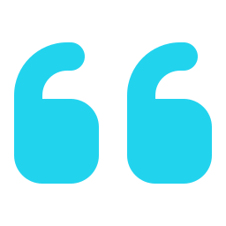
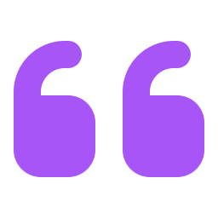
FIELD EVIDENCE · SAME STAGE, FIVE REALITIES
Every role sees the stage clearly — until the plan meets the other four.
“I need everyone's requirements in one place.”
“Late changes make setup difficult.”
“I need the stage design before I finalize lighting.”
“Knowing the setup beforehand would help.”
“We need one updated plan.”
Madhan Kumar
Venkat Prabhu
Thejas Krishna
Samyuktha K L
Rudh
Production Manager
Lighting Team
Art Director
Sound / Event Mgmt
Event Coordinator
Five accurate perspectives that never fully align into one shared plan — the exact gap StageSync closes.
STAGESYNC · REVIEW 1
07 / 15

Slide 8



EMPATHIZE · HOW TEAMS COPE TODAY
What Teams Use Today — And Where It Breaks
WhatsApp / Group Messaging
Shared Documents / Sheets
Printed / Hand-Drawn Sketches
WORKS WELL
WORKS WELL
WORKS WELL
Quick, familiar, reaches everyone at once
Easy to create, gives some structure
Simple, no tech needed, quick reference
GAPS
GAPS
GAPS
No structured plan — updates get buried, no visual layout
Not visual — hard to track changes, version conflicts
Not shareable in real time — outdated quickly
STAGESYNC · REVIEW 1
08 / 15

Slide 9

SYNTHESIS · PAINS & GAINS
What Hurts Today, What Success Looks Like
PAIN POINTS
GAIN POINTS / EXPECTATIONS
1
Scattered information across teams and channels
1
One shared, up-to-date stage plan
2
Late changes causing rework for other teams
2
Early visibility into stage / lighting / sound changes
3
No single, trusted source of truth for the plan
3
Clear ownership of requirements per team
4
Informal, inconsistent approval and sign-off
4
A calm, confident feeling going into event day
STAGESYNC · REVIEW 1
09 / 15

Slide 10
SYNTHESIS · INSIGHTS
Four Insights That Reframed the Problem
1
Coordination roles feel calm and in control only when one shared, current plan exists — the core need is a single source of truth, not more channels.
2
Lighting and sound teams consistently want the finalized layout before physical setup — revealing a need for earlier visibility, not faster reaction.
3
The Art Director's need to review and approve shows that trust in the plan depends on a formal review point, not just information sharing.
4
Frustration concentrates around “late changes,” not the number of teams — timing of updates matters more than which channel carries them.
STAGESYNC · REVIEW 1
10 / 15

Slide 11
DEFINE · POINT OF VIEW
Event production teams (stage, lighting, sound, props & coordination roles) need a way to see one accurate, up-to-date stage plan because information about changes is currently scattered across messages, documents, sketches and verbal discussions — causing last-minute rework and stress.
STAGESYNC · REVIEW 1
11 / 15

Slide 12


DEFINE · HOW MIGHT WE
Three Ways We Framed the Opportunity
HOW MIGHT WE
HOW MIGHT WE
HOW MIGHT WE
Improve coordination between event production teams and enable the Art Director to review, provide feedback and approve stage requirements before the event?
Give every team early visibility into the latest stage layout and timeline so late changes don't force last-minute rework?
Create one shared source of truth that all teams trust and check before setup begins?
STAGESYNC · REVIEW 1
12 / 15

Slide 13




RIGOR · RESEARCH INTEGRITY
Keeping the Research Honest
Privacy & Consent
Accessibility & Inclusion
Voluntary participation, no sensitive personal data collected, responses kept confidential
In-person interviews, simple clear questions, conducted in familiar on-site settings
Bias & Fairness
Feasibility Signals
Small sample size and limited diversity acknowledged — mostly production/coordination roles
Requires internet access, real-time sync infrastructure, cross-device compatibility backstage
STAGESYNC · REVIEW 1
13 / 15

Slide 14


REVIEW 1 · SUBMISSION READINESS
Evidence on Record, Ready for Review
Research plan & interview guide
Interview notes & field records
Photographs & field artefacts
Persona / empathy maps
Existing-solution workflow study
Secondary references
READINESS DECLARATION
Problem is stated from the user's perspective, not as a technology feature
Every insight is traceable to a research observation or quotation
POV and HMW statements remain solution-neutral, open to multiple concepts
STAGESYNC · REVIEW 1
14 / 15

Slide 15
EMPATHIZE · DEFINE · NEXT: IDEATE
Understand Deeply.
Define Precisely.
StageSync's foundation is built on real voices, not assumptions — five interviews, one honest problem, and a POV ready to carry into Ideate.
TEAM STAGESYNC
Abhishek R · Harini M · Mohamed Ashwaaq Rafi
Thank You
STAGESYNC · REVIEW 1
15 / 15

