Slide 1
Research Paper Relationship Analyzer
From semantic relationships to deeper, explainable research analysis
Base Paper: Di Iorio et al. (2014)
“Analysing and Discovering Semantic Relations in Scholarly Data”
Project I | School of Computer Science & Engineering, VIT Chennai

Slide 2
What problem are we trying to solve?
• Existing tools can show that papers are related, but often do not explain how strongly or why.
• Keyword and abstract-based analysis can miss important details inside the paper.
• Extraction, graph construction and gap discovery are often handled separately.
• Direct LLM analysis can produce unsupported or hallucinated information.
Our idea: connect these steps into one continuous, evidence-based pipeline.

Slide 3
Our Base Paper
Di Iorio et al. — Semantic Lancet
• Converts scholarly information into machine-readable semantic data.
• Goes beyond simple “Paper A cites Paper B” relationships.
• Represents different citation purposes, such as using a method, extending work or disagreeing.
• Uses RDF, NLP, SPARQL and scholarly ontologies such as CiTO, FaBiO and DoCO.
This gives us the foundation for our project.

Slide 4
What was missing in the Base Paper?
Base paper → Our extension
• Structured publisher XML → Research PDF processing
• Unweighted relationships → Weighted relationship scoring
• Limited metric comparison → Deeper result and metric analysis
• Direct citation links → Multi-hop bridge entities
• No generative RAG → Evidence-grounded RAG
So, we are extending the semantic relationship idea into a deeper research-analysis system.

Slide 5
Our First Set of Extensions
1. Structured research signals
Objective, Methodology, Dataset, Model, Metrics, Results, Limitations, Gap
2. Weighted relationship score
Different signals can have different importance.
3. Document categorization
Experimental, Review/Survey, or Methodological
4. Bridge entities
Papers can be connected through shared datasets, models or algorithms.

Slide 6
Our Second Set of Extensions
• Explainable Knowledge Graph
Relationships keep their supporting evidence and source location.
• Contextual NLI contradiction detection
NLI + dataset + metric + methodology + context.
• Evidence-grounded RAG
Retrieve evidence first, then ask the LLM to explain.
• Candidate research-gap discovery
Missing connections are checked against literature before being treated as possible gaps.

Slide 7
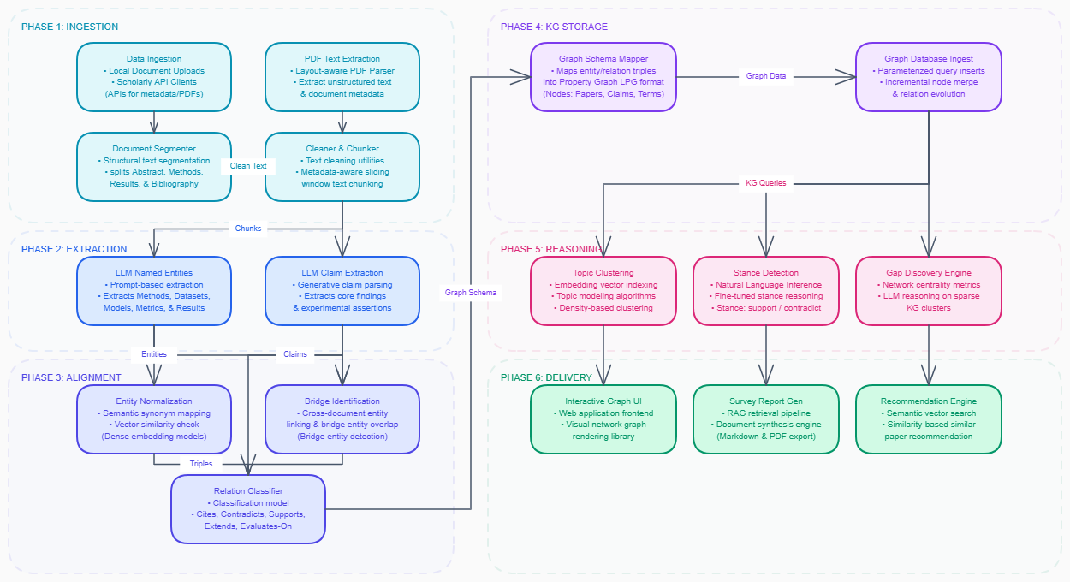
Complete 12-Stage Proposed Architecture Pipeline

Slide 8
Four Core Signals
METRIC
Looks at quantitative results such as accuracy, F1-score, BLEU and loss.
STANCE
Checks whether a claim supports, contradicts or is neutral toward another claim.
BRIDGE
Finds shared datasets, models and algorithms across papers.
NOVELTY
Looks for weak or missing connections that may point to a possible research gap.

Slide 9
Base Paper vs Our System
DATA INPUT
Base: Publisher XML
Our system: Research PDFs + section processing
SEMANTIC INFORMATION
Base: Basic entities and citation tagging
Our system: 8 structured research signals
RELATIONSHIPS
Base: RDF relationships
Our system: Configurable weighted relationships
REASONING
Base: SPARQL querying
Our system: Multi-hop graph + NLI + evidence-grounded RAG

Slide 10
Complete System Workflow
1. Research paper ingestion
2. PDF processing and segmentation
3. Document classification
4. Research-signal extraction
5. Semantic representation
6. Neo4j knowledge graph
7. Similarity / contradiction / gap analysis
8. Weighted fusion
9. Evidence provenance
10. Evidence retrieval
11. Grounded RAG + LLM reasoning
12. Explainable output

Slide 11
Project Objectives
1. Extract important research information directly from PDFs.
2. Build a Neo4j graph using papers and bridge entities.
3. Calculate relationship strength using multiple signals and weights.
4. Detect contradictions using NLI together with scientific context.
5. Identify candidate research gaps and provide evidence-grounded answers.

Slide 12
Literature Survey
We reviewed 18 works across six themes:
• Knowledge Graph Construction
• LLM Information Extraction
• Cross-Document Relation Extraction
• Contradiction & Claim Verification
• Automated Gap Discovery
• Semantic Reasoning & Similarity
Main takeaway: many of these capabilities exist separately. Our focus is to connect them in one pipeline.

Slide 13
Why Document Categorization?
EXPERIMENTAL PAPERS
Focus: methodology, datasets, metrics and results.
REVIEW / SURVEY PAPERS
Focus: topics, trends, chronology and research evolution.
METHODOLOGICAL PAPERS
Focus: algorithms, architecture and complexity.
The paper type helps us decide which signals deserve more importance.

Slide 14
How do we detect contradictions?
NLI tells us whether one claim supports, contradicts or is neutral toward another.
But NLI alone is not enough for scientific papers.
We also check:
• Dataset compatibility
• Metric compatibility
• Methodology similarity
• Experimental context
Example: two different accuracy values are not automatically a contradiction if the papers use different datasets or conditions.
We also keep the evidence location so the result can be checked.

Slide 15
Research Gaps + Evidence-Grounded RAG
RESEARCH GAP
A missing graph connection is only a candidate gap. We check the existing literature before treating it as meaningful.
RAG FLOW
Question → Knowledge Graph → Relevant Evidence → LLM → Explanation
The LLM is given retrieved evidence instead of being asked to freely answer from its own knowledge.
Goal: reduce unsupported information and make answers traceable.

Slide 16
Verification, Outcomes & Future Work
VERIFICATION
• Evaluate signal extraction using F1 score.
• Evaluate stance and contradiction detection.
• Measure Neo4j graph retrieval performance.
• Experimentally validate the scoring weights.
EXPECTED OUTCOME
A continuous system for relationship analysis, contradiction detection and candidate gap discovery.
FUTURE WORK
• Live arXiv / PubMed integration
• Understanding figures and other multimodal content

