Slide 1


K.RAMAKRISHNAN COLLEGE OF TECHNOLOGY
(AUTONOMOUS), TRICHY.
SEARCH ENGINE
PRESENTED
HARINI M
2303811710422053
SUPERVISOR
Mr. M. Saravanan, M.E.,
AP/CSE.

Slide 2
PRESENTATION OVERVIEW
Objective
Project Introduction
Problem Statement
Methodologies (Programming concepts relevant to problem statement)
Architecture of the proposed system
List of Modules
Merits
Results and Discussion
Queries

Slide 3
OBJECTIVE
1.Deliver fast and accurate search results.
2.Provide reliable and up-to-date content.
3.Personalize results based on user preferences.
4.Offer a user-friendly, ad-minimized experience.

Slide 4
PROJECT INTRODUCTION
A search engine is a powerful online tool designed to help users find information quickly and efficiently by indexing vast amounts of content from across the internet. By processing user queries through complex algorithms, search engines rank and display relevant results, making it easier for individuals to discover websites, articles, images, videos, and more. These platforms continually update their databases, prioritize accuracy, and personalize results based on user preferences, location, and search history. With fast performance, robust security measures, and the ability to process various types of content, search engines have become indispensable for navigating the digital world.

Slide 5
PROBLEM STATEMENT
Ensuring the accuracy and relevance of search results and constantly changing content.
Delivering personalized results while maintaining user privacy and data security.
Optimizing search algorithms to minimize spam and low-quality content in search results.
Providing fast and responsive search experiences even with large-scale data.
Improving search result diversity to cater to different user needs and preferences.

Slide 6
METHODOLOGIES
Crawling: Scanning web pages to index their content.
Indexing: Organizing and storing web page data for quick retrieval.
Ranking: Ordering search results based on relevance and quality.
Query Understanding: Interpreting user intent behind search queries.
Keyword Analysis: Identifying important search terms for optimization.
Content Optimization: Improving on-page content for better ranking.
Link Analysis: Evaluating inbound and outbound links for credibility.
Personalization: Customizing search results based on user preferences.
Algorithm Refinement: Continuously improving ranking algorithms for accuracy.
Local Search Optimization: Tailoring results for specific geographic regions.

Slide 7
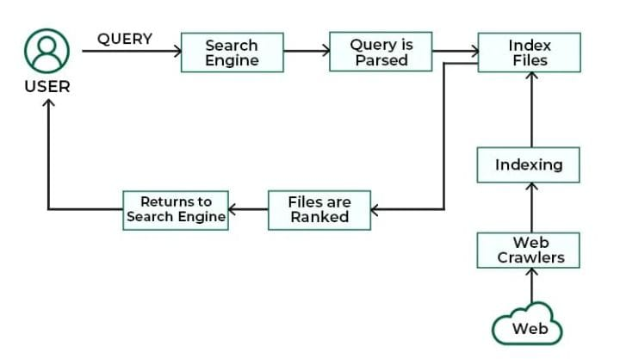
ARCHITECTURE OF THE PROPOSED SYSTEM

Slide 8
LIST OF MODULES
MODULE DESCRIPTON
CRAWLER(WEB SCAPER)
INDEXER
QUERY PROCSSOR
RANKING ALGORITHM

Slide 9
Crawler (Web Scraper)
Scans and collects data from websites across the internet.
Follows links to discover new web pages.
Extracts and stores content for indexing.
Updates existing data to reflect changes on web pages.

Slide 10
Indexer
Organizes and categorizes collected data for efficient retrieval.
Creates a searchable database of web content.
Updates indexes regularly to reflect new or changed information.
Facilitates quick access to relevant results based on user queries.

Slide 11
Query Processor
Analyzes user input to understand intent and context.
Breaks down queries into keywords and phrases for effective searching.
Optimizes queries for improved retrieval from the index.
Applies algorithms to enhance result relevance and ranking.

Slide 12
Ranking Algorithm
Evaluates relevance based on keyword matching and context.
Assesses content quality through factors like authority and trustworthiness.
Incorporates user engagement metrics, such as click-through rates.
Adjusts rankings based on freshness and recency of information.

Slide 13
MERITS
Quick Information Retrieval: Enables fast access to a vast range of information on almost any topic within seconds.
User-Friendly Interface: Simplifies the process of finding relevant content with easy-to-use search bars and filters.
Relevant and Accurate Results: Algorithms rank content based on relevance, delivering precise and reliable search results.
Wide Range of Content: Searches across text, images, videos, news, and other formats, offering diverse types of media.
Global Access: Provides users with access to global information, breaking down geographical barriers.

Slide 14
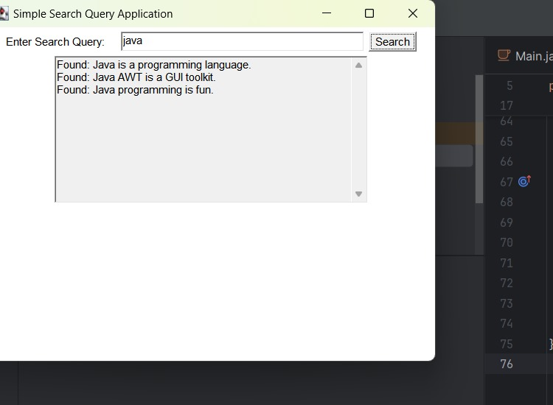
RESULTS AND DISCUSSION

Slide 15
QUERIES ?

