Slide 1

GROCERY DELIVERY
WEBSITE

Slide 2
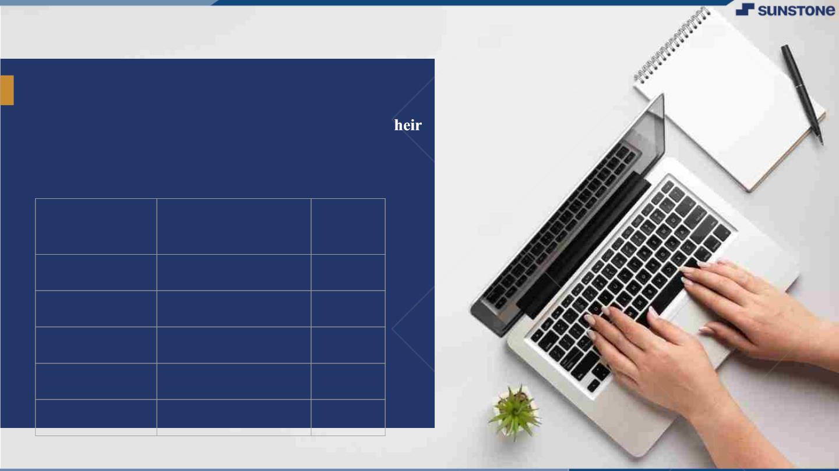
GROCERY DELIVERY WEBSITE
▪ A grocery delivery service is a platform through
which groceries can be delivered to customers at t
homes or a central pickup location. With grocery
delivery services, you can place orders and make
payments for various items online.
LMS
Name
Batch
Username
2115a917
2115a923
2115a926
2115a927
DHARANI.R
HARINI.B
JANANI.G
JANANI.G
A9
A9
A9
A9

Slide 3

Main.html
<?xml version="1.0"encoding="utf-8"?>
<!DOCTYPE html PUBLIC"-//W3C//DTD XHTML 1.0 frameset//EN"
"http://www.w3.org/1999/xhtml">
<frameset rows="20%,80%">
<frame src="logo.html">
<frameset cols="30%,70%">
<frame src="menu.html">
<frame src="contents.html">
</frameset>
</frameset>
</html>

Slide 4
JAVA SCRIPT CODE:
use strict';
const { google } = require('googleapis');
const SCOPES = ['https://www.googleapis.com/auth/spreadsheets',
'https://www.googleapis.com/auth/drive'];
const RANGE = 'A1:C50';
class SheetsGrocerySource {
constructor(logger, clientEmail, privateKey, spreadsheetId) {
this._logger = logger;
this._clientEmail = clientEmail;
this._privateKey = privateKey;
this._spreadsheetId = spreadsheetId;
this._spreadsheetUrl = `https://docs.google.com/spreadsheets/d/${spreadsheetId}`;
} }

Slide 5
async init() {
// authorize a new Google API client
let _ = this;
this._logger.debug('Initializing a new Google API client');
let googlAuthClient = await new Promise((resolve, reject) => {
let client = new google.auth.JWT(
_._clientEmail,
null,
_._privateKey,
SCOPES,
null
);
client.authorize((err, tokens) => {
if (err) {
reject(err);
} else {

Slide 6
this._logger.debug('Initializing a new Google Sheets & Drive clients');
google.options({ auth: googlAuthClient });
this._sheetsService = google.sheets({version: 'v4'});
this._driveService = google.drive({version: 'v3'});
}
async getUrlToSheet(spreadsheetId) {
return new Promise((resolve, reject) => {
resolve(`https://docs.google.com/spreadsheets/d/${spreadsheetId}`);
});
}
async getGroceryList() {
let spreadsheetId = this._spreadsheetId;
let sheetsService = this._sheetsService;
return await new Promise((resolve, reject) => {
sheetsService.spreadsheets.values.get({

Slide 7
spreadsheetId: spreadsheetId,
range: RANGE
}, (err, result) => {
if (err) {
reject(err);
} else if (result && result.data && result.data.values) {
let items = [];
for (let i = 1; i < result.data.values.length; i++) {
let value = result.data.values[i];
items.push({ name: value[0], quantity: value[1] });
}
resolve(items);
} else {
resolve([]);
}

Slide 8
});
async addShoppingResults(title, sheetId, results) {
let sheetsService = this._sheetsService;
let spreadsheetId = this._spreadsheetId;
return new Promise((resolve, reject) => {
let requests = [];
let idx = 1;
let data = [];
let headers = [
{ userEnteredValue: { stringValue: 'Requested' } },
{ userEnteredValue: { stringValue: 'Item' } },
{ userEnteredValue: { stringValue: 'Price' } }, ];
data.push({ values: headers });
for (let i = 0; i < results.length; i++) {
let result = results[i];
let row = [];

Slide 9
row.push({ userEnteredValue: { stringValue: result.requested } });
if (result.result) {
row.push({ userEnteredValue: { stringValue: result.result.title } });
row.push({ userEnteredValue: { numberValue: result.result.price } });
} data.push({ values: row });
}requests.push({
addSheet: {
properties: {
sheetId: sheetId,
title: title,
index: idx,
sheetType: 'GRID',
gridProperties: {
rowCount: data.length,
columnCount: 3
}
}

Slide 10
});
requests.push({
updateCells: {
rows: data ,
fields: '*',
start: {
sheetId: sheetId,
rowIndex: 0,
columnIndex: 0
} });
requests.push({
autoResizeDimensions: {
dimensions: {
sheetId: sheetId,
dimension: "COLUMNS",
startIndex: 0,

Slide 11
async init() {
let _ = this;
this._logger.debug('Initializing a new Google API client');
let googlAuthClient = await new Promise((resolve, reject) => {
let client = new google.auth.JWT(
_._clientEmail,
null,
_._privateKey,
SCOPES,
null );
client.authorize((err, tokens) => {
if (err) {
reject(err);
} else {
resolve(client);
} this._logger.debug('Initializing a new Google Sheets & Drive clients');
google.options({ auth: googlAuthClient });

Slide 12
endIndex: 3
}
}
});
sheetsService.spreadsheets.batchUpdate({
spreadsheetId: spreadsheetId,
resource: { requests: requests }
}, (err, result) => {
if (err) {
reject(err);
} else {
resolve(`https://docs.google.com/spreadsheets/d/${spreadsheetId}/edit#gid=${sheetId}`);
}
});
});
}

Slide 13

MENU.HTML
<html>
<head>
<title>
MENU
</title>
</head>
<body bgcolor=“skyblue”>
<center>
<nav>
<ul>
<h2><a href=“Login.html”/>Login</h2>
<h2><a href=“Fruit.html”/>Fruit</h2>
<h2><a href=“Vegetable.html”/>Vegetable</h2>
<h2><a href=“Daily Essential.html”/>Daily Essential</h2>
<h2><a href=“Fish & Meat.html”/>Fish & Meat</h2>
<h2><a href=“Home Care.html”/>Home Care</h2>
<h2><a href=“Packaged Food.html”/>Packaged Food</h2>
</ul>
</nav>
</center>
</body>
</html>

Slide 14
CONTENTS.HTML
<html>
<head>
<title>
content
</title>
</head>
<body>
<h3><img src="grocery.jpg"/>delivery</h3>
</body>
</html>

Slide 15
LOGO.HTML
<html>
<head>
<title>
LOGO
</title>
</head>
<body bgcolor="yellow">
<center>
<h1> HDJ GROCERY DELIVERY SERVICE</h1>
<h3>why cant't the groceries travel to you</h3>
</center>
</body>
</html>

Slide 16
LOGIN.HTML
<html>
<head>
<meta name="viewport" content="width=device-width, initial-scale=1">
<title> Login Page </title>
<style>
Body {
font-family: Calibri, Helvetica, sans-serif;
background-color: pink;
} button {
background-color: #4CAF50;
width: 100%;
color: orange;
padding: 15px;
margin: 10px 0px;
border: none;
cursor: pointer;
}

Slide 17
form {
border: 3px solid #f1f1f1;
}
input[type=text], input[type=password] {
width: 100%;
margin: 8px 0;
padding: 12px 20px;
display: inline-block;
border: 2px solid green;
box-sizing: border-box;
}
button:hover {
opacity: 0.7;
}
.cancelbtn {
width: auto;
padding: 10px 18px;
margin: 10px 5px;
} .container {
padding: 25px;
background-color: lightblue;

Slide 18
}
</style>
</head>
<body>
<center> <h1> Student Login Form </h1> </center>
<form>
<div class="container">
<label>Username : </label>
<input type="text" placeholder="Enter Username" name="username" required>
<label>Password : </label>
<input type="password" placeholder="Enter Password" name="password" required>
<button type="submit">Login</button>
<input type="checkbox" checked="checked"> Remember me
<button type="button" class="cancelbtn"> Cancel</button>
Forgot <a href="#"> password? </a>
</div>
</form>
</body>
</html>

Slide 19
FRUITS.HTML
<html>
<head>
<title>GROCERY WEBSITE</title> I
</head>
<body bgcolor="white">
<h2>APPLE</h2>
<img src="https://st3.depositphotos.com/29384342/34076/i/600/depositphotos_340760842-stock-photo
-apple-isolated-white-background.jpg" alt="apple"/>
<h2>BANANA</h2>
<img src="https://media.istockphoto.com/id/1400057530/photo/bananas-
isolated.jpg?b=1&s=170667a&w=0&k=20&c=uiSdjIQkTr7S4gEdW_oB_5zfFYhpfe0LP-CryQl49w4="
alt="banana"/>
<h2>GRAPES</h2>
<img src="https://cdn.pixabay.com/photo/2017/08/18/19/48/grapes-2656259__480.jpg" alt="grapes"/>
</body>
</html>

Slide 20
FISH & MEAT.HTML
<html>
<head>
<title>fish and meat</title>
</head>
<body bgcolor="white">
<h2>FISH</h2>
<img src="https://encrypted-
tbn0.gstatic.com/images?q=tbn:ANd9GcSRUIvcfEsTL_nn5DJiCAfJ6-
8UwEhhXMH9cQ&usqp=CAU" alt="fish">
<h2>MEAT</h2>
<img src="meat.jpg"/>
<h2>EGG</h2>
<img src="egg.jpg"/>
</body>
</html>

Slide 21
HOMECARE.HTML
<html>
<head>
<title>HOME CARE</title>
</head>
<body bgcolor="white">
<h2>BRUSH<h2>
<img src="https://m.media-amazon.com/images/W/IMAGERENDERING_521856-
T1/images/I/51hTIwQNGyL._SL1200_.jpg"alt="brush">
<h2>DETERGENT<h2>
<img src="https://5.imimg.com/data5/XC/XB/MY-8261133/4-1000x1000.png"alt="detergent">
<h2>SOAP<h2>
<img src="https://www.littlesoapcompany.co.uk/wp-
content/uploads/2021/02/Avo_Lifestyle.jpg"alt="soap"
<h2>CLEANER<h2>
<img src="https://www.bigbasket.com/media/uploads/p/xxl/40206006-2_2-bb-home-disinfectant-floor-
surface-cleaner-floral-kills-999-germs.jpg"alt="cleaner"/>
</body></html>

Slide 22
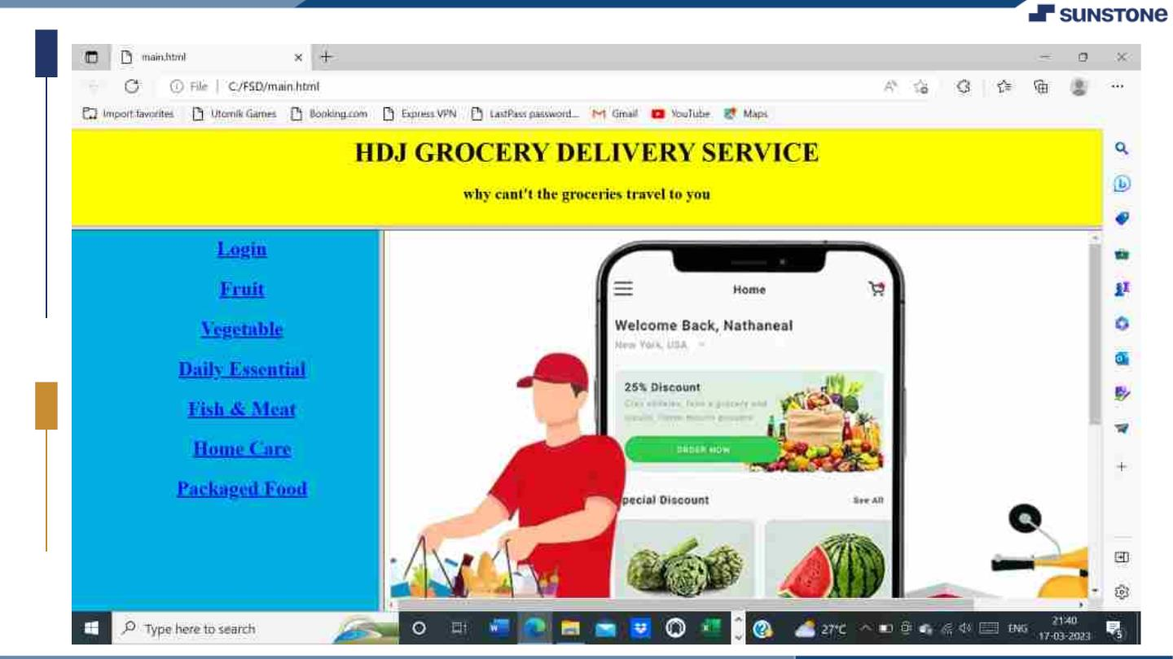

Slide 23
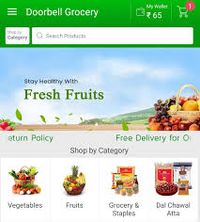

Slide 24
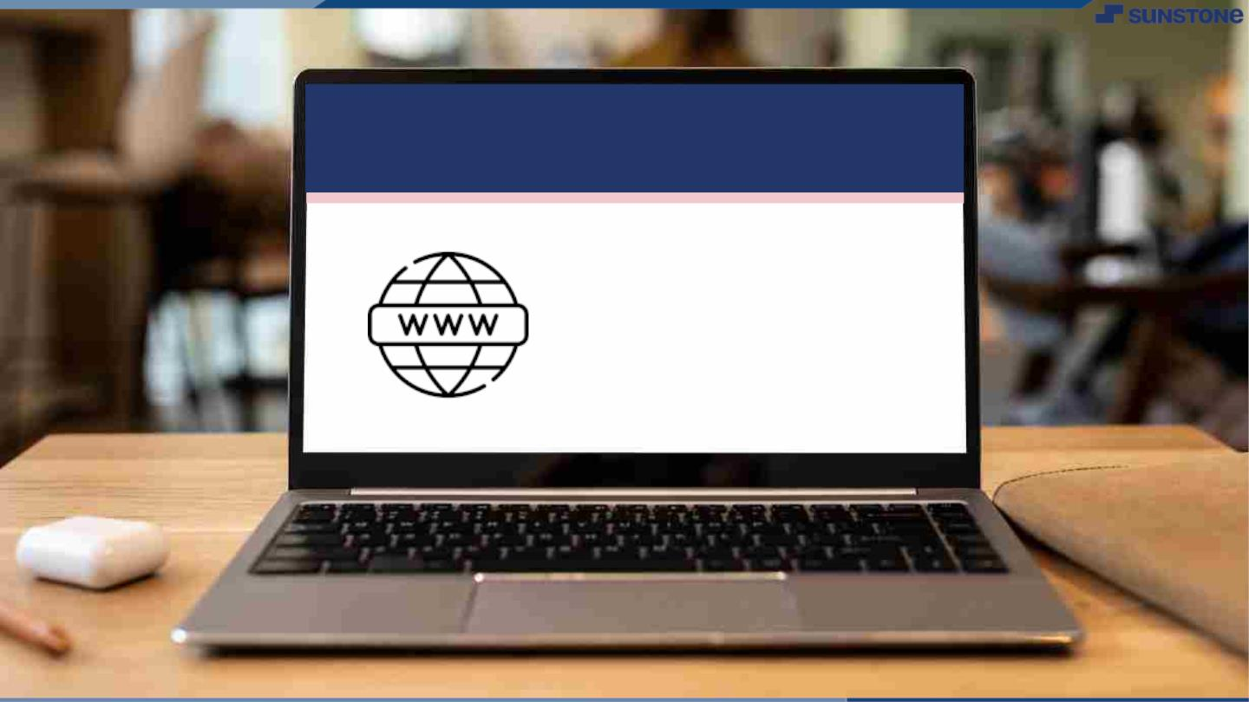
Submission Github
https://github.com/DHARU301/grocer
ywebsite.git

Slide 25


