Slide 1
Harini GA
711721104043
Final Project
3/21/2024 Annual Review

Slide 2
PROJECT TITLE : Traffic signs recognition
3/21/2024 Annual Review

Slide 3


AGENDA
Problem Statement
Project Overview
End Users
Our solution and Proposition
Key Features
Modelling Approach
Results and Evaluation
Conclusion
3/21/2024 Annual Review

Slide 4

PROBLEM STATEMENT
Develop a system that can automatically identify and classify traffic signs in images or video feeds.
3/21/2024 Annual Review

Slide 5

PROJECT OVERVIEW
To develop a robust traffic sign recognition system using Convolutional Neural Networks (CNNs) and Keras to enhance road safety and efficiency in transportation systems. Collect and preprocess a diverse dataset of labeled traffic sign images, design and train a CNN model for accurate detection and classification of traffic signs, and evaluate the model's performance before deploying it into real-world applications. It is used to train model into autonomous vehicles, traffic monitoring systems, and other traffic management applications, with continuous monitoring and maintenance to ensure sustained performance and contribute to improved road safety and efficiency.
3/21/2024 Annual Review

Slide 6

WHO ARE THE END USERS?
Drivers and Passengers
Automotive Industry
Public Authorities and Traffic Management
Research and Development
3/21/2024 Annual Review

Slide 7

YOUR SOLUTION AND ITS VALUE PROPOSITION
Solution: Utilizing state-of-the-art Convolutional Neural Networks (CNNs) and the Keras framework, our solution offers a robust traffic sign recognition system capable of accurately detecting and classifying various traffic signs in real-time.
Value Proposition:
Enhanced Road Safety: By accurately recognizing and interpreting traffic signs in real-time, our solution contributes to improved road safety by providing timely alerts and guidance to drivers and autonomous vehicles, reducing the risk of accidents and traffic violations. Increased Efficiency: The real-time processing capability of our system streamlines traffic flow, reduces congestion, and optimizes navigation, resulting in smoother transportation and reduced travel times for commuters and freight operators. Cost Savings: The implementation of our solution leads to cost savings by minimizing the potential for accidents, traffic delays, and associated expenses such as vehicle damage, medical bills, and productivity losses, benefiting both individuals and organizations.
3/21/2024 Annual Review

Slide 8

THE WOW IN YOUR SOLUTION
Real-time Precision: Our system stands out for its real-time processing capability, swiftly detecting and classifying traffic signs with minimal delay, crucial for instantaneous decision-making in dynamic traffic environments. Pinpoint Accuracy: Leveraging state-of-the-art CNN models powered by Keras, our solution guarantees precise recognition of traffic signs, minimizing false detections and elevating overall reliability, instilling utmost confidence in users. Unwavering Efficiency and Resilience: Through meticulous optimization and training, our system maintains peak performance across diverse environmental conditions and traffic scenarios, ensuring consistent and dependable operation, thereby enhancing road safety and traffic management efficacy. Seamless Scalability and Adaptability: Engineered with seamless scalability and adaptability, our solution effortlessly integrates into various platforms and applications, catering to an array of user needs and evolving traffic management systems, ensuring sustained effectiveness and applicability.
3/21/2024 Annual Review

Slide 9
MODELLING
Data Collection: Gather a diverse dataset of labeled traffic sign images, encompassing various shapes, colors, sizes, and environmental conditions. This dataset forms the groundwork for training the traffic sign recognition model. Data Preprocessing: Preprocess the dataset by standardizing image sizes, adjusting brightness and contrast, and eliminating noise or extraneous background elements. Augment the dataset using techniques such as rotation, scaling, and cropping to bolster its variability and resilience. Model Architecture Design: Develop a suitable deep learning architecture tailored for traffic sign recognition, predominantly relying on Convolutional Neural Networks (CNNs) for their innate ability to extract hierarchical features from raw image data. Model Training: Train the selected CNN model on the preprocessed dataset utilizing methodologies like stochastic gradient descent. Throughout the training process, the model learns to correlate input images with corresponding traffic sign labels, adjusting its internal parameters accordingly.
3/21/2024 Annual Review

Slide 10
MODELLING
Model Evaluation: Assess the trained model's performance using a distinct validation dataset. Measure key metrics such as accuracy, precision, recall, and F1-score to gauge the model's ability to generalize to unseen data effectively. Hyperparameter Tuning: Fine-tune the model's hyperparameters, including learning rate, batch size, and network architecture, to optimize its performance further. Employ techniques such as grid search or random search to identify the most optimal hyperparameter configuration. Deployment: Integrate the trained model into real-world applications, such as autonomous vehicles or traffic monitoring systems. Ensure seamless integration within the target environment, enabling efficient processing of input images and real-time delivery of accurate predictions. Monitoring and Maintenance: Continuously monitor the deployed model's performance and solicit feedback from end-users. Regularly update the model to accommodate changes in traffic signs, road conditions, or environmental factors, ensuring its sustained efficacy and relevance over time.
3/21/2024 Annual Review

Slide 11
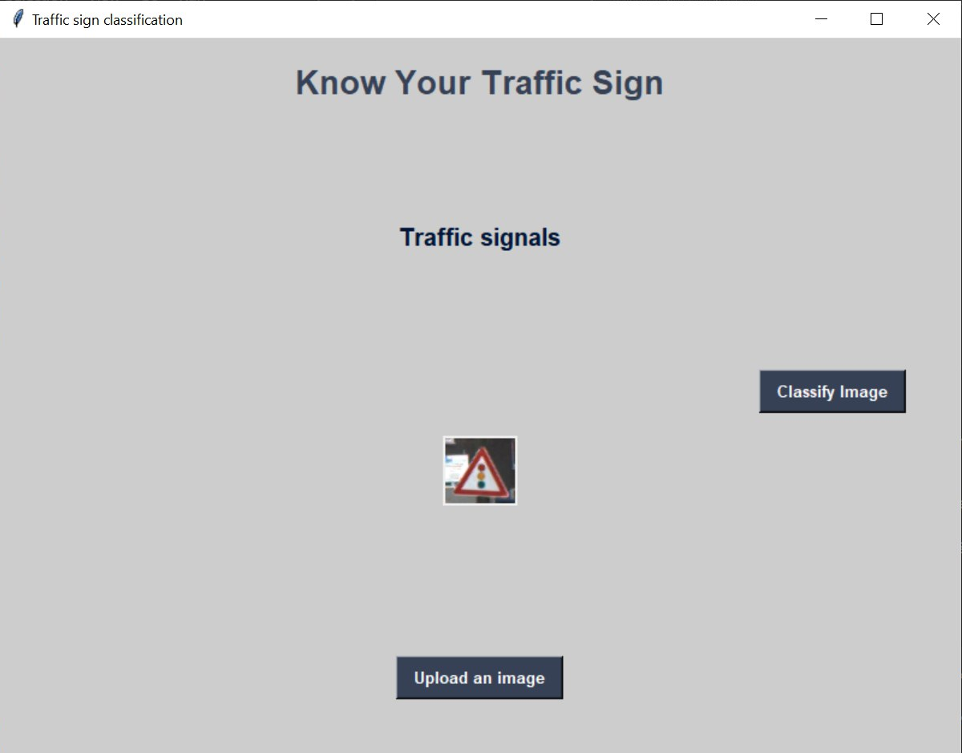
RESULTS
3/21/2024 Annual Review

