Slide 1
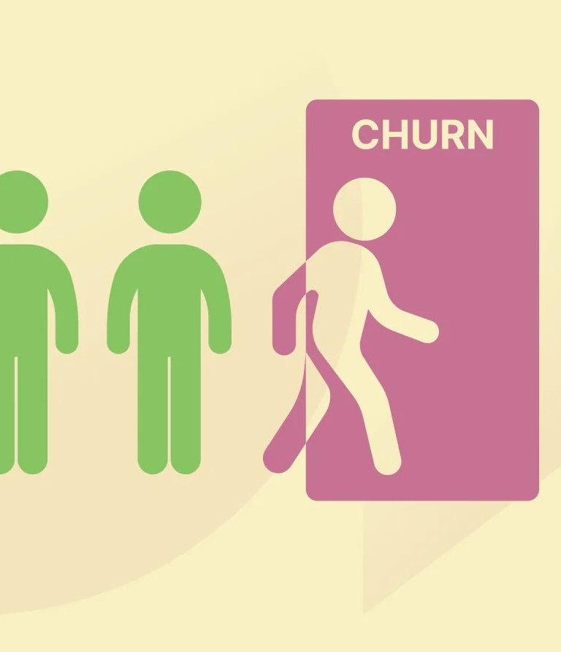
Customer Churn Prediction
Phase – 2 : Innovation

Slide 2
Steps
1
2
3
4
5
Introduction
Importing libraries and Data preprocessing
Visualization
Machine Learning Algorithms
Summary

Slide 3

Introduction
In this phase, we will be looking into the libraries, techniques, and technologies we’ll be using in our data analytics project.

Slide 4
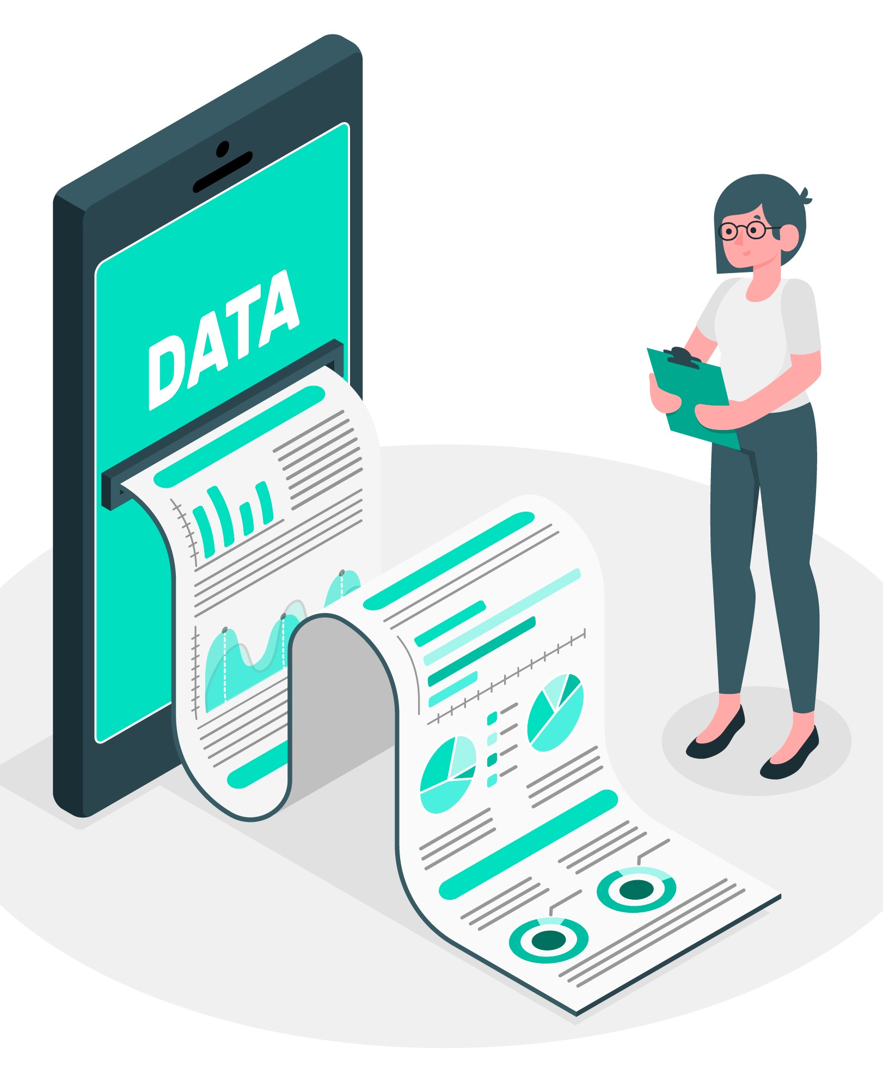
Libraries we use
The libraries that are necessary to use in our project are :
Numpy, Pandas, Matplotlib, Seaborn, Pandas_profiling, Plotly
The usage of such libraries will be seen in the next video.

Slide 5

Steps to be done before data visualization
Import the provided customer churn dataset.
Convert the string values of Churn column to 1 and 0
Convert the required responses to ‘Yes’ or ‘No’.
Convert the columns to specified data types to avoid confusion.

Slide 6
Visualization
Visualization refers to the representation of data through use of common graphics, such as graphs, charts, plots, infographics etc.,
Visualization can be done through IBM Cognos tools, which provide various visualization options like Pie Chart, Bar Chart, Histogram etc.,

Slide 7
Categories of Visualization
Visualization can be done in various methods, such as, Visualizing Total Customer Churn, Churn rate by Gender, Churn rate by Tech Support, Churn rate by Internet Services, Churn rate by Payment method, Contract Duration.
The sample graphics of such visualization techniques are given in the next slide.

Slide 8
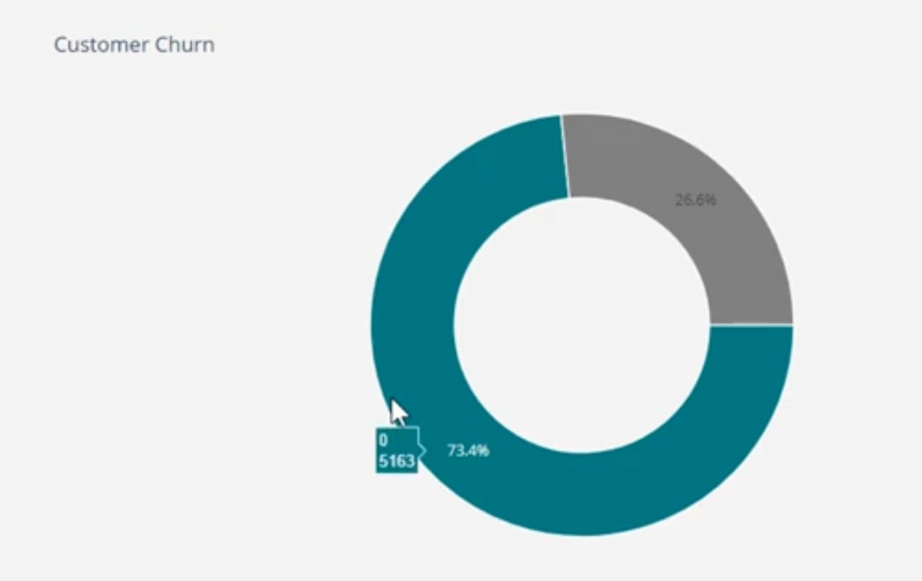
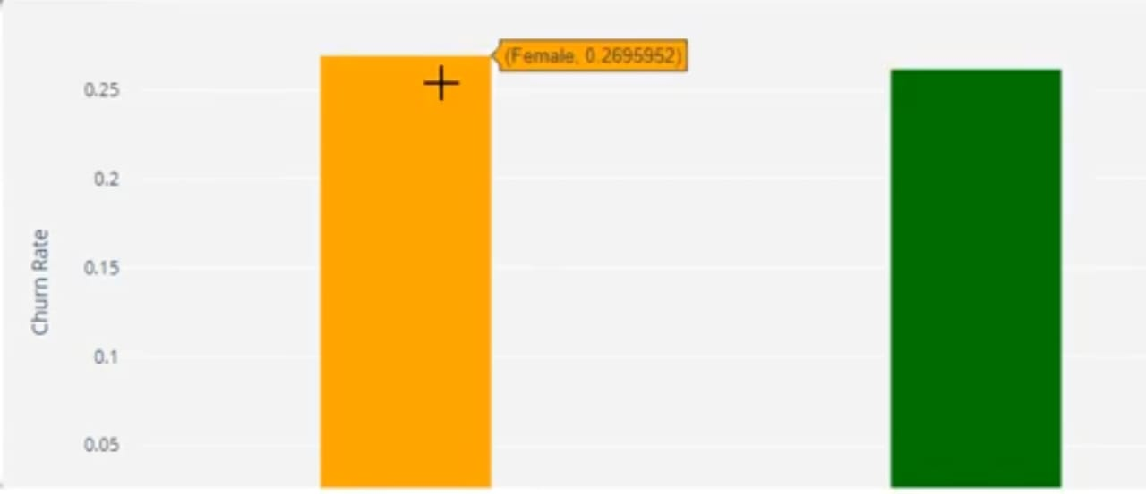
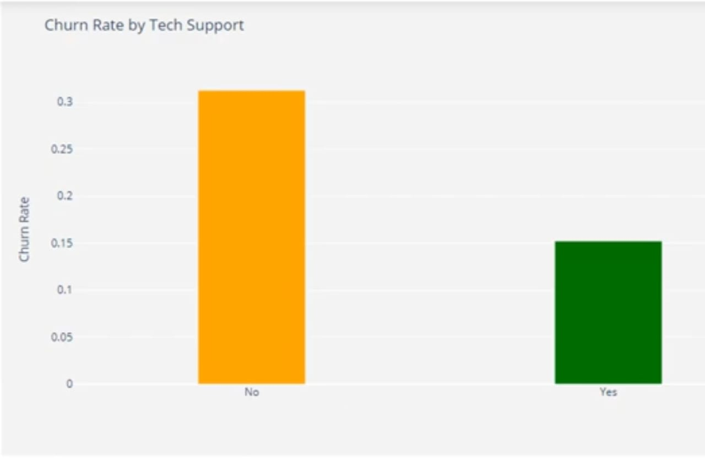
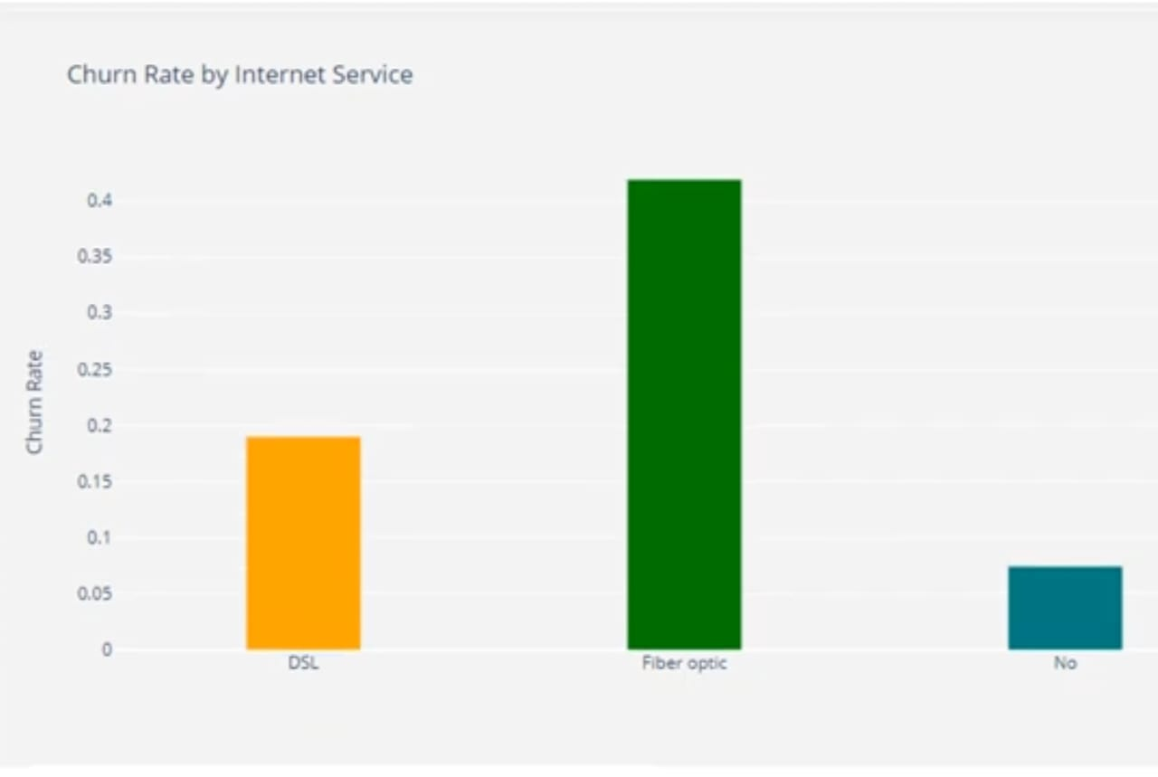
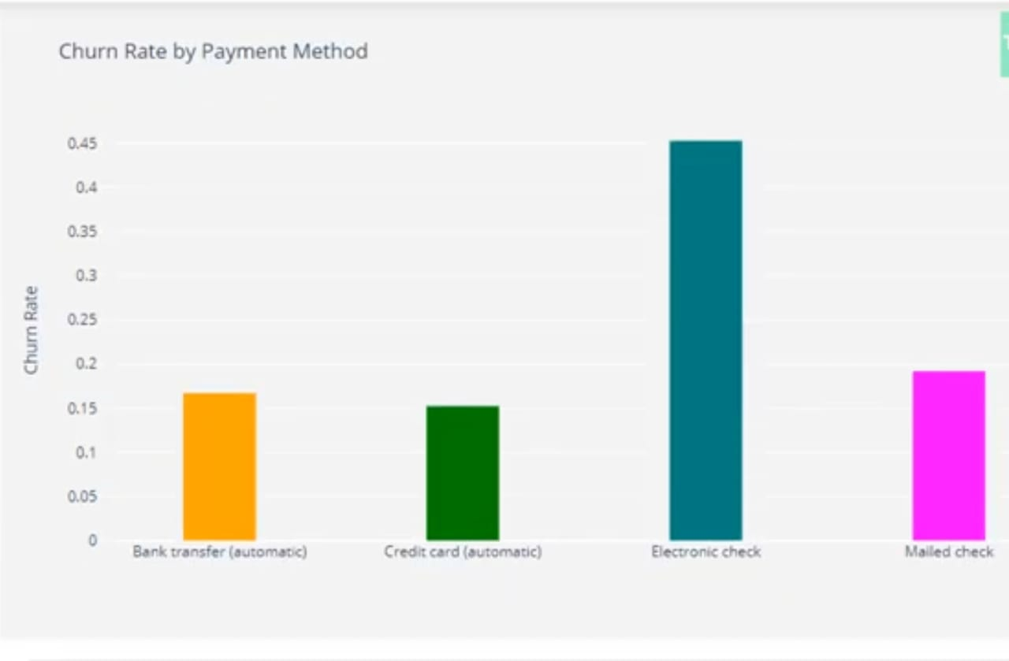
Sample Analysis

Slide 9
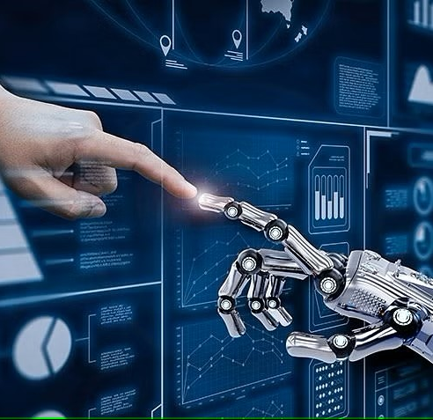
Machine Learning
Pre-works and Algorithms

Slide 10

Steps to be followed
Performing feature scaling and One hot encoding wherever required
Split the data into training set (70%) and test set (30%)
Feed the training data to various ML classification models, observe the accuracy in their outputs, and filter out the best among them in the basis of performance.

Slide 11
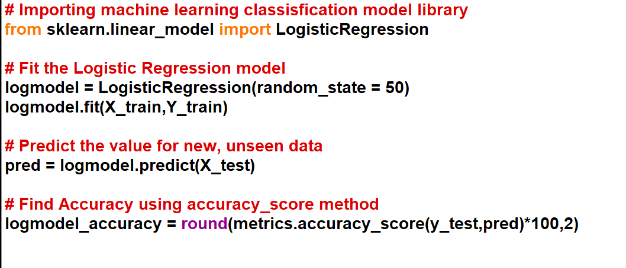
Sample code for Logistic Regression

Slide 12

Conclusion
After implementing multiple machine learning classification algorithms, we’ll be comparing the accuracy of various algorithms to choose the best among them. Then we will also create the part of code that predicts the probability of an individual customer’s churn. This way, we have created a Customer Churn Prediction model that provides analysis of Customer’s Churning routine of a firm, and also checks the probability whether a particular customer will churn out or not.

Slide 13

Phase 2 Submission by :
Harini Divya. G
810021205030

