Slide 1
>_
Week 1: Lab Setup, Linux and Networking Foundations
DG Interns Hub internship | Harini Edward | 23 October 2026

Slide 2
A small lab in VirtualBox
2
3
1
command-line virtual machines
nodes, with the Windows laptop as the third
Host-only network, 192.168.56.0/24
Kali Linux (kali-lab) and Ubuntu Server (ubuntu-lab), 10 GB disks on drive E
A NAT adapter on each VM for internet access
SSH from Windows into the Ubuntu VM, and two snapshots saved

Slide 3
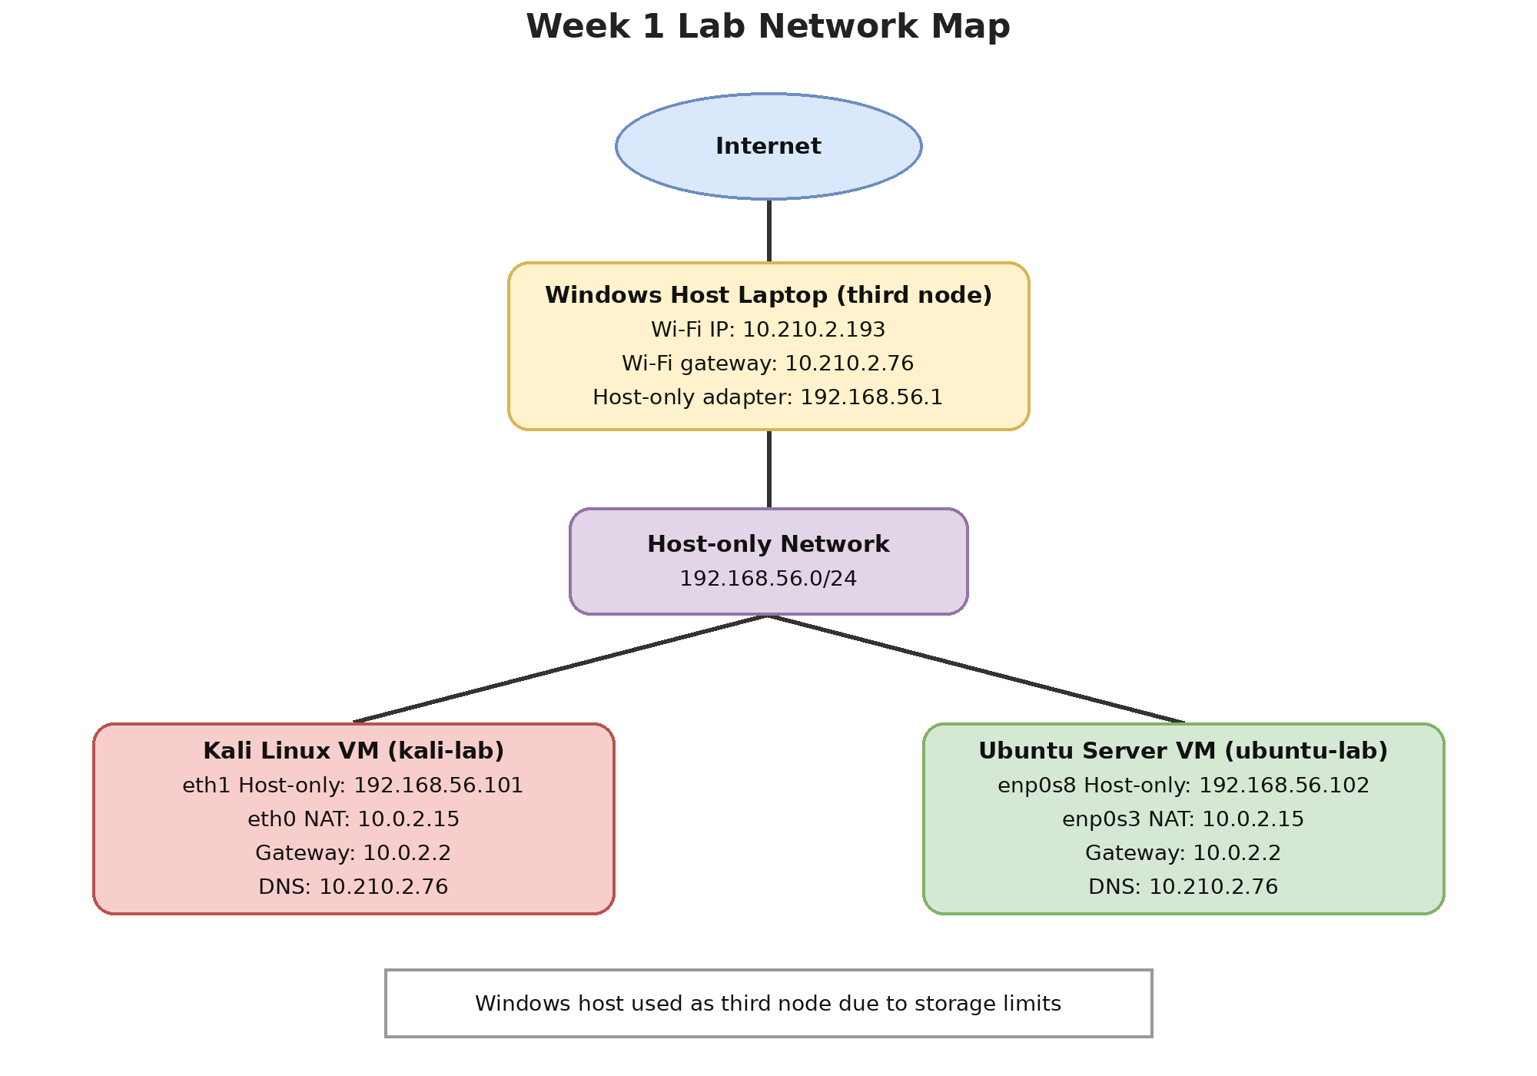
The network map
Host-only
192.168.56.0/24
NAT gateway
10.0.2.2
DNS
10.210.2.76

Slide 4
Linux practice and cheat sheet
30
Files and folders
Reading and searching text
commands practised, with output saved
Permissions and users
Processes and disk space
44
Networking and SSH
Package management
commands in my cheat sheet
The cheat sheet says what each command does and when to use it

Slide 5
Networking tools I used
1
2
3
4
5
ip
ping
traceroute
nslookup, dig
ssh
find addresses
test reachability
trace the path
check DNS
log in remotely
Results captured in eight screenshots and the network map

Slide 6
Learning records
8
8
0-10
theory notes
TryHackMe writeups
OverTheWire Bandit levels written up
Every writeup is kept in the Week 1 folder, and level passwords are left out of the shared work

Slide 7
Challenges and how I handled them
Challenge
How I handled it
Very little free disk space
Two small command-line VMs with 10 GB disks on drive E, and the Windows laptop as the third node
Challenge
How I handled it
traceroute and nslookup need internet access
Added a NAT adapter to each VM next to the Host-only adapter

Slide 8
Week 1 deliverables
Notes, Writeups, Findings, Cheat Sheet, report, presentation and README
LinkedIn: lnkd.in/p/g47QMEFi and lnkd.in/p/gSngYE5t
Thank you, DG Interns Hub

