Slide 1
DG Interns Hub Cyber Security Internship
Week 2 Report
Network Traffic Analysis, Nmap and Windows Logging
Prepared by Harini | 30 October 2026
Notes:
This presentation summarises my Week 2 work: reading network packets, scanning with Nmap and investigating Windows event logs.

Slide 2
What I completed this week
8
6
4
2
3
Theory notes
TryHackMe rooms at 100%
Hands-on tasks
Cheat sheets
Sample capture analyses
The goal of the week was to read packets and Windows event logs, so that the endpoint and IDS work in Week 3 makes sense.
Notes:
Eight theory notes, six TryHackMe rooms, four hands-on tasks, two cheat sheets and three Wireshark sample captures.

Slide 3
My lab setup
Windows 11 laptop
Kali Linux VM
Ubuntu Server VM
192.168.56.1
192.168.56.101
192.168.56.102
Windows target for Nmap and the event log tasks. Runs VirtualBox, Wireshark and PowerShell.
Scanning and testing machine, command line only.
Target machine running the Apache 2.4.66 web server.
Host-only network 192.168.56.0/24. Free tools only: VirtualBox, Nmap 7.991, tcpdump, Wireshark 4.6.9, PowerShell and Event Viewer.
Notes:
I did not have a Windows virtual machine, so my real laptop was the Windows target. Wireshark on the laptop could not see traffic between the VMs, so I recorded on the Ubuntu VM with tcpdump.

Slide 4
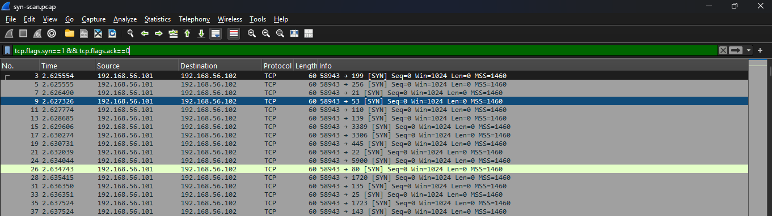
Task 1 and Task 2: Traffic capture and Nmap
32
1000
998 + 2
packets in kali-capture.pcap: ping, TCP handshake, HTTP GET and DNS
SYN packets to 1000 ports in about 0.52 seconds
998 RST from closed ports and 2 SYN-ACK from ports 22 and 80
Ubuntu VM: ports 22 (ssh) and 80 (http) open.
Windows laptop: all 1000 ports filtered. The firewall dropped every probe, and I report it as it is.
Filter: tcp.flags.syn==1 && tcp.flags.ack==0
Notes:
The scan pattern is many SYN packets from one source to many ports in a very short time. This is what an IDS such as Snort can detect in Week 3.

Slide 5
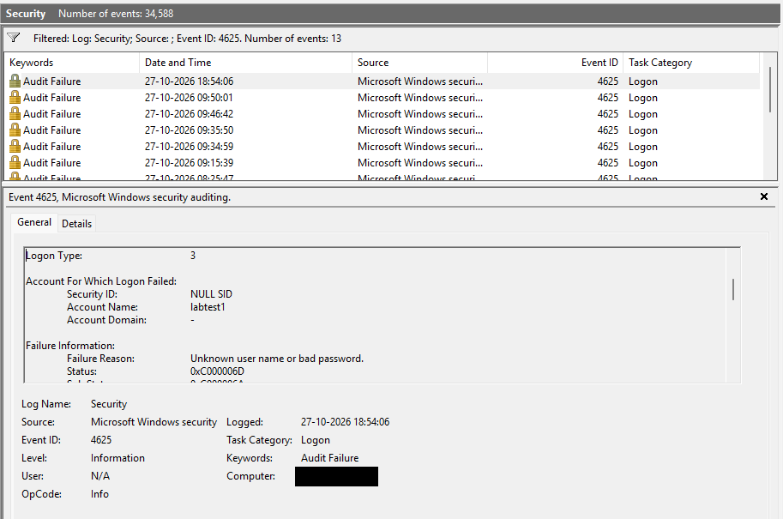
Task 3: Windows events
Event | What I did | Time
4720 | Created the dummy user labtest1 | 18:26:25
4732 | Added labtest1 to Administrators | 18:45:16
4625 | Failed network logon, Logon Type 3 | 18:54:06
4624 | Successful network logon, Logon Type 3 | 19:09:38
7045 | Created and deleted service LabDummySvc | 19:15:37
1102 | Cleared the Security log after a backup | 19:22:31
Event 4625 in Event Viewer
All events were created on 27 October 2026 with a temporary user, which I deleted afterwards. I saved a backup of the Security log before clearing it.
Notes:
Personal details are hidden with black boxes. I saved the Security log with wevtutil before clearing it, so the evidence was not lost.

Slide 6
Task 4, Task 5 and sample captures
PowerShell hunting
Cheat sheets
Wireshark samples
Get-WinEvent with -FilterHashtable found 13 events with ID 4625. Group-Object showed 12 from my local account (Logon Type 2) and 1 from labtest1 (Logon Type 3).
A Wireshark sheet with 20 display filters and a Windows sheet with the 15 Security Event IDs from the task.
http_with_jpegs (HTTP), telnet-cooked (Telnet, login in plain text) and dns.cap (DNS). I found no sign of an attack in any of them.
Notes:
The CSV in the submission is a safe copy where my own account name is replaced by local-user.

Slide 7
What I learned
1
A port scan has a clear pattern: many SYN packets to many ports in a very short time.
2
A firewall can hide a machine: I report filtered results exactly as the scan shows them.
3
The Logon Type explains a logon: Type 3 is a network logon and Type 2 is at the keyboard.
4
Careful evidence handling matters: I saved the log before clearing it and hid personal details before sharing.
Next: endpoint and IDS work in Week 3.
Notes:
This work prepares me for the endpoint and IDS tasks of Week 3.

