Slide 1


Heart Disease analysis Based on Demographic Information
Harini Lakshmanan
Mohammad Mahmoudighaznavi
Verity Pierson

Slide 2
Background/Problem Statement
In United States:
47% have at least one risk factor causing heart problem.
25% of deaths are due to heart disease.
Every 36 seconds, one person dies due to cardiovascular disease
Risk factors contribute to heart disease:
Age
Gender
Family History
Smoking
Obesity
Diabetes
High Blood Pressure or Cholesterol
Other diseases

Slide 3

Purpose of the Analysis
Statistical Analysis:
How each factor impact the target
Feature importance/selection:
Which factors have the most impact on the target
Modeling and prediction
How we can predict the target based on on-hand information

Slide 4
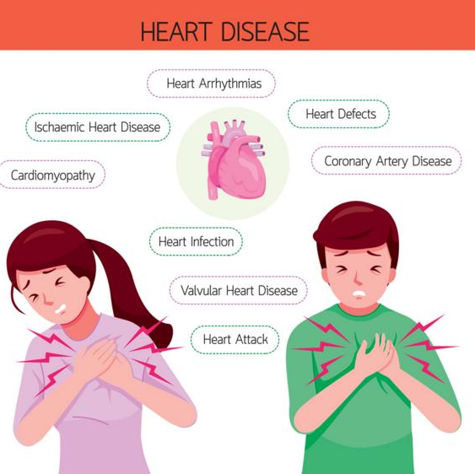
Solution Explored
Final Model:
85% accuracy in prediction
Ability to designate an individual with disease 93% correctly
Identify the most and least important factors causing heart disease

Slide 5
Recommendations to Improve the Model
Gather more information for each patient such as:
BMI
Smoking
Family history
Collect more data such as:
From different hospitals
From different cultures
From different locations with various race and ethnicities

